Slide 1
ARTIFICIAL INTELLIGENCE Week 2
Dr. Momina Moetesum

Slide 2
Uninformed Search Strategies
Uninformed/blind search strategies use only the information available in the problem definition
Generate successors and distinguish a goal state from a non-goal state

Slide 3
Uninformed Search Strategies
Uninformed (blind) strategies use only the information available in the problem definition.
These strategies order nodes without using any domain specific information
Breadth-first search
Depth-first search
Uniform Cost Search
Depth-limited search
Iterative deepening search

Slide 4
Performance Evaluation
A search strategy is defined by picking the order of node expansion
Strategies are evaluated along the following dimensions:
completeness: does it always find a solution if one exists?
Time complexity: number of nodes generated/expanded
space complexity: maximum number of nodes in memory
optimality: does it always find a least-cost/optimal solution?

Slide 5
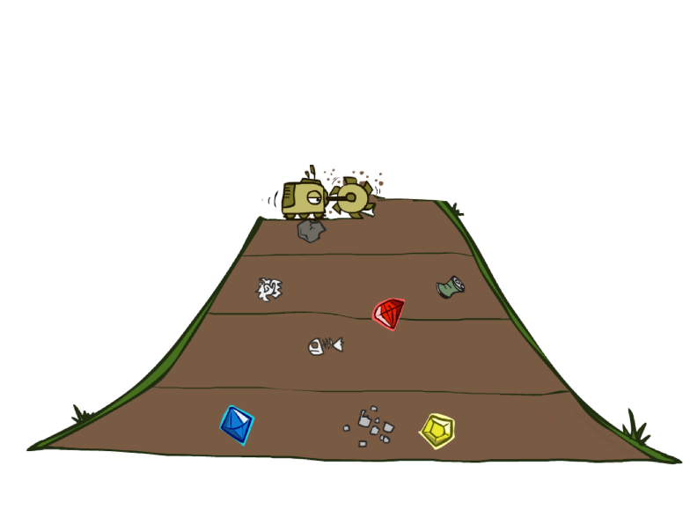
Breadth First Search (BFS)
Expand all nodes at depth (i) before expanding nodes at depth (i + 1)
Level-order Traversal.
Implementation:
Use of a First-In-First-Out queue (FIFO). Nodes visited first are expanded first. Enqueue nodes in FIFO (first-in, first-out) order.

Slide 6
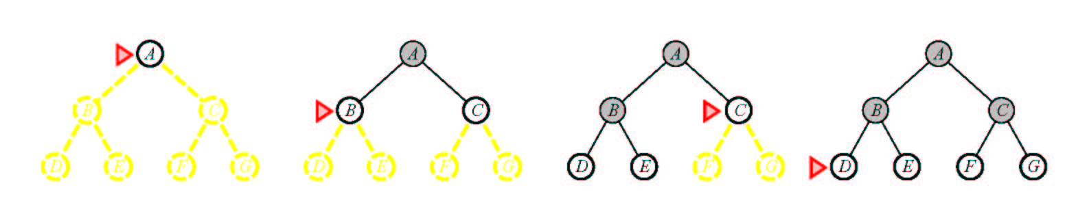
Breadth First Search (BFS)

Slide 7
Breadth First Search (BFS)
S start
generalSearch(problem, queue)
# of nodes tested: 0, expanded: 0
5
2
4
expanded node | Frontier list
 | {S}
A
B
C
9
4
6
2
D
E
6
G
goal
1
F
7
H

Slide 8
Breadth First Search (BFS)
S start
generalSearch(problem, queue)
# of nodes tested: 1, expanded: 1
5
2
4
expanded node | Frontier list
 | {S}
S not goal | {A,B,C}
A
B
C
9
4
6
2
D
E
6
G
goal
1
F
7
H

Slide 9
Breadth First Search (BFS)
S start
generalSearch(problem, queue)
# of nodes tested: 2, expanded: 2
5
2
4
A
B
C
Expanded node | Frontier list
 | {S}
S | {A,B,C}
A not goal | {B,C,D,E}
9
4
6
2
D
E
6
G
goal
1
F
7
H

Slide 10
Breadth First Search (BFS)
S start
generalSearch(problem, queue)
# of nodes tested: 3, expanded: 3
5
2
4
A
B
C
Expanded node | Frontier list
 | {S}
S | {A,B,C}
A | {B,C,D,E}
B not goal | {C,D,E,G}
9
4
6
2
D
E
6
G
goal
1
F
7
H

Slide 11
Breadth First Search (BFS)
S start
generalSearch(problem, queue)
5
2
4
# of nodes tested: 4, expanded: 4
A
B
C
Expanded node | Frontier list
 | {S}
S | {A,B,C}
A | {B,C,D,E}
B | {C,D,E,G}
C not goal | {D,E,G,F}
9
4
6
2
D
E
6
G
goal
1
F
7
H

Slide 12
Breadth First Search (BFS)
S start
generalSearch(problem, queue)
# of nodes tested: 5, expanded: 5
5
2
4
Expanded node | Frontier list
 | {S}
S | {A,B,C}
A | {B,C,D,E}
B | {C,D,E,G}
C | {D,E,G,F}
D not goal | {E,G,F,H}
A
B
C
9
4
6
2
D
E
6
G
goal
1
F
7
H

Slide 13
Breadth First Search (BFS)
S start
generalSearch(problem, queue)
5
2
4
# of nodes tested: 6 , expanded: 6
A
B
C
Expanded node | Frontier list
 | {S}
S | {A,B,C}
A | {B,C,D,E}
B | {C,D,E,G}
C | {D,E,G,F}
D | {E,G,F,H}
E not goal | {G,F,H,G}
9
4
6
2
D
E
6
G
goal
1
F
7
H

Slide 14
Breadth First Search (BFS)
S start
generalSearch(problem, queue)
# of nodes tested: 7 , expanded: 6
5
2
4
Expanded node | Frontier list
 | {S}
S | {A,B,C}
A | {B,C,D,E}
B | {C,D,E,G}
C | {D,E,G,F}
D | {E,G,F,H}
E | {G,F,H,G}
G goal | {F,H,G} no expand
A
B
C
9
4
6
2
D
E
6
G
goal
1
F
7
H

Slide 15
Breadth First Search (BFS)
S start
generalSearch(problem, queue)
5
2
4
# of nodes tested: 7 , expanded: 6
A
B
C
Expanded node | Frontier list
 | {S}
S | {A,B,C}
A | {B,C,D,E}
B | {C,D,E,G}
C | {D,E,G,F}
D | {E,G,F,H}
E | {G,F,H,G}
G goal | {F,H,G} no expand
9
4
6
2
D
E
6
G
goal
1
F
7
H
path: S,B,G cost: 8

Slide 16
BFS Properties
What nodes does BFS expand?
Processes all nodes above shallowest solution
Let depth of shallowest solution be s
Search takes time O(b^{s})
How much space does the fringe take?
Has roughly the last tier, so O(b^{s})
Is it complete?
s must be finite if a solution exists, so yes!
Is it optimal?
Only if costs are all 1 (more on costs later)
b
1 node
…
b nodes
s tiers
b² nodes
b^{s} nodes
b^{m} nodes

Slide 17
BFS Evaluation
Two lessons:
Memory requirements are a bigger problem
Time requirements are major factor. Takes too much time to go at depth

Slide 18
Uniform Cost Search (UCS)
Extension of BFS:
Expand node with lowest path cost
Implementation: fringe = queue ordered by path cost.
UCS is the same as BFS when all step-costs are equal.
UCS does not care about the number of steps a path has, but only about their total cost

Slide 19
Uniform Cost Search (UCS)
generalSearch(problem, priorityQueue)
S start
# of nodes tested: 0, expanded: 0
expnd. node | Frontier list
 | {S}
5
2
4
A
B
C
9
4
6
2
D
E
6
G
goal
1
F
7
H

Slide 20
Uniform Cost Search (UCS)
generalSearch(problem, priorityQueue)
S start
# of nodes tested: 1, expanded: 1
expnd. node | Frontier list
 | {S:0}
S not goal | {B:2,C:4,A:5}
5
2
4
A
B
C
9
4
6
2
D
E
6
G
goal
1
F
7
H

Slide 21
Uniform Cost Search (UCS)
generalSearch(problem, priorityQueue)
S start
# of nodes tested: 2, expanded: 2
expnd. node | Frontier list
 | {S}
S | {B:2,C:4,A:5}
B not goal | {C:4,A:5,G:2+6}
5
2
4
A
B
C
9
4
6
2
D
E
6
G
goal
1
F
7
H

Slide 22
Uniform Cost Search (UCS)
generalSearch(problem, priorityQueue)
S start
# of nodes tested: 3, expanded: 3
expnd. node | Frontier list
 | {S}
S | {B:2,C:4,A:5}
B | {C:4,A:5,G:8}
C not goal | {A:5,F:4+2,G:8}
5
2
4
A
B
C
9
4
6
2
D
E
6
G
goal
1
F
7
H

Slide 23
Uniform Cost Search (UCS)
generalSearch(problem, priorityQueue)
S start
# of nodes tested: 4, expanded: 4
expnd. node | Frontier list
 | {S}
S | {B:2,C:4,A:5}
B | {C:4,A:5,G:8}
C | {A:5,F:6,G:8}
A not goal | {F:6,G:8,E:5+4, D:5+9}
5
2
4
A
B
C
9
4
6
2
D
E
6
G
goal
1
F
7
H

Slide 24
Uniform Cost Search (UCS)
generalSearch(problem, priorityQueue)
S start
# of nodes tested: 5, expanded: 5
expnd. node | Frontier list
 | {S}
S | {B:2,C:4,A:5}
B | {C:4,A:5,G:8}
C | {A:5,F:6,G:8}
A | {F:6,G:8,E:9,D:14}
F not goal | {G:4+2+1,G:8,E:9,D:14}
5
2
4
A
B
C
9
4
6
2
D
E
6
G
goal
1
F
7
H

Slide 25
Uniform Cost Search (UCS)
generalSearch(problem, priorityQueue)
S start
# of nodes tested: 6, expanded: 5
expnd. node | Frontier list
 | {S}
S | {B:2,C:4,A:5}
B | {C:4,A:5,G:8}
C | {A:5,F:6,G:8}
A | {F:6,G:8,E:9,D:14}
F | {G:7,G:8,E:9,D:14}
G goal | {G:8,E:9,D:14} no expand
5
2
4
A
B
C
9
4
6
2
D
E
6
G
goal
1
F
7
H

Slide 26
Uniform Cost Search (UCS)
generalSearch(problem, priorityQueue)
S start
# of nodes tested: 6, expanded: 5
expnd. node | Frontier list
 | {S}
S | {B:2,C:4,A:5}
B | {C:4,A:5,G:8}
C | {A:5,F:6,G:8}
A | {F:6,G:8,E:9,D:14}
F | {G:7,G:8,E:9,D:14}
G | {G:8,E:9,D:14}
5
2
4
A
B
C
9
4
6
2
D
E
6
G
goal
1
F
7
H
path: S,C,F,G cost: 7

Slide 27
UCS Evaluation
Optimality: Yes
nodes expanded in order of increasing path cost.
Therefore, the first goal node selected for expansion is the optimal solution.
Completeness: YES
Time/Space complexity:
Assume C* the cost of the optimal solution.
Assume that every action costs at least ε
Worst-case:

Slide 28
Depth-First Search
a
G
a
c
Strategy: expand a deepest node first
Implementation: Fringe is a LIFO stack
b
c
b
e
d
e
d
f
f
S
h
h
p
p
r
q
r
q
S
d
e
p
b
c
e
h
r
q
a
a
h
r
p
q
f
p
q
f
q
c
G
q
c
G
a
a

Slide 29
Depth-First Search (DFS)
generalSearch(problem, stack)
S start
# of nodes tested: 0, expanded: 0
expnd. node | Frontier
 | {S}
5
2
4
A
B
C
9
4
6
2
D
E
6
G
goal
1
F
7
H
Notes:
CLICK DESC: 1. interior nodes, 2. leaf nodes, 3. arcs

Slide 30
Depth-First Search (DFS)
generalSearch(problem, stack)
S start
# of nodes tested: 1, expanded: 1
expnd. node | Frontier
 | {S}
S not goal | {A,B,C}
5
2
4
A
B
C
9
4
6
2
D
E
6
G
goal
1
F
7
H
Notes:
CLICK ONCE

Slide 31
Depth-First Search (DFS)
generalSearch(problem, stack)
S start
# of nodes tested: 2, expanded: 2
expnd. node | Frontier
 | {S}
S | {A,B,C}
A not goal | {D,E,B,C}
5
2
4
A
B
C
9
4
6
2
D
E
6
G
goal
1
F
7
H
Notes:
CLICK ONCE

Slide 32
Depth-First Search (DFS)
generalSearch(problem, stack)
S start
# of nodes tested: 3, expanded: 3
expnd. node | Frontier
 | {S}
S | {A,B,C}
A | {D,E,B,C}
D not goal | {H,E,B,C}
5
2
4
A
B
C
9
4
6
2
D
E
6
G
goal
1
F
7
H
Notes:
CLICK ONCE

Slide 33
Depth-First Search (DFS)
generalSearch(problem, stack)
S start
# of nodes tested: 4, expanded: 4
expnd. node | Frontier
 | {S}
S | {A,B,C}
A | {D,E,B,C}
D | {H,E,B,C}
H not goal | {E,B,C}
5
2
4
A
B
C
9
4
6
2
D
E
6
G
goal
1
F
7
H
Notes:
CLICK ONCE

Slide 34
Depth-First Search (DFS)
generalSearch(problem, stack)
S start
# of nodes tested: 5, expanded: 5
expnd. node | Frontier
 | {S}
S | {A,B,C}
A | {D,E,B,C}
D | {H,E,B,C}
H | {E,B,C}
E not goal | {G,B,C}
5
2
4
A
B
C
9
4
6
2
D
E
6
G
goal
1
F
7
H
Notes:
CLICK ONCE

Slide 35
Depth-First Search (DFS)
generalSearch(problem, stack)
S start
# of nodes tested: 6, expanded: 5
expnd. node | Frontier
 | {S}
S | {A,B,C}
A | {D,E,B,C}
D | {H,E,B,C}
H | {E,B,C}
E | {G,B,C}
G goal | {B,C} no expand
5
2
4
A
B
C
9
4
6
2
D
E
6
G
goal
1
F
7
H
Notes:
CLICK ONCE

Slide 36
Depth-First Search (DFS)
generalSearch(problem, stack)
S start
# of nodes tested: 6, expanded: 5
expnd. node | Frontier
 | {S}
S | {A,B,C}
A | {D,E,B,C}
D | {H,E,B,C}
H | {E,B,C}
E | {G,B,C}
G | {B,C}
5
2
4
A
B
C
9
4
6
2
D
E
6
G
goal
1
F
7
H
path: S,A,E,G cost: 15
Notes:
CLICK ONCE

Slide 37
Depth-First Search (DFS) Properties
What nodes DFS expand?
Some left prefix of the tree.
Could process the whole tree!
If m is finite, takes time O(b^{m})
How much space does the fringe take?
Only has siblings on path to root, so O(bm)
Is it complete?
m could be infinite, so only if we prevent cycles (more later)
Is it optimal?
No, it finds the “leftmost” solution, regardless of depth or cost
1 node
b
…
b nodes
b² nodes
m tiers
b^{m} nodes

Slide 38
Depth First Search (DFS)
Main idea: Expand node at the deepest level (breaking ties left to right).
Implementation: use of a Last-In-First-Out queue or stack(LIFO). Enqueue nodes in LIFO (last-in, first-out) order.
Complete? No (Yes on finite trees, with no loops).
Optimal? No
Time Complexity: O(b^{m}), where m is the maximum depth.
Space Complexity: O(bm), where m is the maximum depth.

Slide 39
DFS Issue
The drawback of DFS is that It can make a wrong choice and get stuck going down a very long path when a different choice would lead to a solution near the root of the search tree.

Slide 40
Depth-Limited Search (DLS)
It is simply DFS with a depth bound.
Searching is not permitted beyond the depth bound.
Works well if we know what the depth of the solution is.
Termination is guaranteed.
If the solution is beneath the depth bound, the search cannot find the goal (hence this search algorithm is incomplete).
Otherwise use Iterative deepening search (IDS).

Slide 41
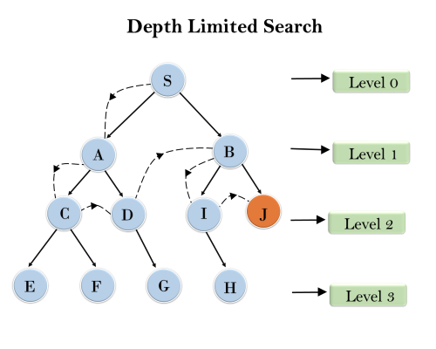
Depth-Limited Search (DLS)

Slide 42
Depth-Limited Search (DLS)
Given the following state space (tree search), give the sequence of visited nodes when using DLS (Limit = 2):
Limit = 0
A
Limit = 1
B
C
D
E
Limit = 2
F
G
H
I
J
K
L
M
N
O

Slide 43
Depth-Limited Search (DLS)
A,
A
B
C
D
E
Limit = 2

Slide 44
Depth-Limited Search (DLS)
A,B,
A
B
C
D
E
Limit = 2
F
G

Slide 45
Depth-Limited Search (DLS)
A,B,F,
A
B
C
D
E
Limit = 2
F
G

Slide 46
Depth-Limited Search (DLS)
A,B,F,
G,
A
B
C
D
E
Limit = 2
F
G

Slide 47
Depth-Limited Search (DLS)
A,B,F,
G,
C,
A
B
C
D
E
Limit = 2
F
G
H

Slide 48
Depth-Limited Search (DLS)
A,B,F,
G,
C,H,
A
B
C
D
E
Limit = 2
F
G
H

Slide 49
Depth-Limited Search (DLS)
A,B,F,
G,
C,H,
D,
A
B
C
D
E
Limit = 2
F
G
H
I
J

Slide 50
Depth-Limited Search (DLS)
A,B,F,
G,
C,H,
D,I
A
B
C
D
E
Limit = 2
F
G
H
I
J

Slide 51
Depth-Limited Search (DLS)
A,B,F,
G,
C,H,
D,I
J,
A
B
C
D
E
Limit = 2
F
G
H
I
J

Slide 52
Depth-Limited Search (DLS)
A,B,F,
G,
C,H,
D,I
J,
E
A
B
C
D
E
Limit = 2
F
G
H
I
J

Slide 53
Depth-Limited Search (DLS)
A,B,F,
G,
C,H,
D,I
J,
E, Failure
A
B
C
D
E
Limit = 2
F
G
H
I
J

Slide 54
Depth-Limited Search (DLS)
DLS algorithm returns Failure (no solution)
The reason is that the goal is beyond the limit (Limit =2): the goal depth is (d=4)
A
B
C
D
E
Limit = 2
F
G
H
I
J
K
L
M
N
O

Slide 55
Depth-Limited Search (DLS)
Main idea: Expand node at the deepest level, but limit depth to L.
Implementation: Enqueue nodes in LIFO (last-in, first-out) order. But limit depth to L
Complete? Yes if there is a goal state at a depth less than L else No
Optimal? No
Time Complexity: O(b^{L}), where L is the cutoff.
Space Complexity: O(bL), where L is the cutoff.

Slide 56
Iterative-Deepening Search (IDS)
IDS is a general strategy often used with depth first search, that finds the best depth limit.
Gradually increases the limit, first 0, then 1, then 2 and so on until a goal is found.
This occurs when the depth limit reaches d, the depth of shallowest goal node.

Slide 57
Iterative-Deepening Search (IDS)
IDS combines benefits of both DFS and BFS.
Like depth-first search, its memory requirements are very modest: O(bd) to be precise.
Like breadth-first search, it is complete when the branching factor is finite and optimal when the path cost is a nondecreasing function of the depth of the node.

Slide 58
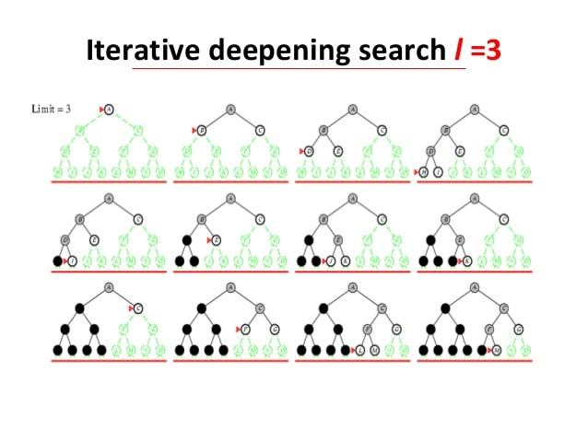
Iterative-Deepening Search (IDS)
In general, iterative deepening is the preferred uninformed search method when there is a large search space and the depth of the solution is not known.

Slide 59
Iterative-Deepening Search (IDS)
deepeningSearch(problem)
S start
depth: 1, # of nodes tested: 1, expanded: 1
expnd. node | Frontier
 | {S}
S not goal | {A,B,C}
5
2
4
A
B
C
9
4
6
2
D
E
6
G
goal
1
F
7
H
Notes:
CLICK ONCE

Slide 60
Iterative-Deepening Search (IDS)
deepeningSearch(problem)
S start
depth: 1, # of nodes tested: 2, expanded: 1
expnd. node | Frontier
 | {S}
S | {A,B,C}
A not goal | {B,C} no expand
5
2
4
A
B
C
9
4
6
2
D
E
6
G
goal
1
F
7
H
Notes:
CLICK ONCE

Slide 61
Iterative-Deepening Search (IDS)
deepeningSearch(problem)
S start
depth: 1, # of nodes tested: 3, expanded: 1
expnd. node | Frontier
 | {S}
S | {A,B,C}
A | {B,C}
B not goal | {C} no expand
5
2
4
A
B
C
9
4
6
2
D
E
6
G
goal
1
F
7
H
Notes:
CLICK ONCE

Slide 62
Iterative-Deepening Search (IDS)
deepeningSearch(problem)
S start
depth: 1, # of nodes tested: 4, expanded: 1
expnd. node | Frontier
 | {S}
S | {A,B,C}
A | {B,C}
B | {C}
C not goal | { } no expand-FAIL
5
2
4
A
B
C
9
4
6
2
D
E
6
G
goal
1
F
7
H
Notes:
CLICK ONCE

Slide 63
Iterative-Deepening Search (IDS)
deepeningSearch(problem)
S start
depth: 2, # of nodes tested: 4, expanded: 2
expnd. node | Frontier
 | {S}
S | {A,B,C}
A | {B,C}
B | {C}
C | { }
S no test | {A,B,C}
5
2
4
A
B
C
9
4
6
2
D
E
6
G
goal
1
F
7
H
Notes:
CLICK ONCE

Slide 64
Iterative-Deepening Search (IDS)
deepeningSearch(problem)
S start
depth: 2, # of nodes tested: 4, expanded: 3
expnd. node | Frontier
 | {S}
S | {A,B,C}
A | {B,C}
B | {C}
C | { }
S | {A,B,C}
A no test | {D,E,B,C}
5
2
4
A
B
C
9
4
6
2
D
E
6
G
goal
1
F
7
H
Notes:
CLICK ONCE

Slide 65
Iterative-Deepening Search (IDS)
deepeningSearch(problem)
S start
depth: 2, # of nodes tested: 5, expanded: 3
expnd. node | Frontier
 | {S}
S | {A,B,C}
A | {B,C}
B | {C}
C | { }
S | {A,B,C}
A | {D,E,B,C}
D not goal | {E,B,C} no expand
5
2
4
A
B
C
9
4
6
2
D
E
6
G
goal
1
F
7
H
Notes:
CLICK ONCE

Slide 66
Iterative-Deepening Search (IDS)
deepeningSearch(problem)
S start
depth: 2, # of nodes tested: 6, expanded: 3
expnd. node | Frontier
 | {S}
S | {A,B,C}
A | {B,C}
B | {C}
C | { }
S | {A,B,C}
A | {D,E,B,C}
D | {E,B,C}
E not goal | {B,C} no expand
5
2
4
A
B
C
9
4
6
2
D
E
6
G
goal
1
F
7
H
Notes:
CLICK ONCE

Slide 67
Iterative-Deepening Search (IDS)
deepeningSearch(problem)
depth: 2, # of nodes tested: 6, expanded: 4
expnd. node | Frontier
 | {S}
S | {A,B,C}
A | {B,C}
B | {C}
C | { }
S | {A,B,C}
A | {D,E,B,C}
D | {E,B,C}
E | {B,C}
B no test | {G,C}
S start
5
2
4
A
B
C
9
4
6
2
D
E
6
G
goal
1
F
7
H
Notes:
CLICK ONCE

Slide 68
Iterative-Deepening Search (IDS)
deepeningSearch(problem)
depth: 2, # of nodes tested: 7, expanded: 4
expnd. node | Frontier
 | {S}
S | {A,B,C}
A | {B,C}
B | {C}
C | { }
S | {A,B,C}
A | {D,E,B,C}
D | {E,B,C}
E | {B,C}
B | {G,C}
G goal | {C} no expand
S start
5
2
4
A
B
C
9
4
6
2
D
E
6
G
goal
1
F
7
H
Notes:
CLICK ONCE

Slide 69
Iterative-Deepening Search (IDS)
deepeningSearch(problem)
depth: 2, # of nodes tested: 7, expanded: 4
expnd. node | Frontier
 | {S}
S | {A,B,C}
A | {B,C}
B | {C}
C | { }
S | {A,B,C}
A | {D,E,B,C}
D | {E,B,C}
E | {B,C}
B | {G,C}
G | {C}
S start
5
2
4
A
B
C
9
4
6
2
D
E
6
G
goal
1
F
7
H
path: S,B,G cost: 8
Notes:
CLICK ONCE

Slide 70
Properties of iterative deepening search
Complete? Yes
Time? (d+1)b⁰ + d b¹ + (d-1)b² + … + b^{d} = O(b^{d})
Space? O(bd)
Optimal? Yes, if step cost = 1

Slide 71
Bidirectional search
Run two simultaneous searches
One forwards, from the initial state
Other backward from the goal.
Stops when the two searches meet in the middle
Breadth First Search is applied at both sides of searches

Slide 72
Bidirectional search
Finds shortest path from initial state to goal
Reduce the search time by searching forward from the start and backward from the goal simultaneously

Slide 73
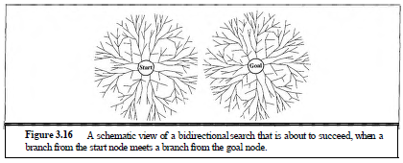
Bidirectional search

Slide 74
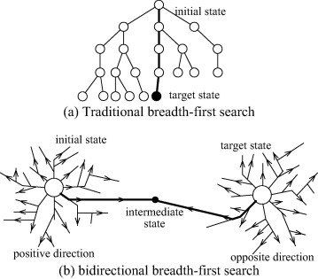
Bidirectional Search

Slide 75
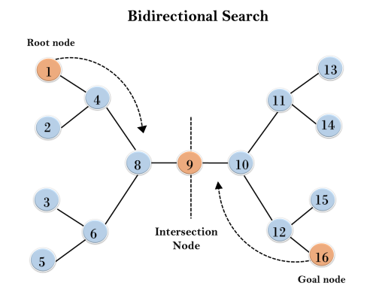
Bidirectional Search

Slide 76
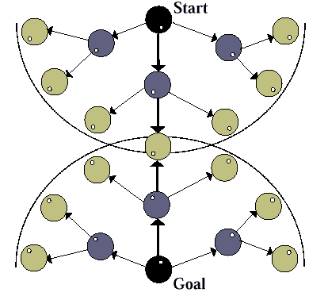
Bidirectional Search

Slide 77
Bidirectional search
S
Forward
A
D
Backwards
B
D
A
E
C
E
E
B
B
F
11
D
F
B
F
C
E
A
C
G
14
17
15
15
13
G
C
G
F
19
19
17
G
25

Slide 78
Bidirectional Search
Complete : Yes
Bidirectional search is complete if BFS is used in both searches.
Optimality : Yes
It is optimal if BFS is used for search and paths have uniform cost.
Time and Space Complexity :
O(b^{d/2})

Slide 79
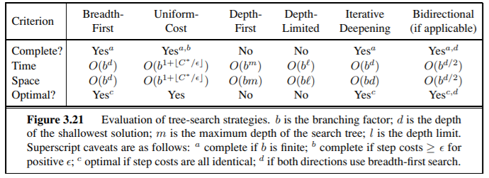
Comparing uninformed search strategies

Slide 80
Reading Reference
The content of this lecture comprise of material from Chapter 3 of the course book.

