Slide 1
ARTIFICIAL INTELLIGENCE Week 3
Dr. Momina Moetesum

Slide 2
Informed (Heuristic) Search
Informed searches use domain knowledge to guide selection of the best path to continue searching
Heuristics are used, which are informed guesses
Heuristic means "serving to aid discovery“
Best-first search (for small search spaces)
Greedy best-first search
A* search
Iterative Deepening A*
Local search algorithms (for large search spaces)
Hill-climbing search
Simulated annealing search
Local beam search
Genetic algorithms

Slide 3
Heuristic Function
Define a heuristic function, h(n)
it estimates
the "goodness" of node n
how close node n is to a goal
the estimated cost of minimal cost (cheapest) path from node n to a goal state

Slide 4
Heuristic Function
h(n) ≥ 0 for all nodes n
h(n)=0 means n is a goal node
h(n) close to 0 means we think n is close to a goal state
h(n) very big means we think n is far from a goal state
All domain knowledge used in the search is encoded in the heuristic function, h

Slide 5
Best First Search
Sort nodes in the fringe/frontier list by increasing values of an evaluation function, f(n), that incorporates domain-specific information
This is a generic way of referring to the class of informed search methods
Idea: use an evaluation function f(n) for each node
estimate of "desirability"
Expand most desirable unexpanded node

Slide 6
Best First Search (implementation)
Contains two lists:
Open List: contains all nodes that have been generated but not expanded
Closed List: Contains those nodes that have already been completely expanded

Slide 7
Best First Search (implementation)
Initially, just the root node is included in the Open list, and Closed list is empty
At each cycle, a node with lowest cost from Open list is expanded and added to the Closed list, and its children are added to the Open list
The algorithm terminates when goal node is chosen for expansion or there are no more nodes remaining in Open list

Slide 8
Example: Path Finding

Slide 9
Heuristic: Straight-Line Distance to Bucharest
380
234
374
226
253
176
366
199
193
329
244
100
151
80
241
161
242
160
77

Slide 10
Greedy Best First Search
Use as an evaluation function, f(n) = h(n), sorting nodes in the Frontier by increasing values of f
Heuristic Function
h(n)= estimated cost of the cheapest path from node n to a goal node
Selects the node to expand that is believed to be closest (i.e., smallest f value) to a goal node
e.g., h_{SLD}(n) = straight-line distance from n to Bucharest

Slide 11
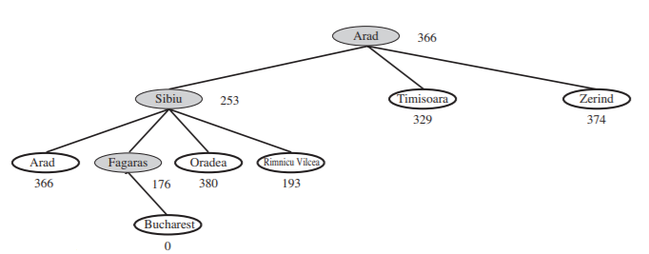
Greedy Best First Search

Slide 12
Greedy Best First Search
f(n) = h(n)
S h=8
# of nodes tested: 0, expanded: 0
expnd. node | Frontier
 | {S:8}
1
5
8
A h=8
B h=4
C h=3
3
7
9
4
5
D h=∞
E h=∞
G h=0

Slide 13
Greedy Best First Search
f(n) = h(n)
S h=8
# of nodes tested: 1, expanded: 1
expnd. node | Frontier
 | {S:8}
S not goal | {C:3,B:4,A:8}
1
5
8
A h=8
B h=4
C h=3
3
7
9
4
5
D h=∞
E h=∞
G h=0

Slide 14
Greedy Best First Search
f(n) = h(n)
S h=8
# of nodes tested: 2, expanded: 2
expnd. node | Frontier
 | {S:8}
S | {C:3,B:4,A:8}
C not goal | {G:0,B:4,A:8}
1
5
8
A h=8
B h=4
C h=3
3
7
9
4
5
D h=∞
E h=∞
G h=0

Slide 15
Greedy Best First Search
f(n) = h(n)
S h=8
# of nodes tested: 3, expanded: 2
expnd. node | Frontier
 | {S:8}
S | {C:3,B:4,A:8}
C | {G:0,B:4, A:8}
G goal | {B:4, A:8} not expanded
1
5
8
A h=8
B h=4
C h=3
3
7
9
4
5
D h=∞
E h=∞
G h=0

Slide 16
Greedy Best First Search
f(n) = h(n)
S h=8
# of nodes tested: 3, expanded: 2
expnd. node | Frontier
 | {S:8}
S | {C:3,B:4,A:8}
C | {G:0,B:4, A:8}
G | {B:4, A:8}
1
5
8
A h=8
B h=4
C h=3
3
7
9
4
5
D h=∞
E h=∞
G h=0
Fast but not optimal
path: S,C,G cost: 13

Slide 17
Greedy Best First Search
Not complete
Not optimal/admissible
S h=5
2
2
A h=3
B h=4
Greedy search finds the left goal (solution cost of 7)
Optimal solution is the path to the right goal (solution cost of 5)
1
2
C h=3
D h=1
1
1
E h=2
G
goal
3
G
goal

Slide 18
Greedy Best First Search
Greedy best-first search resembles depth-first search in the way it prefers to follow a single path all the way to the goal but will back up when it hits a dead end.
It suffers from the same defects as depth-first search-it is not optimal, and it is incomplete (because it can start down an infinite path and never return to try other possibilities).

Slide 19
Greedy Best First Search
Complete? No – can get stuck in loops
Time? O(b^{m}), but a good heuristic can give dramatic improvement
Space? O(b^{m}) -- keeps all nodes in memory
Optimal? No

Slide 20
A* Search
Idea: avoid expanding paths that are already expensive
Evaluation function f(n) = g(n) + h(n)
g(n) = cost so far to reach n from start node
h(n) = estimated cost of cheapest path from n to goal
f(n) = estimated cost of the cheapest path through n to goal

Slide 21
A* Search
Cheapest solution is found by identifying the node with lowest value of g(n)+h(n)
A* is both complete and optimal

Slide 22
Admissible Heuristic Function
When h(n) ≤ h*(n) holds true for all n, h is called an admissible heuristic function
where h*(n) is the actual cost of the minimum-cost path from n to a goal

Slide 23
Admissible Heuristic
n | g(n) | h(n) | f(n) | h*(n)
S
A
B
C
D
E
G
S h=8
n | g(n) | h(n) | f(n) | h*(n)
S
A
B
C
D
E
G
1
5
8
A h=8
B h=4
C h=3
3
7
9
4
5
D h=∞
E h=∞
G h=0
g(n) = actual cost to get to node n from start

Slide 24
Admissible Heuristic
n | g(n) | h(n) | f(n) | h*(n)
S | 0
A
B
C
D
E
G
S h=8
1
5
8
A h=8
B h=4
C h=3
3
7
9
4
5
D h=∞
E h=∞
G h=0
g(n) = actual cost to get to node n from start

Slide 25
Admissible Heuristic
n | g(n) | h(n) | f(n) | h*(n)
S | 0
A | 1
B
C
D
E
G
S h=8
1
5
8
A h=8
B h=4
C h=3
3
7
9
4
5
D h=∞
E h=∞
G h=0
g(n) = actual cost to get to node n from start

Slide 26
Admissible Heuristic
n | g(n) | h(n) | f(n) | h*(n)
S | 0
A | 1
B | 5
C | 8
D
E
G
S h=8
1
5
8
A h=8
B h=4
C h=3
3
7
9
4
5
D h=∞
E h=∞
G h=0
g(n) = actual cost to get to node n from start

Slide 27
Admissible Heuristic
n | g(n) | h(n) | f(n) | h*(n)
S | 0
A | 1
B | 5
C | 8
D | 1+3 = 4
E
G
S h=8
1
5
8
A h=8
B h=4
C h=3
3
7
9
4
5
D h=∞
E h=∞
G h=0
g(n) = actual cost to get to node n from start

Slide 28
Admissible Heuristic
n | g(n) | h(n) | f(n) | h*(n)
S | 0
A | 1
B | 5
C | 8
D | 4
E | 1+7 = 8
G
S h=8
1
5
8
A h=8
B h=4
C h=3
3
7
9
4
5
D h=∞
E h=∞
G h=0
g(n) = actual cost to get to node n from start

Slide 29
Admissible Heuristic
n | g(n) | h(n) | f(n) | h*(n)
S | 0
A | 1
B | 5
C | 8
D | 4
E | 8
G | 10/9/13
S h=8
1
5
8
A h=8
B h=4
C h=3
3
7
9
4
5
D h=∞
E h=∞
G h=0
g(n) = actual cost to get to node n from start

Slide 30
Admissible Heuristic
n | g(n) | h(n) | f(n) | h*(n)
S | 0
A | 1
B | 5
C | 8
D | 4
E | 8
G | 10/9/13
S h=8
1
5
8
A h=8
B h=4
C h=3
3
7
9
4
5
D h=∞
E h=∞
G h=0
h(n) = estimated cost to get to a goal from node n

Slide 31
Admissible Heuristic
n | g(n) | h(n) | f(n) | h*(n)
S | 0 | 8
A | 1
B | 5
C | 8
D | 4
E | 8
G | 10/9/13
S h=8
n | g(n) | h(n) | f(n) | h*(n)
S | 0 | 8
A | 1 | 8
B | 5 | 4
C | 8 | 3
D | 4 | ∞
E | 8 | ∞
G | 10/9/13 | 0
1
5
8
A h=8
B h=4
C h=3
3
7
9
4
5
D h=∞
E h=∞
G h=0
h(n) = estimated cost to get to a goal from node n

Slide 32
Admissible Heuristic
n | g(n) | h(n) | f(n) | h*(n)
S | 0 | 8
A | 1 | 8
B | 5 | 4
C | 8 | 3
D | 4 | ∞
E | 8 | ∞
G | 10/9/13 | 0
S h=8
n | g(n) | h(n) | f(n) | h*(n)
S | 0 | 8 | 8
A | 1 | 8 | 9
B | 5 | 4 | 9
C | 8 | 3 | 11
D | 4 | ∞ | ∞
E | 8 | ∞ | ∞
G | 10/9/13 | 0 | 10/9/13
1
5
8
A h=8
B h=4
C h=3
3
7
9
4
5
D h=∞
E h=∞
G h=0
f(n) = g(n) + h(n) actual cost to get from start to n plus estimated cost from n to goal

Slide 33
Admissible Heuristic
n | g(n) | h(n) | f(n) | h*(n)
S | 0 | 8 | 8
A | 1 | 8 | 9
B | 5 | 4 | 9
C | 8 | 3 | 11
D | 4 | ∞ | ∞
E | 8 | ∞ | ∞
G | 10/9/13 | 0 | 10/9/13
S h=8
1
5
8
A h=8
B h=4
C h=3
3
7
9
4
5
D h=∞
E h=∞
G h=0
h*(n) = true cost of minimum-cost path from n to a goal

Slide 34
Admissible Heuristic
n | g(n) | h(n) | f(n) | h*(n)
S | 0 | 8 | 8 | 9
A | 1 | 8 | 9
B | 5 | 4 | 9
C | 8 | 3 | 11
D | 4 | ∞ | ∞
E | 8 | ∞ | ∞
G | 10/9/13 | 0 | 10/9/13
S h=8
1
5
8
A h=8
B h=4
C h=3
3
7
9
4
5
D h=∞
E h=∞
G h=0
h*(n) = true cost of minimum-cost path from n to a goal

Slide 35
Admissible Heuristic
n | g(n) | h(n) | f(n) | h*(n)
S | 0 | 8 | 8 | 9
A | 1 | 8 | 9 | 9
B | 5 | 4 | 9
C | 8 | 3 | 11
D | 4 | ∞ | ∞
E | 8 | ∞ | ∞
G | 10/9/13 | 0 | 10/9/13
S h=8
1
5
8
A h=8
B h=4
C h=3
3
7
9
4
5
D h=∞
E h=∞
G h=0
h*(n) = true cost of minimum-cost path from n to a goal

Slide 36
Admissible Heuristic
n | g(n) | h(n) | f(n) | h*(n)
S | 0 | 8 | 8 | 9
A | 1 | 8 | 9 | 9
B | 5 | 4 | 9 | 4
C | 8 | 3 | 11
D | 4 | ∞ | ∞
E | 8 | ∞ | ∞
G | 10/9/13 | 0 | 10/9/13
S h=8
1
5
8
A h=8
B h=4
C h=3
3
7
9
4
5
D h=∞
E h=∞
G h=0
h*(n) = true cost of minimum-cost path from n to a goal

Slide 37
Admissible Heuristic
n | g(n) | h(n) | f(n) | h*(n)
S | 0 | 8 | 8 | 9
A | 1 | 8 | 9 | 9
B | 5 | 4 | 9 | 4
C | 8 | 3 | 11 | 5
D | 4 | ∞ | ∞
E | 8 | ∞ | ∞
G | 10/9/13 | 0 | 10/9/13
S h=8
1
5
8
A h=8
B h=4
C h=3
3
7
9
4
5
D h=∞
E h=∞
G h=0
h*(n) = true cost of minimum-cost path from n to a goal

Slide 38
Admissible Heuristic
n | g(n) | h(n) | f(n) | h*(n)
S | 0 | 8 | 8 | 9
A | 1 | 8 | 9 | 9
B | 5 | 4 | 9 | 4
C | 8 | 3 | 11 | 5
D | 4 | ∞ | ∞
E | 8 | ∞ | ∞
G | 10/9/13 | 0 | 10/9/13
S h=8
n | g(n) | h(n) | f(n) | h*(n)
S | 0 | 8 | 8 | 9
A | 1 | 8 | 9 | 9
B | 5 | 4 | 9 | 4
C | 8 | 3 | 11 | 5
D | 4 | ∞ | ∞ | ∞
E | 8 | ∞ | ∞ | ∞
G | 10/9/13 | 0 | 10/9/13 | 0
1
5
8
A h=8
B h=4
C h=3
3
7
9
4
5
D h=∞
E h=∞
G h=0
h*(n) = true cost of minimum-cost path from n to a goal

Slide 39
Admissible Heuristic
n | g(n) | h(n) | f(n) | h*(n)
S | 0 | 8 | 8 | 9
A | 1 | 8 | 9 | 9
B | 5 | 4 | 9 | 4
C | 8 | 3 | 11 | 5
D | 4 | ∞ | ∞ | ∞
E | 8 | ∞ | ∞ | ∞
G | 10/9/13 | 0 | 10/9/13 | 0
S h=8
1
5
8
A h=8
B h=4
C h=3
3
7
9
4
5
D h=∞
E h=∞
G h=0
optimal path = S,B,G
cost = 9

Slide 40
Admissible Heuristic
n | g(n) | h(n) | f(n) | h*(n)
S | 0 | 8 | 8 | 9
A | 1 | 8 | 9 | 9
B | 5 | 4 | 9 | 4
C | 8 | 3 | 11 | 5
D | 4 | ∞ | ∞ | ∞
E | 8 | ∞ | ∞ | ∞
G | 10/9/13 | 0 | 10/9/13 | 0
S h=8
1
5
8
A h=8
B h=4
C h=3
3
7
9
4
5
D h=∞
E h=∞
G h=0
Since h(n) ≤ h*(n) for all n,
h is admissible

Slide 41
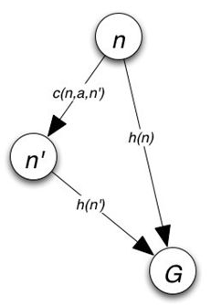
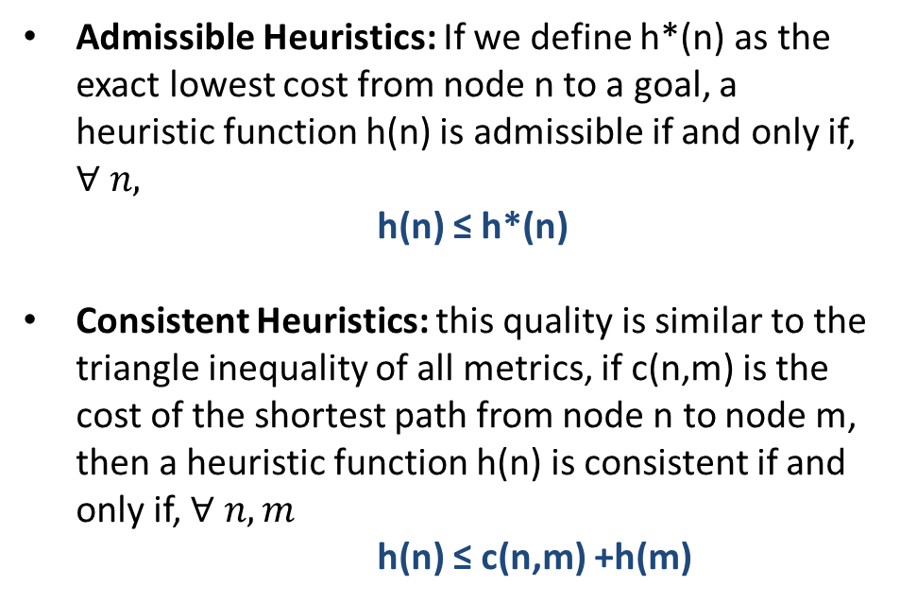
Admissible vs Consistent Heuristics
Admissible Heuristics: If we define h*(n) as the exact lowest cost from node n to a goal, a heuristic function h(n) is admissible if and only if, $∀ n,$
h(n) ≤ h*(n)
Consistent Heuristics: this quality is similar to the triangle inequality of all metrics, if c(n,m) is the cost of the shortest path from node n to node m, then a heuristic function h(n) is consistent if and only if, $∀ n,m$
h(n) ≤ c(n,m) +h(m)

Slide 42
A* Search
Is h admissible and/or consistent?
f(n) = g(n) + h(n)
S h=8
# of nodes tested: 0, expanded: 0
expnd. node | Frontier
 | {S:0+8}
1
5
8
A h=8
B h=4
C h=3
3
7
9
4
5
D h=∞
E h=∞
G h=0

Slide 43
A* Search
f(n) = g(n) + h(n)
S h=8
# of nodes tested: 1, expanded: 1
expnd. node | Frontier
 | {S:8}
S not goal | {A:1+8,B:5+4,C:8+3}
1
5
8
A h=8
B h=4
C h=3
3
7
9
4
5
D h=∞
E h=∞
G h=0

Slide 44
A* Search
f(n) = g(n) + h(n)
S h=8
# of nodes tested: 2, expanded: 2
expnd. node | Frontier
 | {S:8}
S | {A:9,B:9,C:11}
A not goal | {B:9,G:1+9+0,C:11, D:1+3+∞,E:1+7+∞}
1
5
8
A h=8
B h=4
C h=3
3
7
9
4
5
D h=∞
E h=∞
G h=0

Slide 45
A* Search
f(n) = g(n) + h(n)
S h=8
# of nodes tested: 3, expanded: 3
expnd. node | Frontier
 | {S:8}
S | {A:9,B:9,C:11}
A | {B:9,G:10,C:11,D:∞,E:∞}
B not goal | {G:5+4+0,G:10,C:11, D:∞,E:∞} replace
1
5
8
A h=8
B h=4
C h=3
3
7
9
4
5
D h=∞
E h=∞
G h=0

Slide 46
A* Search
f(n) = g(n) + h(n)
S h=8
# of nodes tested: 4, expanded: 3
expnd. node | Frontier
 | {S:8}
S | {A:9,B:9,C:11}
A | {B:9,G:10,C:11,D:∞,E:∞}
B | {G:9,C:11,D:∞,E:∞}
G goal | {C:11,D:∞,E:∞} not expanded
1
5
8
A h=8
B h=4
C h=3
3
7
9
4
5
D h=∞
E h=∞
G h=0

Slide 47
A* Search
f(n) = g(n) + h(n)
S h=8
# of nodes tested: 4, expanded: 3
expnd. node | Frontier
 | {S:8}
S | {A:9,B:9,C:11}
A | {B:9,G:10,C:11,D:∞,E:∞}
B | {G:9,C:11,D:∞,E:∞}
G | {C:11,D:∞,E:∞}
1
5
8
A h=8
B h=4
C h=3
3
7
9
4
5
D h=∞
E h=∞
G h=0
Pretty fast and optimal
path: S,B,G cost: 9

Slide 48
Example: Path Finding

Slide 49
Heuristic: Straight-Line Distance to Bucharest
380
234
374
226
253
176
366
199
193
329
244
100
151
80
241
161
242
160
77

Slide 50
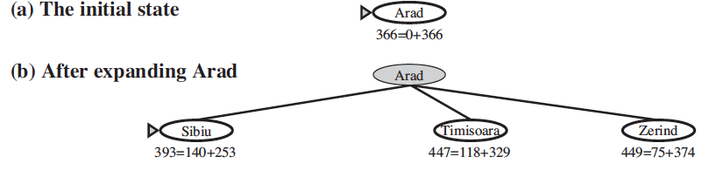
Heuristic: Straight-Line Distance to Bucharest

Slide 51
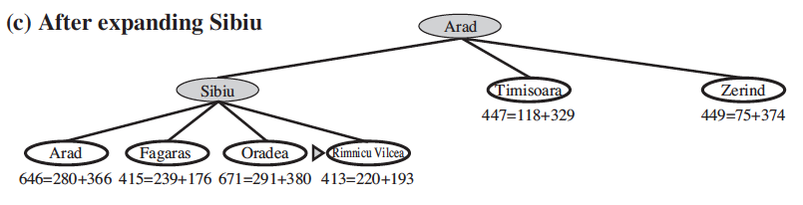
Heuristic: Straight-Line Distance to Bucharest

Slide 52
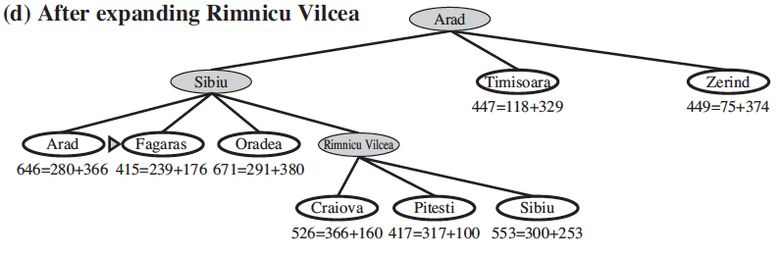
Heuristic: Straight-Line Distance to Bucharest

Slide 53
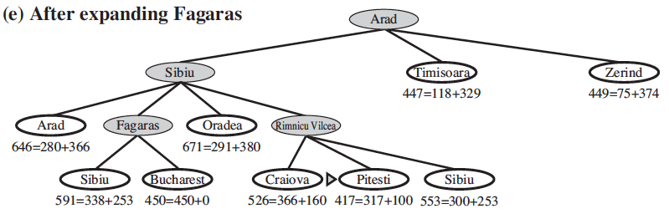
Heuristic: Straight-Line Distance to Bucharest

Slide 54
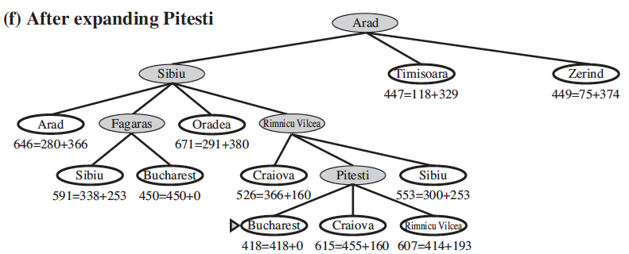
Heuristic: Straight-Line Distance to Bucharest

Slide 55
Pruning
—eliminating possibilities from consideration without having to examine them.

Slide 56
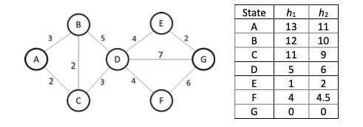

Self Test

Slide 57
Draw Backs of A*
It can use lot of memory
O (number of states)
For big search spaces, A* will run out of memory

Slide 58
Iterative Deepening A*
Iterative deepening A* or IDA* is similar to iterative deepening depth first, but with following modifications:
The depth bound modification to be an f-limit
Start with f-limit= h(start)
Prune any node if f(node) > f-limit
Next f-limit=minimum cost of any node pruned

Slide 59
Iterative Deepening A*
Iterative-deepening A*
Cutoff based on f = g + h value rather than depth
At each iteration do loop-avoiding DFS, not expanding any node with an f-value that exceeds current threshold
At each iteration increase the f-value threshold by setting it to the smallest f-value of any node that exceeded the cutoff in the previous iteration
Complete
Optimal / Admissible
Linear space required

Slide 60
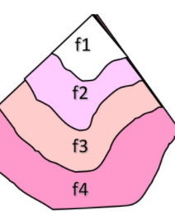
Iterative Deepening A*
Perform depth-first search LIMITED to some f-bound.
If goal found: Ok
Else: increase the f-bound and restart.
How to establish the f-bounds?
-initially: f(S)
Generate all successors
Record the minimal f(succ) > f(S)
Continue with f(succ) instead of f(S)

Slide 61
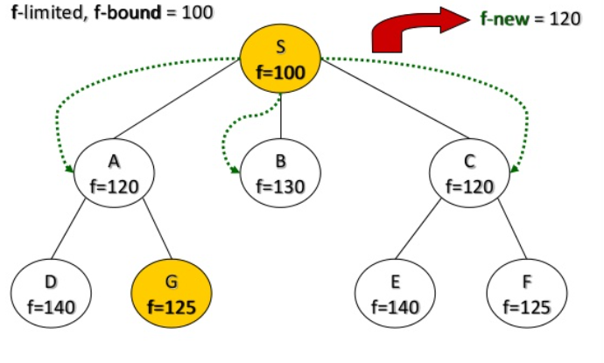
Iterative Deepening A*

Slide 62
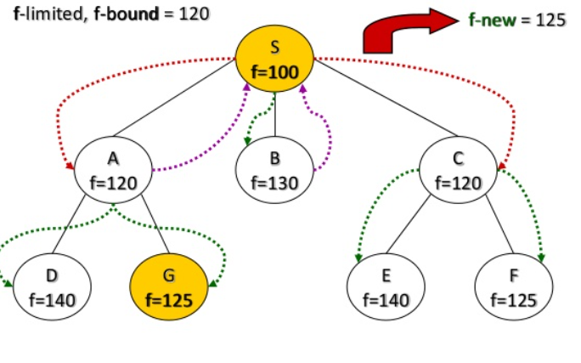
Iterative Deepening A*

Slide 63
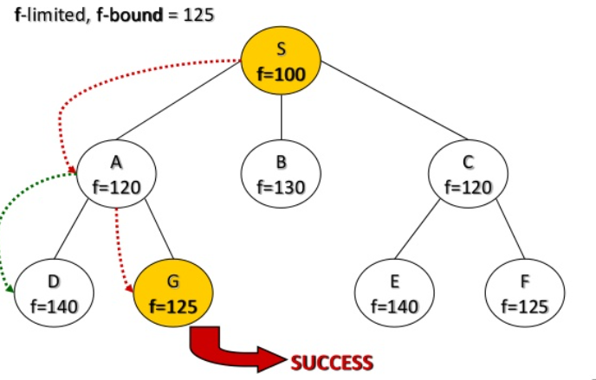
Iterative Deepening A*

Slide 64
Iterative Deepening A*

Slide 65
Systematic Searching
Systematic (global) searching: Search for a path from start state to a goal state, then “execute” solution path’s sequence of operators
BFS, DFS, IDS, UCS, Greedy Best-First, A*, etc.
ok for small search spaces
ok for the problems where path is relevant

Slide 66
Reading Reference
The content of this lecture comprise of material from Chapter 3 of the course book.

