Slide 1
ARTIFICIAL INTELLIGENCE Week 4
Dr. Momina Moetesum

Slide 2
Informed (Heuristic) Search
Informed searches use domain knowledge to guide selection of the best path to continue searching
Heuristics are used, which are informed guesses
Heuristic means "serving to aid discovery“
Best-first search (for small search spaces)
Greedy best-first search
A* search
Iterative Deepening A*
Local search algorithms (for large search spaces)
Hill-climbing search
Simulated annealing search
Local beam search
Genetic algorithms

Slide 3
Genetic Algorithms
Genetic algorithms (GAs) are a family of search methods that have been shown to be effective in finding optimal or near-optimal solutions to a wide range of optimization problems.
A GA maintains a population of solutions to the problem being solved and uses crossover, mutation, and selection operations to iteratively modify them.
As the population evolves across generations, better solutions are created and inferior ones are selectively discarded.
GAs usually run for a fixed number of iterations (generations) or until further improvements do not obtain.

Slide 4
Genetic Algorithm
Genetic algorithms are a particular class of evolutionary algorithms that use techniques inspired by evolutionary biology, these include:
Parental Selection
Cross Over
Mutation
Survival of the Fittest

Slide 5
Genetic Algorithms-Advantages
Does not require any derivative information (which may not be available for many real-world problems).
Is faster and more efficient as compared to the traditional methods.
Has very good parallel capabilities.
Optimizes both continuous and discrete functions and also multi-objective problems.
Provides a list of “good” solutions and not just a single solution.
Always gets an answer to the problem, which gets better over the time.
Useful when the search space is very large and there are a large number of parameters involved.

Slide 6
Genetic Algorithms-Limitations
GAs are not suited for all problems, especially problems which are simple and for which derivative information is available.
Fitness value is calculated repeatedly which might be computationally expensive for some problems.
Being stochastic, there are no guarantees on the optimality or the quality of the solution.
If not implemented properly, the GA may not converge to the optimal solution.

Slide 7
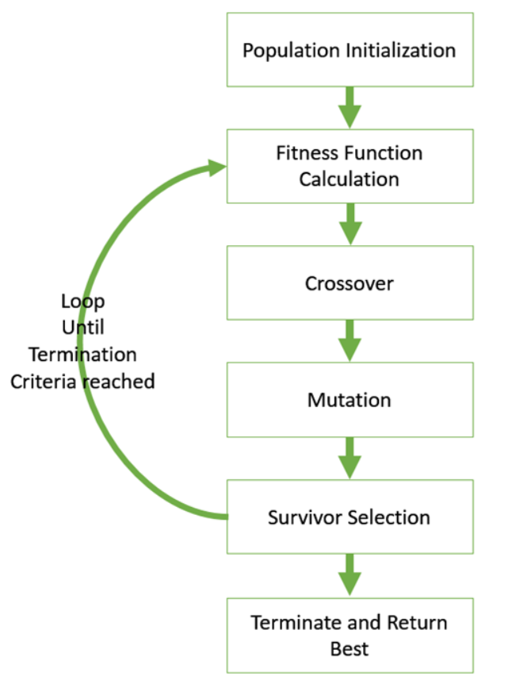
Genetic Algorithms
General Steps:
Select Encoding Type
Choose Population Size
Randomly Choose Initial Population
Select Parental Chromosomes
Crossover and Mutation
Evaluation of the Offspring
If Stopping Criteria not reached, go to step 4

Slide 8
Genetic Algorithms
Evolution usually starts from a population of randomly generated individuals in the form of iteration. (Iteration will lead to a new generation).
In every iteration or generation, the fitness of each individual is determined to select the fittest.
Genome fittest individuals selected are mutated or altered to form a new generation, and the process continues until the best solution has reached.
Initialization
Selection
Crossover
Mutation
Evaluate
Generate

Slide 9
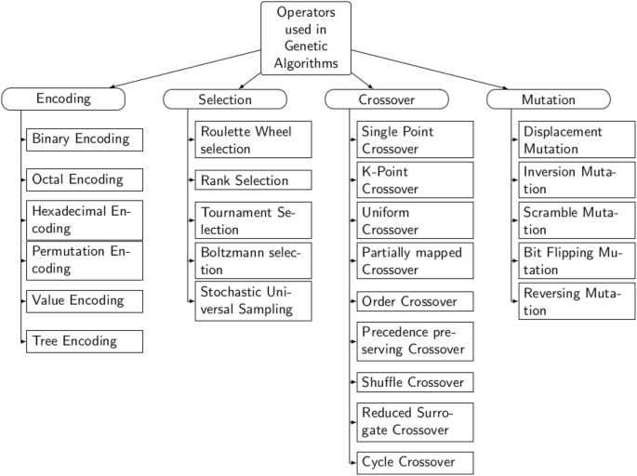
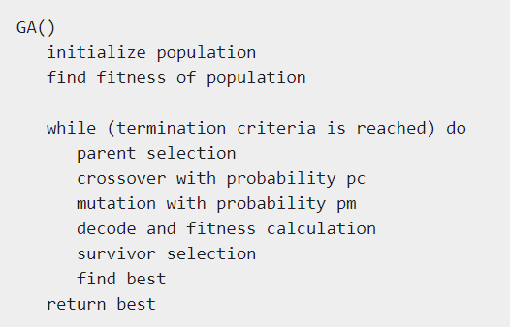
Genetic Algorithms-Pseudocode

Slide 10
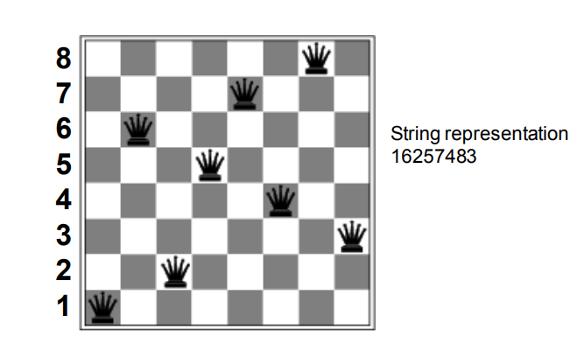
Genetic Algorithms - Encoding
Binary Encoding
Value-Based Encoding
Permutation Encoding
And more …..
8-queens •
State = position of 8 queens each in a column

Slide 11
Genetic Algorithms-Selection
Selection/Reproduction
First operator applied on encoded population
The chromosomes are selected to be parents to crossover and produce offsprings
Selection is based on fitness functions
Most commonly chromosomes selection methods:
Roulette wheel selection
Boltzman selection
Tournament selection
Rank selection
Steady state selection

Slide 12
Genetic Algorithms-CrossOver
Crossover
Generating offspring from two selected parents
Idea behind crossover is that new chromosomes (offsprings) may be better
Many types of crossover operators:
Single point crossover
Two point crossover (Multi point crossover)
Uniform crossover

Slide 13
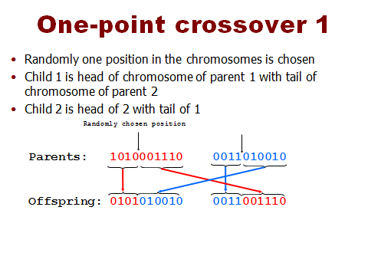
One-Point Crossover

Slide 14
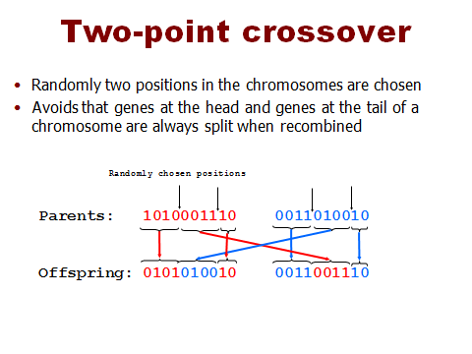
Two-Point Crossover

Slide 15
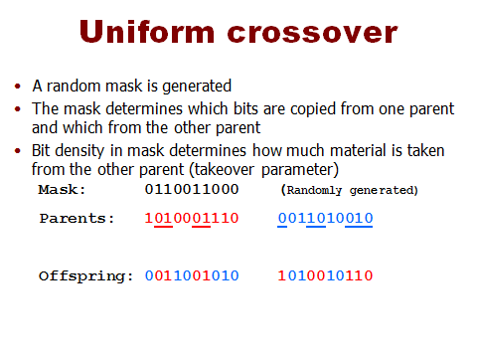
Uniform Crossover

Slide 16
Genetic Algorithms-Mutation
Mutation
After crossover, mutation takes place
Genetic operator used to maintain diversity from one population of chromosomes to the next
Alters one or more genes values in a chromosome
As a result, entirely new chromosomes added to the pool
GA may be able to arrive at better solution than the previous

Slide 17
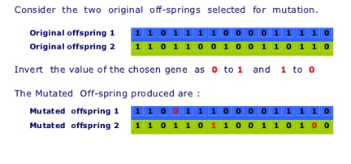
Genetic Algorithms-Mutation

Slide 18
Genetic Algorithms-Operators

Slide 19
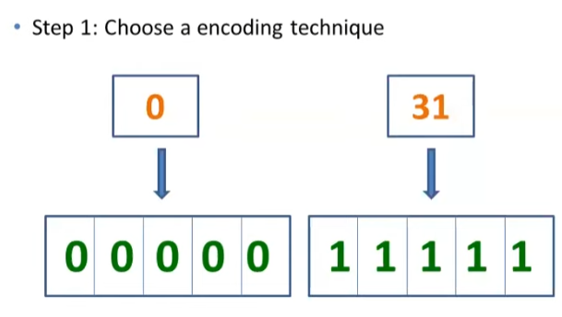
Genetic Algorithms-Example

Slide 20
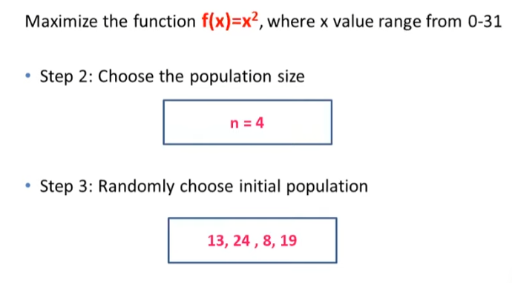
Genetic Algorithms-Example

Slide 21
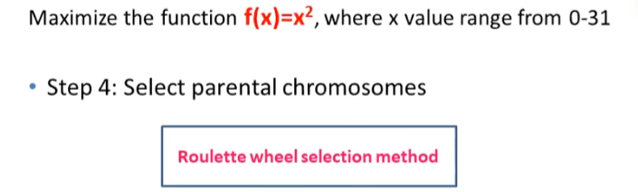
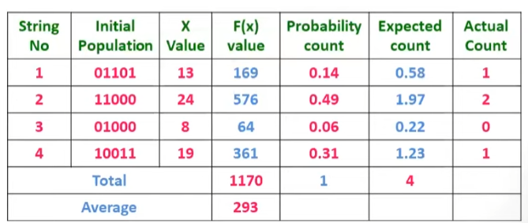
Genetic Algorithms-Example
Round off Expected Value
F(x)/Total
F(x)/Average

Slide 22
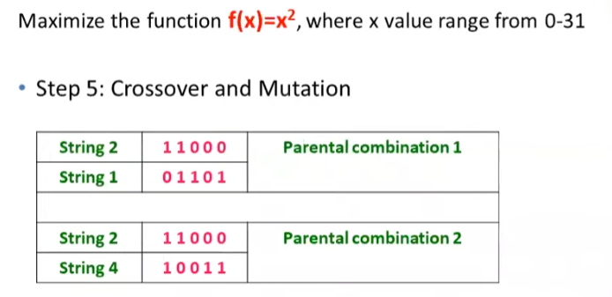
Genetic Algorithms-Example

Slide 23
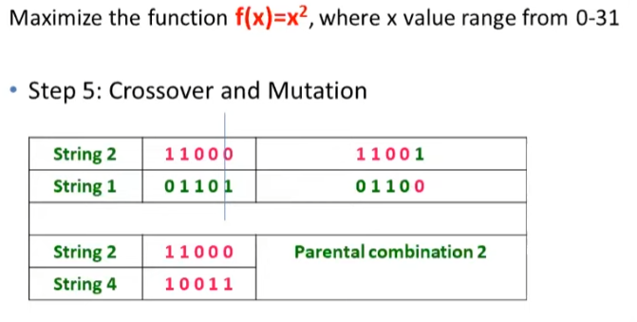
Genetic Algorithms-Example

Slide 24
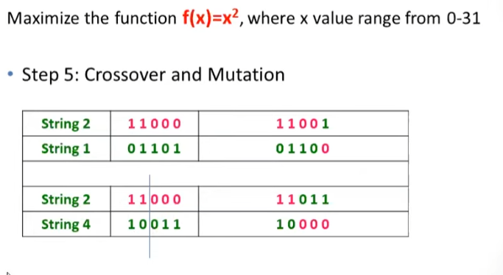
Genetic Algorithms-Example

Slide 25
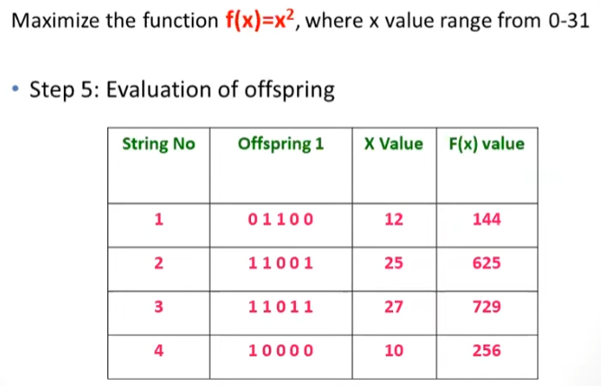
Genetic Algorithms-Example
Fitness Values have increased in the next generation

Slide 26
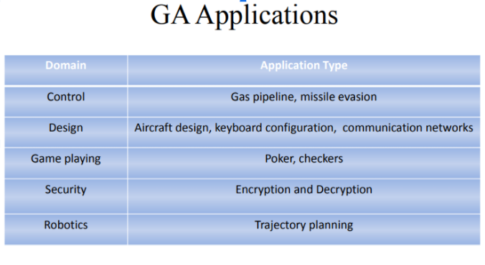
Genetic Algorithms-Application Areas

Slide 27
Reading Reference
The content of this lecture comprise of material from Chapter 4 of the course book.

