Slide 1
ARTIFICIAL INTELLIGENCE Week 5
Dr. Momina Moetesum

Slide 2
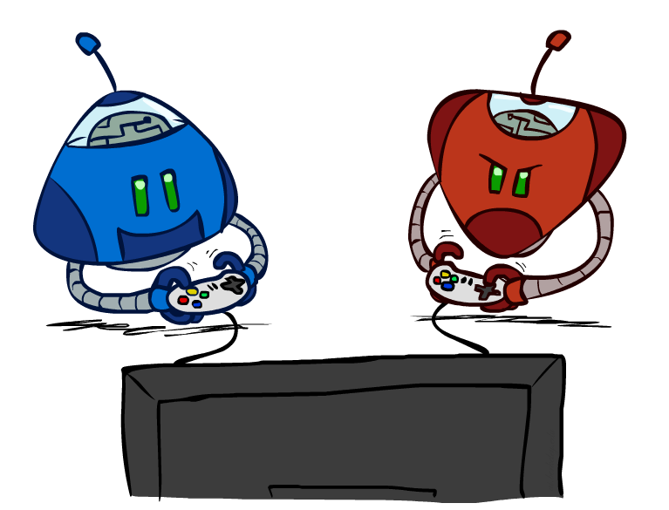
Game Playing

Slide 3
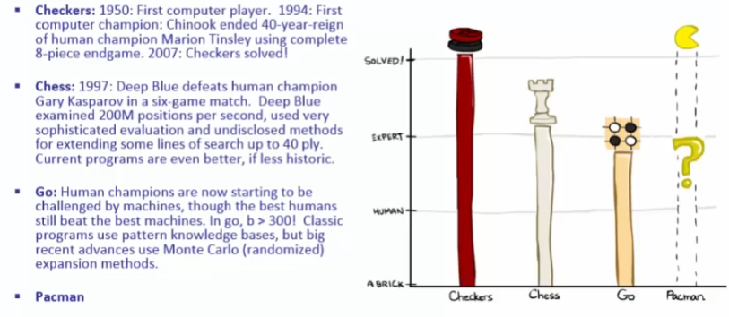
Game Playing – State of the Art

Slide 4
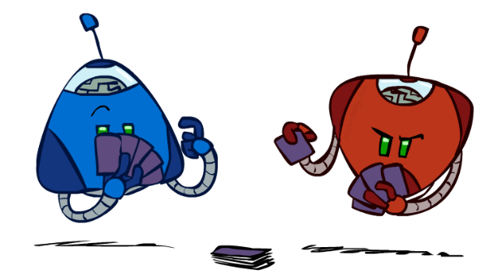
Types of Games
Many different kinds of games!
Axes:
Deterministic or stochastic?
One, two, or more players?
Zero sum?
Perfect information (can you see the state)?
Want algorithms for calculating a strategy (policy) which recommends a move from each state

Slide 5

Deterministic Games
Many possible formalizations, one is:
States: S (start at s₀)
Players: P={1...N} (usually take turns)
Actions: A (may depend on player / state)
Transition Function: SxA → S
Terminal Test: S → {t,f}
Terminal Utilities: SxP → R
Solution for a player is a policy: S → A

Slide 6
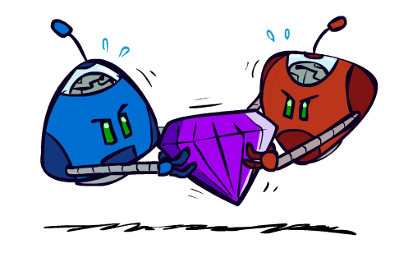
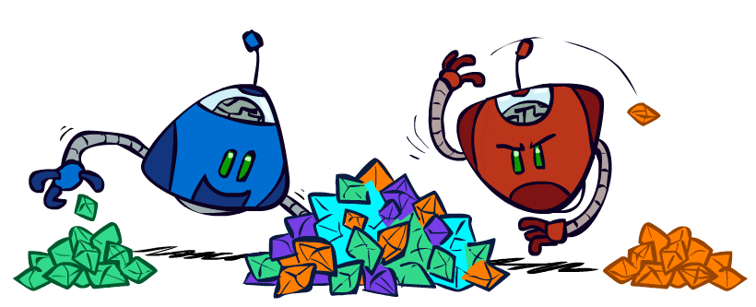
Zero-Sum Games
General Games
Agents have independent utilities (values on outcomes)
Cooperation, indifference, competition, and more are all possible
More later on non-zero-sum games
Zero-Sum Games
Agents have opposite utilities (values on outcomes)
Lets us think of a single value that one maximizes and the other minimizes
Adversarial, pure competition

Slide 7
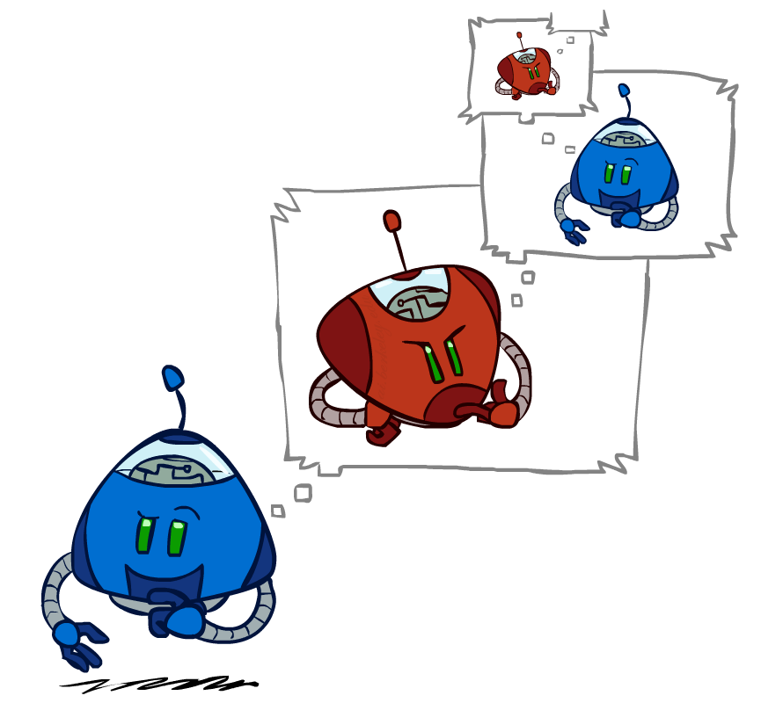
Adversarial Search

Slide 8
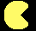
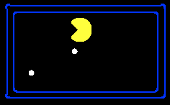
Single-Agent Trees
8
2
0
…
2
6
…
4
6

Slide 9


Value of a State
Non-Terminal States:
Value of a state: The best achievable outcome (utility) from that state
8
2
0
…
2
6
…
4
6
Terminal States:

Slide 10

Adversarial Game Trees
-20
-8
…
-18
-5
…
-10
+4
-20
+8

Slide 11


Minimax Values
States Under Agent’s Control:
States Under Opponent’s Control:
-8
-5
-10
+8
Terminal States:

Slide 12

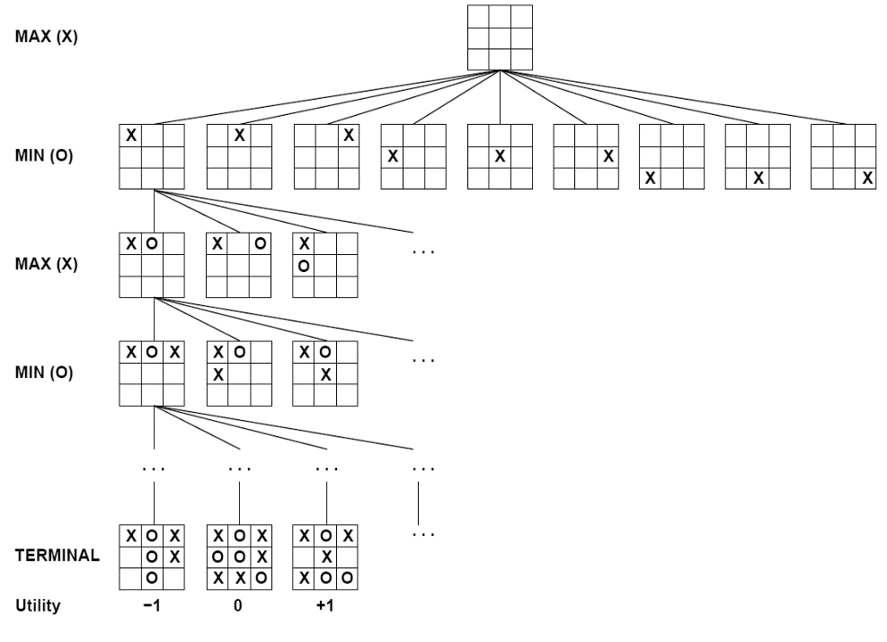

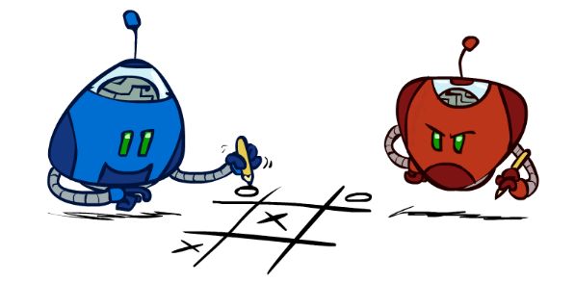
Tic-Tac-Toe Game Tree

Slide 13
Minimax Search
Deterministic, zero-sum games:
Tic-tac-toe, chess, checkers
One player maximizes result
The other minimizes result
Minimax search:
A state-space search tree
Players alternate turns
Compute each node’s
minimax value: the best achievable
utility against a rational (optimal)
adversary
Minimax values: computed recursively
5
max
2
5
min
8
2
5
6
Terminal values: part of the game

Slide 14


Minimax Implementation
def max-value(state):
initialize v = -∞
for each successor of state:
v = max(v, min-value(successor))
return v
def min-value(state):
initialize v = +∞
for each successor of state:
v = min(v, max-value(successor))
return v

Slide 15
Minimax Implementation (Dispatch)
def value(state):
if the state is a terminal state: return the state’s utility
if the next agent is MAX: return max-value(state)
if the next agent is MIN: return min-value(state)
def max-value(state):
initialize v = -∞
for each successor of state:
v = max(v, value(successor))
return v
def min-value(state):
initialize v = +∞
for each successor of state:
v = min(v, value(successor))
return v
Notes:
Pick an order for two reasons: sequential processor and pruning

Slide 16
Minimax Example
3
12
8
2
4
6
14
5
2

Slide 17

Minimax Properties
How efficient is minimax?
Complete? Yes (finite tree)
Optimal? Yes (playing against rational agent)
Time: O(b^{m})
Space: O(bm)
Example: For chess, b ≈ 35, m ≈ 100
Exact solution is completely infeasible
But, do we need to explore the whole tree?

Slide 18
Resource Limits
Cannot search to leaves
Limited search
Instead, search a limited depth of the tree
Replace terminal utilities with an eval function for non-terminal positions
Example:
Suppose we have 100 seconds, can explore 10K nodes / sec
So can check 1M nodes per move
α-β reaches about depth 8 – decent chess program
max
4
-2
min
4
min
-1
-2
4
9
?
?
?
?

Slide 19
Evaluation Functions
Function which scores non-terminals
Ideal function: returns the utility of the position
In practice: typically weighted linear sum of features:
e.g. f₁(s) = (num white queens – num black queens), etc.

Slide 20
Alpha-Beta Pruning
A way to improve the performance of the Minimax Procedure
Basic idea: “If you have an idea which is surely bad, don’t take the time to see how truly awful it is” ~ Pat Winston
>=2
We don’t need to compute the value at this node.
No matter what it is it can’t affect the value of the root node.
=2
<=1
2
7
1
?

Slide 21
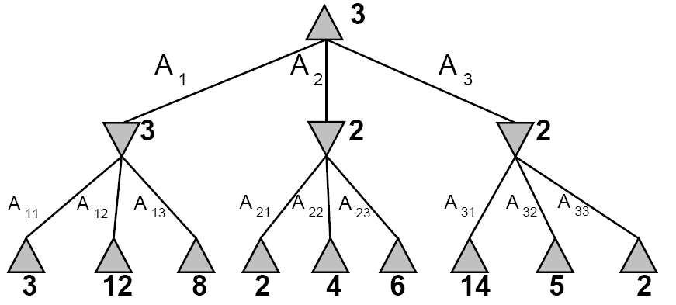
α-β Pruning Example

Slide 22
Pruning in Minimax Search
[-∞,+∞]
[3,+∞]
[3,14]
[3,5]
[3,3]
[-∞,3]
[3,3]
[-∞,2]
[-∞,14]
[-∞,5]
[2,2]
3
12
8
2
14
5
2

Slide 23
α-β Pruning
General configuration
α is the best value the Player can get at any choice point along the current path
If n is worse than α, MAX will avoid it, so prune n’s branch
Define β similarly for MIN
Player
Opponent
α
Player
Opponent
n

Slide 24
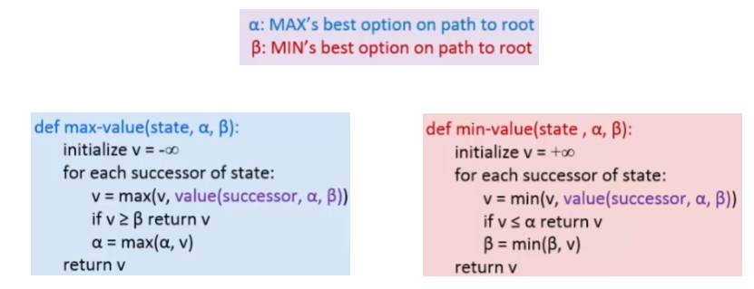
α-β Pruning Pseudocode

Slide 25
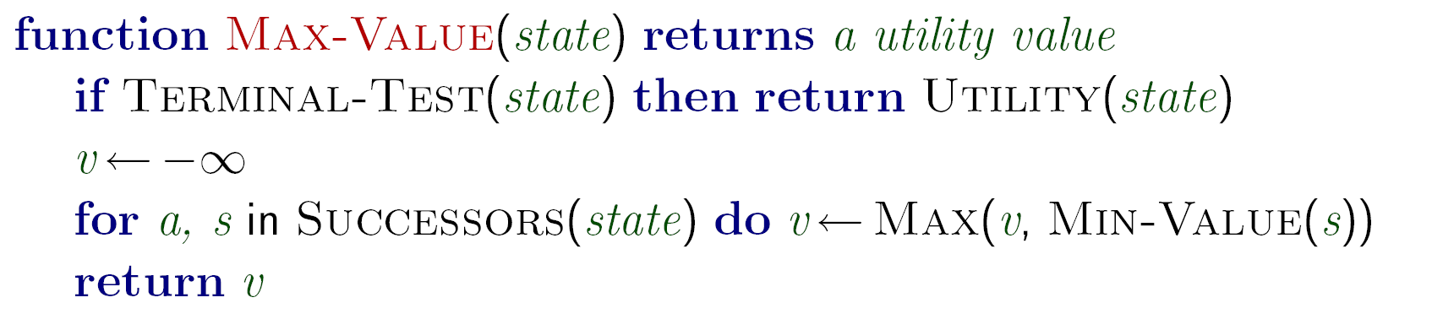
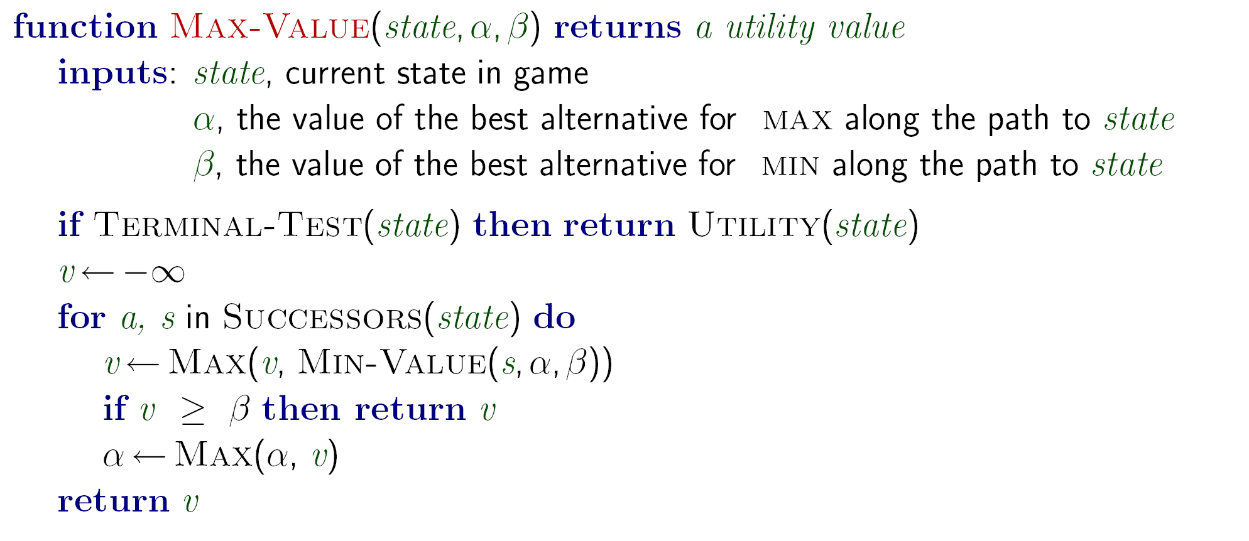
α-β Pruning Pseudocode
β
v

Slide 26
α-β Pruning Properties
Pruning has no effect on final result
Good move ordering improves effectiveness of pruning
With “perfect ordering”:
Time complexity drops to O(b^{m/2})
Doubles solvable depth
Full search of, e.g. chess, is still hopeless!
A simple example of metareasoning, here reasoning about which computations are relevant

Slide 27
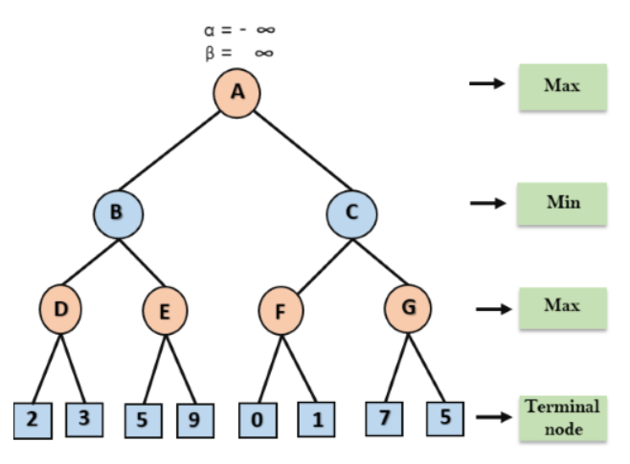
α-β Pruning

Slide 28
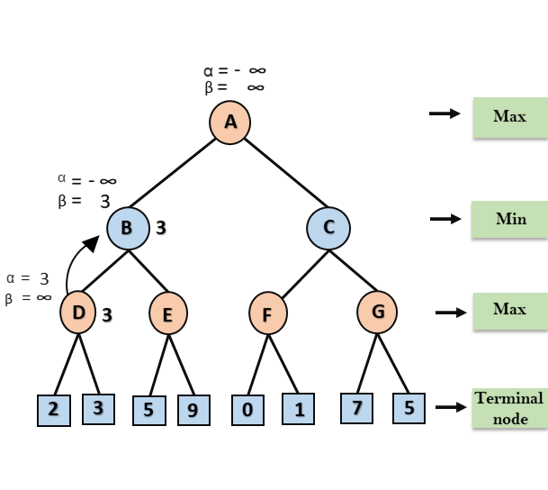
α-β Pruning

Slide 29
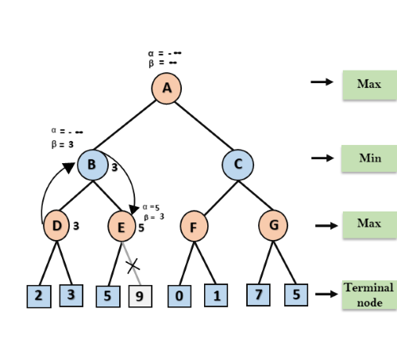
α-β Pruning

Slide 30
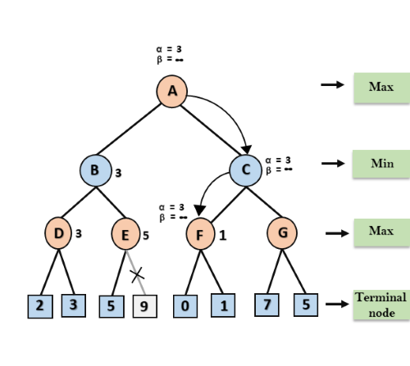
α-β Pruning

Slide 31
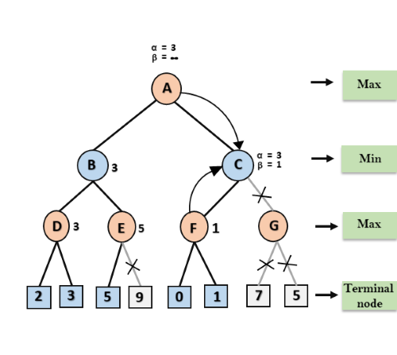
α-β Pruning

Slide 32
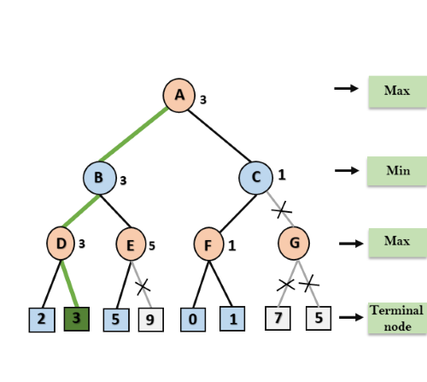
α-β Pruning

Slide 33
Reading Reference
The content of this lecture comprise of material from Chapter 5 of the course book.

