Slide 1
ARTIFICIAL INTELLIGENCE Week 6
Dr. Momina Moetesum

Slide 2
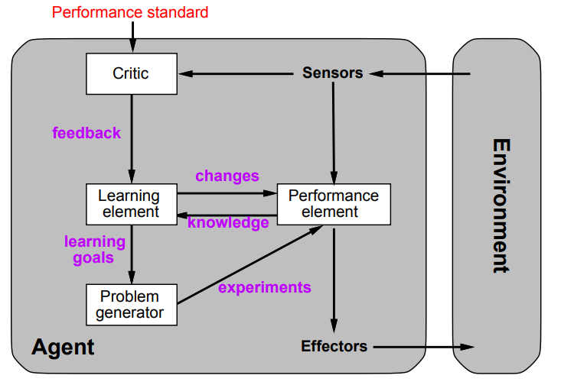
Learning Agents
Chooses action upon percept history
Improves performance by time
Learning is essential for unknown environments
A tool in AI that is capable of learning from its experiences

Slide 3
Components of Learning Agents
Critic: compares sensor’s input specifying effects of agent’s action on the environment with the performance standards and generates feedback for learning element
Learning Element: learns from the difference between the performance standard and feedback from the critic. According to current percept it is supposed to understand the expected behavior and enhance its standard
Performance Element: based on current percept received from sensors and input obtained by the learning element, performance element chooses the actions to act upon the external environment
Problem Generator: based on new goal learned by the agent, problem generator suggests new or alternative action which will lead to new and instructive understanding

Slide 4
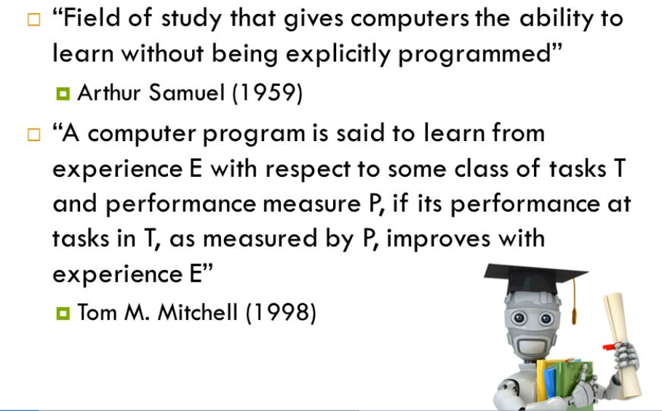
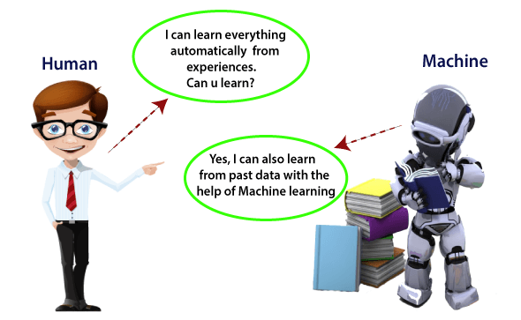
Machine Learning

Slide 5
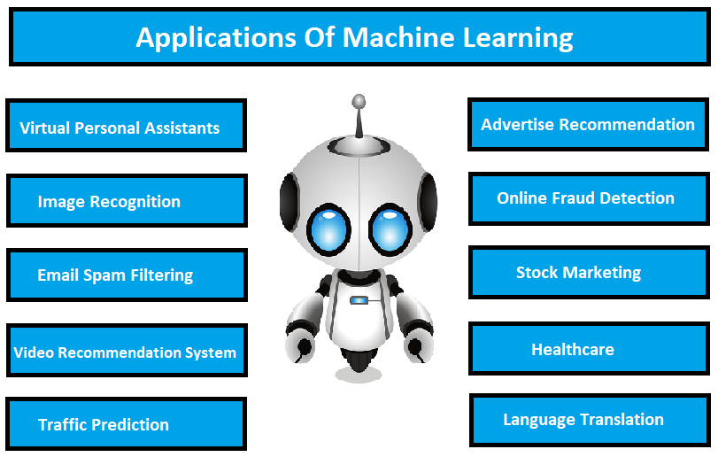
Applications of Machine Learning

Slide 6
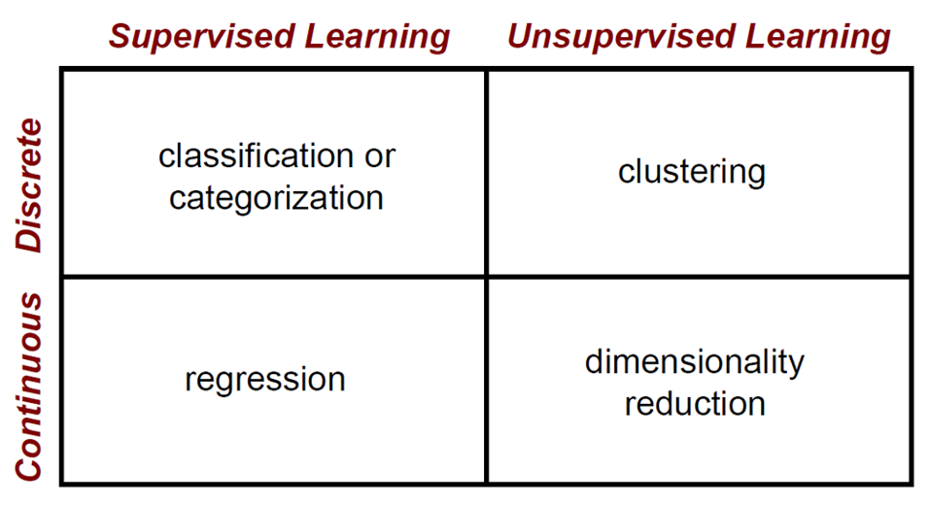
Machine Learning Algorithms

Slide 7
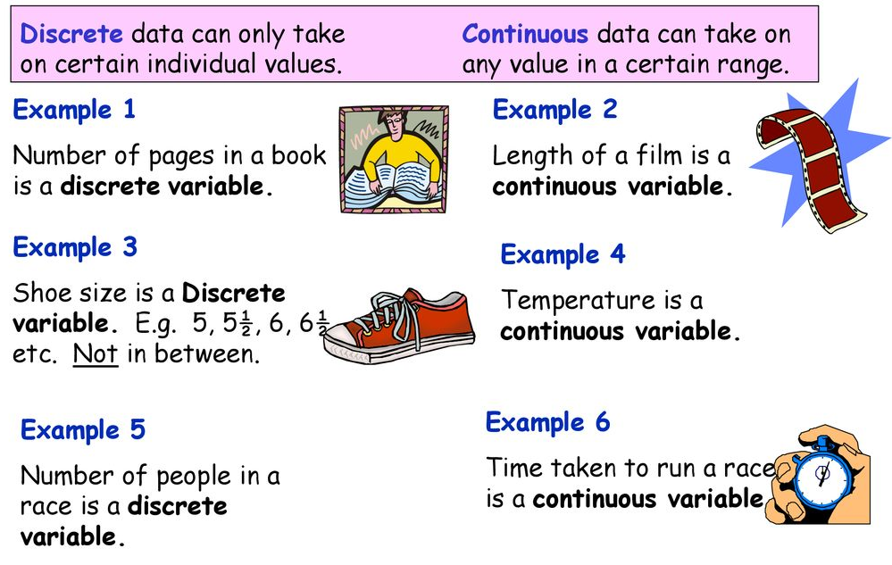
Discrete versus Continuous

Slide 8
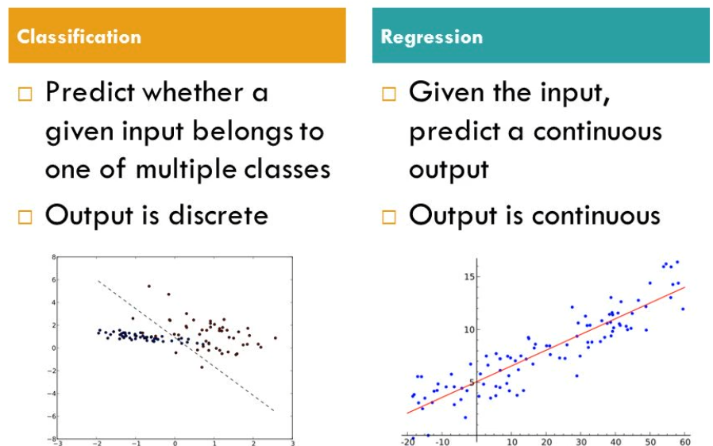
Supervised Learning

Slide 9
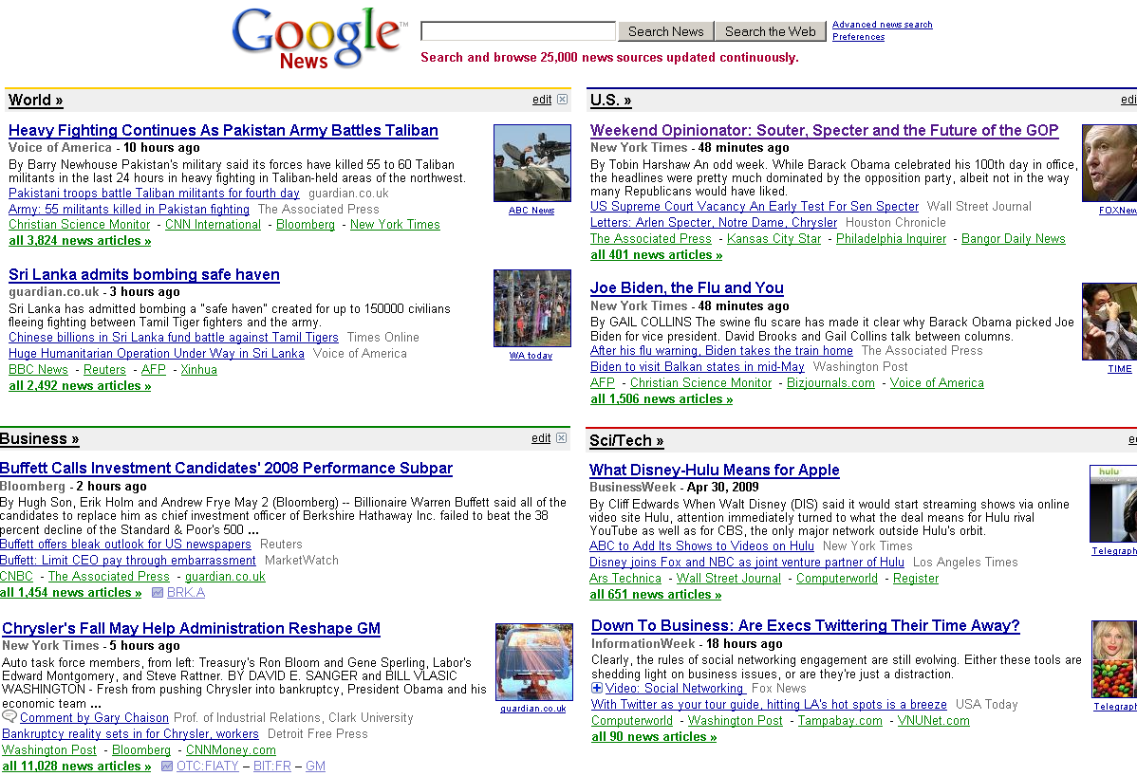
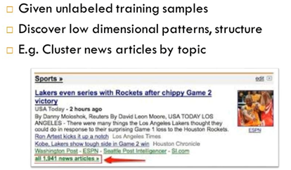
Unsupervised Learning
Top-level categories: supervised classification
Story groupings:
unsupervised clustering

Slide 10
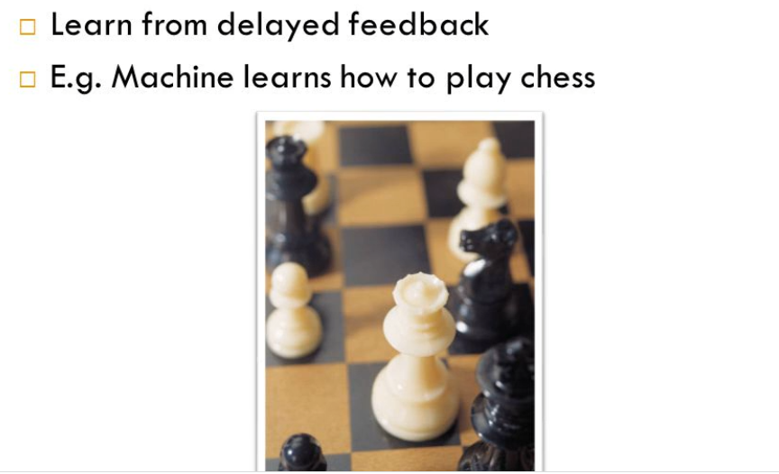
Reinforcement Learning

Slide 11
Reading Reference
The content of this lecture comprise of material from Chapter 18 of the course book.

