Slide 1
ARTIFICIAL INTELLIGENCE Week 6
Dr. Momina Moetesum

Slide 2
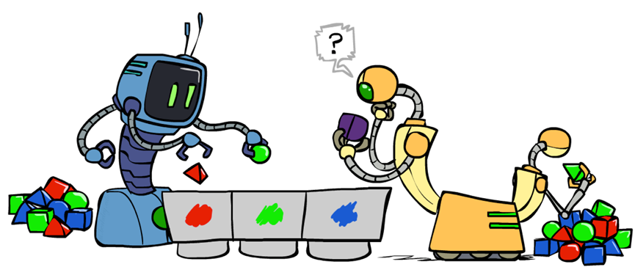
Unsupervised Learning
The class labels of training data is unknown
Given a set of measurements, observations, etc. with the aim of establishing the existence of classes or clusters in the data
Clustering
Dimensionality Reduction

Slide 3
Clustering
Clustering: the process of grouping a set of objects into classes of similar objects
Documents within a cluster should be similar.
Documents from different clusters should be dissimilar.
The commonest form of unsupervised learning
Unsupervised learning = learning from raw data, as opposed to supervised data where a classification of examples is given

Slide 4
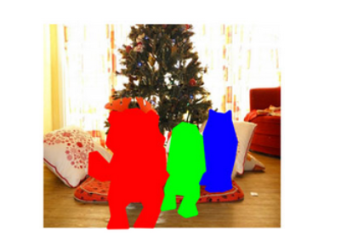
Clustering - Applications
Customer Segmentation
Document Clustering
Image Segmentation
Recommendation Engines

Slide 5
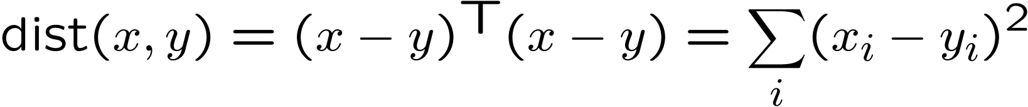
Clustering - Properties
Basic idea: group together similar instances
Example: 2D point patterns
What could “similar” mean?
One option: small (squared) Euclidean distance

Slide 6
Clustering - Algorithms
Flat algorithms
Usually start with a random (partial) partitioning
Refine it iteratively
K means clustering
Hierarchical algorithms
Bottom-up, agglomerative

Slide 7
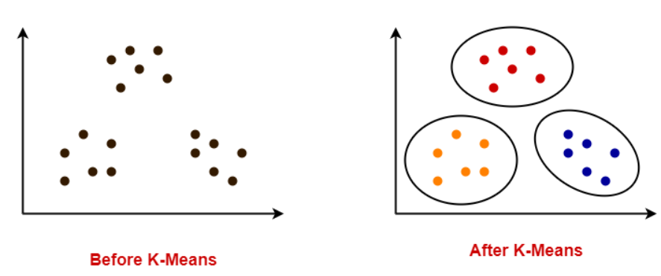
K-Means Clustering Algorithms

Slide 8
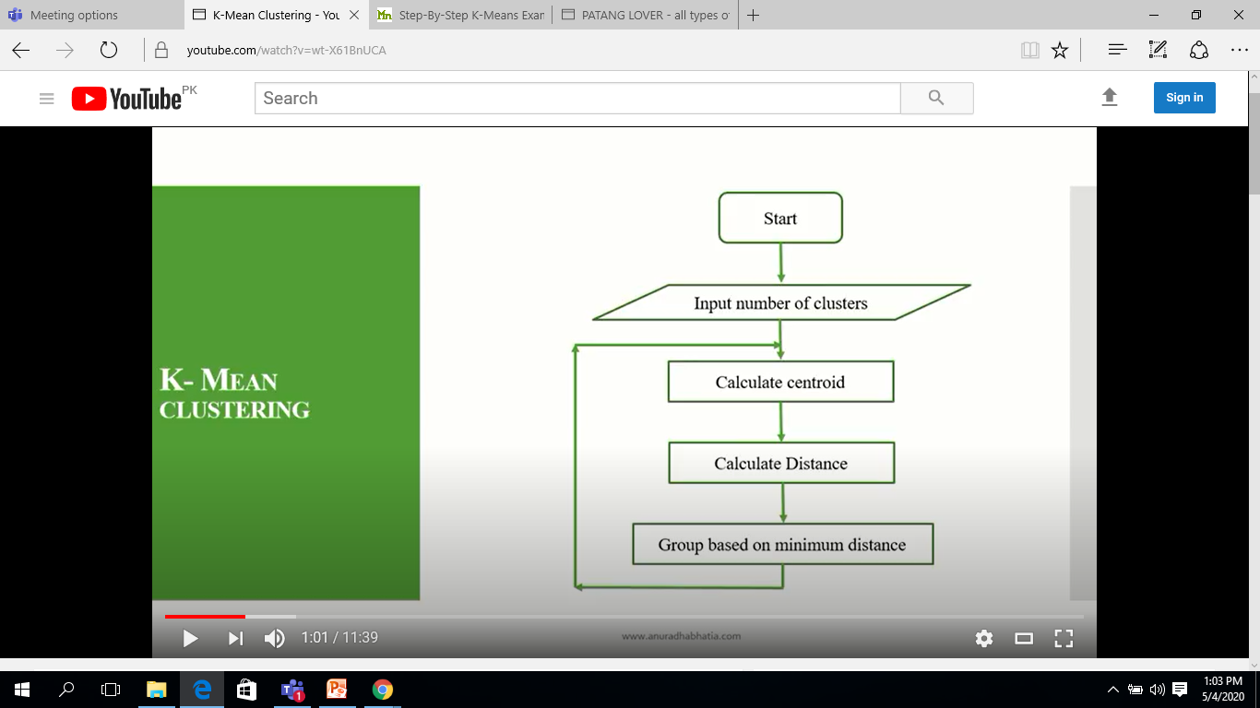
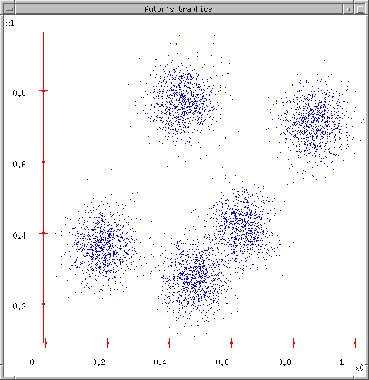
K-Means Clustering Algorithm
An iterative clustering algorithm
Pick K random points as cluster centers (means)
Alternate:
Assign data instances to closest mean
Assign each mean to the average of its assigned points
Stop when no points’ assignments change

Slide 9
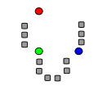
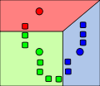
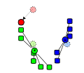
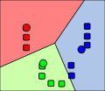
K-Means Clustering Algorithm
0. Initialize Cluster Centers
1. Assign Points to Clusters
2. Re-compute Means
Repeat (1) and (2)

Slide 10
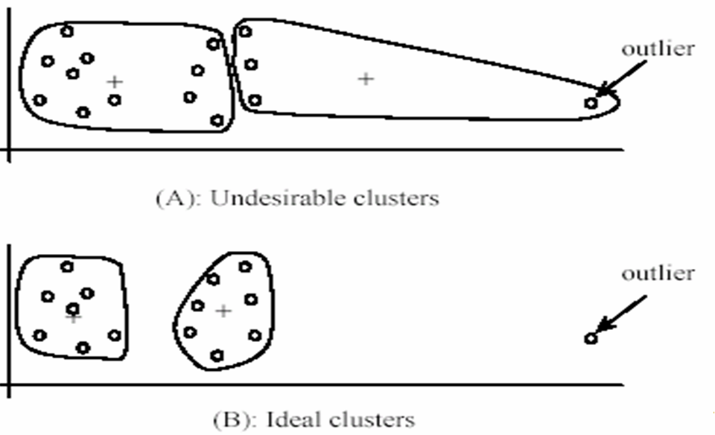
K-Means Clustering Algorithm
Pros
Finds cluster centers that minimize conditional variance (good representation of data)
Simple and fast*
Easy to implement
Cons
Need to choose K
Can only handle numerical data
Sensitive to outliers
All clusters have the same parameters (e.g., distance measure is non-adaptive)
*Can be slow: each iteration is O(KNd) for N d-dimensional points

Slide 11
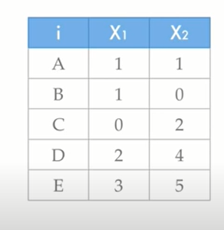

K-Means Clustering Example

Slide 12
K-Means Clustering Example
Step 1: Select number of clusters k=?
Let K = 2

Slide 13
K-Means Clustering Example
Step 2: Select K centroids randomly.
c1=A(1,1)
c2=E(3,5)

Slide 14
K-Means Clustering Example
Samples | D1 from C1(1,1) | D2 from C2(3,5) | Cluster
A(1,1) | 0 | 4.47 | C1
B(1,0) | 1 | 5.38 | C1
C(0,2) | 1.41 | 4.24 | C1
D(2,4) | 3.16 | 1.41 | C2
E(3,5) | 4.47 | 0 | C2
Step 3: Place samples in the two clusters based on their minimum distance from either centroid

Slide 15
K-Means Clustering Example
Samples in C1 | Samples in C2
A(1,1) | D(2,4)
B(1,0) | E(3,5)
C(0,2)
[(1+1+0)/3,(1+0+2)/3] | [(2+3)/2,(4+5)/2]
C1(0.6, 1) | C2(2.5,4.5)
Step 4: Compute the new centroids by averaging the respective coordinates of the samples in each cluster

Slide 16
K-Means Clustering Example
Samples | D1 from C1(0.6,1) | D2 from C2(2.5,4.5) | Cluster
A(1,1)
B(1,0)
C(0,2)
D(2,4)
E(3,5)
Step 5: Repeat Steps from 3-5 till values of centroids or samples in each cluster do not change anymore

Slide 17
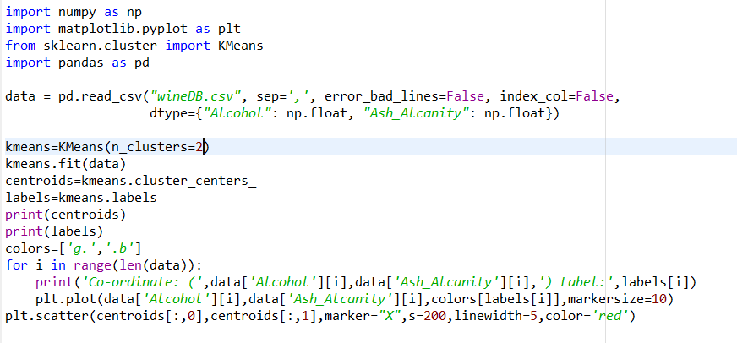
K-Means Clustering – Python Code

Slide 18
Agglomerative Clustering Algorithms
Agglomerative clustering:
First merge very similar instances
Incrementally build larger clusters out of smaller clusters
Algorithm:
Maintain a set of clusters
Initially, each instance in its own cluster
Repeat:
Pick the two closest clusters
Merge them into a new cluster
Stop when there’s only one cluster left
Produces not one clustering, but a family of clusterings represented by a dendrogram

Slide 19
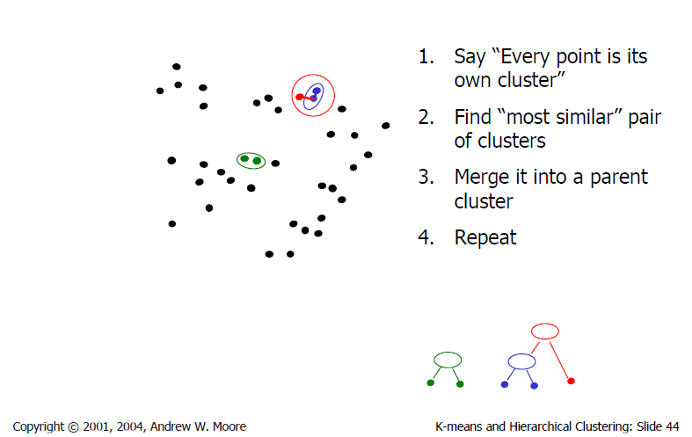
Agglomerative Clustering Algorithms

Slide 20
Agglomerative Clustering Example
Plot a dendogram using complete linkage for following data set.
Given input distance matrix of size 5 by 5.
In beginning we have 5 clusters.
Our goal is to group 5 clusters such that in the end we have only single cluster consisting of whole 5 objects.
Pick smallest value from given distance matrix
Item | A | B | C | D | E
A | 0
B | 9 | 0
C | 3 | 7 | 0
D | 6 | 5 | 9 | 0
E | 11 | 10 | 2 | 8 | 0

Slide 21
Agglomerative Clustering Example
(C,E)=2
Compute distance of pair (C,E) from A,B & D
(C,E) → A =max[ C→A, E→A]=max [3,11]=11
(C,E) → B =max[ C→B, E→B]=max[7,10]=10
(C,E) → D=max[ C→D, E→D]=max[9,8]=9
Item | A | B | C, E | D
A | 0
B | 9 | 0
C,E | 11 | 10 | 0
D | 6 | 5 | 9 | 0

Slide 22
Agglomerative Clustering Example
(C,E)=2
(B,D)=5
Compute distance of pair (B,D) from A
(B,D) → A= max[ B→A, D→A]=max [9,6] =9
Compute distance of pair (C,E) from (B,D)
((C,E)→(B,D))= max[ C→B, C→D] [E→B, E→D]=7,9,10,8=10
Item | A | (B,D) | (C,E)
A | 0
(B,D) | 9 | 0
(C,E) | 11 | 10 | 0

Slide 23
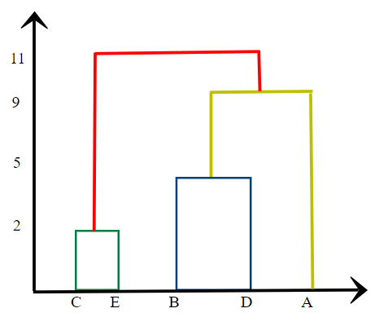
Agglomerative Clustering Example
(C,E)=2
(B,D)=5
(A, (B,D)=9
(A, (B,D)), (C,E)=11
Item | A,(B,D) | (C,E)
A,(B,D) | 0
(C,E) | 11 | 0

Slide 24
Conclusions: Agglomerative Clustering
Good
Simple to implement, widespread application
Provides a hierarchy of clusters
Bad
May have imbalanced clusters
Still have to choose number of clusters or threshold

Slide 25
Reading Reference
The content of this lecture comprise of material from Chapter 18 of the course book and Chapter 6 of “Introduction to Machine Learning”, E. Alpyadin, MIT Press

