Slide 1
ARTIFICIAL INTELLIGENCE Week 7
Dr. Momina Moetesum

Slide 2
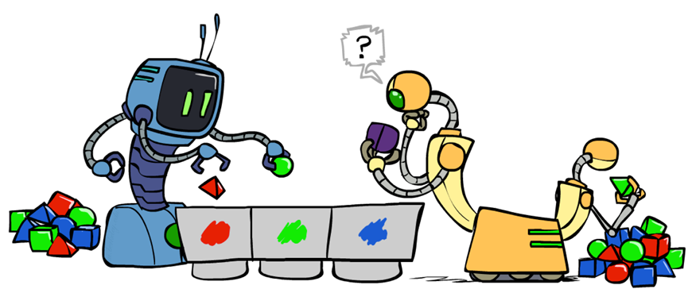
Unsupervised Learning
The class labels of training data is unknown
Given a set of measurements, observations, etc. with the aim of establishing the existence of classes or clusters in the data
Clustering
Dimensionality Reduction

Slide 3
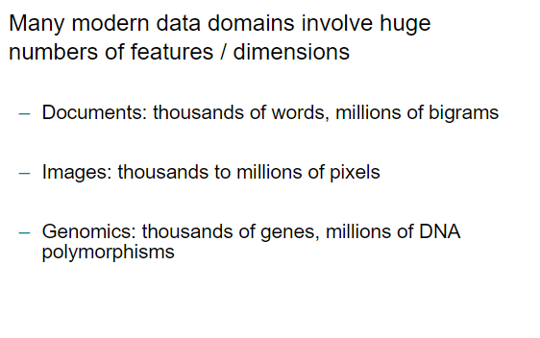
Dimensionality

Slide 4
Curse of Dimensionality
Most machine learning and data mining techniques may not be effective for high dimensional data
Query accuracy and efficiency degrade rapidly as the dimension increases

Slide 5
Dimensionality Reduction
Dimensionality reduction aims to map the data from the original dimension space to lower dimension space while minimizing information loss
Dimensionality reduction is an effective approach to downsizing data
Data compression: efficient storage and retrieval
Noise removal: positive effect on query accuracy

Slide 6
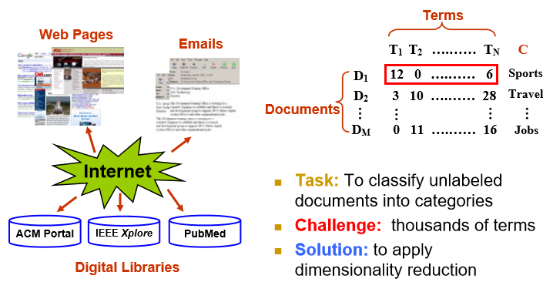
Dimensionality Reduction

Slide 7
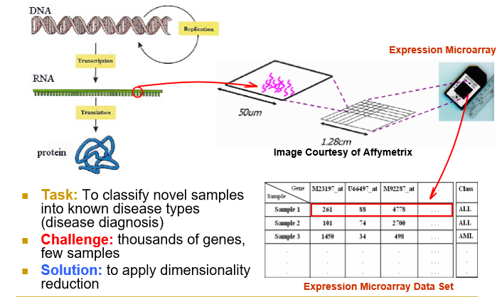
Dimensionality Reduction

Slide 8
Advantages
By reducing the dimensions of the features, the space required to store the dataset also gets reduced.
Less Computation training time is required for reduced dimensions of features.
Reduced dimensions of features of the dataset help in visualizing the data quickly.
It removes the redundant features (if present) by taking care of multicollinearity.

Slide 9
Disadvantages
Some data may be lost due to dimensionality reduction.
In the PCA dimensionality reduction technique, sometimes the principal components required to consider are unknown.

Slide 10
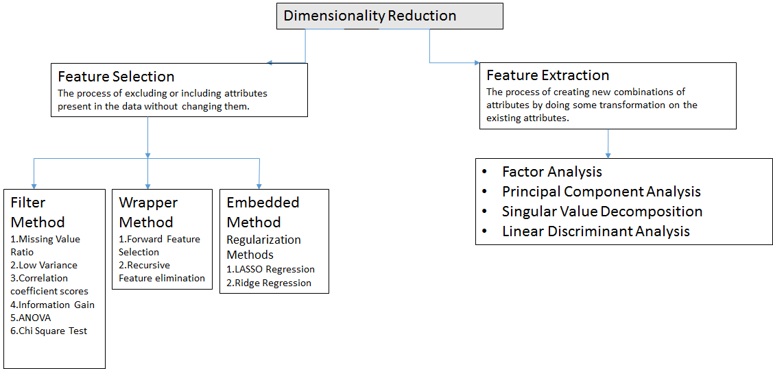
Dimensionality Reduction - Techniques

Slide 11
Principal Component Analysis (PCA)
PCA is one of the most common feature extraction techniques
Reduce the dimensionality of a data set by finding a new set of variables, smaller than the original set of variables
Allows us to combine much of the information contained in n features into m features where m < n

Slide 12
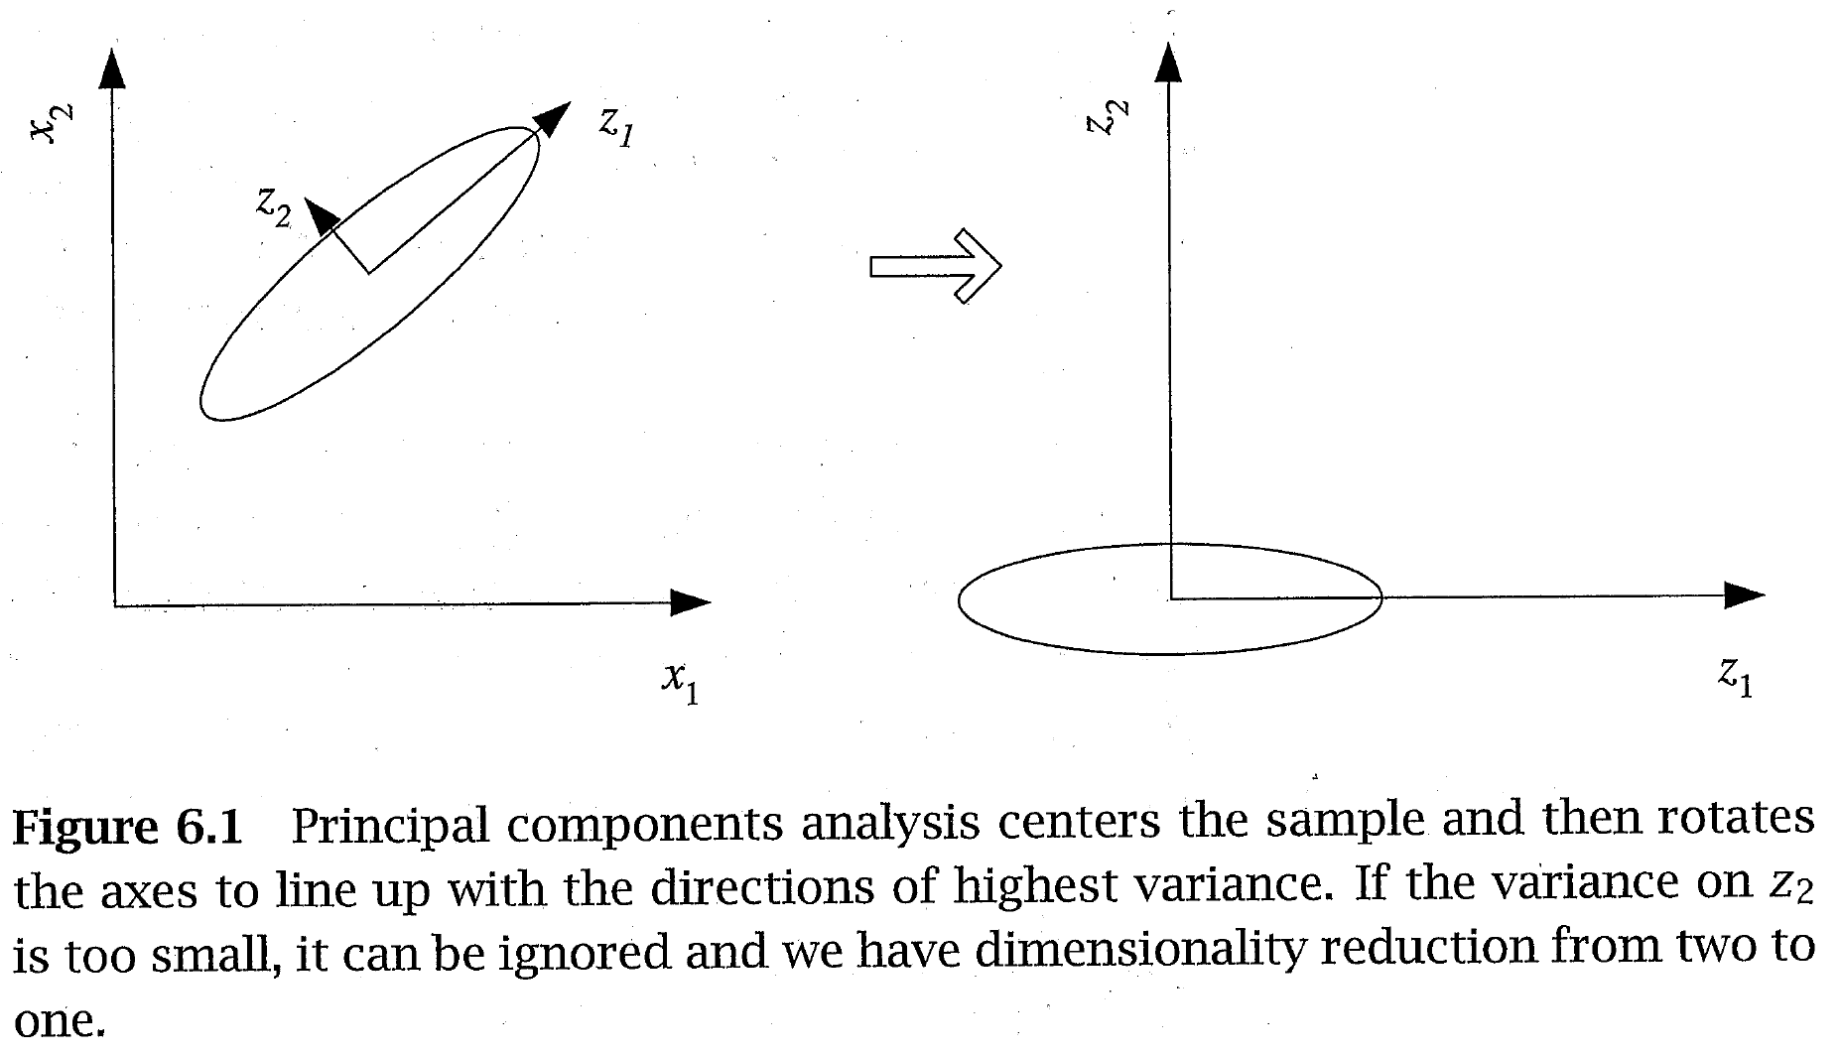
Principal Component Analysis (PCA)
Transform n-dimensional data to a new n-dimensions
The new dimension with the most variance is the first principal component
The next is the second principal component, etc.

Slide 13
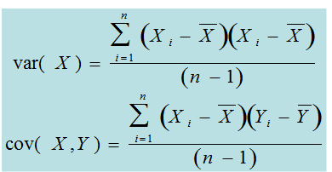
Variance and Covariance
Variance is a measure of data spread in one dimension (feature)
Covariance measures how two dimensions (features) vary with respect to each other

Slide 14
Covariance
Focus on the sign (rather than exact value) of covariance
Positive value means that as one feature increases or decreases the other does also (positively correlated)
Negative value means that as one feature increases the other decreases and vice versa (negatively correlated)
A value close to zero means the features are independent

Slide 15
Covariance Matrix
Covariance matrix is an n × n matrix containing the covariance values for all pairs of features in a data set with n features (dimensions)
The diagonal contains the covariance of a feature with itself which is the variance (which is the square of the standard deviation)
The matrix is symmetric

Slide 16
Main Steps of PCA
Center data around 0
Form the covariance matrix S.
Compute its eigenvectors:
The first p eigenvectors form the p PCs.
The transformation G consists of the p PCs.

Slide 17
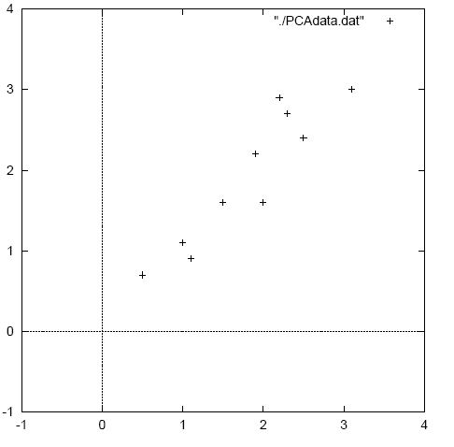
PCA – Worked Example

Slide 18
PCA – Worked Example
First step is to center the original data around 0
Subtract mean from each value

Slide 19
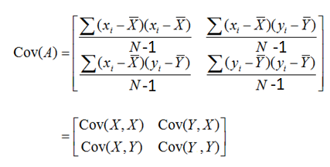
PCA – Worked Example
Calculate the covariance matrix of the centered data – Only 2 × 2 for this case

Slide 20
PCA – Worked Example
Calculate the eigenvectors and eigenvalues of the covariance matrix
- Covariance matrix – square n × n ; n eigenvalues will exist
All eigenvectors (principal components/dimensions) are orthogonal to each other and will make a new set of dimensions for the data
The magnitude of each eigenvalue corresponds to the variance along that new dimension – Just what we wanted!
We can sort the principal components according to their eigenvalues
Just keep those dimensions with largest eigenvalues

Slide 21
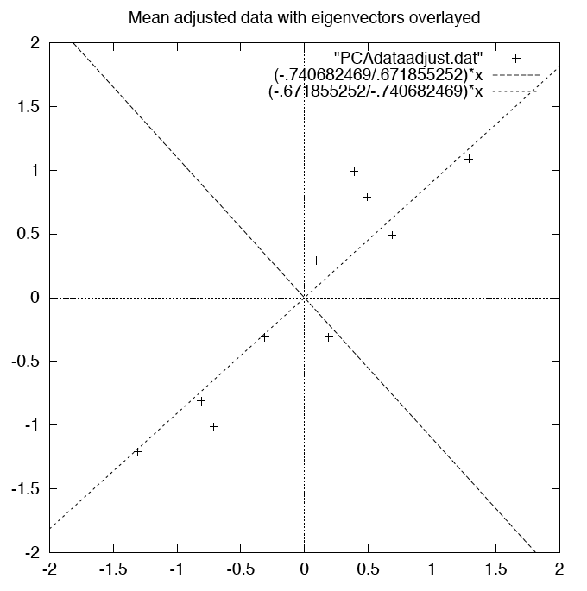
PCA – WORKED EXAMPLE
Two eigenvectors overlaying the centered data

Slide 22
PCA – WORKED EXAMPLE
Just keep the p eigenvectors with the largest eigenvalues
Do lose some information, but if we just drop dimensions with small eigenvalues then we lose only a little information
We can then have p input features rather than n
How many dimensions p should we keep?
Eigenvalue
Proportion
of Variance
1 2 3 4 5 6 7 … n

Slide 23
PCA – WORKED EXAMPLE
Proportion of Variance (PoV)
when λ_{i} are sorted in descending order
Typically, stop at PoV>0.9

Slide 24
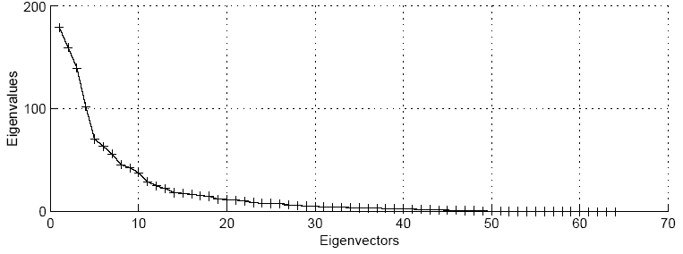
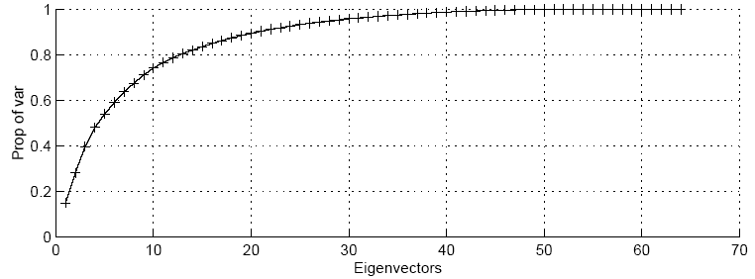
PCA – WORKED EXAMPLE

Slide 25
PCA – WORKED EXAMPLE
Transform the features to the p chosen Eigenvectors
Take the p eigenvectors that you want to keep from the list of eigenvectors, and forming a matrix with these eigenvectors in the columns.
For our example; either keep both vectors or chose to leave out the smaller less significant one
OR

Slide 26
PCA – WORKED EXAMPLE
FinalData = RowFeatureVector x RowDataAdjust
RowFeatureVector is matrix with eigenvectors in the columns transposed so that eigenvectors are now in the rows with most significant eigenvector at the top
RowDataAdjust is the mean-adjusted data transposed
FinalData is the final data set with data items in columns and dimensions along the rows

Slide 27
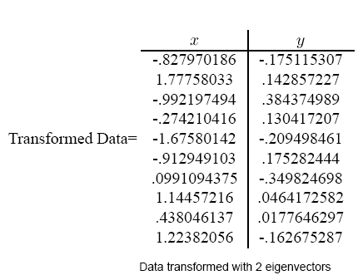
PCA – WORKED EXAMPLE
Step 5

Slide 28
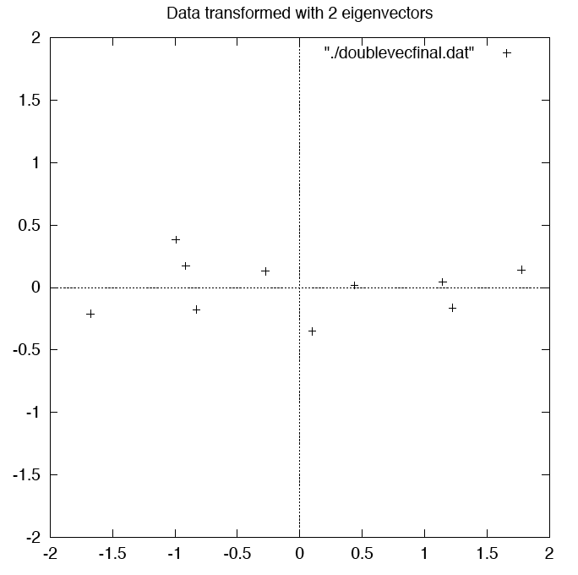
PCA – WORKED EXAMPLE
Step 5

Slide 29
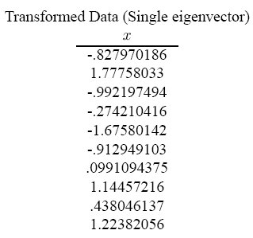
PCA – WORKED EXAMPLE
Step 5

Slide 30
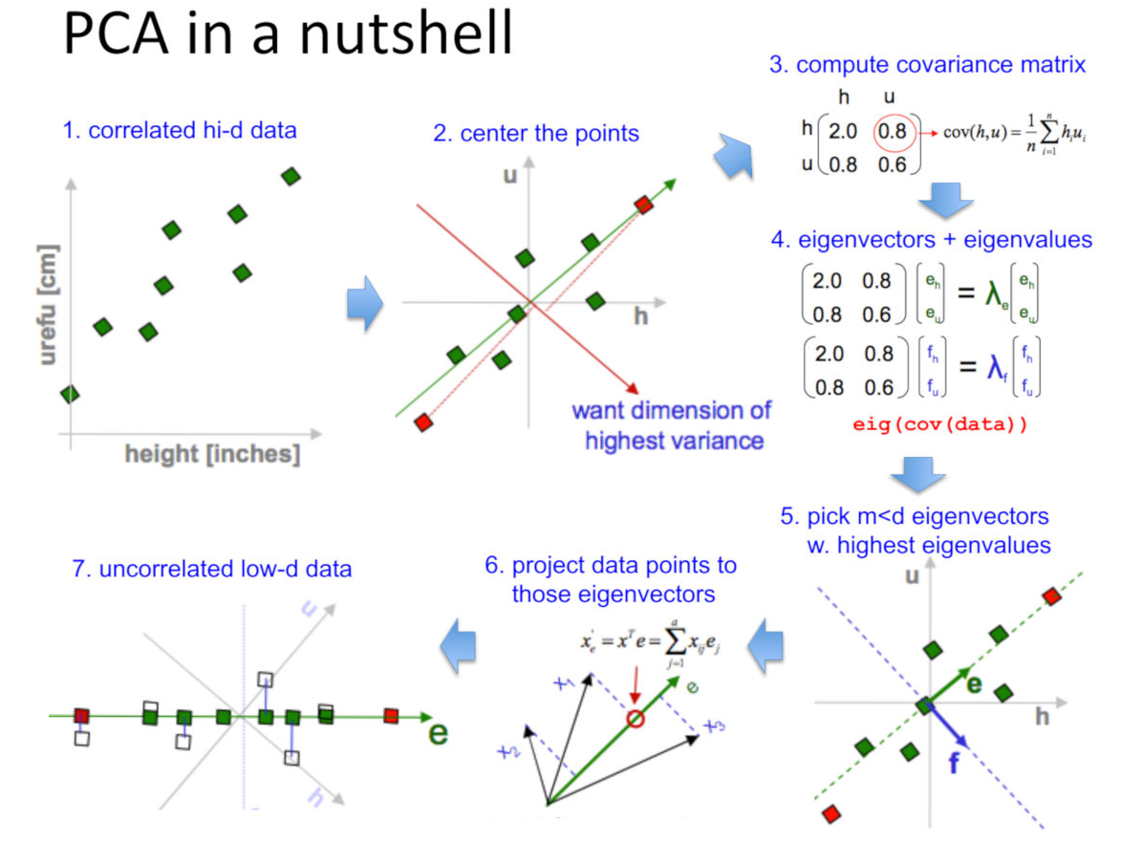
PCA – WORKED EXAMPLE

Slide 31
PCA – WORKED EXAMPLE
Getting back original data
We used the transofrmation
This gives
In our case, inverse of feature vector is equal to its transpose
FinalData = RowFeatureVector x RowDataAdjust
RowDataAdjust = RowFeatureVector⁻¹ x FinalData
RowDataAdjust = RowFeatureVector^{T} x FinalData

Slide 32
PCA – WORKED EXAMPLE
Getting back original data
Add mean to get back raw data:
If we use all (two in our case) eigenvectors we get back exactly the original data
With one eigenvector, some information is lost
OriginalData= (RowFeatureVector^{T} x FinalData) + Mean

Slide 33
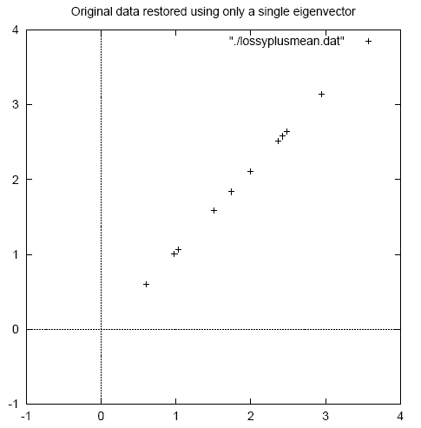
PCA – WORKED EXAMPLE
Original Data restored with one eigenvector
Original Data

Slide 34
Reading Reference
The content of this lecture comprise of material from Chapter 18 of the course book and Chapter 6 of “Introduction to Machine Learning, E. Alpyadin, MIT Press

