Slide 1
DSSTNE: A New Deep Learning Framework For Large Sparse Datasets https://github.com/amznlabs/amazon-dsstne
Scott Le Grand
Senior Scientist
Teza Technologies
varelse2005@gmail.com

Slide 2
Outline
What's Deep Learning?
Why GPUs?
What's Unique about Deep Learning at Amazon
DSSTNE
Benchmarks
DSSTNE at scale
Fun with CNNs
How to buy Deep Learning Hardware

Slide 3

Neural Networks
World’s most lucrative application of the chain rule from calculus
x is the input data
A1 and A2 are linear transformations
f1 and f2 are some sort of nonlinear function
x
A1
f1
A2
f2

Slide 4

Nonlinear Functions

Slide 5

Neural Network Training
x
A1
f1
A2
f2

Slide 6

Neural Network Derivatives (BackPropagation)

Slide 7
Deep Learning/Neural Networks in One Slide*
X_{L+1} = X_{L} * W_{L→L+1}
d_{L} = d_{L+1} * W_{L→L+1}
DW_{L→L+1} = X^{T}_{L} * d_{L+1}
*The definitive answer to whether you should take Calculus, Statistics and Linear Algebra in college

Slide 8
What's a GPU
“A Graphics Processing Unit (GPU) is a specialized electronic circuit designed to rapidly manipulate and alter memory to accelerate the creation of images in a frame buffer intended for output to a display.”

Slide 9
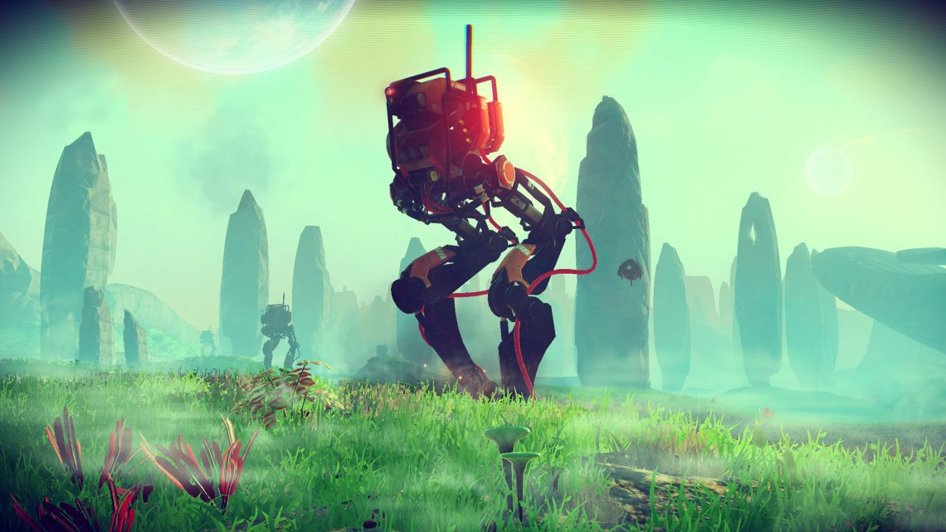
Pretty Pictures

Slide 10

More Pretty Pictures

Slide 11
Pretty Pictures Require Lots of Arithmetic
$1,723 for the Intel Core i7-6950x: 10 cores, 1.12 TFLOPS
$1,200 for the NVIDIA GTX Titan XP, 56 cores, 10.8 TFLOPS
$600 for the NVIDIA GTX 1080, 40 cores, 8.9 TFLOPS
$500 for the AMD R9 Fury X, 64 cores, 8.6 TFLOPS

Slide 12
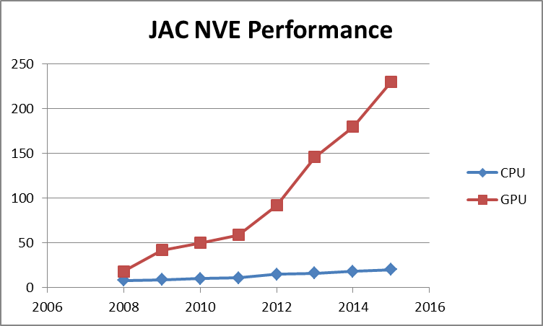
“If It's Not Running on The GPU, It's Crap!”

Slide 13
Product Recommendations Also Require Lots of Arithmetic (2014)
What are people who bought items A, B, C...Z most likely to purchase next?
Traditionally addressed with variants of Matrix Factorization, Logistic Regression, Naive Bayes, etc...

Slide 14
Neural Networks For Product Recommendations
Output (10K-10M)
Hidden (100-1K)
Input (10K-10M)

Slide 15
Large Output Layers, Small Hidden Layers
Output (10K-10M)
Hidden (100-1K)
Input (10K-10M)
Existing frameworks were not designed to handle neural networks with input (purchase history) and output (recommendations) layers 10K to 10M units wide because…

Slide 16
This Is A Huge Sparse Data Problem
Uncompressed sparse data either eats a lot of memory or it eats a lot of bandwidth uploading it to the GPU
Naively running networks with uncompressed sparse data leads to lots of multiplications of zero and/or by zero. This wastes memory, power, and time
Product Recommendation Networks can have billions of parameters that cannot fit in a single GPU so summarizing...

Slide 17
Framework Requirements (2014)
Efficient support for large input and output layers
Efficient handling of sparse data (i.e. don't store zero)
Automagic multi-GPU support for large networks and scaling
Avoids multiplying zero and/or by zero
<24 hours training and recommendations cycle
Human-readable descriptions of networks (API)

Slide 18
DSSTNE: Deep Sparse Scalable Tensor Network Engine*
A Neural Network framework released into OSS by Amazon in May of 2016
Optimized for large sparse data problems and fully connected layers
Extremely efficient model-parallel multi-GPU support
~6x faster than TensorFlow on such datasets (and that's just on one GTX Titan X (Maxwell), ~15x faster using 4 of them)
100% Deterministic Execution #reproducibilitymatters #noASGD
Full SM 3.x, 5.x, and 6.x support (Kepler or better GPUs)
Distributed training support OOTB (~20 lines of MPI #HPCOpenStandardsFTW)
CNN and (Full) RNN support soon based on cuDNN 5.x and Neon (best of both)
*”Destiny”

Slide 19
Key Features
Stores networks and data sets in NetCDF format with optional HDF5 support
Multi-GPU handled with MPI and Interprocess P2P copies
Initial emphasis on fully-connected networks, conv and pooling layer support is a work-in-progress
Dependencies are C++11, CUDA 7.x+, netcdf, a C++11-aware MPI library, and libjsoncpp (coming soon: cuDNN)
There are no computational shortcuts here, all we're doing is avoiding multiplying by zero and storing zeroes

Slide 20
Describes Neural Networks As JSON Objects
{
"Version" : 0.7,
"Name" : "AE",
"Kind" : "FeedForward",
"SparsenessPenalty" : {
"p" : 0.5,
"beta" : 2.0
},
"ShuffleIndices" : false,
"Denoising" : {
"p" : 0.2
},
"ScaledMarginalCrossEntropy" : {
"oneTarget" : 1.0,
"zeroTarget" : 0.0,
"oneScale" : 1.0,
"zeroScale" : 1.0
},
"Layers" : [
{ "Name" : "Input", "Kind" : "Input", "N" : "auto", "DataSet" : "input", "Sparse" : true },
{ "Name" : "Hidden", "Kind" : "Hidden", "Type" : "FullyConnected", "N" : 128, "Activation" : "Sigmoid", "Sparse" : true },
{ "Name" : "Output", "Kind" : "Output", "Type" : "FullyConnected", "DataSet" : "output", "N" : "auto", "Activation" : "Sigmoid", "Sparse" : true }
],
"ErrorFunction" : "ScaledMarginalCrossEntropy"
}

Slide 21
AlexNet As A JSON Object*
{
"Version" : 0.81,
"Name" : "AlexNet",
"Kind" : "FeedForward",
"LocalResponseNormalization" :
{
"k" : 2,
"n" : 5,
"alpha" : 0.0001,
"beta" : 0.75
},
"Layers" : [
{ "Kind" : "Input", "Type" : "Convolutional", "N" : "auto", "DataSet" : "input"},
{ "Kind" : "Hidden", "Type" : "Convolutional", "N" : 96, "Kernel" : [11, 11], "KernelStride" : [4, 4], "Activation" : "Relu" },
{ "Kind" : "Hidden", "Type" : "Pooling", "Function" : "LRN" },
{ "Kind" : "Hidden", "Type" : "Pooling", "Function" : "Max", "Kernel" : [3, 3], "KernelStride" : [2, 2]},
{ "Kind" : "Hidden", "Type" : "Convolutional", "N" : 256, "Kernel" : [5, 5], "Activation" : "Relu" },
{ "Kind" : "Hidden", "Type" : "Pooling", "Function" : "LRN" },
{ "Kind" : "Hidden", "Type" : "Pooling", "Function" : "Max", "Kernel" : [3, 3], "KernelStride" : [2, 2] },
{ "Kind" : "Hidden", "Type" : "Convolutional", "N" : 384, "Kernel" : [3, 3], "Activation" : "Relu" },
{ "Kind" : "Hidden", "Type" : "Convolutional", "N" : 384, "Kernel" : [3, 3], "Activation" : "Relu" },
{ "Kind" : "Hidden", "Type" : "Convolutional", "N" : 256, "Kernel" : [3, 3], "Activation" : "Relu" },
{ "Kind" : "Hidden", "Type" : "Pooling", "Function" : "Max", "Kernel" : [3, 3], "KernelStride" : [2, 2] },
{ "Kind" : "Hidden", "Type" : "FullyConnected", "N" : 4096, "Activation" : "Relu", "pDropout" : 0.5 },
{ "Kind" : "Hidden", "Type" : "FullyConnected", "N" : 4096, "Activation" : "Relu", "pDropout" : 0.5 },
{ "Kind" : "Output", "Type" : "FullyConnected", "N" : "auto", "DataSet" : "output", "Activation" : "SoftMax" }
],
"ErrorFunction" : "CrossEntropy"
}
*Accidentally similar to Andrej Karpathy's ConvnetJS framework

Slide 22
VGG16 As A JSON object
{
"Version" : 0.81,
"Name" : "VGG-16",
"Kind" : "FeedForward",
"LocalResponseNormalization" :
{
"k" : 2,
"n" : 5,
"alpha" : 0.0001,
"beta" : 0.75
},
"Layers" : [
{ "Kind" : "Input", "N" : [224, 224, 3], "DataSet" : "input"},
{ "Kind" : "Hidden", "Type" : "Convolutional", "N" : 64, "Kernel" : [3, 3], "KernelStride" : [1, 1], "Activation" : "Relu" },
{ "Kind" : "Hidden", "Type" : "Convolutional", "N" : 64, "Kernel" : [3, 3], "KernelStride" : [1, 1], "Activation" : "Relu" },
{ "Kind" : "Pooling", "Function" : "Max", "Kernel" : [2, 2], "KernelStride" : [2, 2] },
{ "Kind" : "Hidden", "Type" : "Convolutional", "N" : 128, "Kernel" : [3, 3], "KernelStride" : [1, 1], "Activation" : "Relu" },
{ "Kind" : "Hidden", "Type" : "Convolutional", "N" : 128, "Kernel" : [3, 3], "KernelStride" : [1, 1], "Activation" : "Relu" },
{ "Kind" : "Pooling", "Function" : "Max", "Kernel" : [2, 2], "KernelStride" : [2, 2] },
{ "Kind" : "Hidden", "Type" : "Convolutional", "N" : 256, "Kernel" : [3, 3], "KernelStride" : [1, 1], "Activation" : "Relu" },
{ "Kind" : "Hidden", "Type" : "Convolutional", "N" : 256, "Kernel" : [3, 3], "KernelStride" : [1, 1], "Activation" : "Relu" },
{ "Kind" : "Hidden", "Type" : "Convolutional", "N" : 256, "Kernel" : [3, 3], "KernelStride" : [1, 1], "Activation" : "Relu" },
{ "Kind" : "Pooling", "Function" : "Max", "Kernel" : [2, 2], "KernelStride" : [2, 2] },
{ "Kind" : "Hidden", "Type" : "Convolutional", "N" : 512, "Kernel" : [3, 3], "KernelStride" : [1, 1], "Activation" : "Relu" },
{ "Kind" : "Hidden", "Type" : "Convolutional", "N" : 512, "Kernel" : [3, 3], "KernelStride" : [1, 1], "Activation" : "Relu" },
{ "Kind" : "Hidden", "Type" : "Convolutional", "N" : 512, "Kernel" : [3, 3], "KernelStride" : [1, 1], "Activation" : "Relu" },
{ "Kind" : "Pooling", "Function" : "Max", "Kernel" : [2, 2], "KernelStride" : [2, 2] },
{ "Kind" : "Hidden", "Type" : "Convolutional", "N" : 512, "Kernel" : [3, 3], "KernelStride" : [1, 1], "Activation" : "Relu" },
{ "Kind" : "Hidden", "Type" : "Convolutional", "N" : 512, "Kernel" : [3, 3], "KernelStride" : [1, 1], "Activation" : "Relu" },
{ "Kind" : "Hidden", "Type" : "Convolutional", "N" : 512, "Kernel" : [3, 3], "KernelStride" : [1, 1], "Activation" : "Relu" },
{ "Kind" : "Pooling", "Function" : "Max", "Kernel" : [2, 2], "KernelStride" : [2, 2] },
{ "Kind" : "Hidden", "Type" : "FullyConnected", "N" : 4096, "Activation" : "Relu", "pDropout" : 0.5 },
{ "Kind" : "Hidden", "Type" : "FullyConnected", "N" : 4096, "Activation" : "Relu", "pDropout" : 0.5 },
{ "Kind" : "Output", "Type" : "FullyConnected", "N" : "auto", "DataSet" : "output", "Activation" : "SoftMax" }
],
"ErrorFunction" : "CrossEntropy"
}

Slide 23
Human-Readable Doesn't Suck..
name: "AlexNet"
layer {
name: "data"
type: "Input"
top: "data"
input_param { shape: { dim: 10 dim: 3 dim: 227 dim: 227 } }
}
layer {
name: "conv1"
type: "Convolution"
bottom: "data"
top: "conv1"
param {
lr_mult: 1
decay_mult: 1
}
param {
lr_mult: 2
decay_mult: 0
}
convolution_param {
num_output: 96
kernel_size: 11
stride: 4
}
}
layer {
name: "relu1"
type: "ReLU"
bottom: "conv1"
top: "conv1"
}
layer {
name: "norm1"
type: "LRN"
bottom: "conv1"
top: "norm1"
lrn_param {
local_size: 5
alpha: 0.0001
beta: 0.75
}
}
layer {
name: "pool1"
type: "Pooling"
bottom: "norm1"
top: "pool1"
pooling_param {
pool: MAX
kernel_size: 3
stride: 2
}
}
layer {
name: "conv2"
type: "Convolution"
bottom: "pool1"
top: "conv2"
param {
lr_mult: 1
decay_mult: 1
}
param {
lr_mult: 2
decay_mult: 0
}
convolution_param {
num_output: 256
pad: 2
kernel_size: 5
group: 2
}
}
layer {
name: "relu2"
type: "ReLU"
bottom: "conv2"
top: "conv2"
}
layer {
name: "norm2"
type: "LRN"
bottom: "conv2"
top: "norm2"
lrn_param {
local_size: 5
alpha: 0.0001
beta: 0.75
}
}
layer {
name: "pool2"
type: "Pooling"
bottom: "norm2"
top: "pool2"
pooling_param {
pool: MAX
kernel_size: 3
stride: 2
}
}
layer {
name: "conv3"
type: "Convolution"
bottom: "pool2"
top: "conv3"
param {
lr_mult: 1
decay_mult: 1
}
param {
lr_mult: 2
decay_mult: 0
}
convolution_param {
num_output: 384
pad: 1
kernel_size: 3
}
}
layer {
name: "relu3"
type: "ReLU"
bottom: "conv3"
top: "conv3"
}
layer {
name: "conv4"
type: "Convolution"
bottom: "conv3"
top: "conv4"
param {
lr_mult: 1
decay_mult: 1
}
param {
lr_mult: 2
decay_mult: 0
}
convolution_param {
num_output: 384
pad: 1
kernel_size: 3
group: 2
}
}
layer {
name: "relu4"
type: "ReLU"
bottom: "conv4"
top: "conv4"
}
layer {
name: "conv5"
type: "Convolution"
bottom: "conv4"
top: "conv5"
param {
lr_mult: 1
decay_mult: 1
}
param {
lr_mult: 2
decay_mult: 0
}
convolution_param {
num_output: 256
pad: 1
kernel_size: 3
group: 2
}
}
layer {
name: "relu5"
type: "ReLU"
bottom: "conv5"
top: "conv5"
}
layer {
name: "pool5"
type: "Pooling"
bottom: "conv5"
top: "pool5"
pooling_param {
pool: MAX
kernel_size: 3
stride: 2
}
}
layer {
name: "fc6"
type: "InnerProduct"
bottom: "pool5"
top: "fc6"
param {
lr_mult: 1
decay_mult: 1
}
param {
lr_mult: 2
decay_mult: 0
}
inner_product_param {
num_output: 4096
}
}
layer {
name: "relu6"
type: "ReLU"
bottom: "fc6"
top: "fc6"
}
layer {
name: "drop6"
type: "Dropout"
bottom: "fc6"
top: "fc6"
dropout_param {
dropout_ratio: 0.5
}
}
layer {
name: "fc7"
type: "InnerProduct"
bottom: "fc6"
top: "fc7"
param {
lr_mult: 1
decay_mult: 1
}
param {
lr_mult: 2
decay_mult: 0
}
inner_product_param {
num_output: 4096
}
}
layer {
name: "relu7"
type: "ReLU"
bottom: "fc7"
top: "fc7"
}
layer {
name: "drop7"
type: "Dropout"
bottom: "fc7"
top: "fc7"
dropout_param {
dropout_ratio: 0.5
}
}
layer {
name: "fc8"
type: "InnerProduct"
bottom: "fc7"
top: "fc8"
param {
lr_mult: 1
decay_mult: 1
}
param {
lr_mult: 2
decay_mult: 0
}
inner_product_param {
num_output: 1000
}
}
layer {
name: "prob"
type: "Softmax"
bottom: "fc8"
top: "prob"
}
278 Lines
TLDR: 278 Lines of Code for AlexNet in Caffe...

Slide 24
JSON API Is Just An Interface to DSSTNE
struct NNNetworkDescriptor
{
string _name; // Optional name for neural network
NNNetwork::Kind _kind; // Either AutoEncoder or FeedForward (default)
ErrorFunction _errorFunction; // Error function for training
vector<NNLayerDescriptor> _vLayerDescriptor; // Vector containing neural network layers
vector<NNWeightDescriptor> _vWeightDescriptor; // Vector containing preloaded weight data
bool _bShuffleIndices; // Flag to signal whether to shuffle training data or not
uint32_t _maxout_k; // Size of Maxout (default 2)
NNFloat _LRN_k; // Local Response Normalization offset (default 2)
uint32_t _LRN_n; // Local Response Normalization spread (default 5)
NNFloat _LRN_alpha; // Local Response Normalization scaling (default 0.0001)
NNFloat _LRN_beta; // Local Response Normalization exponent (default 0.75)
bool _bSparsenessPenalty; // Specifies whether to use sparseness penalty on hidden layers or not
NNFloat _sparsenessPenalty_p; // Target sparseness probability for hidden layers
NNFloat _sparsenessPenalty_beta; // Sparseness penalty weight
bool _bDenoising; // Specifies whether to use denoising on input layers
NNFloat _denoising_p; // Probability of denoising inputs (for sparse layers, only denoise on non-zero values)
NNFloat _deltaBoost_one; // Adjusts scaling of nonzero-valued outputs
NNFloat _deltaBoost_zero; // Adjusts scaling of zero-valued outputs
NNFloat _SMCE_oneTarget; // Relaxed target for non-zero target values (Default 0.9)
NNFloat _SMCE_zeroTarget; // Relaxed target for zero target values (Default 0.1)
NNFloat _SMCE_oneScale; // Scaling factor for non-zero target values (Default 1.0)
NNFloat _SMCE_zeroScale; // Scaling factor for zero target values (Default 1.0)
string _checkpoint_name; // Checkpoint file name
int32_t _checkpoint_interval; // Number of epochs between checkpoints
int32_t _checkpoint_epochs; // Number of epochs since last checkpoint
NNNetworkDescriptor();
};
DSSTNE's Engine is API-Agnostic

Slide 25
Amazon's Definition Of Sparsity
0.01% to 0.1% Density, far lower than the optimal sparsity for the cuSparse library (too cuSlow)
Sparse data stored in CSR format (Index, value) or just indices
Sparse SGEMM is 5-20x faster than a full SGEMM depending on density (ultimately memory-limited)
Sparse input layers are nearly “free”

Slide 26
Sparse Neural Network Training*
X_{L+1} = X_{L} * W_{L→L+1}
DW = X^{T}_{L} * d_{L+1}
*Sparse output layers are easy (exercise for the listener)

Slide 27
Sparse X_{L+1} = X_{L} * W_{L→L+1}
X
=

Slide 28
Sparse DW = X^{T}_{L} * d_{L+1}
Need to transpose X_{L} matrix in parallel
This is easy to do with atomic ops
But the transpose ordering is not deterministic, floating point math is not associative (A + B + C) != (C + A + B)
Solution: use 64-bit fixed point summation because fixed point accumulation is associative (A + B + C) == (C + A + B)
64-bit fixed point adds with are 32-bit instructions

Slide 29
Sparse DW = X^{T}_{L} * d_{L+1}
X
=

Slide 30
Model Parallel vs Data Parallel
Amazon Product Categories range from 10K to 10M items
Amazon Catalog is billions of items
GPUs have up to 12 (2015) $ I mean 24 (2016) $$ oops I mean 32 GB (2016) $$$ of memory
All the interesting problems need >12 GB of memory
Data Parallel Implementation unacceptably slow (GBs of weight gradients)

Slide 31
“Automagic” Model Parallel
Uses the same JSON Object
1 GPU/process because reasons(tm) and simplicity
DSSTNE Engine automatically distributes the neural network based on the number of processes running
./trainer (serial job, 1 GPU)
mpirun -np 3 ./trainer (model parallel, 3 GPUs)
mpirun -np n ./predictor (model parallel, n GPUs)

Slide 32
One Weird Trick For Model Parallelism
To parallelize an SGEMM operation, one shards the input data across all N GPUs (N = 4 here)
W1
X_{L}
X_{L1}
X_{L2}
X_{L3}
X_{L4}

Slide 33
Two Ways To Shard The Weights
W1
W₁
W₂
W
W₁
W₂
W₃
W₄
W
W₃
W₄

Slide 34
Output Layer Larger Than Input Layer? allGather* Input Layer Data Then SGEMM
X_{L+1}
X_{L}
W1
W1
W1
=
X_{L1}
X_{L2}
X_{L3}
X_{L4}
W₁
*
X_{L+1 1}
*Using custom 2d allGather code, not NCCL/MPI

Slide 35
Input Layer Larger Than Output Layer?
SGEMM Then Reduce Outputs*
X_{L+1}
X_{L}
W1
W₁
*
=
X_{L+1 1}
X_{L1}
*Using custom 2D partial reduction code which is also O(n)

Slide 36
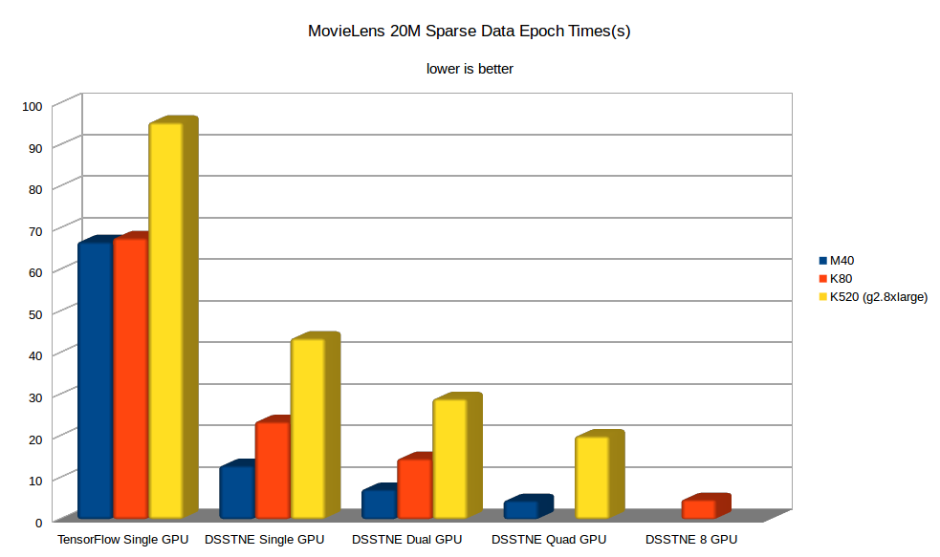
How Well Does it Work?

Slide 37
Yes Yes But How Good Are The Recommendations?
This is a strange question IMO
DSSTNE runs the same mathematics as everyone else
Amazon OSSed the framework, not the actual networks, and definitely not how they prepare customer purchase histories
So for a surrogate, let's use the binary prediction of a random 80/20 split of the MovieLens 20M dataset
Competing numbers provided by Saul Vargas

Slide 38
MovieLens 20M DSSTNE
{
"Version" : 0.8,
"Name" : "AIV NNC",
"Kind" : "FeedForward",
"ShuffleIndices" : false,
"ScaledMarginalCrossEntropy" : {
"oneTarget" : 1.0,
"zeroTarget" : 0.0,
"oneScale" : 1.0,
"zeroScale" : 1.0
},
"Layers" : [
{ "Name" : "Input", "Kind" : "Input", "N" : "auto", "DataSet" : "input", "Sparse" : true },
{ "Name" : "Hidden1", "Kind" : "Hidden", "Type" : "FullyConnected", "N" : 1536, "Activation" : "Relu", "Sparse" : false, "pDropout" : 0.37, "WeightInit" : { "Scheme" : "Gaussian", "Scale" : 0.01 } },
{ "Name" : "Hidden2", "Kind" : "Hidden", "Type" : "FullyConnected", "N" : 1536, "Activation" : "Relu", "Sparse" : false, "pDropout" : 0.37, "WeightInit" : { "Scheme" : "Gaussian", "Scale" : 0.01 } },
{ "Name" : "Hidden3", "Kind" : "Hidden", "Type" : "FullyConnected", "N" : 1536, "Activation" : "Relu", "Sparse" : false, "pDropout" : 0.37, "WeightInit" : { "Scheme" : "Gaussian", "Scale" : 0.01 } },
{ "Name" : "Output", "Kind" : "Output", "Type" : "FullyConnected", "DataSet" : "output", "N" : "auto", "Activation" : "Sigmoid", "Sparse" : true , "WeightInit" : { "Scheme" : "Gaussian", "Scale" : 0.01, "Bias" : -10.2 }}
],
"ErrorFunction" : "ScaledMarginalCrossEntropy"
}

Slide 39
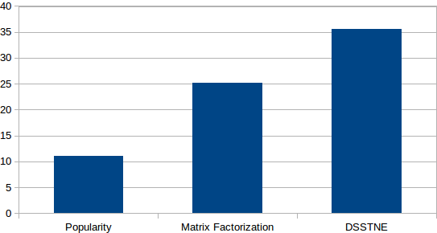
MovieLens 20M P@10
https://github.com/RankSys/RankSys

Slide 40
Raw Performance
P@K
K

Slide 41
AWS Recommendations at Scale
AWS released a blog by Kiuk Chung on how to perform product recommendations with DSSTNE (and other frameworks BTW) and Spark to experiment with deep learning for product recommendations at scale
This is the Amazon Deep Learning Recommendations System minus the secret sauce networks, hyperparameters, and private customer data

Slide 42
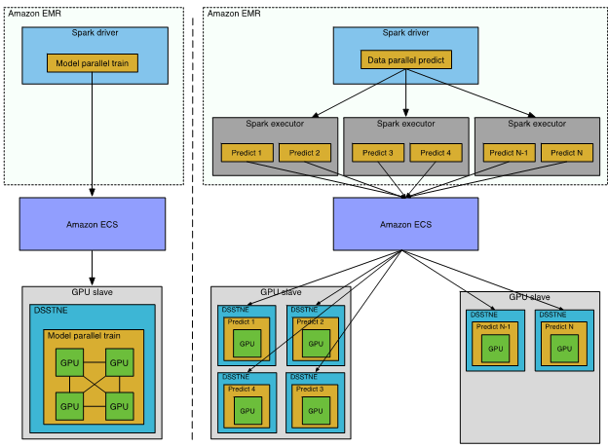
Recommendations At Scale: How Do They Work?
http://blogs.aws.amazon.com/bigdata/post/TxGEL8IJ0CAXTK/Generating-Recommendations-at-Amazon-Scale-with-Apache-Spark-and-Amazon-DSSTNE

Slide 43
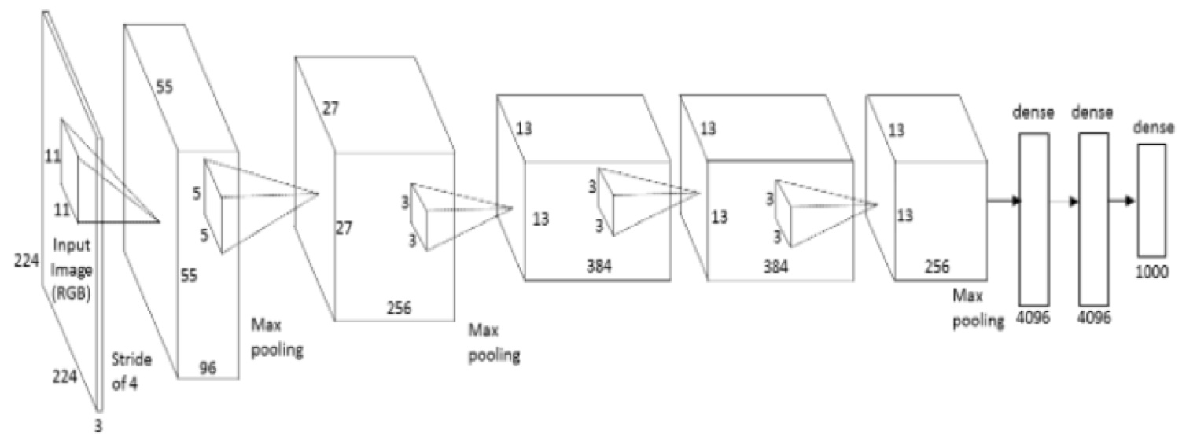
Adventures In Convolutional Neural Networks

Slide 44
AlexNet in DSSTNE
{
"Version" : 0.81,
"Name" : "AlexNet",
"Kind" : "FeedForward",
"LocalResponseNormalization" :
{
"k" : 2,
"n" : 5,
"alpha" : 0.0001,
"beta" : 0.75
},
"Layers" : [
{ "Kind" : "Input", "Type" : "Convolutional", "N" : "auto", "DataSet" : "input"},
{ "Kind" : "Hidden", "Type" : "Convolutional", "N" : 96, "Kernel" : [11, 11], "KernelStride" : [4, 4], "Activation" : "Relu" },
{ "Kind" : "Hidden", "Type" : "Pooling", "Function" : "LRN" },
{ "Kind" : "Hidden", "Type" : "Pooling", "Function" : "Max", "Kernel" : [3, 3], "KernelStride" : [2, 2]},
{ "Kind" : "Hidden", "Type" : "Convolutional", "N" : 256, "Kernel" : [5, 5], "Activation" : "Relu" },
{ "Kind" : "Hidden", "Type" : "Pooling", "Function" : "LRN" },
{ "Kind" : "Hidden", "Type" : "Pooling", "Function" : "Max", "Kernel" : [3, 3], "KernelStride" : [2, 2] },
{ "Kind" : "Hidden", "Type" : "Convolutional", "N" : 384, "Kernel" : [3, 3], "Activation" : "Relu" },
{ "Kind" : "Hidden", "Type" : "Convolutional", "N" : 384, "Kernel" : [3, 3], "Activation" : "Relu" },
{ "Kind" : "Hidden", "Type" : "Convolutional", "N" : 256, "Kernel" : [3, 3], "Activation" : "Relu" },
{ "Kind" : "Hidden", "Type" : "Pooling", "Function" : "Max", "Kernel" : [3, 3], "KernelStride" : [2, 2] },
{ "Kind" : "Hidden", "Type" : "FullyConnected", "N" : 4096, "Activation" : "Relu", "pDropout" : 0.5 },
{ "Kind" : "Hidden", "Type" : "FullyConnected", "N" : 4096, "Activation" : "Relu", "pDropout" : 0.5 },
{ "Kind" : "Output", "Type" : "FullyConnected", "N" : "auto", "DataSet" : "output", "Activation" : "SoftMax" }
],
"ErrorFunction" : "CrossEntropy"
}

Slide 45
Unfortunately...
ImageNet is ~200 GB of Data
GPUs have about 12 GB of data
Titan XP was supposed to have solved this with unified memory
But that turns out to be a disappointing work in progress for now
So we'll need something a lot smaller
And then we'll need to stream data old-school style

Slide 46
CIFAR-100
50,000 32x32x3 images classified into 100 categories
About 150 MB of data, or *perfect*
State of the art prediction accuracy is a P@1of 70-80%

Slide 47
Strawman CNN
{
"Version" : 0.81,
"Name" : "CIFAR-100",
"Kind" : "FeedForward",
"LocalResponseNormalization" :
"Layers" : [
{ "Kind" : "Input", "Type" : "Convolutional", "N" : "auto", "DataSet" : "input", "Name" : "Input"},
{ "Kind" : "Hidden", "Type" : "Convolutional", "N" : 96, "Kernel" : [3, 3], "KernelStride" : [1, 1],
"Activation" : "Relu", "pDropout" : 0.2, "WeightInit" : { "Scheme" : "Gaussian", "Scale" : 0.04 , "Bias" : 0.0 } },
{ "Kind" : "Hidden", "Type" : "Convolutional", "N" : 96, "Kernel" : [3, 3], "KernelStride" : [1, 1],
"Activation" : "Relu", "WeightInit" : { "Scheme" : "Gaussian", "Scale" : 0.04 , "Bias" : 0.0 } },
{ "Kind" : "Hidden", "Type" : "Convolutional", "N" : 96, "Kernel" : [3, 3], "KernelStride" : [2, 2],
"Activation" : "Relu", "pDropout" : 0.5, "WeightInit" : { "Scheme" : "Gaussian", "Scale" : 0.04 , "Bias" : 0.1 } },
{ "Kind" : "Hidden", "Type" : "Convolutional", "N" : 192, "Kernel" : [3, 3], "KernelStride" : [1, 1],
"Activation" : "Relu", "WeightInit" : { "Scheme" : "Gaussian", "Scale" : 0.04 , "Bias" : 0.0 } },
{ "Kind" : "Hidden", "Type" : "Convolutional", "N" : 192, "Kernel" : [3, 3], "KernelStride" : [1, 1],
"Activation" : "Relu", "WeightInit" : { "Scheme" : "Gaussian", "Scale" : 0.04 , "Bias" : 0.0 } },
{ "Kind" : "Hidden", "Type" : "Convolutional", "N" : 192, "Kernel" : [3, 3], "KernelStride" : [2, 2],
"Activation" : "Relu", "pDropout" : 0.5, "WeightInit" : { "Scheme" : "Gaussian", "Scale" : 0.04 , "Bias" : 0.1 } },
{ "Kind" : "Output", "Type" : "FullyConnected", "N" : "auto", "DataSet" : "output", "Name" : "Output",
"Activation" : "SoftMax", "WeightInit" : { "Scheme" : "Gaussian", "Scale" : 0.01 , "Bias" : 0.0 } }
],
"ErrorFunction" : "CrossEntropy"
}

Slide 48
Results
First attempt with buggy code hit 18% P@1
Second attempt with running code hit 38% P@1
Third attempt with a tweaked network hit 46% P@1
Fourth attempt after another bug fix hit 57% P@1
~58% is state of the art without data whitening/augmentation
Best effort ever is ~80% after heroic augmentation

Slide 49
Deep Learning For The 99%
“You have to spend at least $24,000(US) to be able to run experiments on Atari or ImageNet competitively.” - Nando de Freitas

Slide 50
P13N at Amazon
Developed DSSTNE and changed the way Amazon does recommendations with:
A $3000 GTX 880M Laptop
A $3000 GTX 980M Laptop
A $2000 Desktop with two $1000 GTX TitanX GPUs
A bunch of AWS time on GPUs from 2012

Slide 51
What Do you REALLY Need?
GPU 0
GPU 1
GPU 2
GPU 3
16x
16x
16x
16x
8747 PCIE Switch
8747 PCIE Switch
16x
16x
CPU

Slide 52
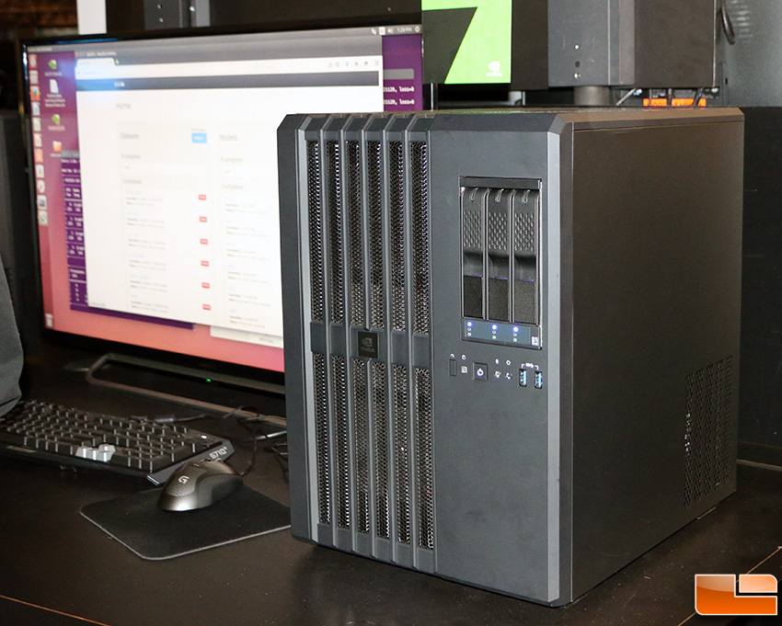
Total Cost: $7,000 or less
Asus P9X79-E WS MB ($500) plus Intel Core-i7 4820 (Ivybridge) CPU ($320)
Asus X99-E WS MB ($520) plus Intel Core-i7 5930K (Haswell) CPU ($560)
4 Titan XP or (when they come) GTX 1080 Ti GPUs
44 TFLOPs for $7,000! (<<$24,000)
Was sold by NVIDIA as the Digits Dev Box for $15,000

Slide 53
What if $24K is Burning A Hole in Your Pocket?
GPU 0
GPU 3
GPU 3
GPU 0
GPU 1
GPU 2
GPU 0
GPU 0
GPU 1
GPU 2
16x
16x
16x
16x
16x
16x
16x
16x
8796 PCIE Switch
16x
8796 PCIE Switch
CPU
16x

Slide 54
Or Do You Need A $149K DGX-1?
85 TFLOPS FP32 (~10.6 TFLOPS per GPU) no FP16 for now
~64 GB/s connected in a cube (N == 8)
Significant reduction in communication costs, but is AlexNet communication-limited?
Reduction:
Gather:
AllReduce:
D * (N – 1) / N
D * (N – 1) / N
D * 2 * (N – 1) / N

Slide 55
Are you data-parallel?
AlexNet has ~61M parameters
We'll assume a batch size of 128 and Soumith Chintala's training perf numbers for TitanX scaled up by ~1.6 to arrive at 2,884 images/s FP32
16 images/s/GPU at 2,884 images/s is ~5.5 ms
AllReducing 61M (244 MB) parameters at ~64 GB/s is ~6.7 ms (buried 5.5 ms of backprop for overlapping copy and compute) for a final result of 1.2 ms.
Using 12.5 GB/s P2P, this would take ~34 ms, $129K^H^H^H^H149K is a bargain! Such value! Very Deeply! So much Learnings!

Slide 56
Alex Krizhevsky to the Rescue!
(or are you model-parallel?)
AlexNet has ~61M parameters. ~4.3M of which are convolutional (data-parallel) and ~56.7M of which are fully-connected (model-parallel)
Fully connected layers at a batch size of 128 is ~1.7M neurons
P2P allReduce of 4.3M parameters takes ~2.4 ms
P2P gather/reduction of 1.7M neurons is ~0.5 ms
2.9 ms is << 5.5 ms so once again it's free(tm)
It's also faster than NVLINK data-parallel…
NVLINK model-parallel would of course win here but it doesn't exist...
Similar arguments apply to INT16/FP16

Slide 57
DSSTNE RoadMap
Finish CNN/Pooling/LSTM support
Compile DSSTNE under Radeon Open Compute (ROC) and truly fulfill the promise of “CUDA Everywhere(tm)”*
Don't port your code to OpenCL, port your processor to CUDA and get instant access to all existing OSS CUDA applications
Provide a Python API through Python extensions (section 2.7.12)
Caffe/TensorFlow import
Automagic streaming of models and data on SM 6.x and up
*https://github.com/RadeonOpenCompute

Slide 58
Summary
DSSTNE's automagic model-parallel training is a big win
DSSTNE's efficient sparse data processing is a big win
Both of these required bespoke GPU code as will filling in the rest of the road map
AWS has released all the tools for using DSSTNE for recommendations at scale
Torch and Caffe have recently improved their sparse data support
CNN/RNN support is a work-in-progress

Slide 59
Acknowledgments (DSSTNE/Amazon/AWS)
Rejith Joseph George
Kiuk Chung
Tristan Penman
Oleg Rybakov
Avishkar Misra
Jane You
Shruti Kamath
Mitchell Goodman
Cesar Romero
Jeff Bezos
Leo Dirac
Sebastian Gunningham
Srikanth Thirumulai
Henri Yandell
Matias Benitez

Slide 60
Acknowledgments (NVIDIA)
Jonathan Bentz
Mark Berger
Jerry Chen
Kate Clark
Simon Layton
Duncan Poole
Sarah Tariq

Slide 61
Acknowledgments (AMD/ROC)
Greg Stoner
Ben Sander
Michael Mantor

