Slide 1

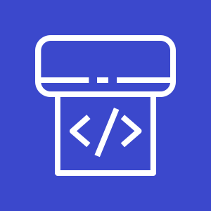


CodePipeline Artifact Store S3 Bucket
fetches packaged SAM template
aws-serverless-codepipeline-serverlessrepo-publish app
invokes
publishes app to
CodePipline
ServerlessRepoPublish Lambda
AWS Serverless
Application Repository

