Slide 1
Spread of the coronavirus epidemic as covered by the news media using NLP
Aviva Mazurek & Ben Johnson-Laird

Slide 2
Methodology & Goals
Goals
Can the progression of the virus be tracked using NLP using newspaper articles. E.g.:
Identity the cities that the virus travelled too
Can the virus symptoms be inferred from the articles
Methodology
Data source N.Y. Times with time period (Jan-Feb 2020)
Extensible framework using Spacy allows matched articles to be filtered through successive query pipes
N.Y Times API for article URl’s (about coronavirus) → scraped content → NLP for sentences with virus and geographic locations and symptoms
Notes:
We used the nytimes API to pull all articles since the beginning of january that had coronavirus in it. The Nytimes API actually doesnt let you pull text, so we had to get the URLs, and then scrape the contents of every article, we actually had to run that program overnight
We then used a program spacey where we found sentences that had virus, or synonyms of virus and a geographic locaiton in the same sentence, and we also pulled sentences that ahd the virus and a symptom in the same sentence.
We did a lot of EDA, and Ben is going to kick us off with that
We did a lot of EDA

Slide 3
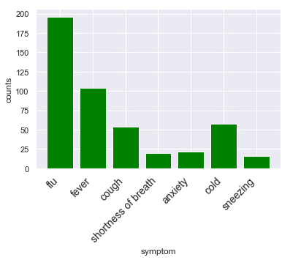
Number of mentions for symptoms with mentions >15
Consistent with CDC listed symptoms
Actual CDC listed Symptoms
Fever
Cough
Shortness of breath
Notes:
Consistent with the actual symptoms
Number of mentions actually means something - methodology for looking for mentions works

Slide 4
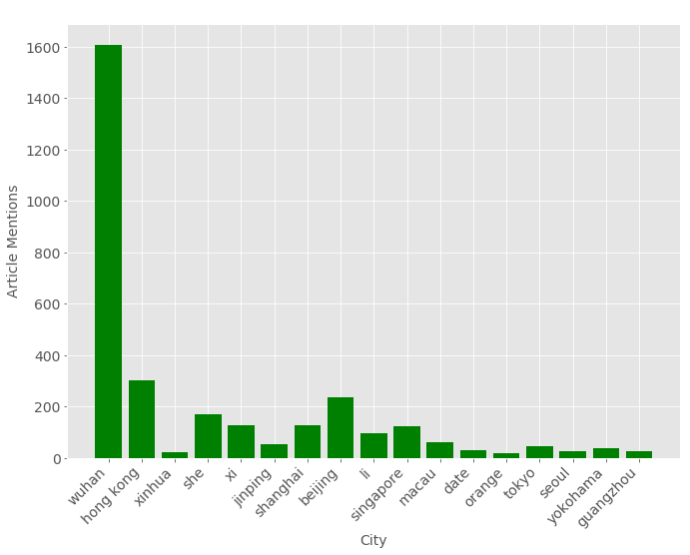
Number of mentions for cities with mentions >15

Slide 5
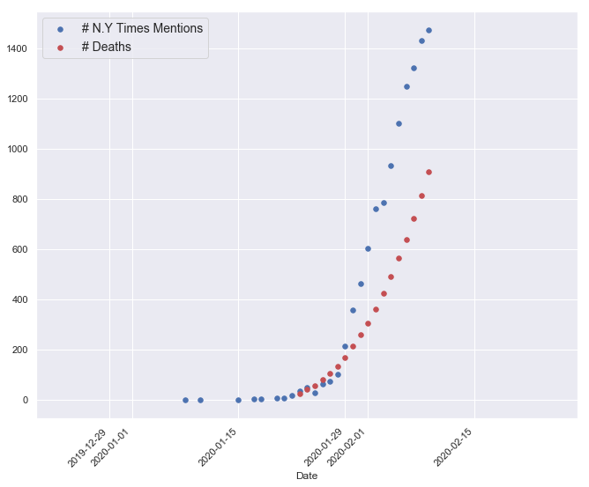
N.Y Times Mentions and Number of Deaths by Date
Notes:
We were wondering if the number of ny times mentions of coronavirus per day corrolated with the deaths per day so on this graph, the red series are cumulative deaths, and the blue series is ny times mentions of the coronavirus, so each one of these points are cumulative deaths or nytimes mentions per day, and the graph behavior is really similar so we decided to do linear regression
Would be interesting to see a virus thats old - like sars to see if they level off

Slide 6
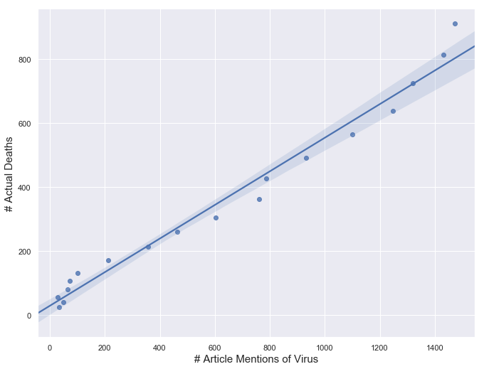
Nearly Linear Relationship Between Article Mentions and Deaths by Date
Slightly sigmoidal
Y = 0.53x + 28.75
R² = 0.978

Slide 7
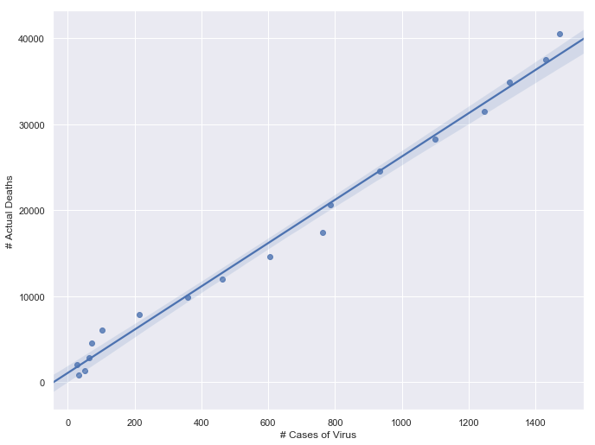
Linear Relationship Between Article Mentions and Cases by Date
Slightly sigmoidal
Y = 25.17x + 1054.25
R² = 0.989

Slide 8
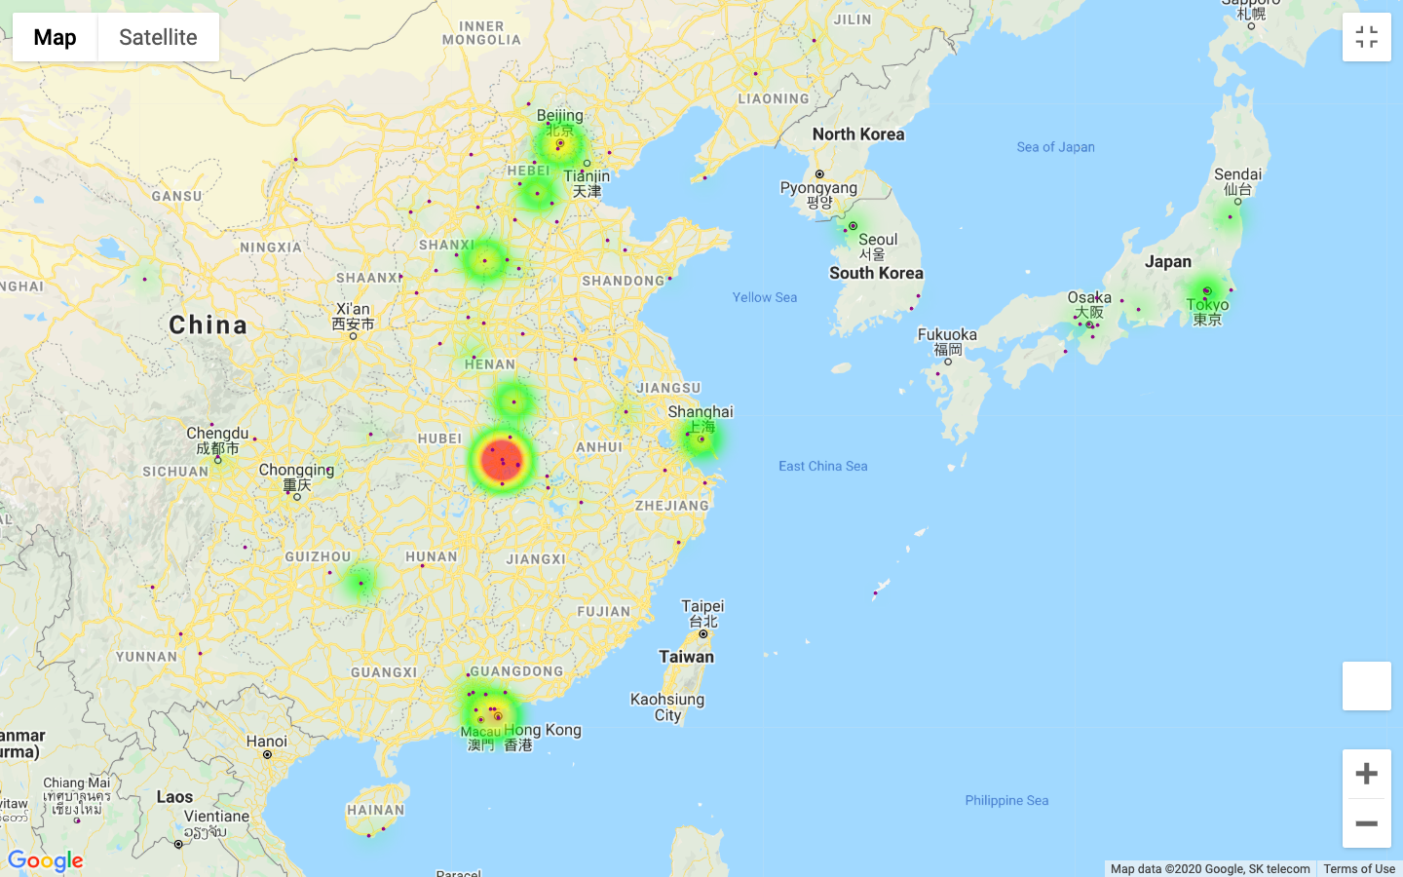
Heatmap of Virus Mentions in N.Y Times articles
Consistent with The Economist’s heatmap

Slide 9
Conclusions & Future Work
NLP program features
Map out hot spots of infectious diseases geographically
Determine symptoms of infectious diseases
Future Work
Reusable framework could be used to track future emergent diseases
Map out other infectious diseases to further validate model (i.e SARS)
Differences in newspaper coverages (i.e geographic bias, scaremongering)

