Slide 1
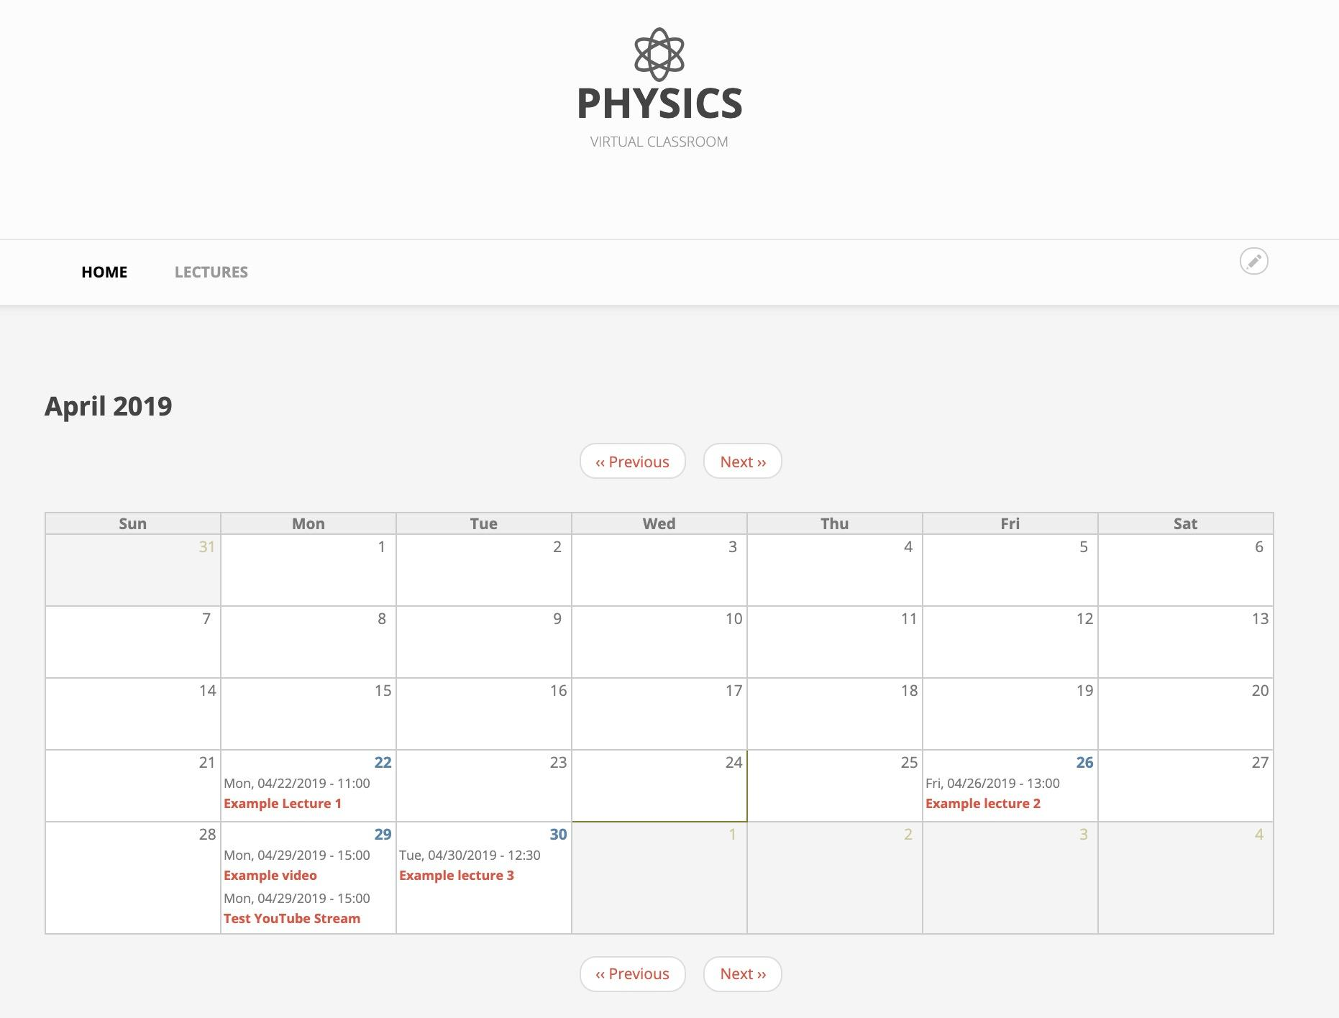
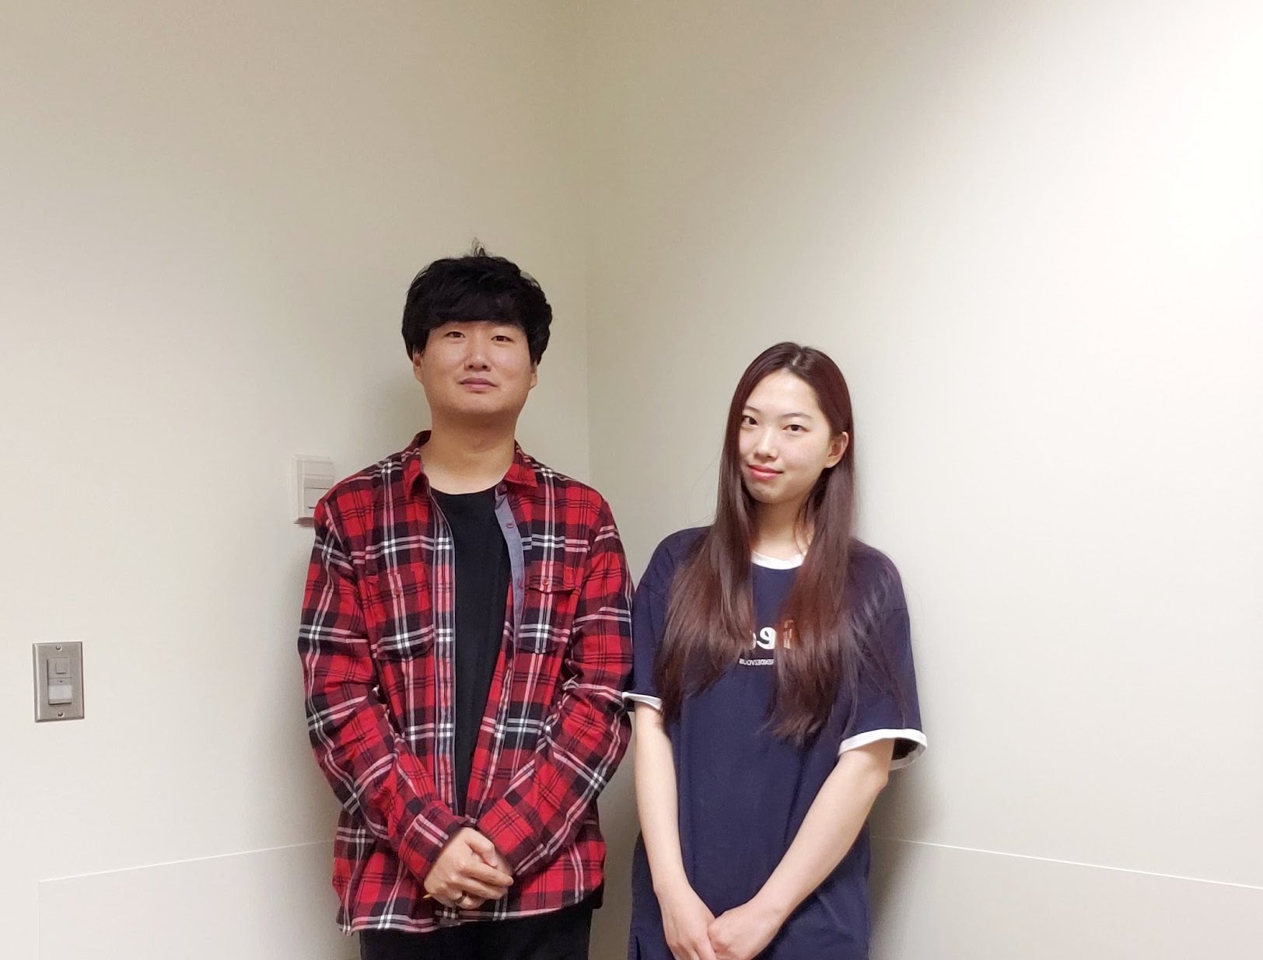
CS51
What’s important
Physics Virtual Classroom
Team Members:
Yeongae Lee: leeye@oregonstate.edu
Jaehyung You(Eric): youja@oregonstate.edu
Client: Dr.Kenneth C. Walsh
Kenneth is a professor at Oregon State University in the Physics Department. He graduated from Oregon State University with a Bachelor of Science in Physics and Engineering Physics. He remained at Oregon State University to complete his Doctorate of Philosophy in physics.
Why we chose this project?
This project was the top choice for each team member because we want to make the world a better place by making learning more accessible to everyone. This project allowed us to build something that would directly affect students here at OSU and make learning more accessible for future students. As OSU students, making the students learn in a better environment was the most fascinating aspect of this project.
Special Thanks to Max Moulds
Max is a programmer for the BoxSand project and was a vital part to the success of our team. His knowledge and expertise helped guide us through this process.
Students will improve their understanding of the material by collaborating on problems, instead of working alone
Live lectures encourage active participation of students by allowing students to ask questions in real time.
Students experience a better learning environment because of the increased accessibility of educational tools.
Through group activities in the middle of the class, students develop their ability to solve problems through cooperation.
Physic Virtual Classroom provides researchers at OSU about the efficiency of the software and learning resources. It will be improved to further increase the learning experience for students to come.
This change in the educational paradigm will be an important beginning for not only studying in physics, but it also helps to improve the efficiency and the quality of all studying in the future.
An educational websites/online learning environment, where students can watch lecture videos, practice problems, and collaborate with others.
Figure 1. The main page of Physics Virtual Classroom
Overview
Features
Project BoxSand has already started substituting countless traditions textbooks with digital ones. It provides better accessibility to materials and saves students from spending on traditional textbooks. By providing free learning materials, this has helped students save an accumulated amount of approximately $70,000. The goal of our project, ‘Physics Virtual Classroom’ is to build on the existing Sandbox platform and create an online collaboration system that provides students a better educational experience.
One of the features that we are proud to introduce in Physics Virtual Classroom is the function which allows the professors to conduct or upload a live lecture (YouTube Live). Additionally, we’ve also introduced a built-in public whiteboard which acts as a public space that allows students to collaborate with each other, either through collective note-taking or problem solving.
Lectures
Lectures show up on the calendar. The calendar allows students to see lecture schedule for this month. The page redirects the user to the lecture page by clicking a lecture item on the calendar.
Chatting System
Chat channel is offered in physical virtual classroom lobby. Students can check who is in the lobby in real time. Also, they can search for students who will take a lecture and work on group activities together.
Online Whiteboard
AWW whiteboard is an open space where students can freely exchange opinions during group activities. A whiteboard is provided for each group.
Figure 2. Team photo. Jaehyung You, Yeongae Lee (from left)
Notes:
이름은 오른쪽으로 (오렌지랑 회색이랑 자리 바꾸기) -- 했음!
헤드라인 바꾸기(좀더 자세하게 직접적으로)
시진 바꾸기 - 추가하기 (태그??)
텍스트를 조금 줄이기?? -- 사이즈말고 양을!!

