Slide 1
VANTAGE
COMMUNITY-DRIVEN SAFETY INTELLIGENCE
“What if every safety problem people notice could become visible to the people who can act on it?”
Presented By:
Aafiya Rahila.A
Lisah Marcie.S
Hafna Fathima.M

Slide 2



THE PROBLEM
Safety problems are visible.
The information isn’t.
For people
For communities
For authorities
People often don’t know what problems have recently been reported in an area before travelling through it.
Someone may experience poor lighting, unsafe infrastructure, isolation or stray animals — but the information stays isolated.
Repeated local problems are hard to see as a single pattern when reports are scattered across conversations and channels.
VANTAGE does not claim existing systems fail — it closes the gap between an observation and the people who need to see it.
VANTAGE
02 — PROBLEM

Slide 3




EVIDENCE
We asked people about the problem.
78%
61%
84%
72%
have felt unsafe in a particular area
have changed their route because of safety concerns
wanted to know about an area’s safety before travelling there
would report a problem through a platform like VANTAGE
Our survey is helping us understand what people experience, what information they want, and what would make community reports trustworthy.
Placeholder figures — to be replaced with verified results from our Google Forms survey.
VANTAGE
03 — EVIDENCE

Slide 4




THE SOLUTION
A community-powered map of
real-world safety problems.
Poor lighting
Stray animals
Unsafe infrastructure
Isolation
1. REPORT
A person reports an issue.
2. VERIFY
Other people can confirm or flag it.
3. MAP
The issue becomes visible at its location.
4. IDENTIFY PATTERNS
Repeated reports reveal recurring problems.
5. ACT
Relevant authorities receive structured information for review.
VANTAGE
VANTAGE
04 — SOLUTION

Slide 5





HOW IT WORKS
From one observation to community intelligence.
1
2
3
4
5
A person notices a problem
They submit a location-based report
Other users confirm or flag the report
VANTAGE maps verified signals
Recurring issues become actionable insights
“Street lights not working near Central Bus Stop”
LOCATION
CATEGORY
TIME REPORTED
EVIDENCE
CONFIRMATIONS
VERIFICATION STATUS
—
—
—
—
—
—
A single report is a signal — not an established fact — until the community confirms it.
VANTAGE
05 — HOW IT WORKS

Slide 6



THE PRODUCT
One platform. Two perspectives.
FOR CITIZENS
FOR AUTHORITIES
Poor lighting
Area: Central Bus Stop
12 community confirmations
Reported today
Live map of nearby reports
Problem categories at a glance
Confirmation count per report
RECURRING ISSUE IDENTIFIED
Report age & verification status
Poor lighting
VANTAGE
06 — PRODUCT

Slide 7





TRUST & VERIFICATION
A safety map is only useful if
people can trust it.
Layer 1 — Evidence
Optional photographs or supporting information.
REPORT LIFECYCLE
Layer 2 — Independent reports
Multiple people reporting the same issue increases confidence.
Submitted
Layer 3 — Community confirmation
1 report · unverified
Users can confirm or flag a report.
Layer 4 — Recency
Confirmed
Recent reports are surfaced appropriately.
Multiple independent reports
Layer 5 — Moderation
Suspicious, misleading or inappropriate reports can be flagged and reviewed.
Stronger signal
High confidence · visible to authorities
VANTAGE presents community-reported information with context and verification status — not absolute claims about a location.
VANTAGE
07 — TRUST

Slide 8
WHY THIS IS DIFFERENT
We aren’t predicting danger.
We’re making existing problems visible.
TRADITIONAL APPROACH
VANTAGE
Individual complaints
Location-based reporting
Information can remain fragmented
Community confirmation
Map-based visibility
Limited community visibility
Recurring issue aggregation
Difficult to see recurring local patterns
Structured information for relevant authorities
VANTAGE connects citizen observations, community verification and civic action in one loop.
VANTAGE
08 — DIFFERENT

Slide 9










IMPACT & SCALABILITY
Start local. Scale through the same system.
ONE STREET
ONE NEIGHBOURHOOD
ONE CITY
REGIONAL / STATE-WIDE
People can understand recurring problems around them.
Shared visibility across residents nearby.
Patterns can reveal recurring infrastructure and safety issues.
Aggregated, structured reports could help departments prioritize response.
POTENTIAL FUTURE INTEGRATIONS
Municipal services
Road & infrastructure
Lighting maintenance
Animal control
Public transport
Other civic departments
VANTAGE
09 — IMPACT

Slide 10
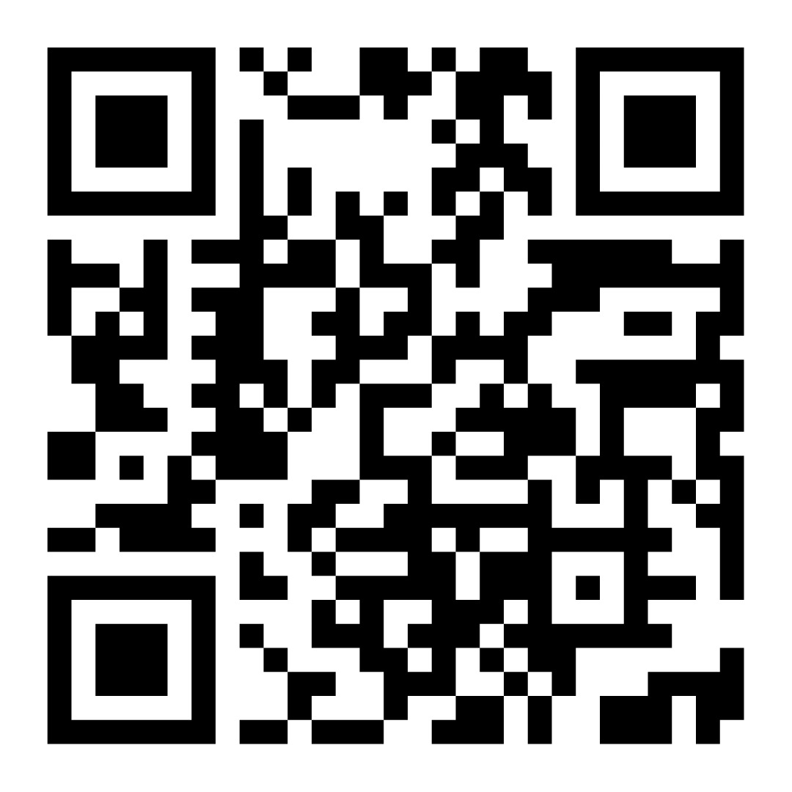
MAKE THE INVISIBLE VISIBLE.
REPORT. VERIFY. MAP. ACT.
“We don’t need to predict every danger. We need to make the problems people already experience visible, verifiable and actionable.”
SCAN FOR OUR SURVEY

