Slide 1
CTFx – An Online Platform for CTF Practice
MLSA Web Development Project
Ambar Chakravartty

Slide 2
Overview
CTFx is an interactive online platform designed to help users practice Capture the Flag (CTF) challenges.
Users can register, solve challenges, create challenges, and track their progress on a leaderboard.

Slide 3
Tech Stack
Node.js: Server-side Javascript runtime
Express.js: Backend framework used to define API routes and middleware
MongoDB: NoSQL database for data management
Bulma.CSS: CSS component framework used for styling

Slide 4
Key Features
User Registration and Authentication
Challenges: Solve and create unique challenges
Leaderboard: Compete with others globally

Slide 5
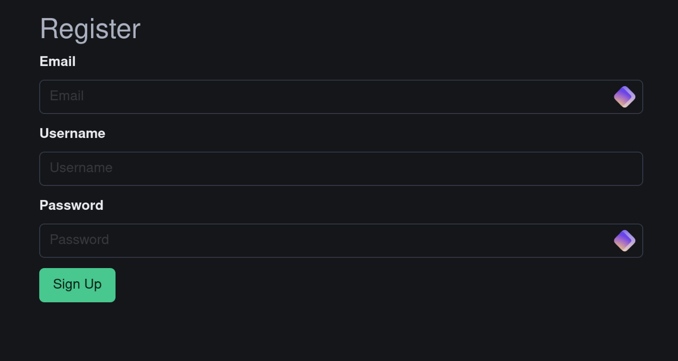
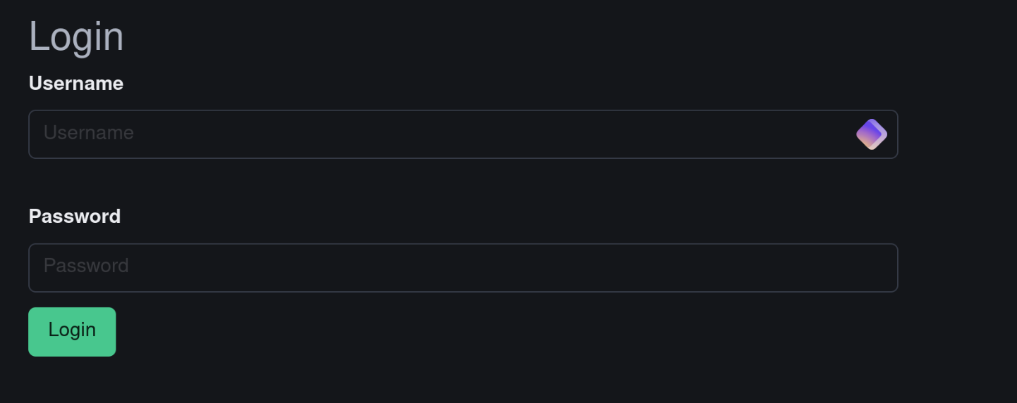
Key Features
User Registration and Authentication

Slide 6
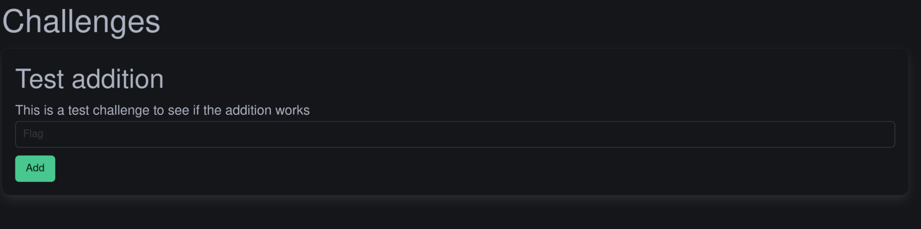
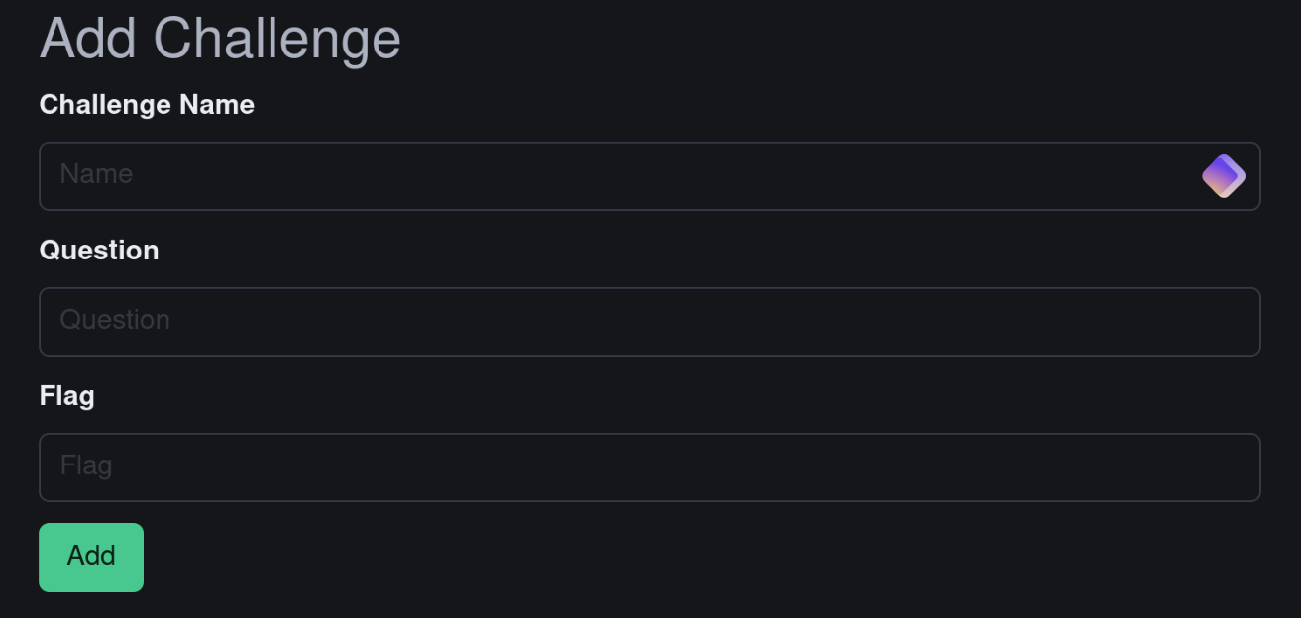
Key Features
Challenges: Solve and create challenges

Slide 7
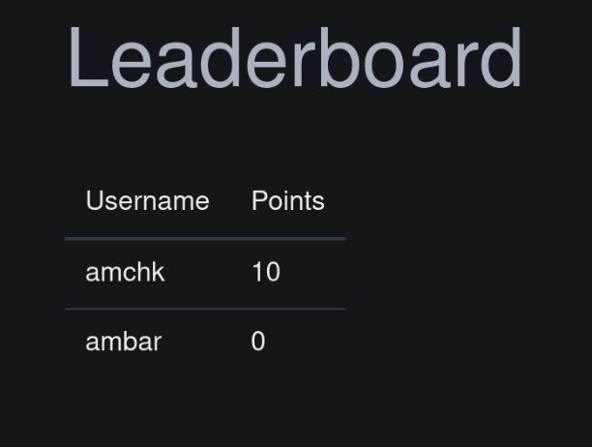
Key Features
Leaderboard

Slide 8
Future Enhancements
Challenge Categories: Add more topics like OSINT and network security
Team-Based Challenges: Allow team formations
Timed Events: Host real-time CTF events
Hint System: Optional hints for beginners
Profile Customization: Avatars, achievements, and badges

