Slide 1
Business and Technical Insights for X education
Understanding data patterns to drive effective decisions
Presentation by Ambar Chaudhari
Notes:
AI-generated content may be incorrect. ---

Slide 2

Introduction to Logistic Regression in Business
Binary Classification Role
Logistic regression predicts binary outcomes like customer conversion in sales and marketing analytics.
Probability Estimation
It estimates the probability of categorical outcomes using a sigmoid function, enhancing interpretability.
Strategic Business Insights
It helps understand in identifying potential customer so business can use sales team to contact them.
Notes:
Logistic Regression is a widely used supervised machine learning algorithm primarily applied for binary classification problems. In a business context, especially in sales and marketing analytics, it plays a crucial role in predicting whether a customer is likely to convert or not. Unlike linear regression, which predicts continuous outcomes, logistic regression estimates the probability of a categorical outcome using a sigmoid function. This probability-based output makes it highly interpretable and actionable for business stakeholders. One of the biggest advantages of logistic regression is its simplicity and transparency, allowing business teams to understand the relationship between independent variables such as customer demographics, engagement behavior, and purchase history, and the dependent variable, which in this case is conversion. Moreover, logistic regression models can be deployed quickly and integrated into CRM systems to support real-time decision-making. From a strategic standpoint, organizations leverage this model to enhance customer targeting, improve campaign effectiveness, and allocate resources efficiently. By understanding which factors influence conversion, businesses gain deeper insights into customer behavior, enabling them to design personalized experiences. Overall, logistic regression acts as a bridge between data science and business strategy, helping companies make data-driven decisions that directly impact revenue growth and operational efficiency.

Slide 3
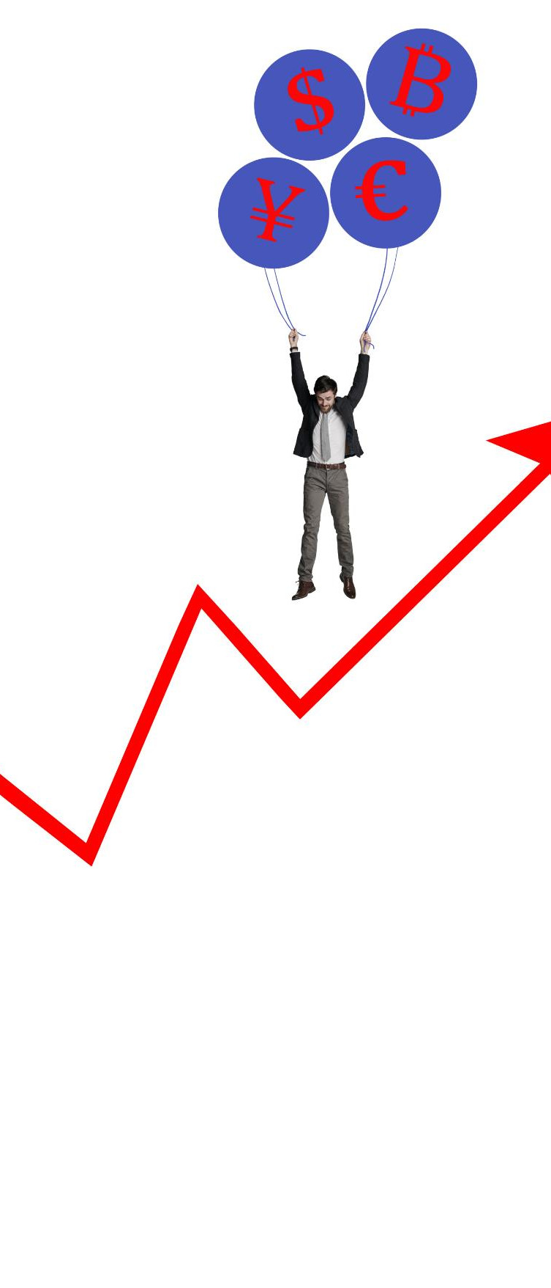
Business Problem: Improving Sales Conversion
Sales Conversion Challenge
Sales teams face inefficiencies by focusing on leads with low conversion potential. The conversion rate is just around 30%.
Logistic Regression Solution
Logistic regression classifies customers as converted or non-converted to prioritize high-quality leads.
Improved Decision-Making
Predictive analytics enables proactive sales strategies and better marketing-sales alignment.
Business Benefits
Data-backed decisions improve productivity, customer experience, profitability in sale and increase in the revenue.
Notes:
The primary business challenge addressed in this presentation is improving the conversion rate of the sales team. Organizations often deal with large volumes of leads, but not all leads have the same probability of converting into customers. Without a data-driven approach, sales teams may spend time and effort on low-potential prospects, leading to inefficiencies and missed revenue opportunities. Logistic regression helps solve this problem by classifying customers into two categories: converted and non-converted. This classification enables businesses to prioritize high-quality leads and design targeted engagement strategies. Additionally, the model helps identify patterns such as which customer segments are more responsive, what channels drive higher conversions, and which behaviors indicate purchase intent. By incorporating predictive analytics into the sales workflow, organizations can shift from reactive to proactive decision-making. Another benefit is improved alignment between marketing and sales teams, as both can rely on a unified scoring mechanism. This reduces friction and enhances collaboration. Ultimately, addressing this problem leads to improved productivity, better customer experiences, and higher profitability. The use of logistic regression ensures that decisions are backed by data rather than intuition, making the sales process more efficient and scalable.

Slide 4
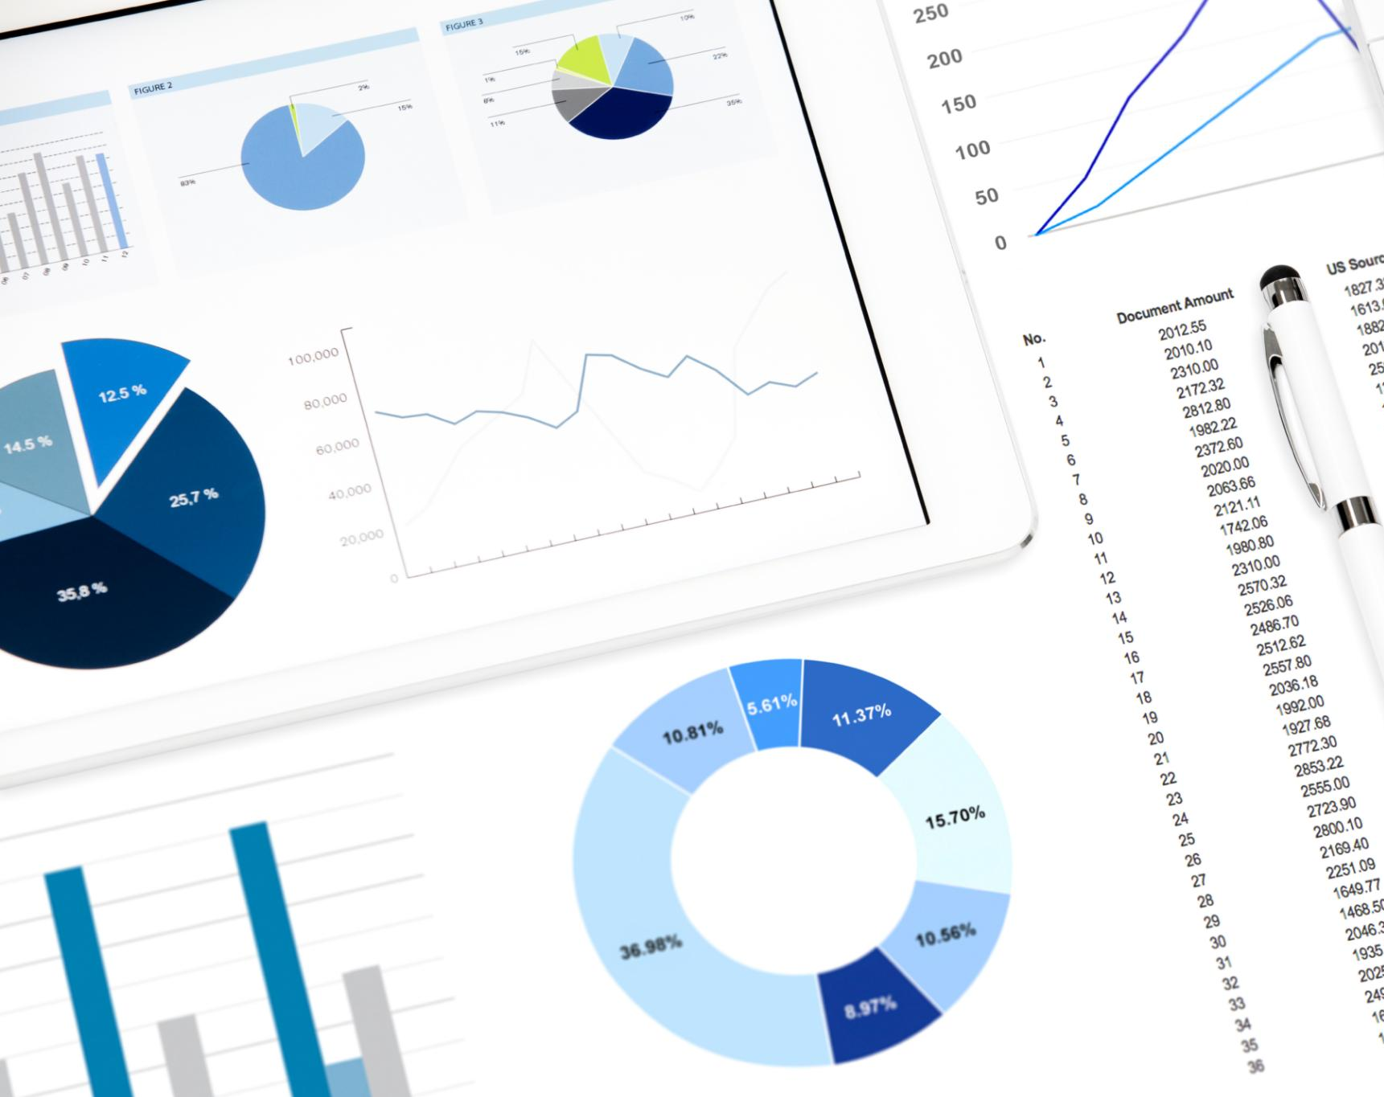
Business Value and Impact
Lead Prioritization
Logistic regression assigns probabilities to prospects helping sales teams focus on high-conversion leads, boosting revenue.
Marketing ROI Improvement
Model identifies best-performing marketing channels enabling budget reallocation to maximize ROI and reduce wasted spend.
Strategic Decision Support
Interpretable logistic regression results guide stakeholders in understanding conversion drivers for better decisions.
These are main driver of conversion as per the logistic regression model.
Notes:
Implementing logistic regression for customer classification delivers significant business value across multiple dimensions. First, it enables better lead prioritization by assigning probabilities to each prospect, allowing sales teams to focus on high-conversion opportunities. This directly increases conversion rates and revenue generation. Second, it improves the return on investment (ROI) for marketing campaigns by identifying which channels and strategies yield the best results. Businesses can reallocate budgets toward high-performing campaigns, reducing wasted spend. Third, it enhances customer experience through personalization, as insights from the model allow companies to tailor offerings based on predicted behavior. Additionally, logistic regression supports strategic decision-making by providing interpretable results, helping stakeholders understand the drivers of conversion. Another key advantage is cost reduction, as resources are used more efficiently and less effort is spent on unqualified leads. Over time, continuous model improvement through feedback loops ensures sustained performance and adaptability to changing market conditions. Furthermore, organizations can integrate these insights into automation tools, enabling real-time recommendations and dynamic customer engagement. Overall, the business impact includes increased efficiency, higher revenue, improved customer satisfaction, and stronger competitive advantage in the marketplace.

Slide 5

Exploratory Data Analysis (EDA)
Understanding Data Structure
EDA helps summarize and visualize data to reveal patterns, trends, and anomalies effectively.
Following the insight found in EDA.
Most of the leads are generated from unemployed professionals.
Google is the largest lead provider with most number of conversion.
The lead source like ‘reference’ and ‘welingak website’ provides a better conversion rate.
Converted students have spent more time on website than the non-converted once.
Most of students are in Mumbai.
Notes:
Exploratory Data Analysis (EDA) is a vital step in understanding the structure and characteristics of the dataset לפני building a logistic regression model. It involves summarizing and visualizing data to uncover patterns, trends, and anomalies. EDA helps analysts identify relationships between variables, detect outliers, and assess data quality. Common techniques include univariate analysis to understand individual feature distributions, and bivariate analysis to examine relationships between features and the target variable. Visualization tools such as histograms, box plots, and correlation heatmaps provide intuitive insights into the data. EDA also helps in identifying multicollinearity, which can negatively impact logistic regression models. By understanding feature relationships, analysts can make informed decisions about feature selection and transformation. Additionally, EDA provides business insights, such as which customer segments have higher conversion rates or which factors influence purchasing behavior. This step not only improves model performance but also enhances interpretability and stakeholder confidence. Ultimately, EDA bridges the gap between raw data and actionable insights, laying the foundation for successful machine learning implementation.

Slide 6
Data Preparation for Machine Learning
Data Collection and Cleaning
Handling Variables
Encode categorical variables(one hot encoder or pandas get dummies) and scale numerical data to ensure model compatibility and uniformity.
Train-Test Split
Split the dataset into training and testing sets to evaluate model performance on unseen data. For this dataset we are using 70-30 split.
Missing value interpolation
For numeric data we can use median, for categorical use most preferred values or ignore it one hot encoder will handle it.
Notes:
Data preparation is a critical step in building an effective logistic regression model, as the quality of input data directly impacts model performance. The process begins with data collection from various sources such as CRM systems, marketing platforms, and transactional databases. Once collected, data must be cleaned to remove inconsistencies, duplicates, and irrelevant information. Handling categorical variables is another essential aspect, often achieved through encoding techniques such as one-hot encoding or label encoding. Numerical variables may require normalization or scaling to ensure uniformity and improve model convergence. Feature engineering also plays a significant role, where new variables are derived from existing data to capture meaningful patterns. For example, combining customer behavior metrics can create more predictive features. Additionally, splitting the dataset into training and testing sets ensures that the model is evaluated on unseen data, providing a realistic measure of performance. Proper data preparation not only improves accuracy but also enhances model stability and interpretability. From a business standpoint, well-prepared data ensures reliable insights, enabling organizations to make informed decisions and maximize the effectiveness of their predictive models.

Slide 7
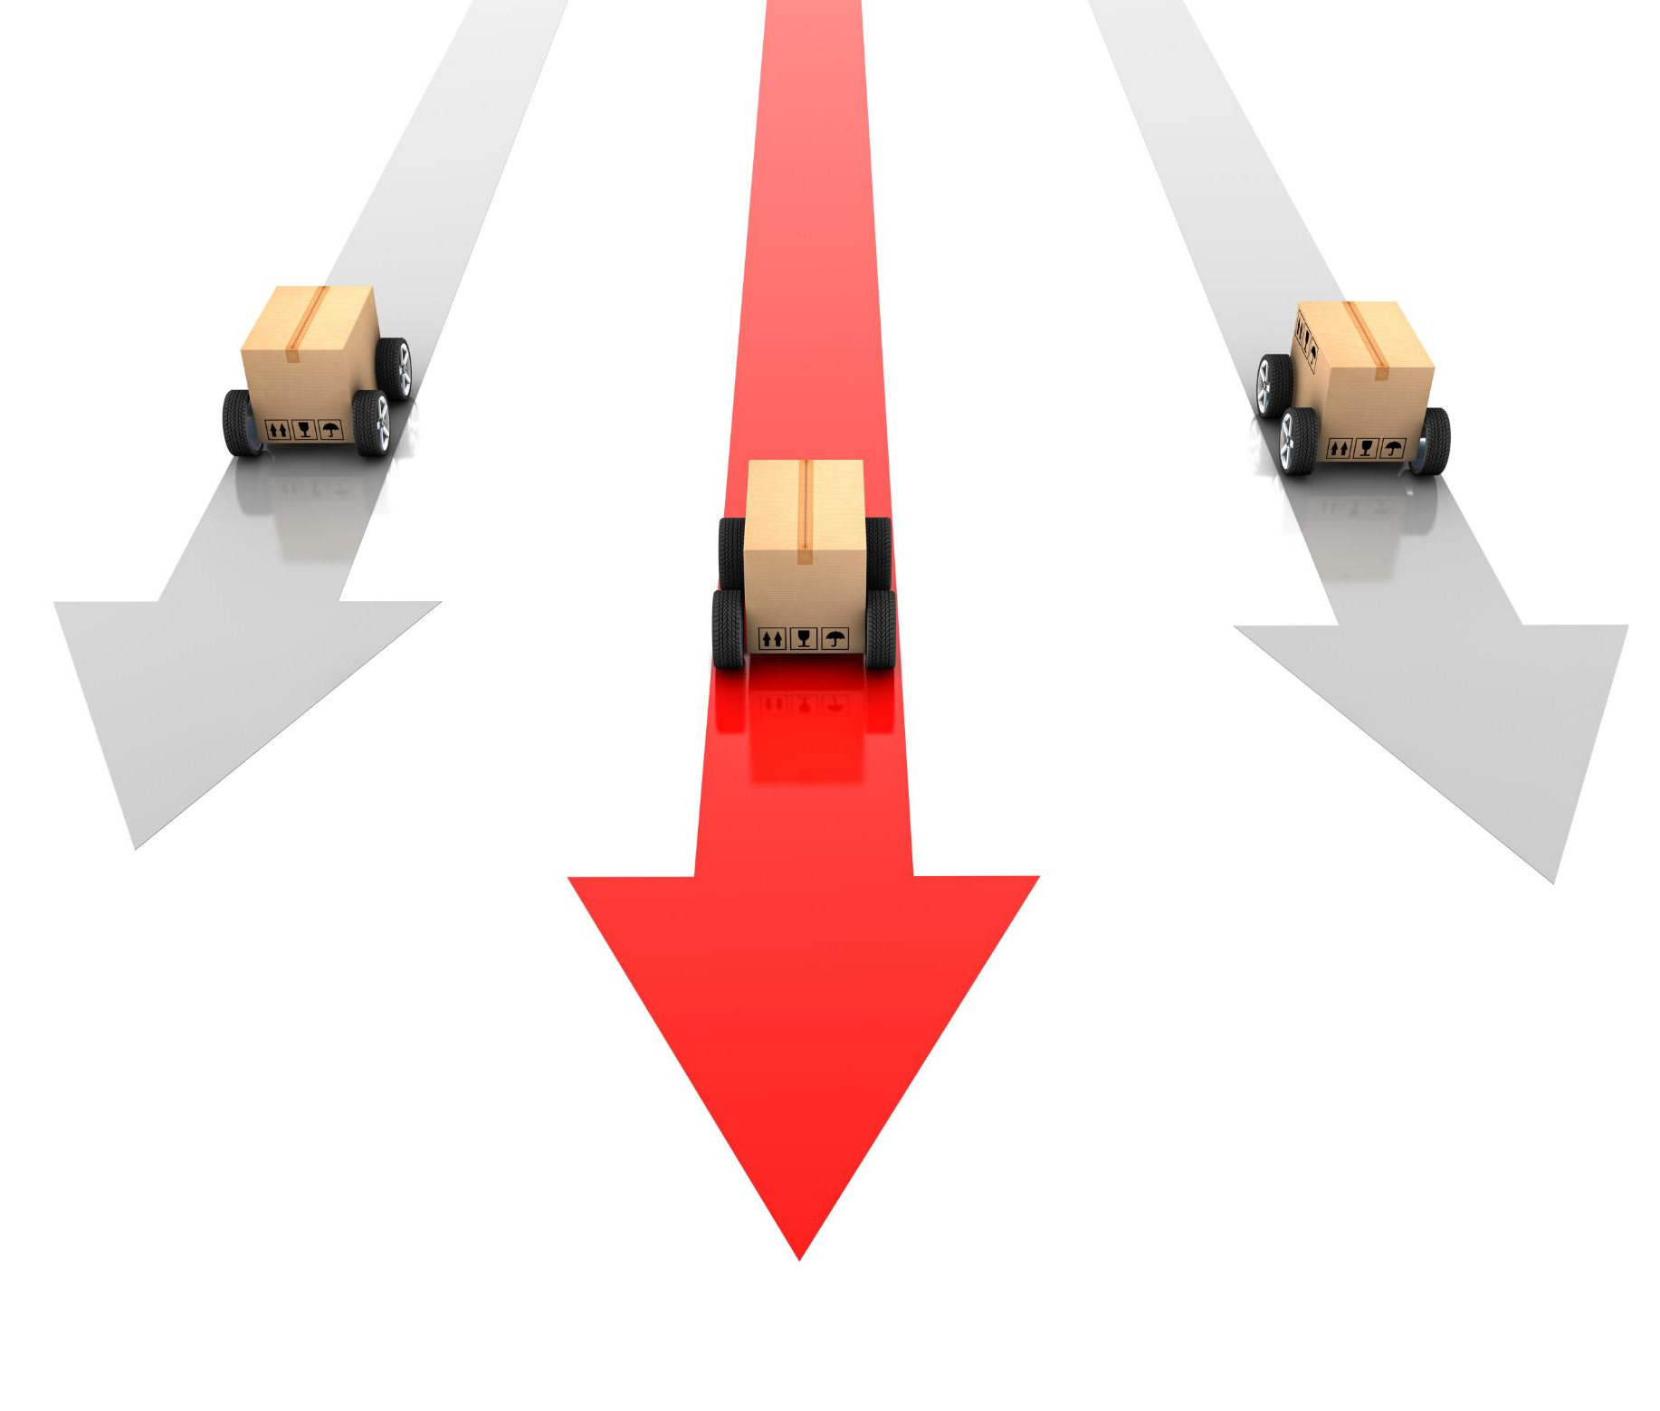
Feature Selection using RFE and VIF
Recursive Feature Elimination (RFE)
RFE iteratively removes less important features to find the optimal subset improving model performance. We have used top 15 features for the final model.
Variance Inflation Factor (VIF)
VIF detects multicollinearity in the dataset. For our dataset there is no multicollinearity no features removed.
Benefits of Combined Approach
Using RFE and VIF together creates simpler, more stable models focusing on impactful conversion drivers.
Notes:
Feature selection is essential for improving the performance and interpretability of logistic regression models. Two commonly used techniques are Recursive Feature Elimination (RFE) and Variance Inflation Factor (VIF). RFE works by iteratively removing less important features based on model performance until the optimal subset is achieved. This helps in identifying the most significant predictors contributing to customer conversion. On the other hand, VIF is used to detect multicollinearity among independent variables. High multicollinearity can distort coefficient estimates and reduce model reliability. VIF measures how much the variance of a coefficient is increased due to correlation with other variables. Features with high VIF values are typically removed to ensure model stability. Combining RFE and VIF provides a robust approach to feature selection, resulting in a simpler and more efficient model. From a business perspective, selecting the right features ensures that the model focuses on the most impactful drivers of conversion, making insights more actionable. This step also reduces computational complexity and enhances the scalability of the solution in real-world applications.

Slide 8

Model Building and Evaluation
Evaluation Metrics
Metrics such as accuracy, precision, recall, F1-score, and ROC-AUC provide insight into model performance.
Threshold Optimization
Adjusting the probability cutoff balances precision and recall to meet specific business needs. In our case low threshold is good as it reduce the risk of losing potential student.
Test score of Machine learning model.
 | precision | recall | f1-score | support
False | 0.94 | 0.93 | 0.94 | 1656
True | 0.89 | 0.90 | 0.89 | 998
accuracy |  |  | 0.92 | 2654
macro avg | 0.91 | 0.92 | 0.91 | 2654
weighted avg | 0.92 | 0.92 | 0.92 | 2654
Confusion matrix
True Positive | 901
True Negative | 1540
False Positive | 116
False Negative | 97
Notes:
Model building involves training the logistic regression algorithm on prepared data and evaluating its performance using appropriate metrics. The dataset is typically split into training and testing sets to ensure unbiased evaluation. During training, the model learns the relationship between input features and the target variable. Once trained, it is tested on unseen data to assess its predictive accuracy. Key evaluation metrics include accuracy, precision, recall, F1-score, and ROC-AUC. Each metric provides different insights; for example, precision indicates how many predicted conversions are correct, while recall measures how many actual conversions are captured. Threshold optimization is also important, as adjusting the probability cutoff can balance precision and recall based on business needs. Cross-validation techniques can further improve model reliability by ensuring consistent performance across different data subsets. From a business perspective, these evaluation steps ensure that the model meets performance expectations and can be trusted for decision-making. A well-evaluated model can significantly enhance sales strategies and improve overall business outcomes.

Slide 9
Business Insights and Final Impact
Targeting High-Potential Customers
Logistic regression helps identify leads with the highest conversion likelihood, improving sales efficiency.
Insights into Customer Behavior
The model reveals key drivers of customer choices, aiding marketing and product strategy refinement.
Increase in the revenue
With increase in the conversion rate there will increase in the revenue of company.
Notes:
The final outcome of implementing logistic regression in a business setting is the generation of actionable insights that drive measurable impact. By identifying high-potential customers, organizations can focus their efforts on leads with the highest likelihood of conversion, resulting in improved sales efficiency. The model also provides insights into key drivers of customer behavior, enabling businesses to refine their marketing strategies and product offerings. Additionally, continuous monitoring and updating of the model ensure that it adapts to changing customer preferences and market dynamics. Integration with business systems allows for real-time decision-making, enhancing responsiveness and agility. From a strategic standpoint, these insights contribute to better planning, resource allocation, and competitive positioning. The ability to quantify and predict customer behavior transforms the way organizations approach sales and marketing, shifting from intuition-based decisions to data-driven strategies. Ultimately, the use of logistic regression leads to increased conversion rates, higher revenue, and improved customer satisfaction, making it a valuable tool for both technical teams and business stakeholders.

Slide 10
Solutions
Impact of variable on sales
If students said interested in next batch or came from welingak website, they are most likely to convert.
If the phone ringing not answered or switch-off they might be not interested in course.
If they are not interested in further education, interested in other course or want to do full-time MBA ignore those.
Solution
Most of the leads are coming from unemployed professionals we can target laid off professional from industry. These professionals want to upskills.
Google is most lead generator for X-education increase the add spent could help.
Make changes in website like improve UI, add free course, host educational events etc. this will increase the engagement on the website.
Add referral rewards for the existing student because referral students has good conversion rate.

