Slide 1
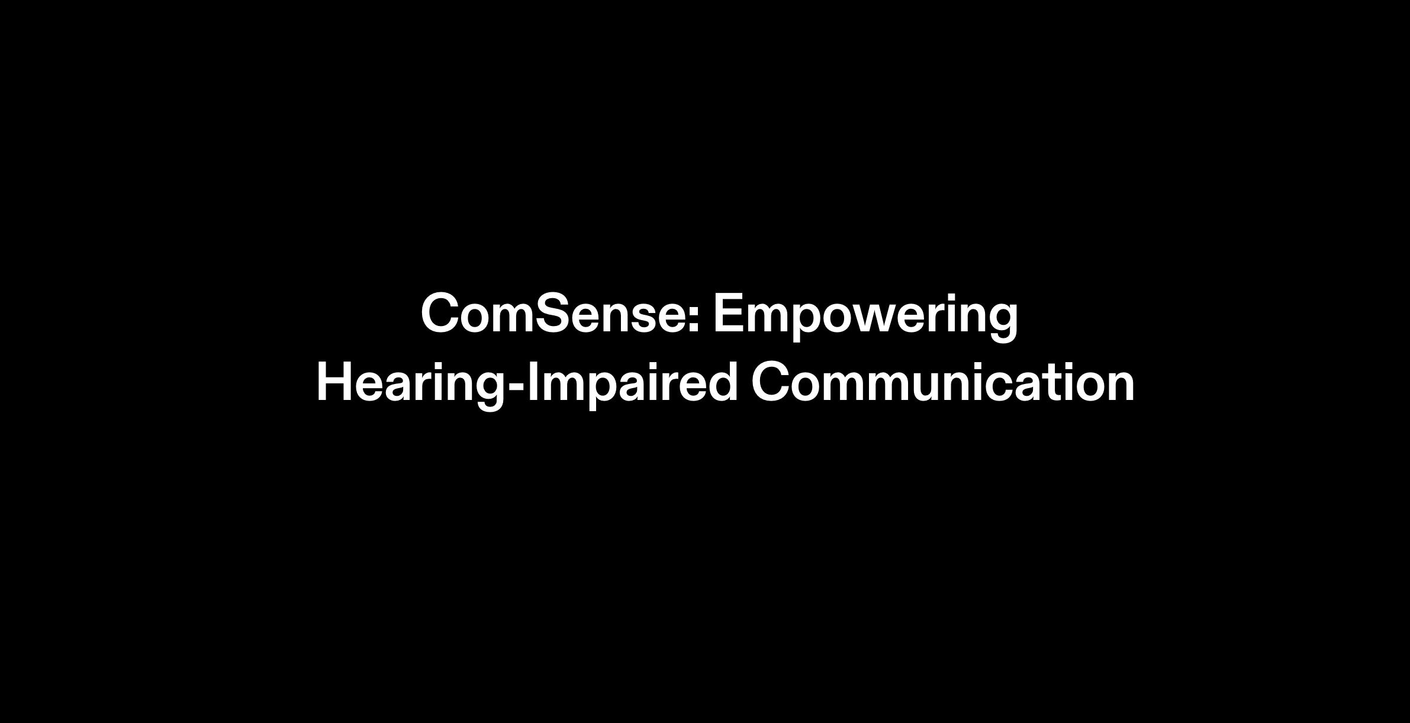
Notes:
Hi guys, it's good to be back with exciting updates on ComSense, our venture in helping the hearing-impaired community.

Slide 2
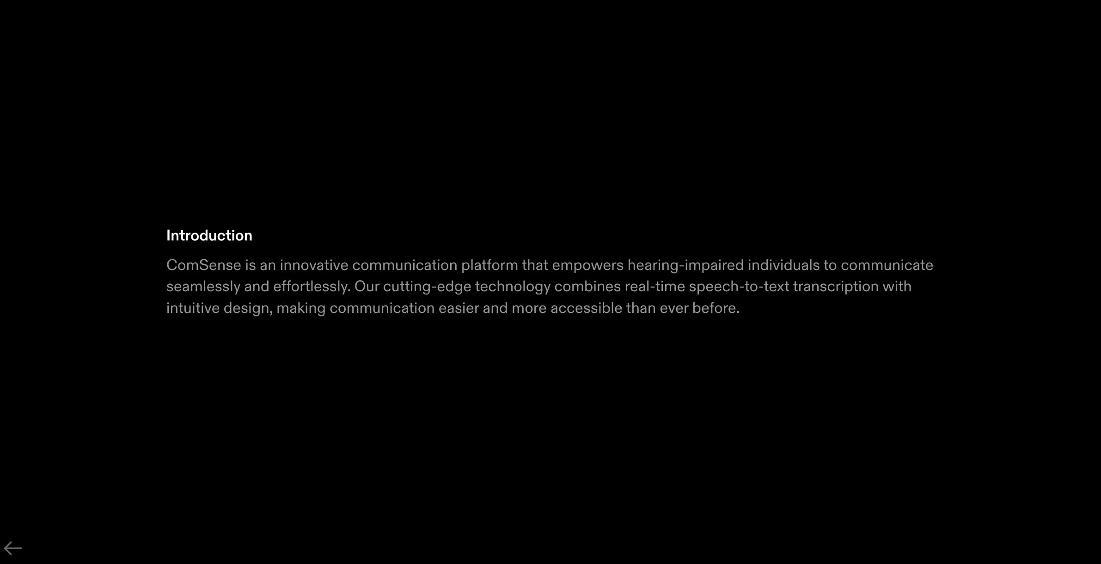

Slide 3
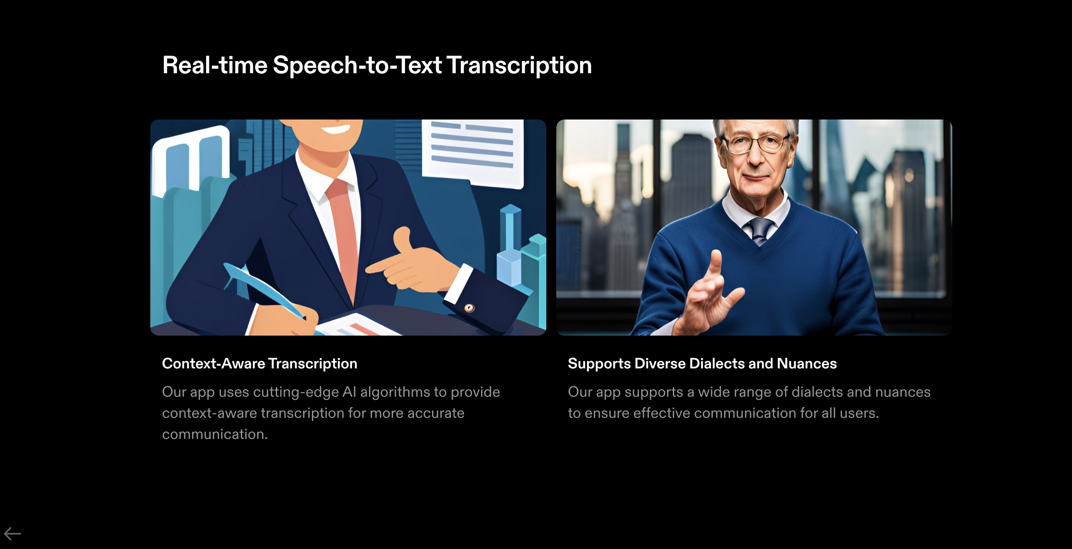
Notes:
That's right! Plus, we had implemented a Real-time Speech-to-Text Transcription feature. Users could just speak, and their words would seamlessly transform into text, opening doors to a world of communication.

Slide 4

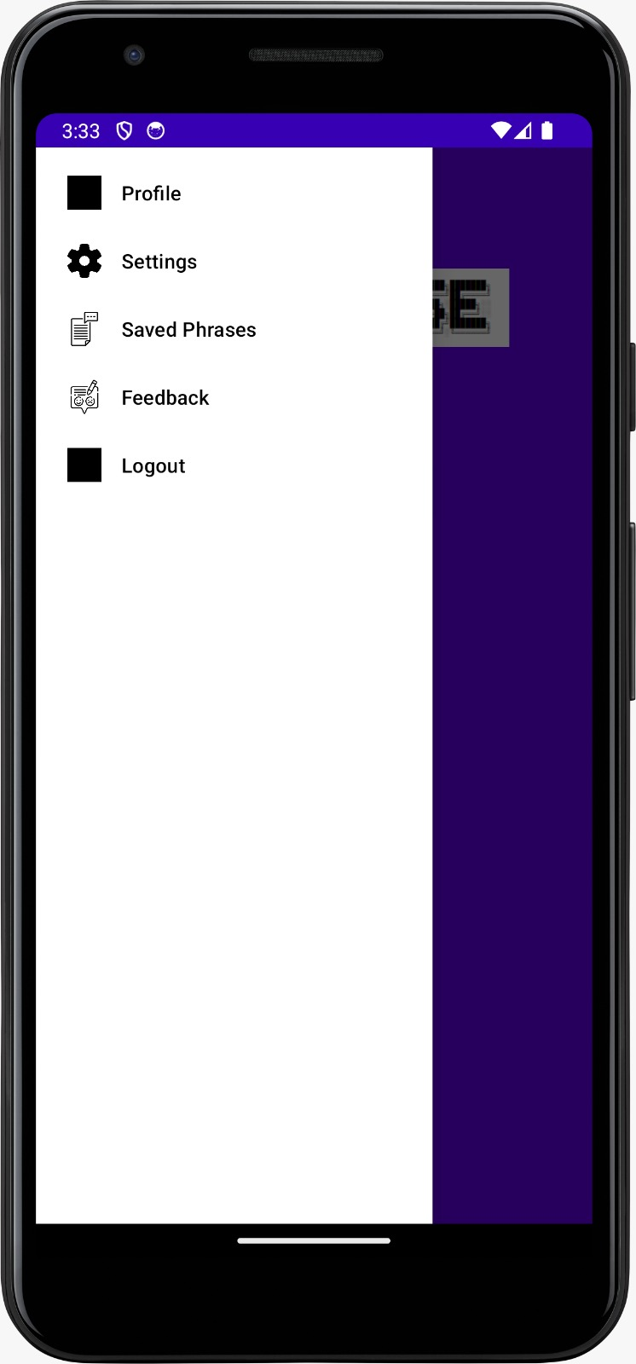

Slide 5
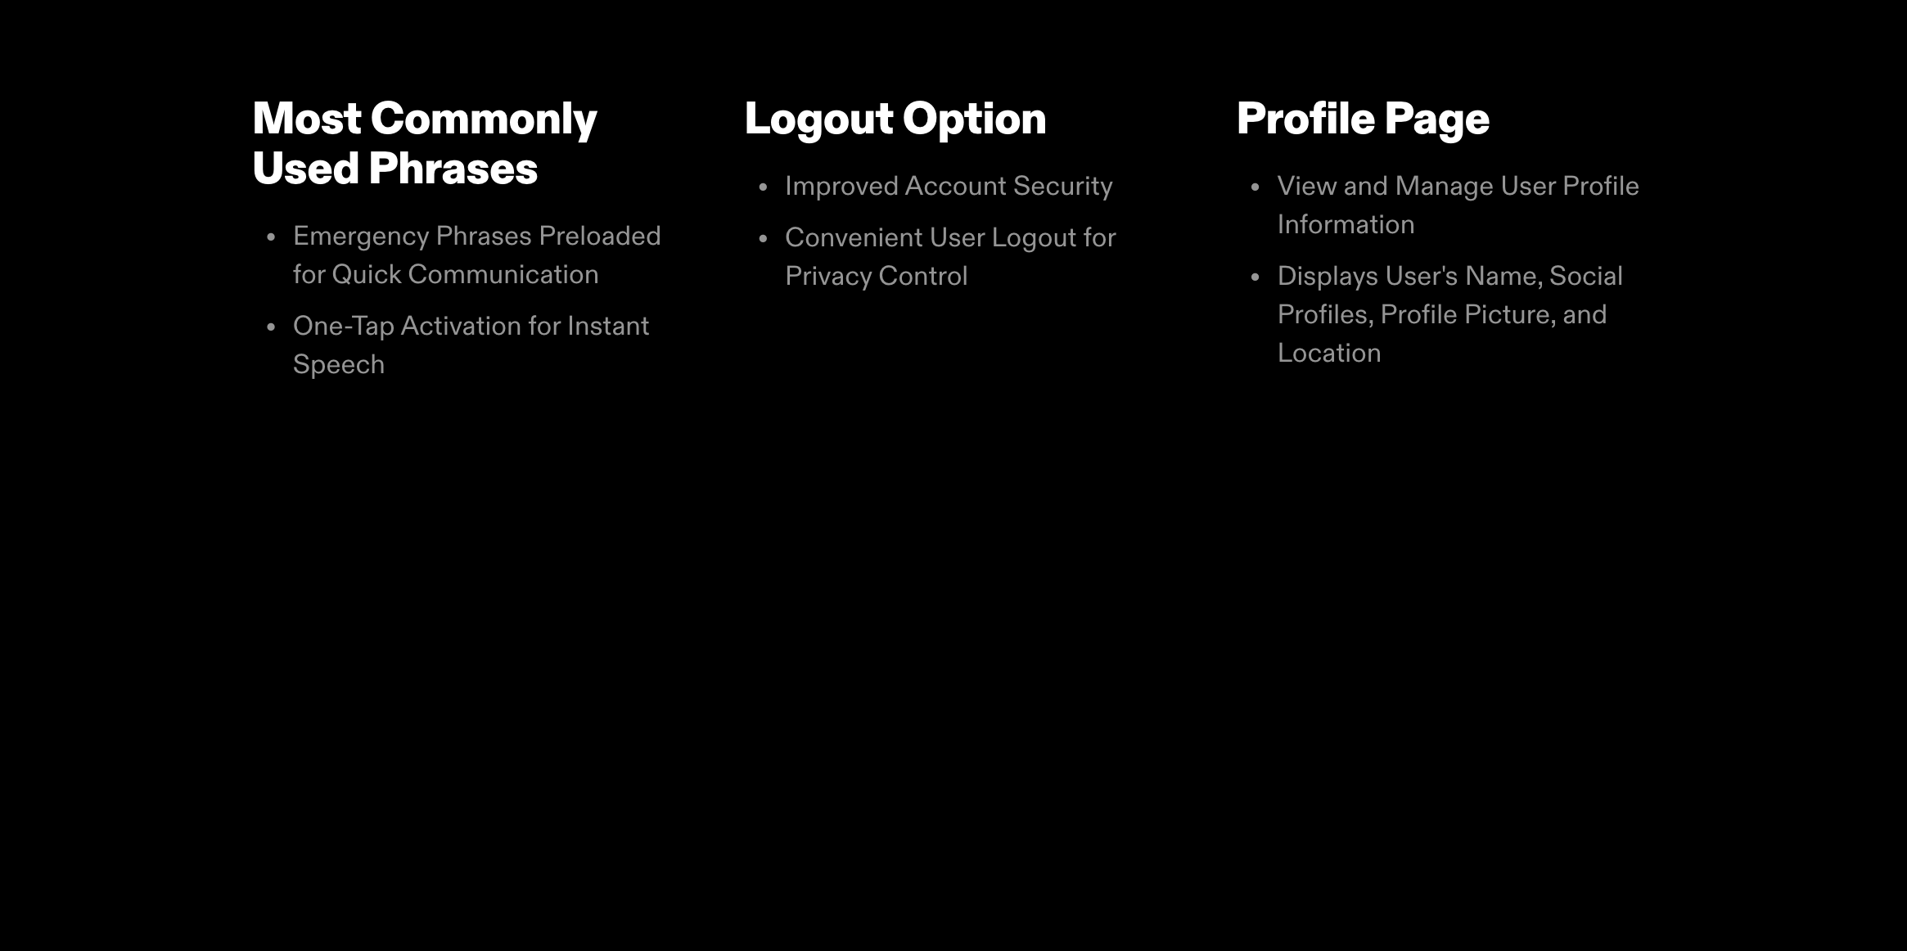
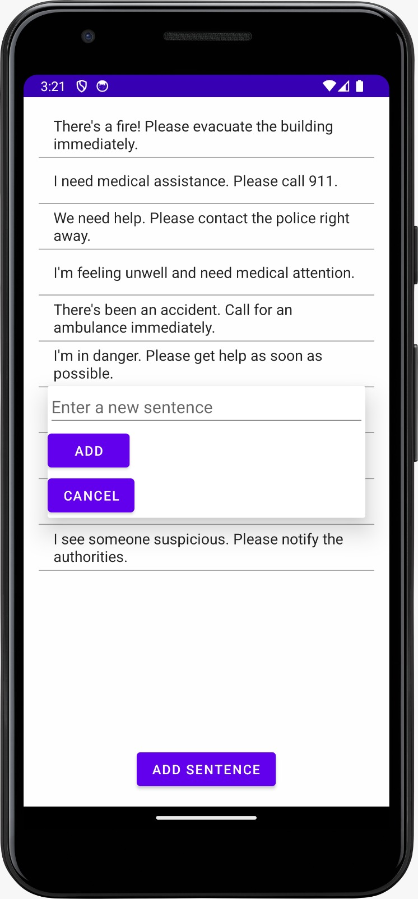
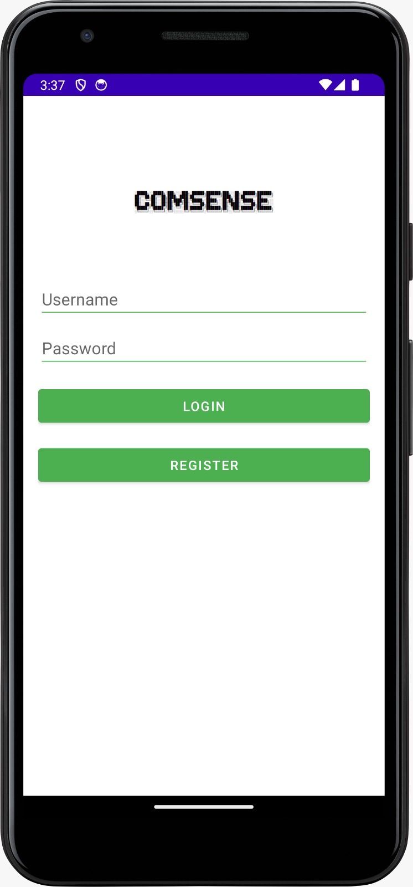
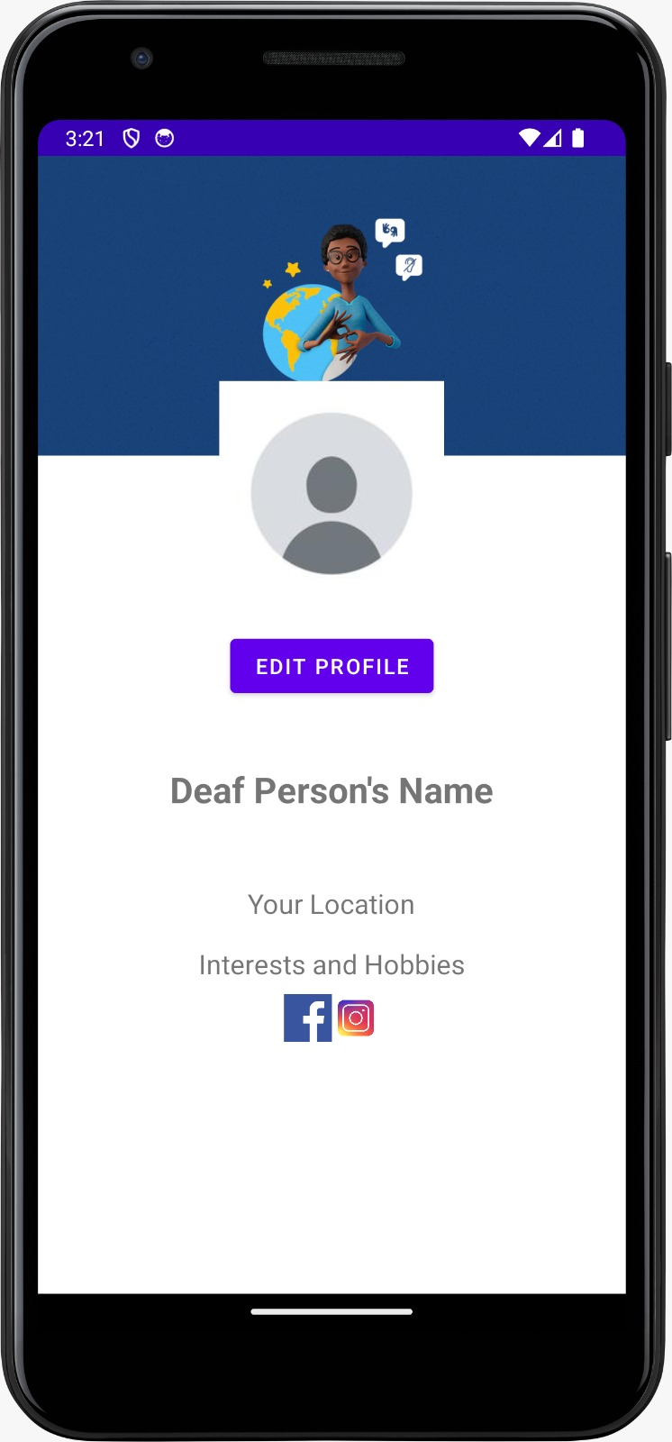
Notes:
Indeed! And within this menu, we've integrated a feature that speaks out Most Commonly Used Phrases. Imagine emergency situations where a hearing-impaired person can convey vital messages just by tapping a button.

Slide 6
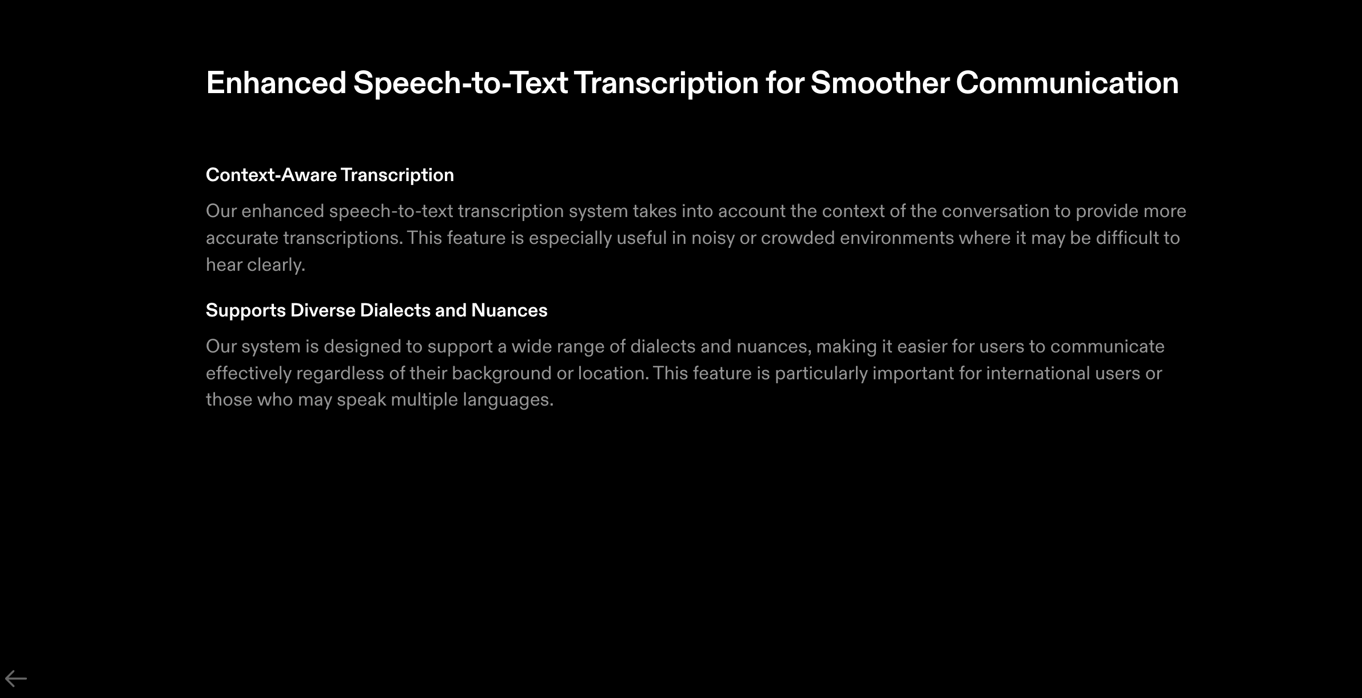
Notes:
Lastly, like we mentioned, our Speech-to-Text Transcription has been enhanced. Now, it's not just accurate; it’s intelligent. It understands context, dialects, and nuances, making communication even smoother.

Slide 7


