Slide 1

DocExplore
`
A new interface to consume text
See gramener.com/docexplore/

Slide 2
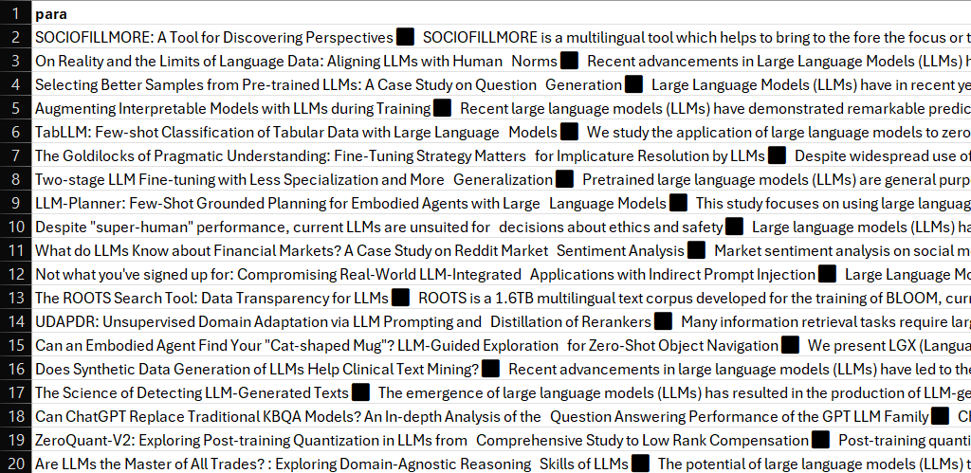
DocExplore needs a list of strings
Feedback, emails, abstracts…
If it’s long, chunk it.

Slide 3
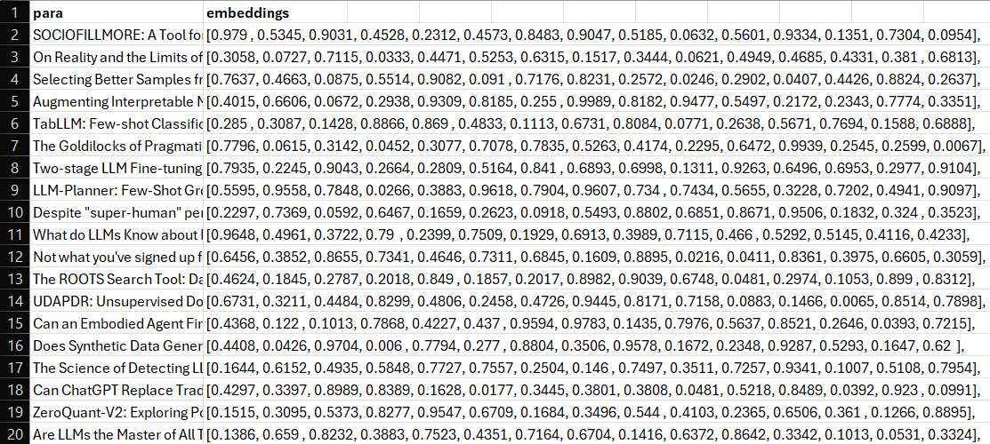
It converts each string into a list of numbers called vector embeddings
Models like e5, bge, text-embedding-3, etc. do this well.
It’s cheap at ~10c / 1M words.

Slide 4
These numbers are grouped using a clustering algorithm
K-Means clustering works fine.
Pick 25 clusters by default.

Slide 5
We ask an LLM to name each cluster by sending it a few examples in each cluster
Use GPT-4, Mistral, Gemini, …
3-5 sample strings are enough
Text generation
evaluation
LLM Programming
LLM Integration
Hallucination
Ethical LLM
Prompt injection
Cross-lingual
Enhancement

Slide 6
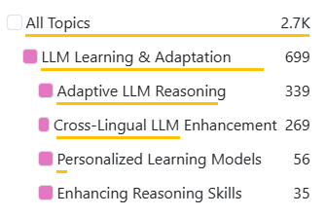
… and group the clusters into higher-level topics
Use GPT-4, Mistral, Gemini, …
Group clusters into 3-6 topics
This gives us topic frequency
LLM Performance
LLM Applications
Text generation
evaluation
LLM Programming
LLM Integration
Hallucination
Ethical LLM
Prompt injection
Cross-lingual
Enhancement
LLM Safety
LLM Learning

Slide 7
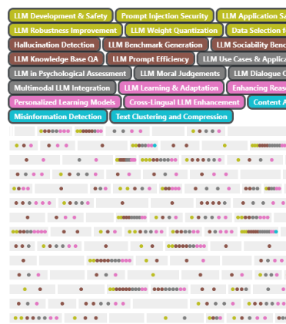
Does the string really belong to the topic? We calculate a similarity score
We use cosine similarity
Use cutoff similarity (e.g., 80%)
Show which strings have which topics
LLM Performance
LLM Applications
Text generation
evaluation
LLM Programming
LLM Integration
Hallucination
Ethical LLM
Prompt injection
Cross-lingual
Enhancement
LLM Safety
LLM Learning

Slide 8
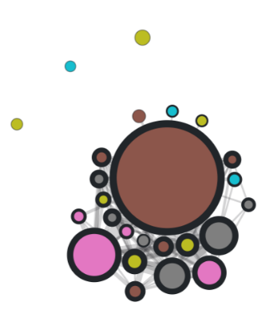
We count how many strings 2 topics have in common to create a topic network
Same string having 2 topics indicates a connection
Similarity cutoff is adjustable
This builds a knowledge graph
LLM Performance
LLM Applications
Many common strings
Many common strings
Few common strings
Few common strings
LLM Safety
LLM Learning

Slide 9
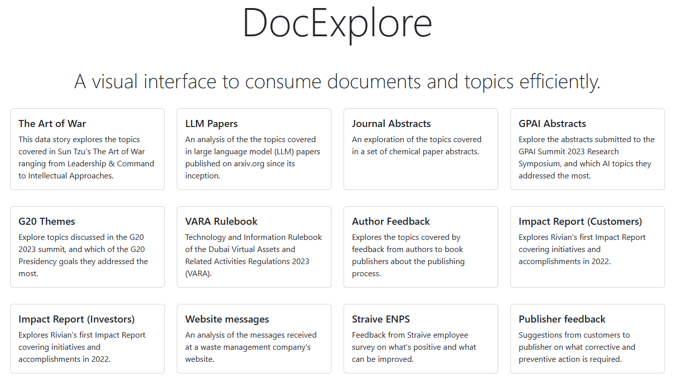
This lets is automate the process of exploring documents in a visually way

