Slide 1
IMPROVING THE CUSTOMER SATISFACTION OF AIRLINES IN THE USA
IST 687: Introduction to data science
PROJECT BY:
AMBARISH PATANKAR

Slide 2
Overview
Introduction
Data Summary
Business Questions
Visualizations
Modeling techniques
Map Visualizations
Actionable Insights & Recommendations
References

Slide 3
Introduction
The United States of America is a huge country, and most people take flights to travel between states. Although driving from one state to another is feasible, people usually look to save time and take flights. Hence, many airlines go head-to-head in order to gain more customers and are always looking out to improve their products and services like loyalty, reliability, ease of use, etc. Southeast Airlines can be the top dogs in the market by improving the experience of their customers and by reducing customer churn.
In order to get an idea of experience of the customers, the loyalty program was introduced. However, the loyalty program did not work, as it was not enough in keeping low customer churn. In this project, I will extract attributes which are of use to me and generate models in order to generate insights and provide recommendations to the airlines.

Slide 4
Data Summary
The data consisted of 10282 different observations of 32 variables
While surveying the customers, some customers might not have filled the survey. Completed as it consisted of a lot of missing values
I have deleted all of the missing values in the data for my analysis
The loyalty program was introduced, in order to find out about the customer experience
The program did not work, as it was not enough in keeping low customer churn
The ‘Likelihood to Recommend’ variable is the most important variable in the data, I have based most of my analysis on it
This value ranges from 0 to 10, if score is less than 6, then the customer is a detractor, if the score is 7 or 8, then the customer is passive and if the score is 9 or 10, then the customer is a promoter
For my analysis, I have considered the following variables for generating insights: age, gender, airline status, total frequent flyer accounts, price sensitivity, likelihood to recommend, loyalty, shopping at the airport, dining at the airport and type of travel

Slide 5
Business Questions
I have addressed the following business questions:
Which airlines have the lowest and highest levels of customer satisfaction?
Why I chose FlyFast Airways Inc. and Northwest Business Airlines Inc. for my analysis?
How old are people who have been taking the flights?
How is age affecting the likelihood of a customer recommending a specific airline to another customer?
Which age group is likely to recommend an airline?
Are males recommending the airlines more or are females?
How is price sensitivity affecting the satisfaction of a customer?
Is customer satisfaction affected by the type of travel of the customers?
Are customers with a certain airline status more likely to recommend an airline?
Are loyal customers most likely to recommend an airline?

Slide 6
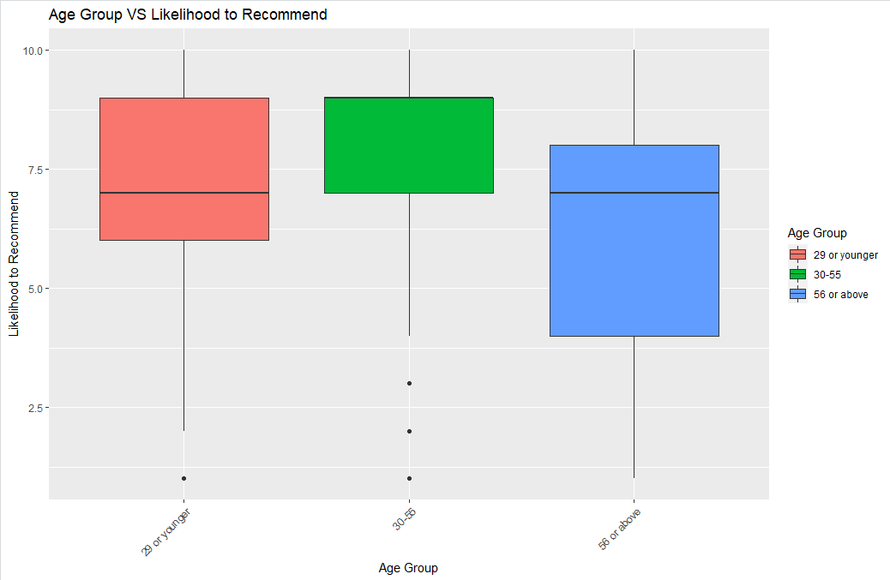
Visualizations
i) Age
For my analysis, I have divided the age groups into 3 groups: a) 29 or younger, b) 30-55, c) 56 or above
The most satisfied age group is the second group
The least satisfied group is the last age group, which mainly consists of senior citizens
The first age group has a range of scores, which consists of both detractors and promoters
The median of the first and third seem to be passives

Slide 7
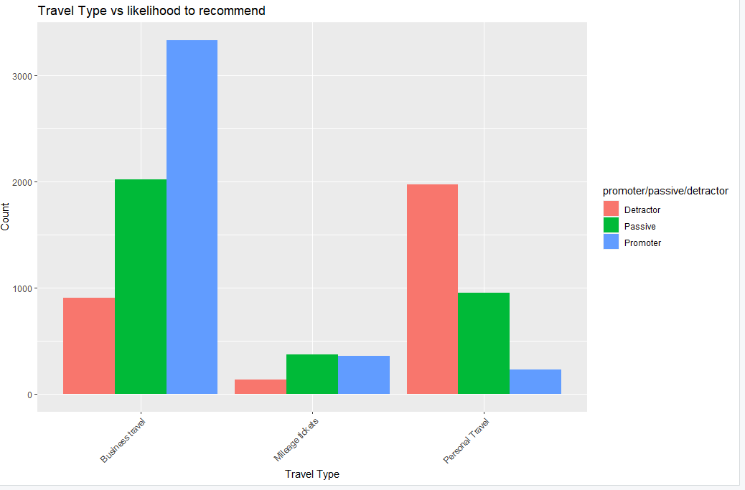
Visualizations
ii) Type of travel
‘Mileage tickets’ customers are much less as compared to the ‘Business travel’ and ‘Personal travel’ customers
‘Business travel’ has more promoters as compared to detractors and passives
‘Mileage tickets’ has almost equal number of passives and promoters
‘Personal travel’ has a lot of detractors as compared to passives and promoters
‘Personal travel’ has the least number of promoters, which indicates that the customers travelling for personal reasons are not satisfied

Slide 8
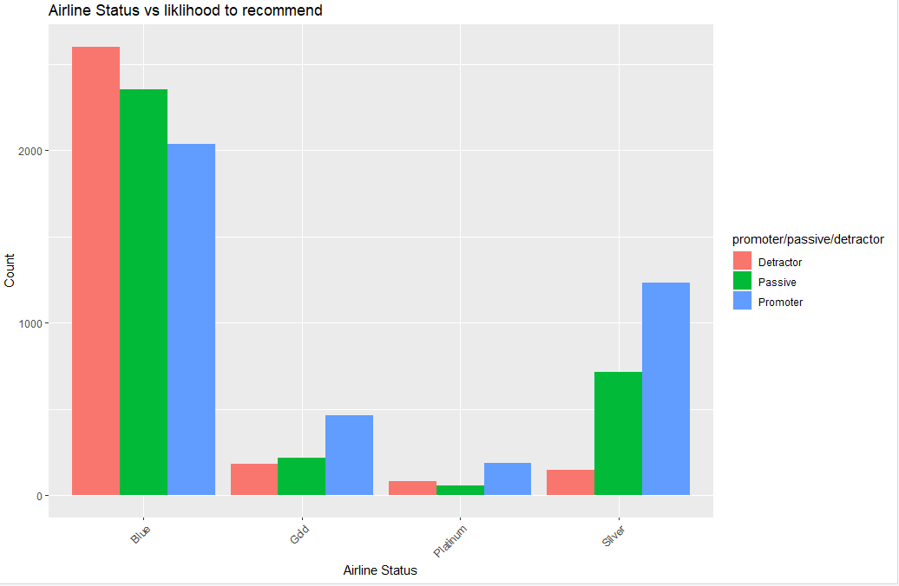
Visualizations
iii) Airline status
Types: Blue, Gold, Platinum and Silver
Blue has the maximum number of customers
Platinum has the least number of customers
Blue has the maximum number of detractors, followed by passives
Gold, Platinum and Silver have more promoters as compared to detractors
Silver has considerable amount of promoters as compared to detractors
Most of the customers in Blue are not satisfied and as a result are not promoting an airline

Slide 9
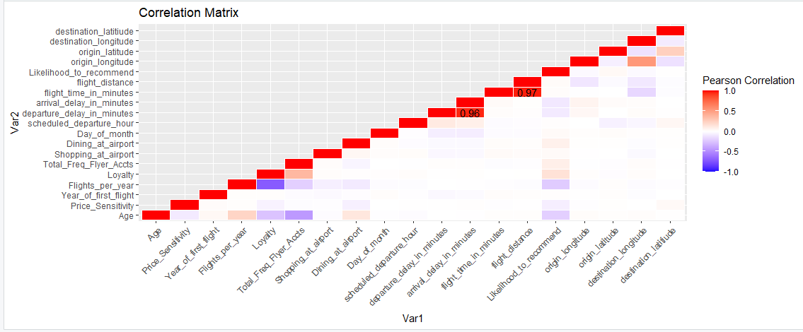
Modeling techniques
i) Linear Modeling
Correlation matrix tells us which variables have the strongest correlation and are considered for linear modeling
Flight distance and Flight time in minutes have the strongest correlation (0.97)
Arrival delay in minutes and departure delay in minutes have the second strongest correlation (0.96)
Chose the independent variables after analyzing the diagram.

Slide 10
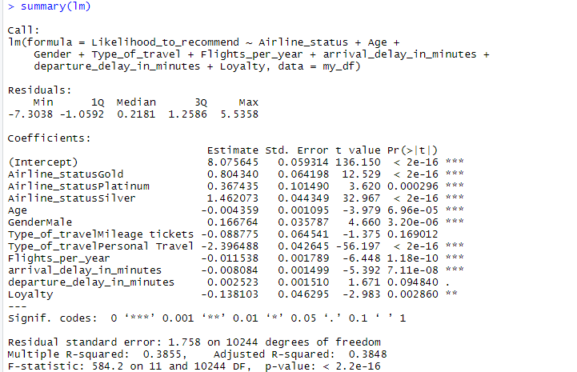
Modeling techniques
i) Linear modeling (contd.)
The multiple r-squared value is 0.38555 and adjusted r-squared value is 0.3848
Likelihood to recommend variable accounts for about 38% of the variability
P-value is less than 0.05, which means the equation is significant
Variables with 3 asterisks represent a highly significant p-value, which means the variable plays an important role in the recommendation
As the adjusted r-squared value is not high, linear modeling wouldn’t be the best model for prediction

Slide 11
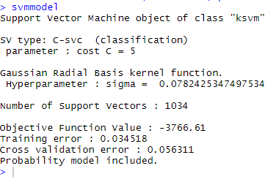
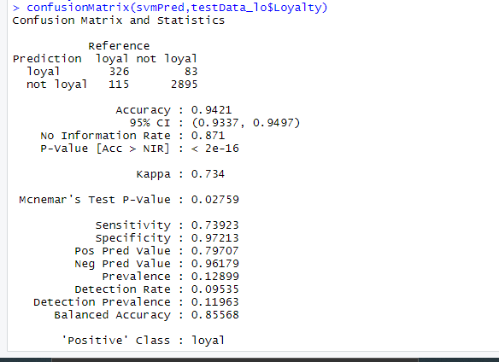
Modeling techniques
ii) Support Vector Machine (for loyalty)
Accuracy of the model is 0.9421 or 94.21%, which means that the prediction model is reliable
The sensitivity and specificity are also high, which means that the model is surely reliable
Southeast Airlines could use the model to predict the loyalty of a customer
If the company gets some additional data from the customer, we can predict the customers behavior based on a customized scheme
Confusion matrix shows that 2895 customers are not loyal

Slide 12
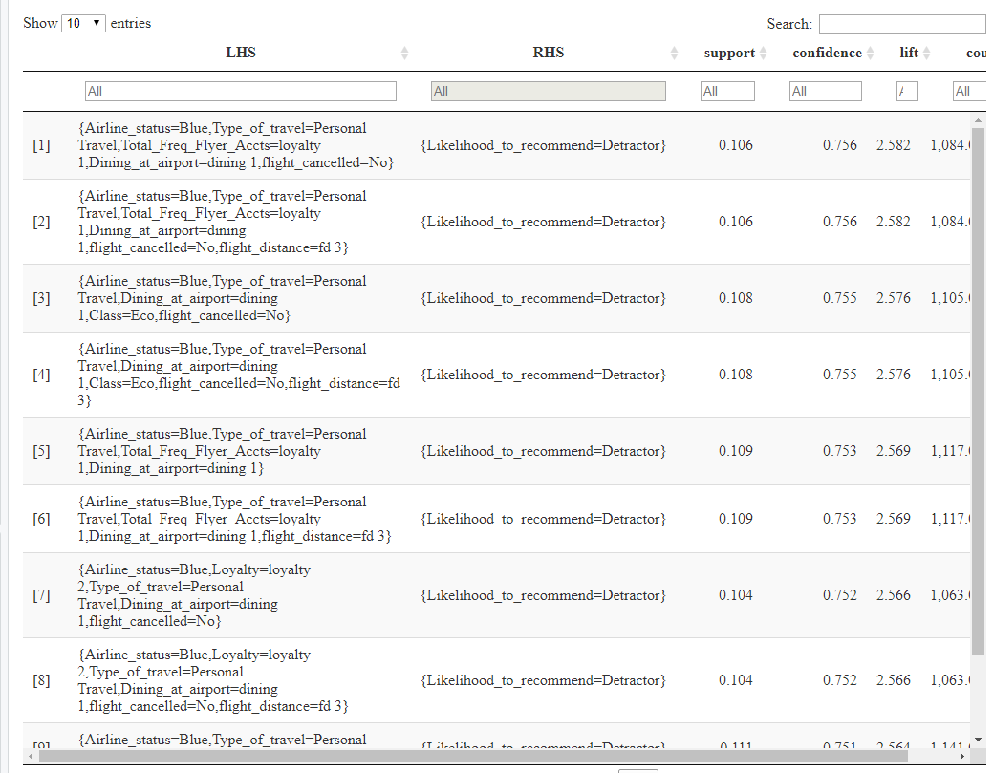
Modeling techniques
iii) Association Rules Mining
a) Detractors
Visualization for Detractors
Customers having a Blue airline flyer status, who are personal travelers and aren’t frequent flyer are detractors
Customers who dine rarely at the airport or do not dine at all, are not satisfied
The airlines need to improve the customer experience for ‘Blue’ passengers, as most of them are detractors

Slide 13
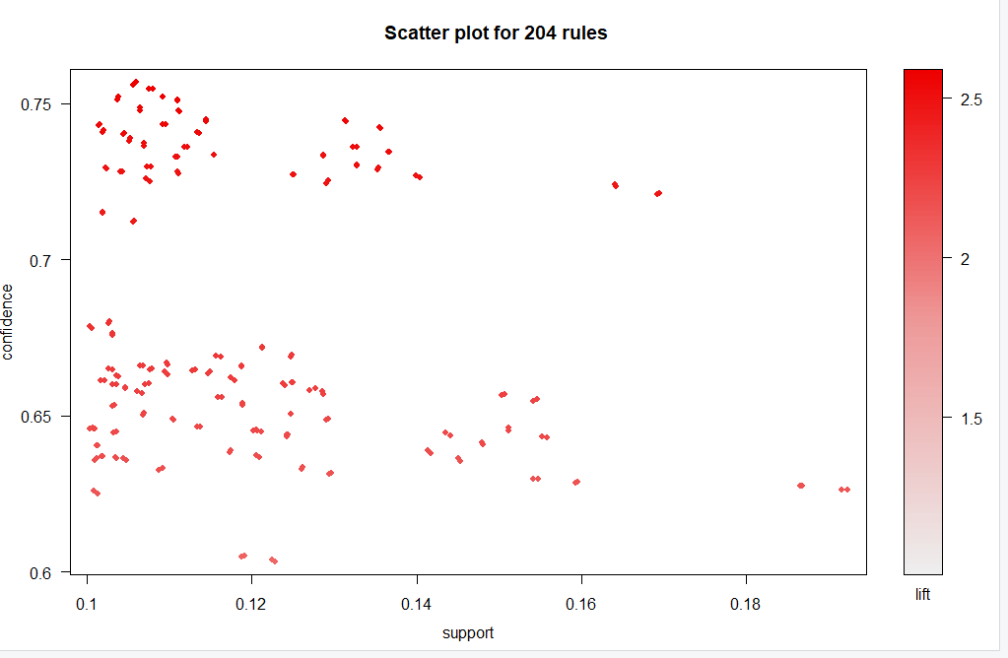
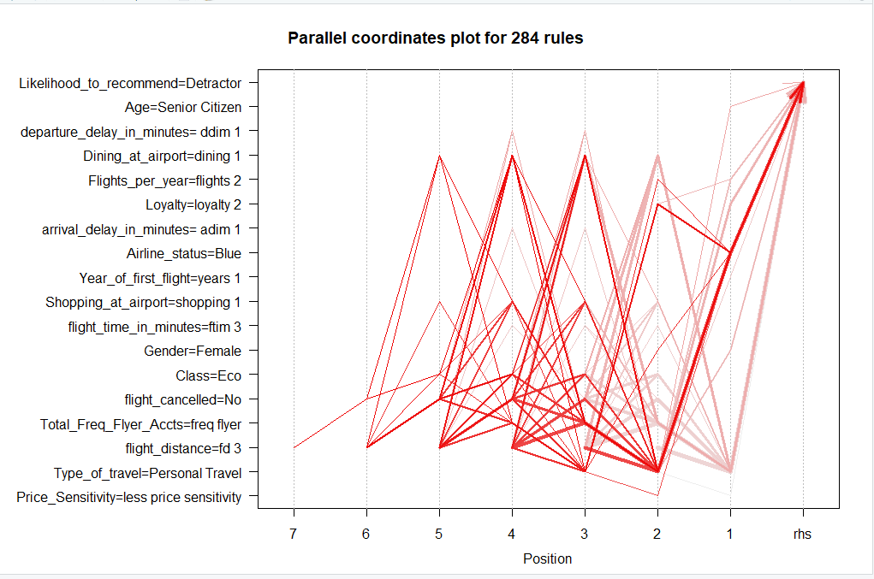
Modeling techniques
iii) Association Rules Mining (contd)
Scatter plot and parallel coordinates for Detractors

Slide 14
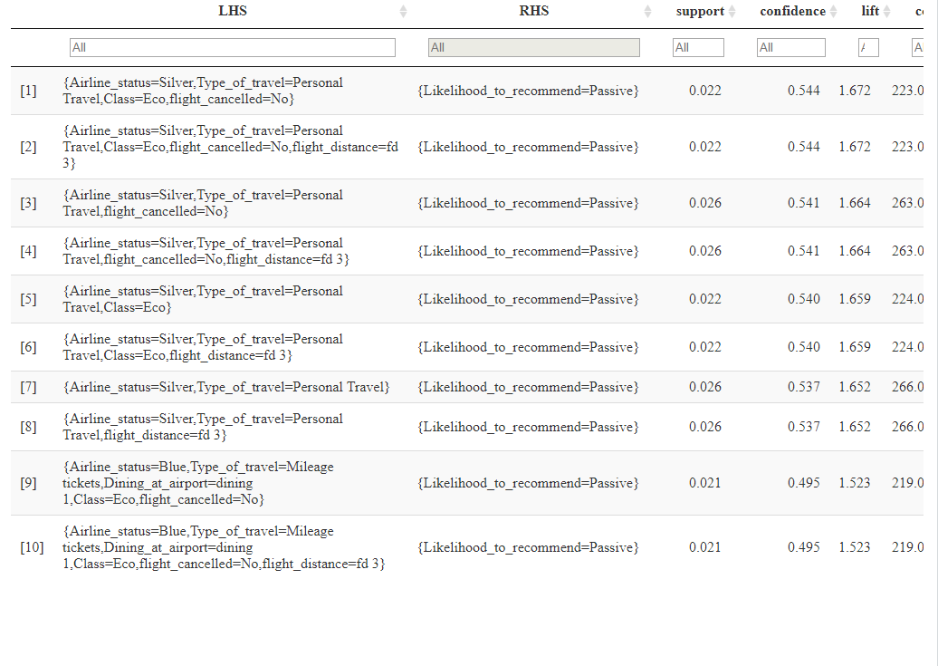
Modeling techniques
iii) Association Rules Mining (contd)
b) Passives
Customers having Silver airline flyer status and travelling for personal reasons are passives
Most of the customers fly economy class, travelling a long distance and rarely dining at the airport
Travelling for long time and rarely dining at the airports are the reasons that they are not promoting the airlines

Slide 15
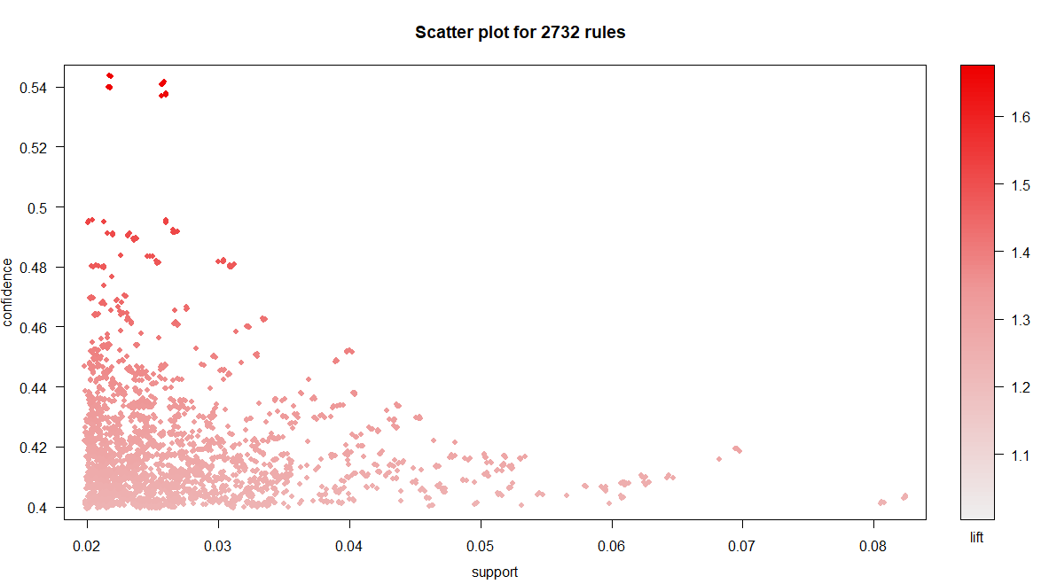
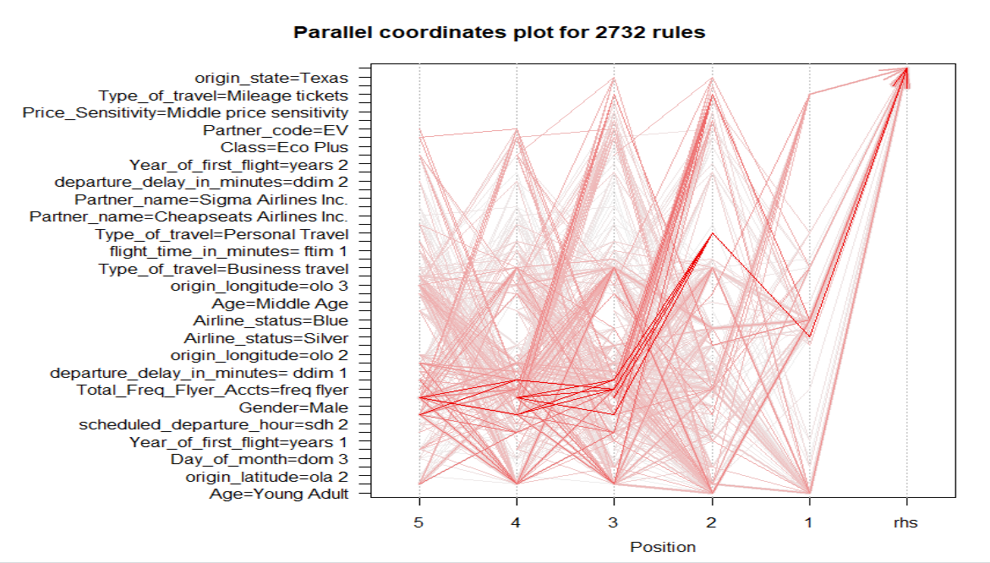
Modeling techniques
iii) Association Rules Mining (contd)
Scatter plot and parallel coordinates for Passives

Slide 16
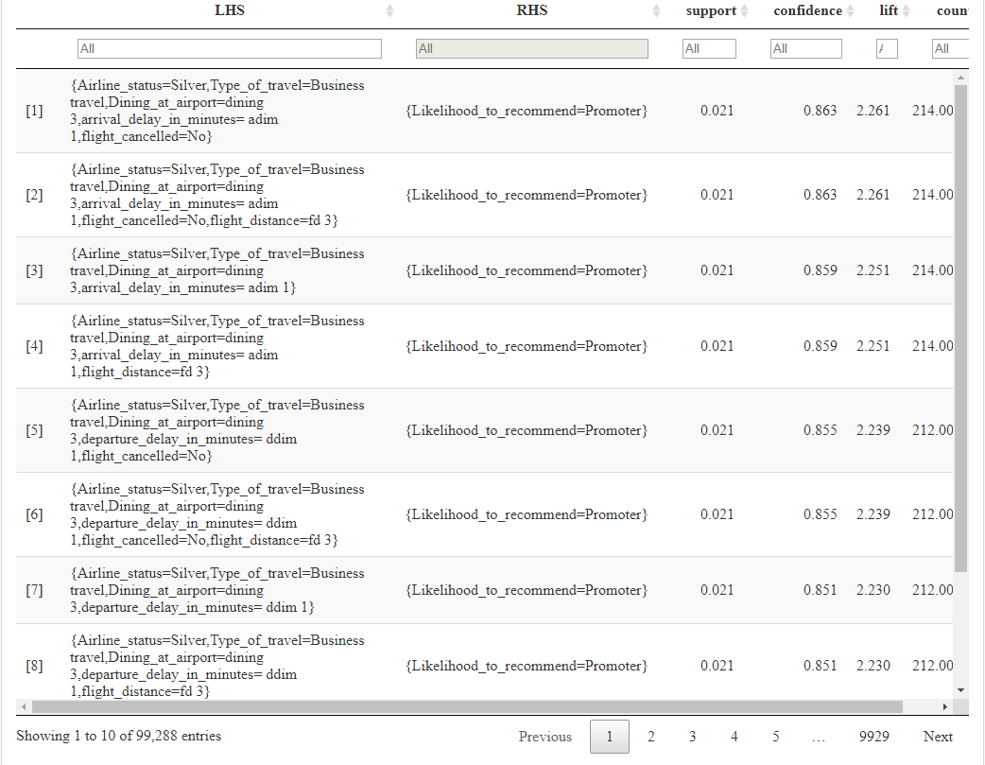
Modeling techniques
iii) Association Rules Mining (contd)
c) Promoters
Customers having a Silver airline flyer status, travelling for business reasons and dine at the airport a lot are the promoters
Promoters have very less flight arrival delay, which is one of the reasons they are satisfied
There is also no delay in the departure of the flights, which us another positive
Most of the Silver airline flyer status customers seem to be satisfied

Slide 17
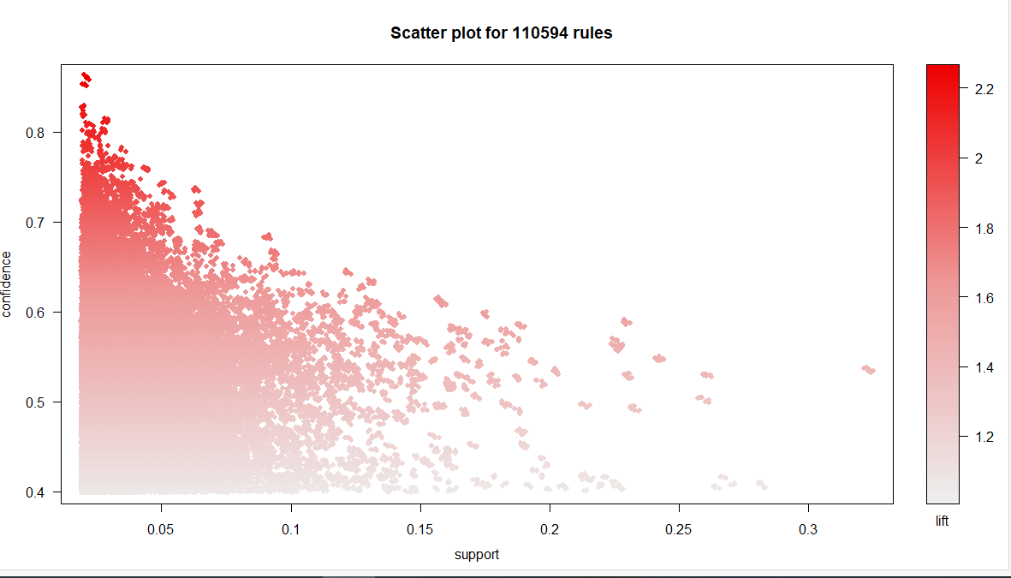
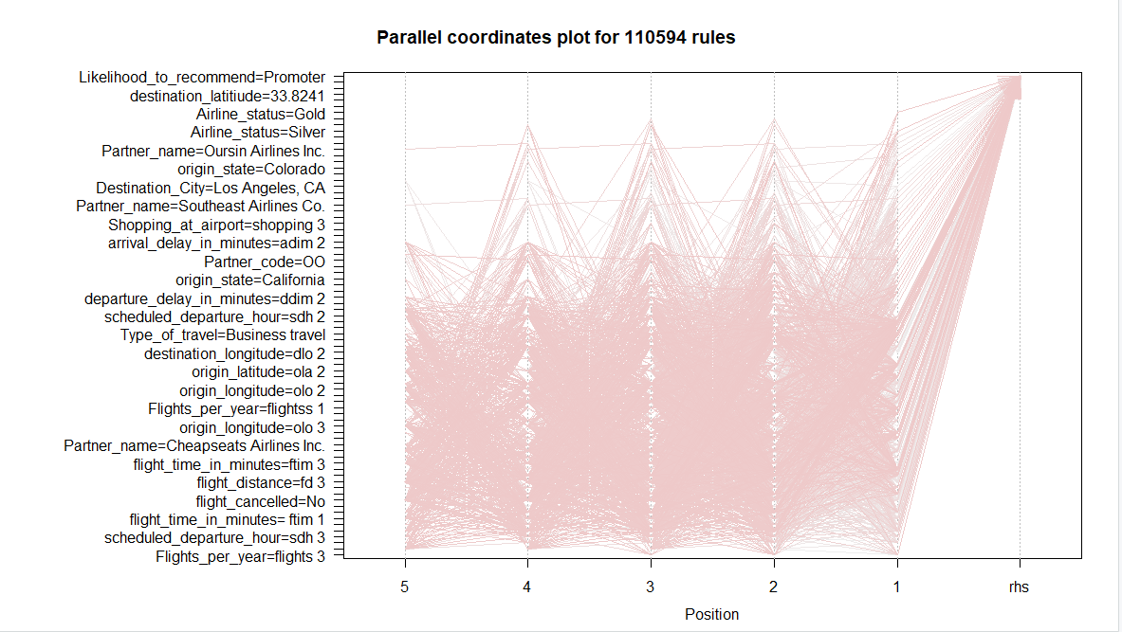
Modeling techniques
iii) Association Rules Mining (contd)
Scatter plot and parallel coordinates for Promoters

Slide 18
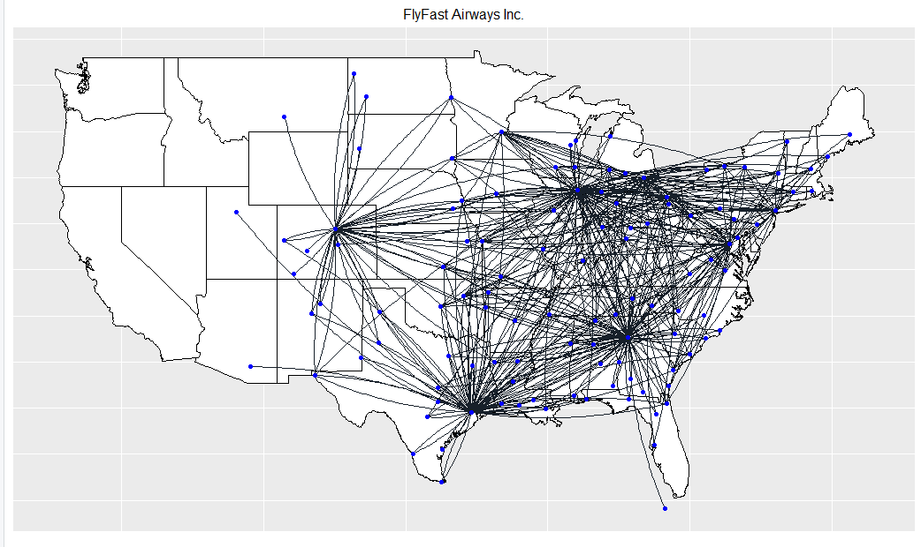
Map Visualizations
FlyFast Airways Inc. (Low Customer Satisfaction)

Slide 19
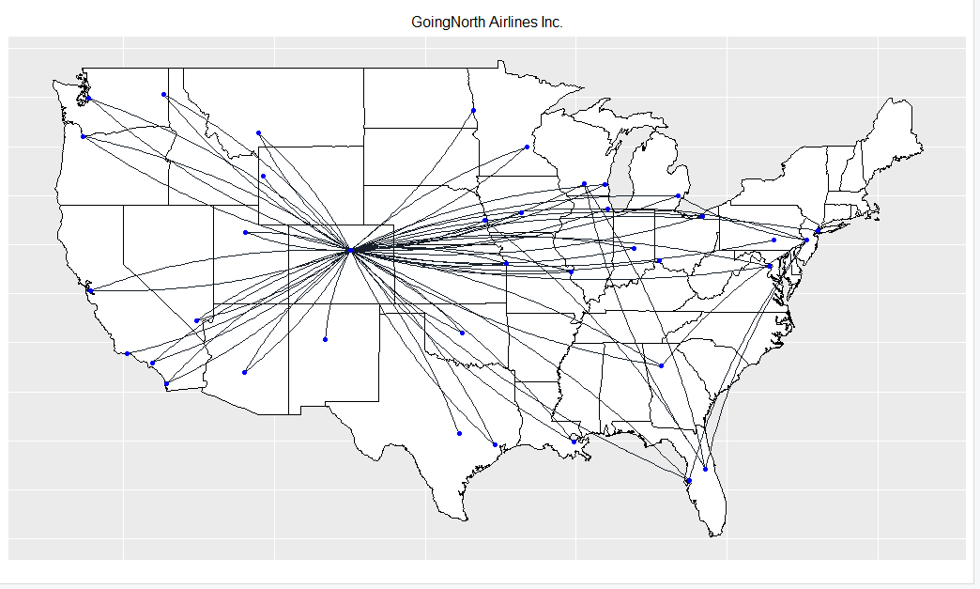
Map Visualizations
GoingNorth Airlines Inc. (Low Customer Satisfaction)

Slide 20
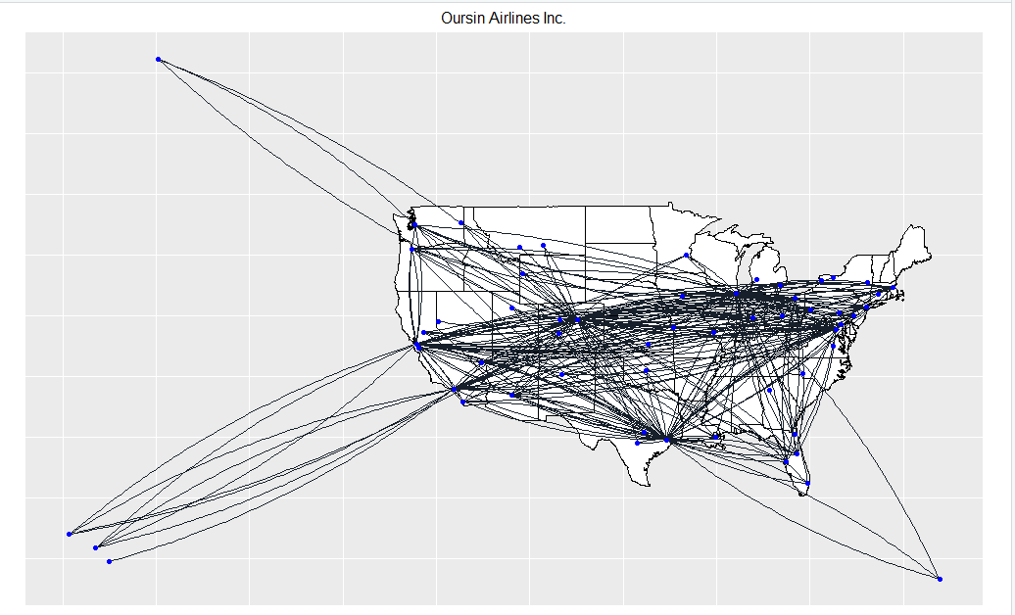
Map Visualizations
Oursin Airlines Inc. (Low Customer Satisfaction)

Slide 21
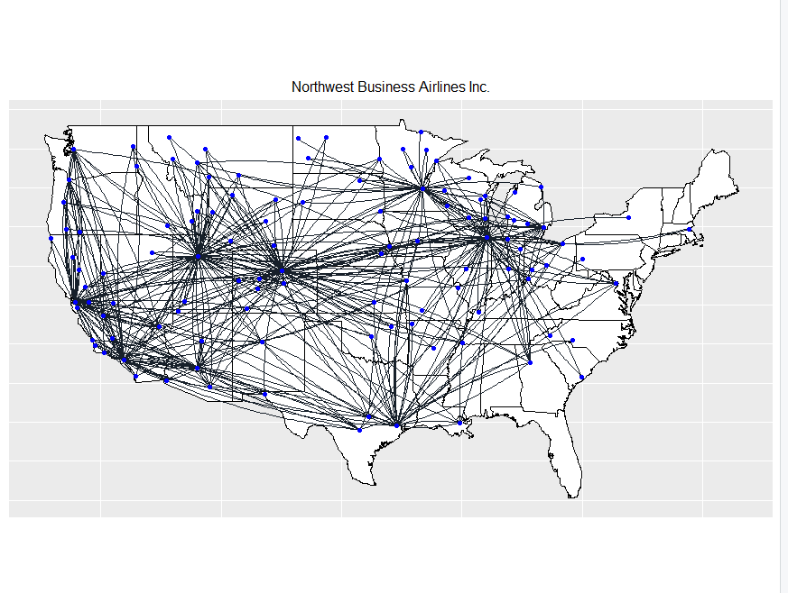
Map Visualizations
Northwest Business Airlines Inc. (High Customer Satisfaction)

Slide 22
Actionable Insights & Recommendations
Age
Customers above the age of 55 are Detractors
Senior citizens can be helped with navigation at the airport, in order to find their flights on time
Provide express lines to fatigued customers, so that they can go through the check point process without waiting in long queues
Provide better in-air entertainment, like movies which the senior citizens can enjoy
If the customer is in good mood, he/she is likely to recommend the airline
ii) Frequent Flyer Accounts
Most customers don’t have a frequent flyer account, which means that customers are changing airlines quite often while travelling
For Northwest Business Airlines Inc., customers with low frequent flyer account are detractors
Suggest the customers to create an account on the website, while booking their flights
For example, for a customer’s first flight with an airline, the customer can be provided with a free meal on the airplane, but the customers can only register for a free meal if they create an account and register for it online

Slide 23
Actionable Insights & Recommendations
ii) Frequent Flyer Accounts(contd.)
Customers can be provided with promotional codes, by sending them these codes via e-mail.
Give miles to the customers on their personal accounts, whenever they complete a flight
Customers can be rewarded with points, if they refer the airline to a friend, who creates an account too
iii) Shopping and Dining at the airport
Customers who dine very less or don’t dine at all at the airport are Detractors
Number of customers dining at the airport is more than the people shopping
Promote the airport as a shopping destination, example: Dubai International Airport
Shopping can be improved by providing discounts to customers who have frequent flyer accounts
Duty-free shopping center can also offer sales at their stores, in order to attract customers
Dining options can be improved by providing lounge access to customers

Slide 24
References
Saltz, J. S., & Stanton, J. M. (2018). An introduction to data science.
Skift (2014). The Biggest Issues Faced by Elderly Travelers at American Airports. Retrieved from https://skift.com/2014/04/16/the-biggest-issues-faced-by-elderly-travelers-at-american-airports/
Faraway, J. J. (2005). Extending the Linear Model with R: Generalized Linear, Mixed Effects and Nonparametric Regression Models. United Kingdom: CRC Press.
O’Donnell (2003). How Frequent Flyer Programs Work. Retrieved from https://adventure.howstuffworks.com/destinations/travel-guide/tips/ff-programs.htm
5. n.a. (2020). What is Net Promoter Score? Retrieved from https://www.qualtrics.com/experience- management/customer/net-promoter-score/

Slide 25
Thank you!

