Slide 1

GitHub Copilot Hackathon
Team Name- Ambarish Ganguly
Team Leader Name- Ambarish Ganguly
Team Leader Email Address-Ambarish.ganguly@gmail.com

Slide 2

Brief Summary of Project:
Theme 1: Weather Forecasting Tool (Python)
Create a command-line tool that accepts a city's name and returns the current weather forecast. Leverage OpenWeatherMap API to fetch weather data and parse it using Python. Your solution should demonstrate how GitHub Copilot can help you with API usage, data parsing, and error handling.

Slide 3
Business Challenge /Use Cases
Weather Forecasting Tool (Python)
Weather Forecasting as a SERVICE can be used effectively for various applications in
Energy
Utilities
Agriculture
Cross Industry

Slide 4
Proposed Solution
The API would be written in Python
The API would be exposed through FastAPI
The API key would be stored in KeyVault
The API would be deployed as a Azure ContainerApp

Slide 5
Technology/Tool Stack Used:
The API would be written in Python
The API would be exposed through FastAPI
The API key would be stored in KeyVault
The API would be deployed as a Azure ContainerApp

Slide 6
Mention of usage of Github Copilot
All code will be written using GitHub Copilot
We have done the 1st step and written the code of the API using GitHub Copilot

Slide 7
Source code in zip file / Github link :
https://github.com/ambarishg/github_hack

Slide 8
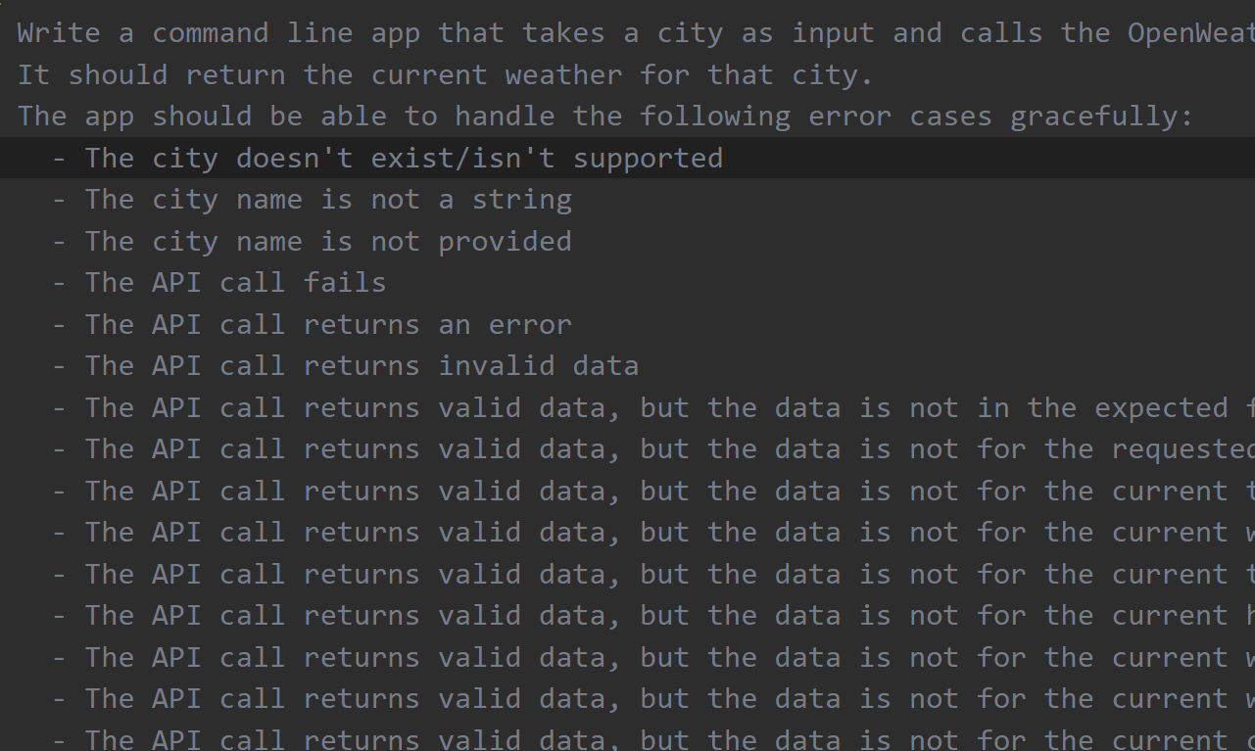
Execution Demo(Video/Screenshots) showing usage of the GitHub Copilot Platform :

Slide 9
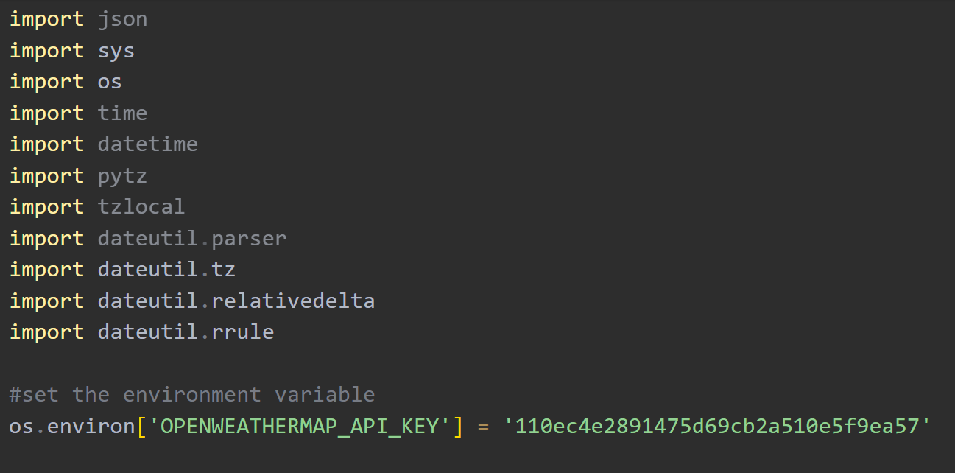

Slide 10
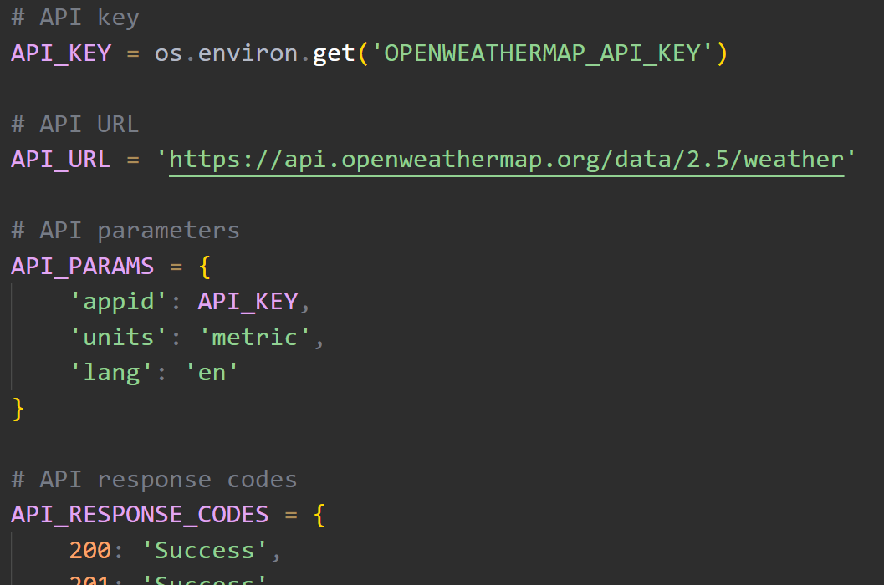

Slide 11
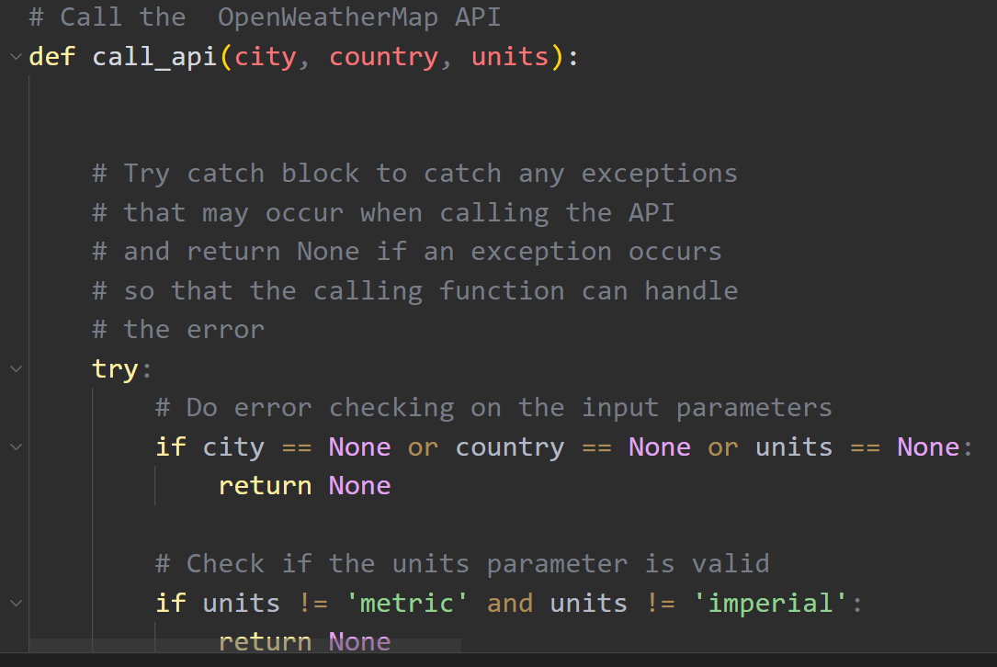

Slide 12
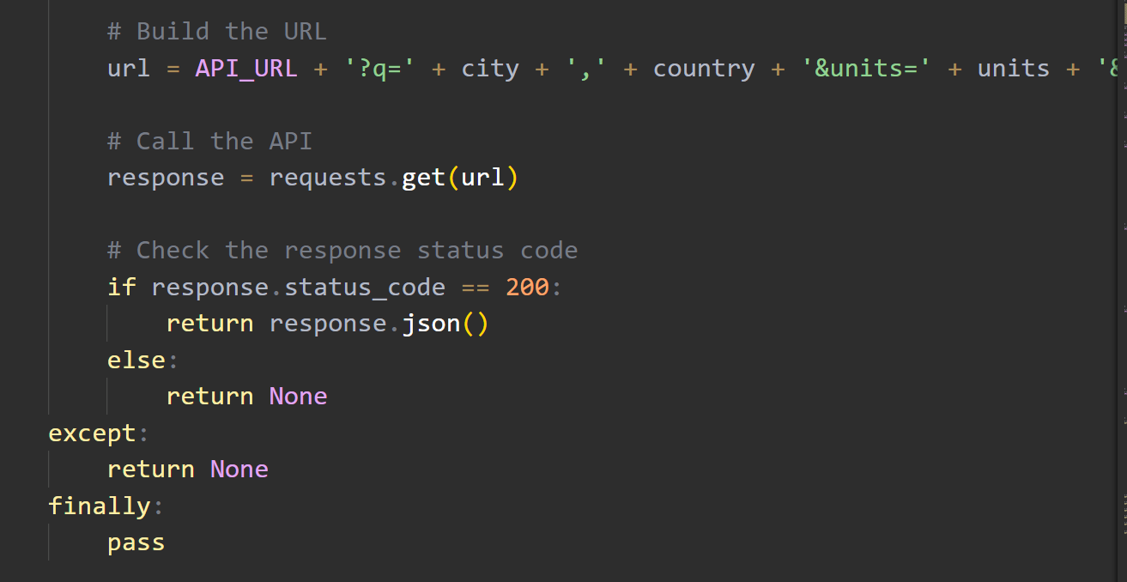

Slide 13
THANK YOU

