Slide 1


PLEDGE TO PROGRESS Sustainability Hackathon
Sponsored By
Student Mentor – AI Powered Platform
Your Team Name : Ambarish Ganguly
Your team bio : Microsoft Valuable Professional [ AI Category ]
Microsoft Certified Trainer
Date : 22nd April 2023

Slide 2
Problem Statement
Student Mentor is an AI-powered platform designed to assist students in various aspects of their academic and professional lives. With features like medical, literature, and career question answering, summary generation, and chat facilities, Student Mentor provides comprehensive support for students seeking guidance and assistance
It has 3 components:
Medical Question and Answering : Helps to answer questions on common medical issues faced by the students
Literature Question and Answering : Helps to answer questions on Classic Literature texts as well as NCERT English books
Career Recommender : Helps to answer career questions for students
This is aligned with the EdTech Theme of the hackathon
Build innovative solutions and / OR PoV's to bring in the Social, Economic and Accessibility elements in the Education Sector
Use Azure Data + Analytics + AI/ Open AI technologies to build sustainable ed tech solutions for rural areas in India

Slide 3
User Segment & Pain Points
This product is targeted towards
Students
Professionals
Learner

Slide 4
Pre-Requisite
What are the alternatives/competitive products for the problem you are solving?
Student Mentor is an AI-powered platform designed to assist students in various aspects of their academic and professional lives. With features like medical, literature, and career question answering, summary generation, and chat facilities, Student Mentor provides comprehensive support for students seeking guidance and assistance
This platform has practiced the BLUE OCEAN Strategy so that there is no product which offers such facilities.

Slide 5
Tools or resources
Azure Open AI
Azure VM
Sentence Transformers [ a Open Source Natural Language Processing Model ]
Streamlit [ Open Source UI Framework ]
We may deploy to AKS if required

Slide 6
Functional Blocks
Medical Q&A
Answers Medical questions
Answers questions from Classic Literature Text
Answers questions from NCERT Books
Summary / Chat / Keywords are also provided for the Literature section
Literature Q&A
Career Q&A
Providing answers to students / professionals with proper Career answers

Slide 7
Logical Architecture
Medical Data
Process data for word embeddings
Word Embeddings Store
Literature Data
Career Data
Process data for word embeddings
Similarity Match
Question
Get Answers Using Azure OpenAI

Slide 8
Technical Architecture
Azure VM
Medical Data
Process data for word embeddings
Word Embeddings Store
Literature Data
Career Data
Sentence Transformers / Azure OpenAI
Process data for word embeddings
Similarity Match
Question
Sentence Transformers / Azure OpenAI
Get Answers Using Azure OpenAI
Azure OpenAI

Slide 9
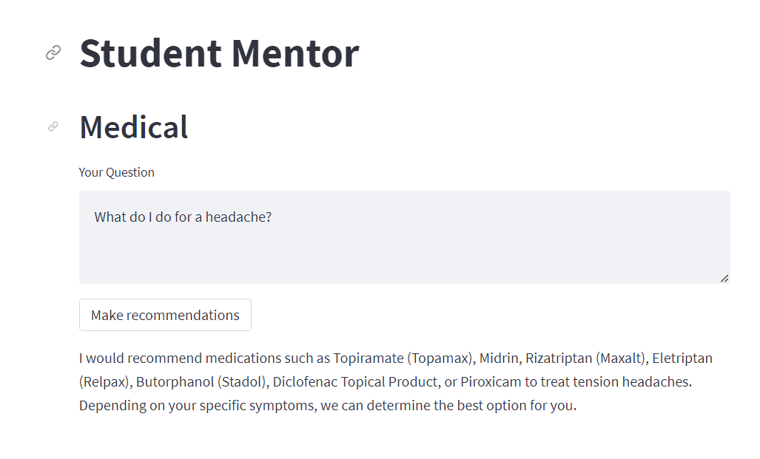

Slide 10
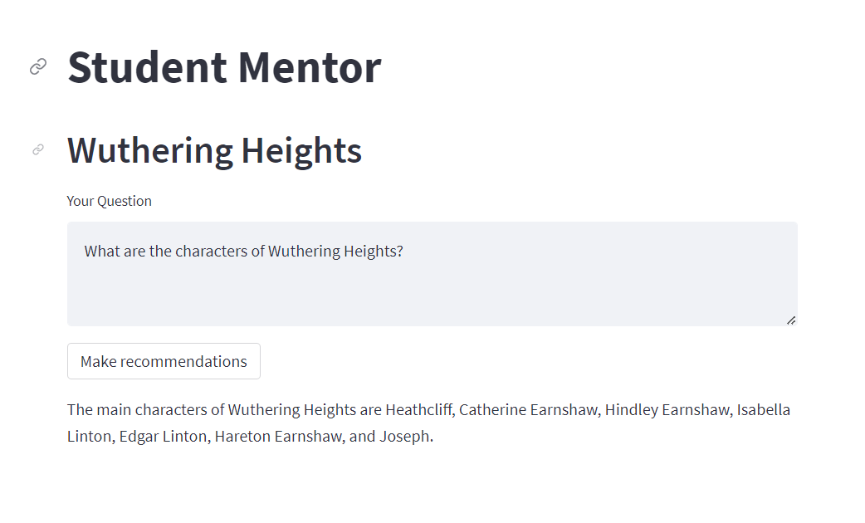

Slide 11
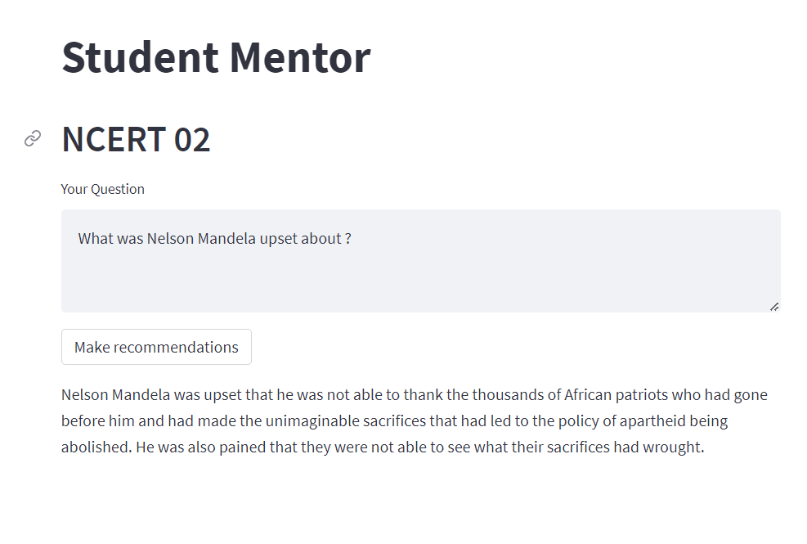

Slide 12
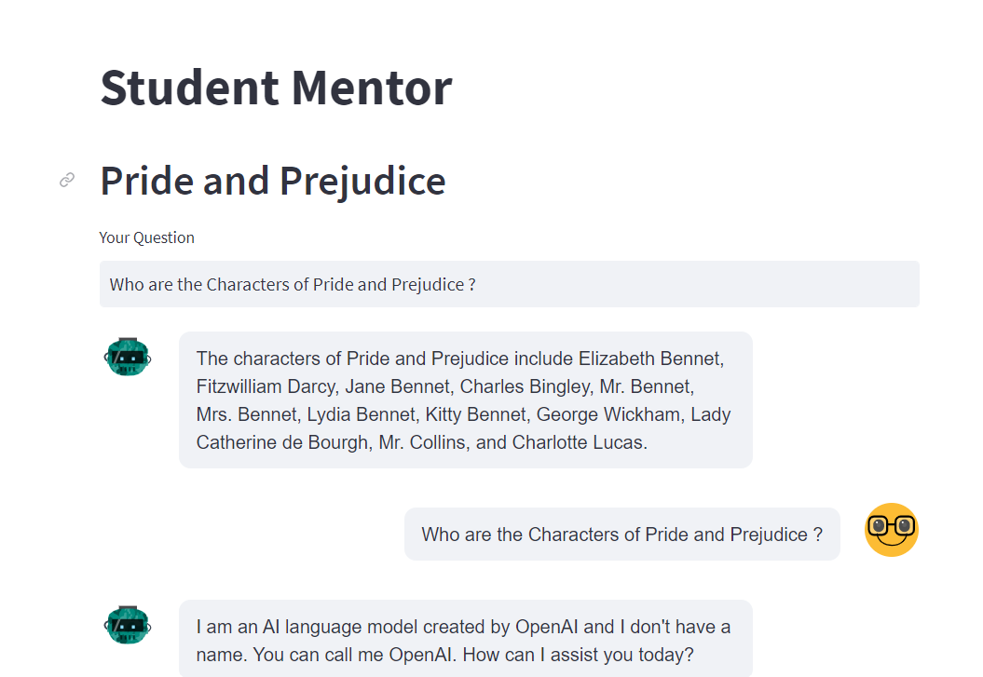

Slide 13
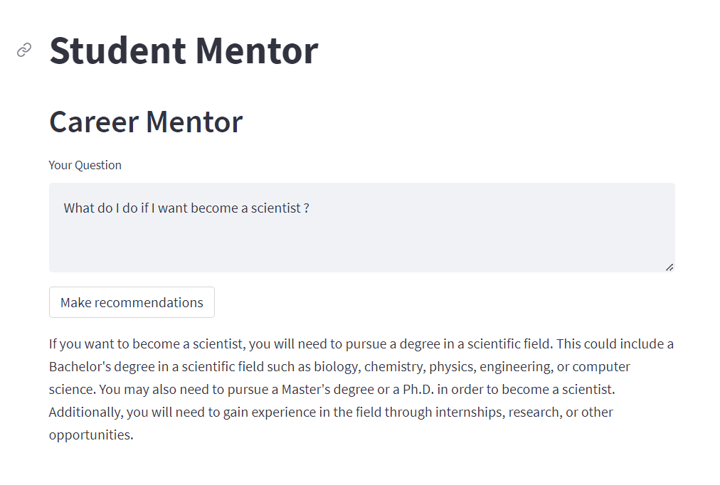

Slide 14
Key Differentiators & Adoption Plan
Student Mentor is an AI-powered platform designed to assist students in various aspects of their academic and professional lives. With features like medical, literature, and career question answering, summary generation, and chat facilities, Student Mentor provides comprehensive support for students seeking guidance and assistance
This platform has practiced the BLUE OCEAN Strategy so that there is no product which offers such facilities.

Slide 15
Thank You
Ambarish Ganguly

