Slide 1


PLEDGE TO PROGRESS Sustainability Hackathon
Sponsored By
Sustainability Hub powered by Generative AI– AI Powered Platform
Your Team Name : Ambarish Ganguly
Your team bio : Microsoft Valuable Professional [ AI Category ]
Microsoft Certified Trainer
Date : 21 May 2023

Slide 2
Problem Statement
1 Stop Solution for Sustainability Questions , Chat , Plant Disease Classification and Meat Freshness Classification
Sustainability Hub for answering questions as well as do chat on the following topics
Sustainability reports of the following cities and companies
Kolkata Sustainability Report
Varanasi Sustainability Report
Novartis Sustainability Report
Nestle Sustainability Report
Educational Sustainability Question Answering and Chat
15 NCERT Class 11 Chapters considered
Ecology book - Ecology-From-Individuals-to-Ecosystems-by-Michael-Begon—2006 Question Answering and Chat
Plant Disease Question Answering and Chat
1 stop shop for farmers for improving their crops and their betterment of life
Less fertilizers , Better Health for all of us
4 components [ Paddy Disease Classification, Bees Disease Classification, Cassava Disease Classification, Meat Freshness Classification]
For India and the world
Extend also to researchers all over the world to improve Ecology through Technology

Slide 3
Relevance to the Hackathon
This addresses various themes
EdTech - Build innovative solutions and / OR PoV's to bring in the Social, Economic and Accessibility elements in the Education Sector thru Sustainability Question and Answering module as well as Chat [ NCERT Biology , General , Sustainability Reports and Ecology Books ]
Agriculture - Build innovative green software to that can help with extending product life and reducing waste[Paddy Disease Classification, Bees Disease Classification, Cassava Disease Classification]
Retail - Addressing waste across all processes and implementing remediating processes, like recycling, re-commerce, and reuse accomplished thru Meat Freshness Classification module
FSI -Improve reporting capabilities Innovate to build GREEN financial tools, products, reporting capabilities to create relevant sustainability solutions & enhance customer engagement thru Sustainability Question and Answering module as well as Chat

Slide 4
User Segment & Pain Points
This product is targeted towards
Sustainability experts
Farmers
Agriculture Researchers
Ecologists
Anybody who loves Plants and Animals

Slide 5
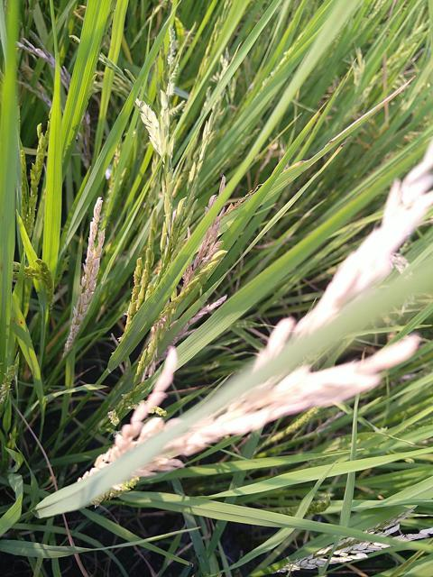
Why Paddy
Rice (Oryza sativa) is one of the staple foods worldwide.
Paddy cultivation requires consistent supervision because several diseases and pests might affect the paddy crops, leading to up to 70% yield loss.
Important to automate the disease identification process by leveraging computer vision-based techniques that achieved promising results in various domains.
9 paddy plant diseases and 1 normal variety to be classified

Slide 6
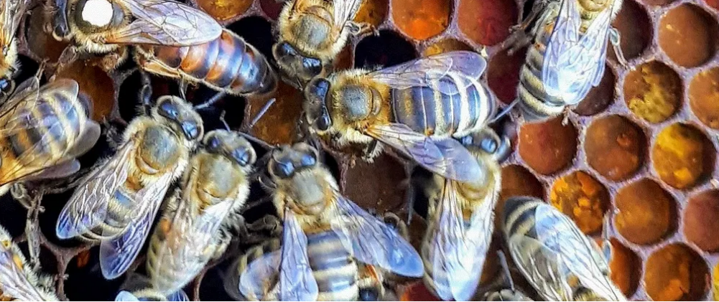
Why Bees
Every third bite of food relies on pollination by bees. Honey beehive losses are quite prevalent due to the diseased bees.
While many indications of hive strength and health are visible on the inside of the hive, frequent check-ups on the hive are time-consuming and disruptive to the bees' workflow and hive in general.
By investigating the bees that leave the hive, we can gain a more complete understanding of the hive itself. These characteristics can be observed without opening the hive.
2 bees diseases and 1 healthy variety to be classified

Slide 7
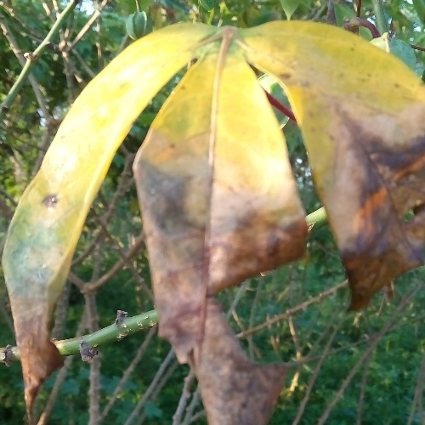
Why Cassava
Cassava is a rich, affordable source of carbohydrates.
It can provide more calories per acre of the crop than cereal grain crops, which makes it a very useful crop in developing nations.
As the 2nd largest provider of carbohydrates in Africa, cassava is a key food security crop grown by small-holder farmers because it can withstand harsh conditions.
4 cassava diseases and 1 healthy variety to be classified

Slide 8
Architecture [ Generative AI ] Logical Architecture
NCERT Biology
Process data for word embeddings
Word Embeddings Store
Sustainability Reports
Ecology Book
Process data for word embeddings
Similarity Match
Question
Get Answers Using Azure OpenAI

Slide 9
Architecture [ Generative AI ] Technical Architecture
Azure VM
NCERT Biology
Process data for word embeddings
Word Embeddings Store
Sustainability Reports
Ecology Book
Sentence Transformers / Azure OpenAI
Process data for word embeddings
Similarity Match
Question
Sentence Transformers / Azure OpenAI
Get Answers Using Azure OpenAI
Azure OpenAI

Slide 10
Architecture
Domains
Bees
Static Website
Paddy
Cassava
Meat Freshness

Slide 11








Architecture Part 1 [ Vision only ]
Azure Key Vault
Azure Blob Storage
GitHub Actions
Azure Container Registry
Azure Container Apps
Cosmos DB
Azure Custom Vision API
Training is done separately in Azure Custom Vision
Then the model is exposed through the Azure Custom Vision API
Azure Log Analytics Workspace

Slide 12
Components
The solution would be implemented as web application which is also mobile enabled. The farmers can access this application anywhere and can upload the images to detect the disease in the cassava leaves.
The UI is made of Flask
The application is deployed as a Container App
Azure Custom Vision API used to detect the diseases
Azure Container Registry used to store the container images
The various secrets required for the solution are stored in Azure Key Vault
The Azure Container App uses Managed Identity
The integration of Azure Container App with GitHub Actions is used for CD
The images are stored in the Azure Blob Storage
The predictions obtained from the Azure Custom Vision API are stored in Cosmos DB.

Slide 13
Data Flow
The image is uploaded into the Container App through the Flask UI
The Container App
uploads the image into Azure Blob Storage
predicts the disease through the Azure Custom Vision API
saves the filename and the predictions in Cosmos DB
Also provides the Recommendations on prevention and cure of the disease

Slide 14
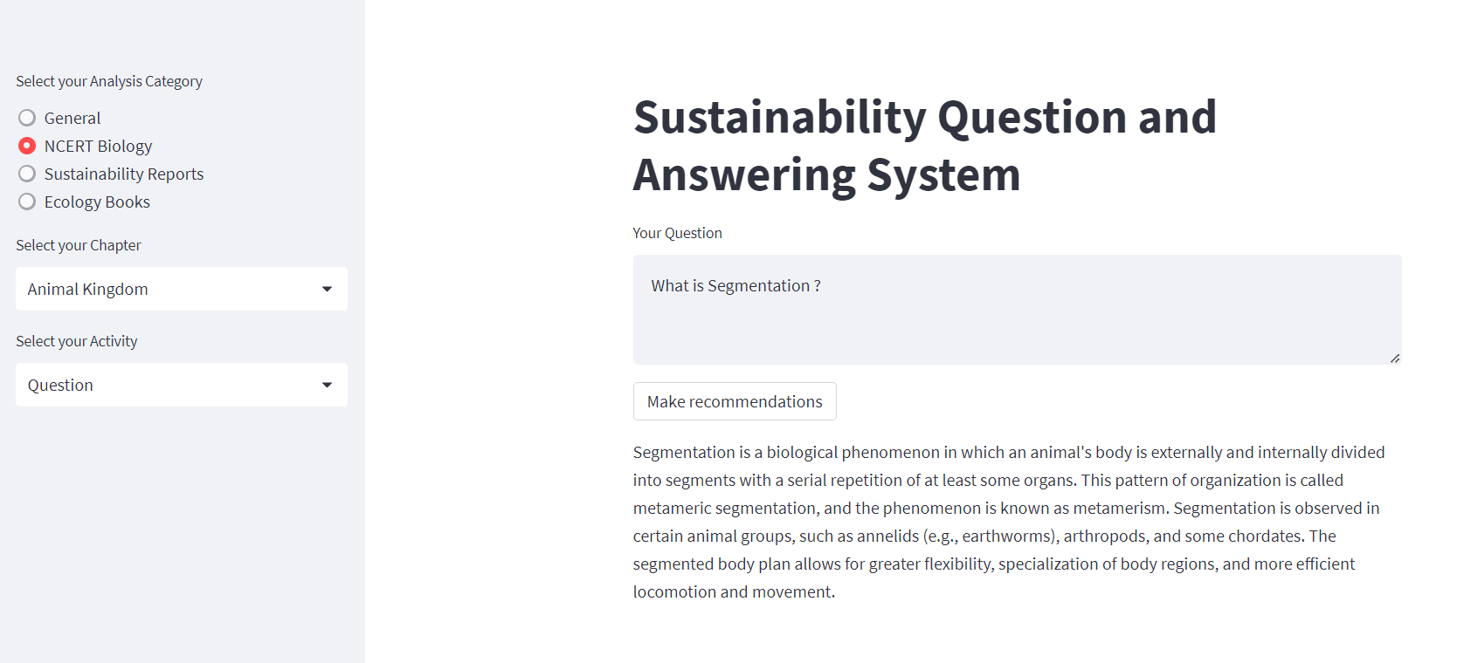

Slide 15
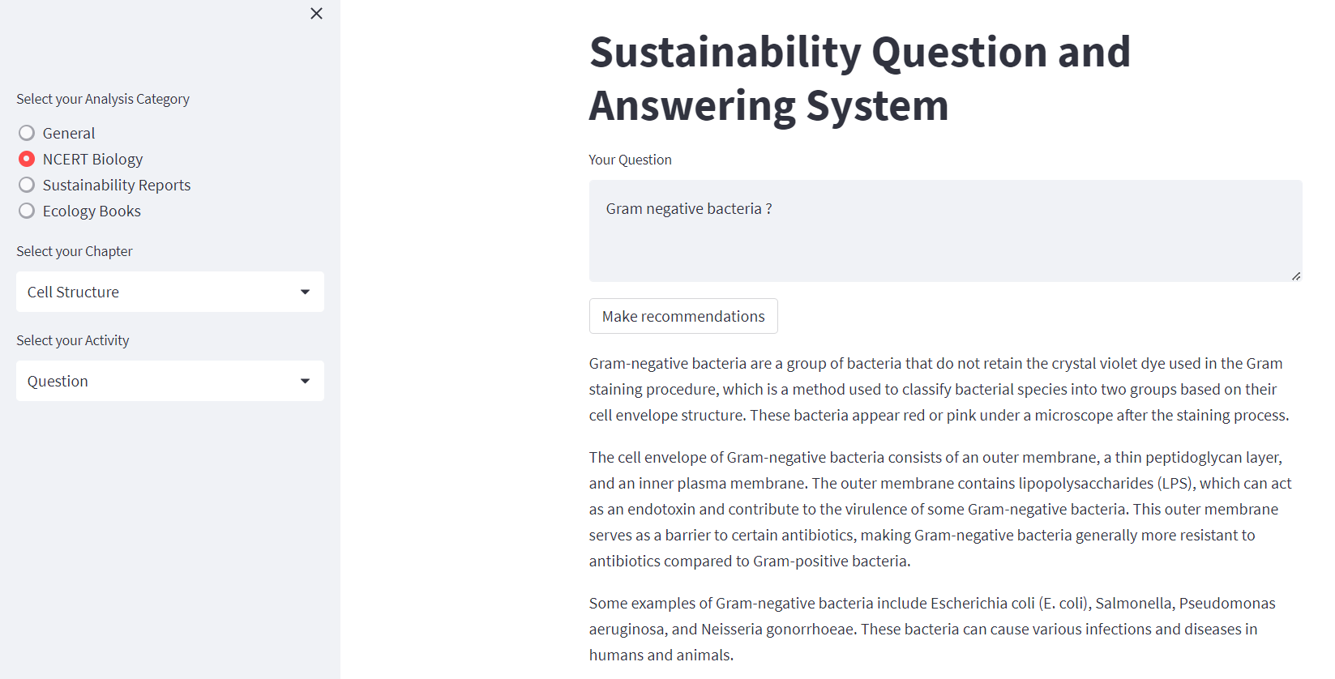

Slide 16
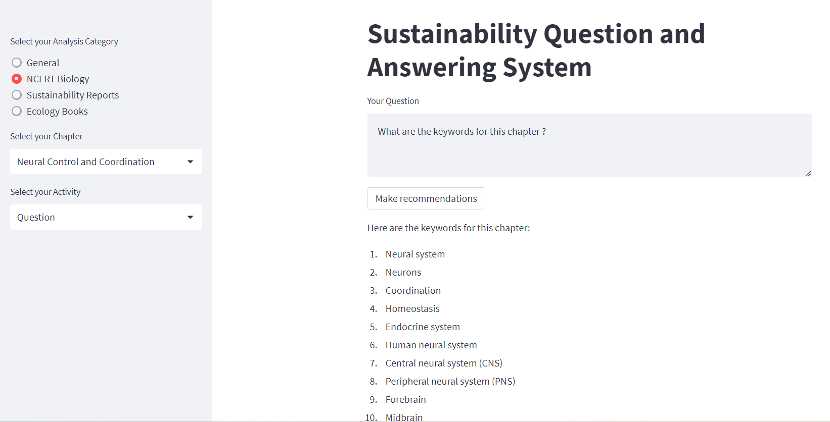

Slide 17
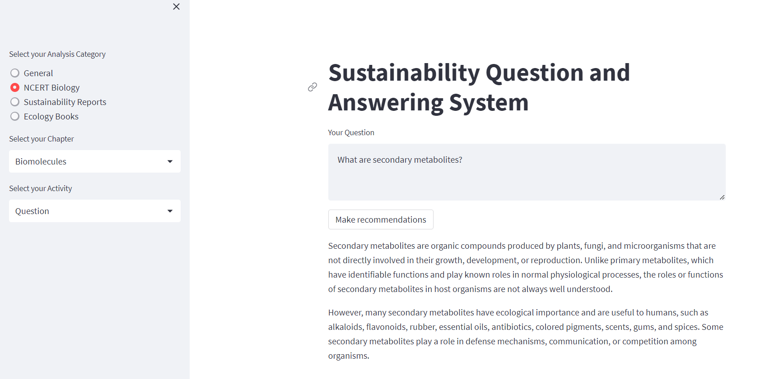

Slide 18
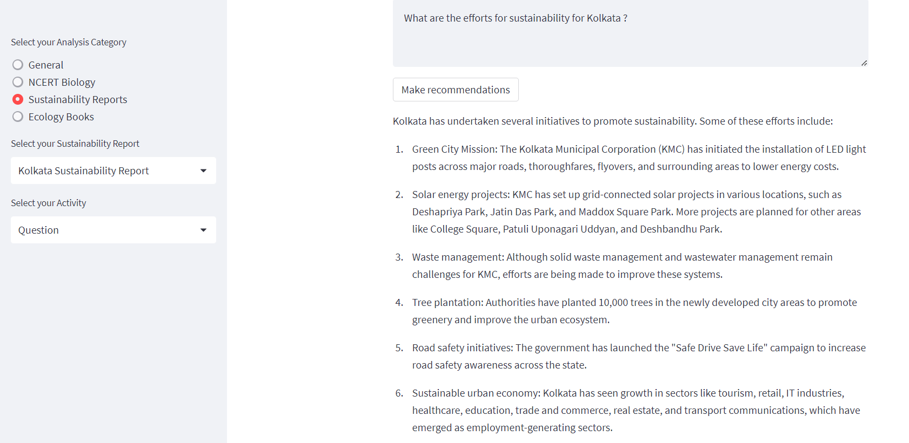

Slide 19
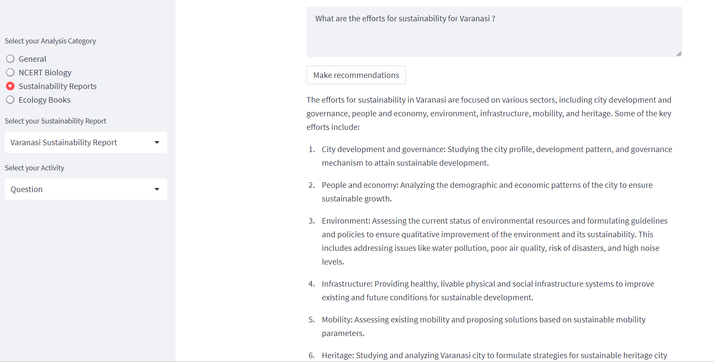

Slide 20
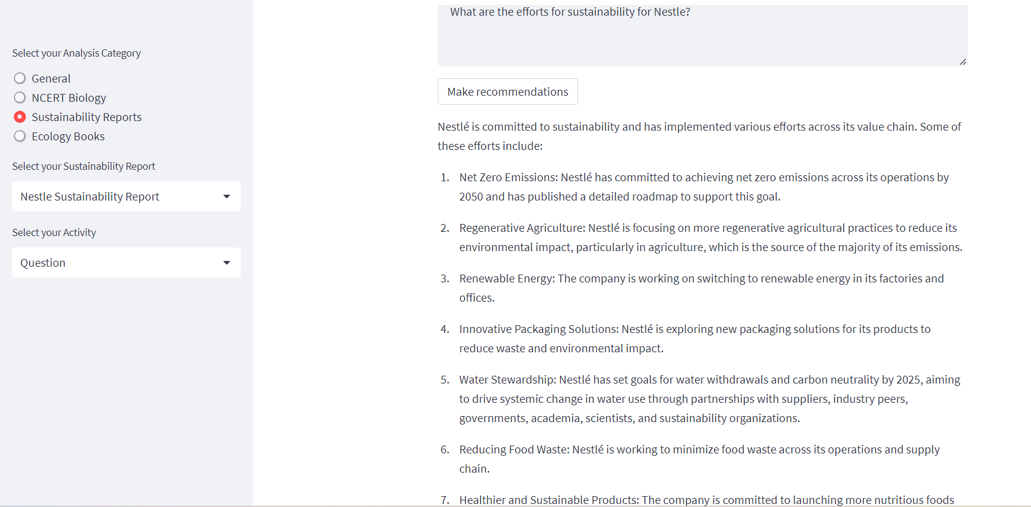

Slide 21
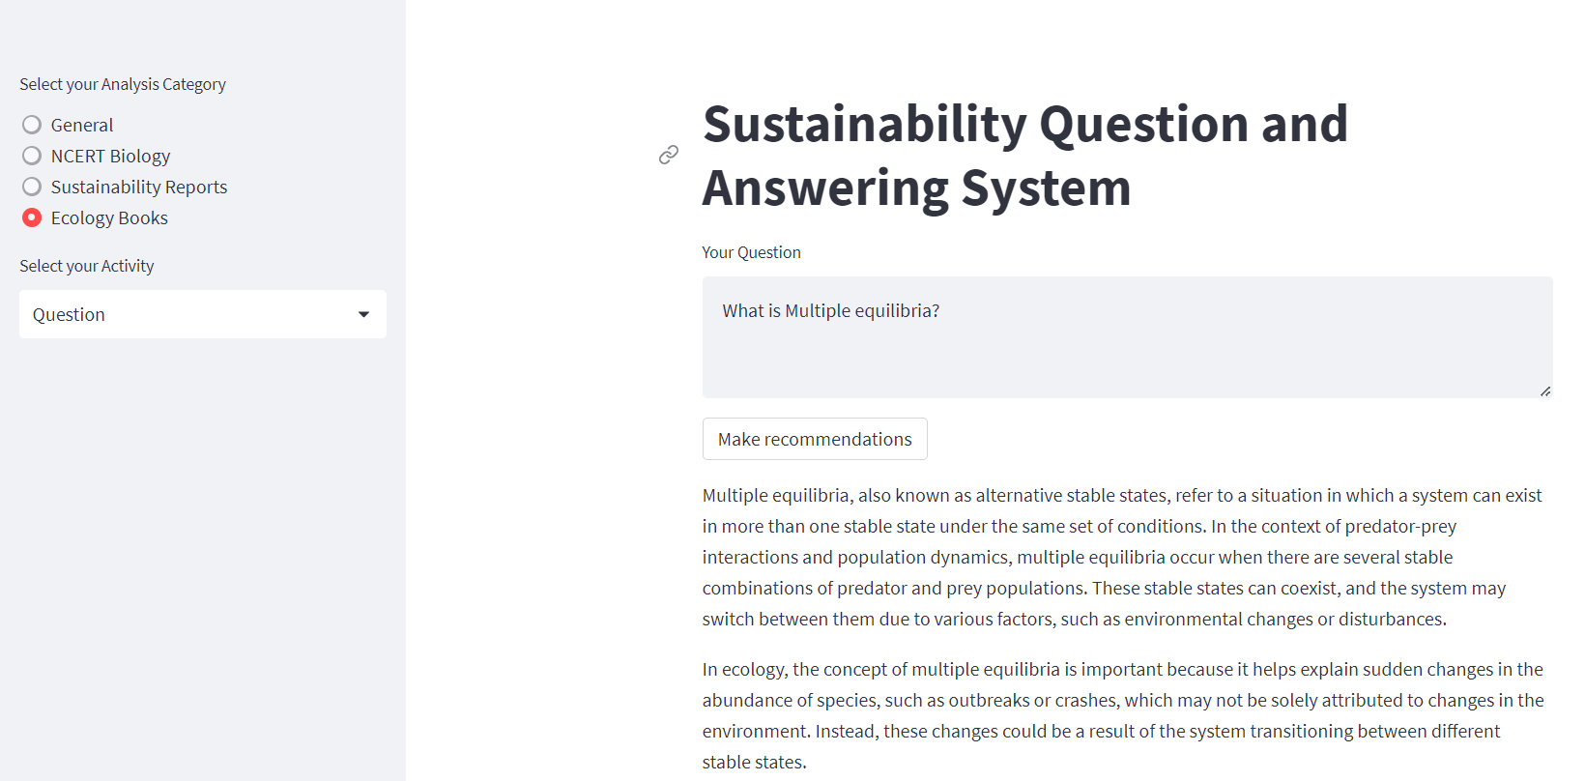

Slide 22
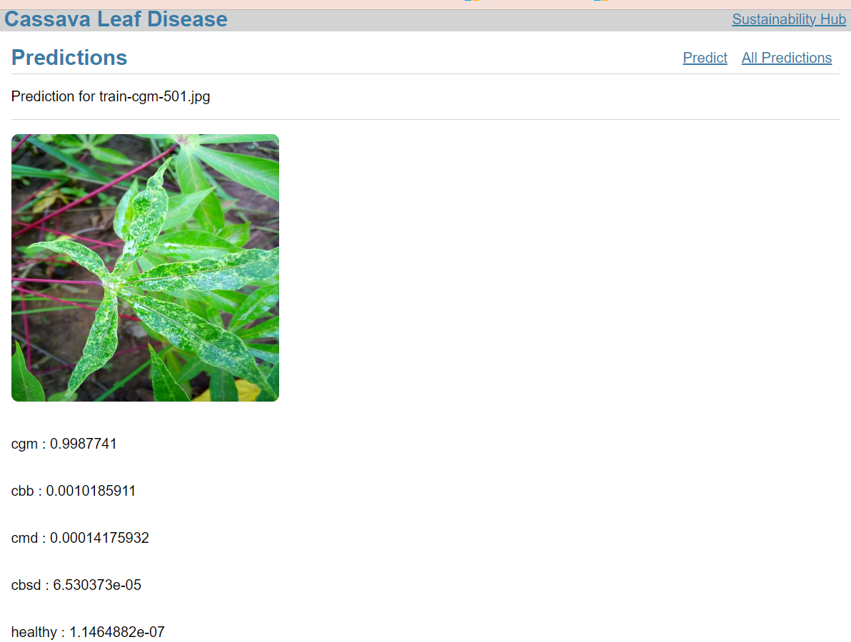

Slide 23
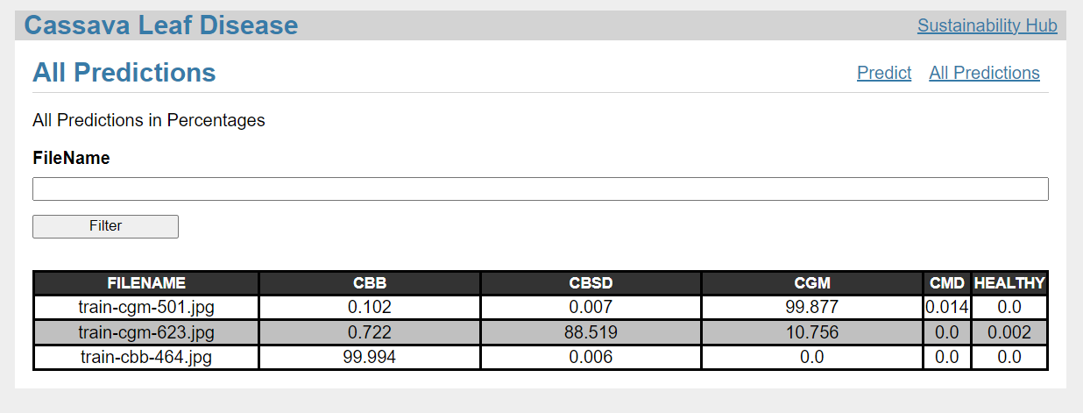

Slide 24
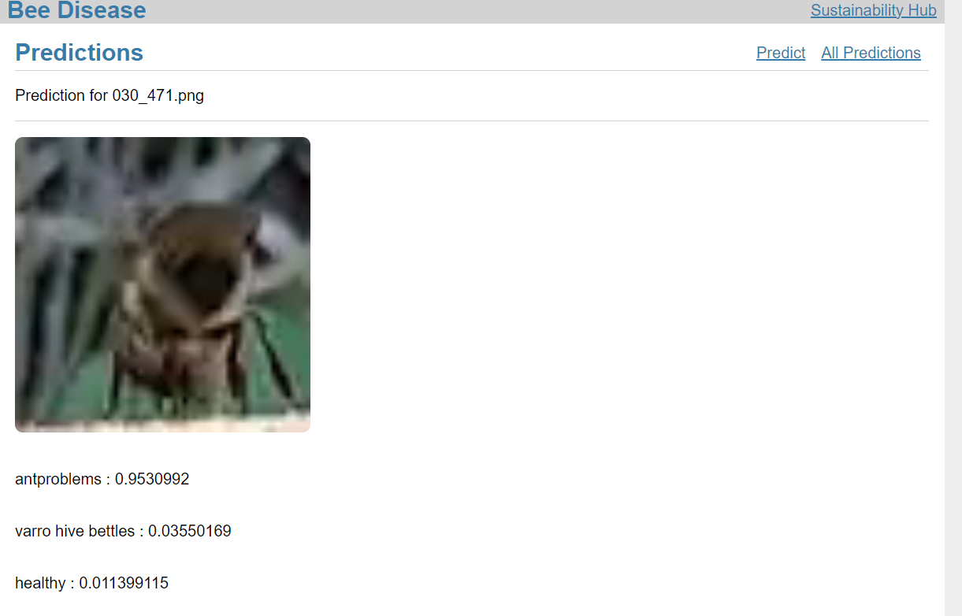

Slide 25
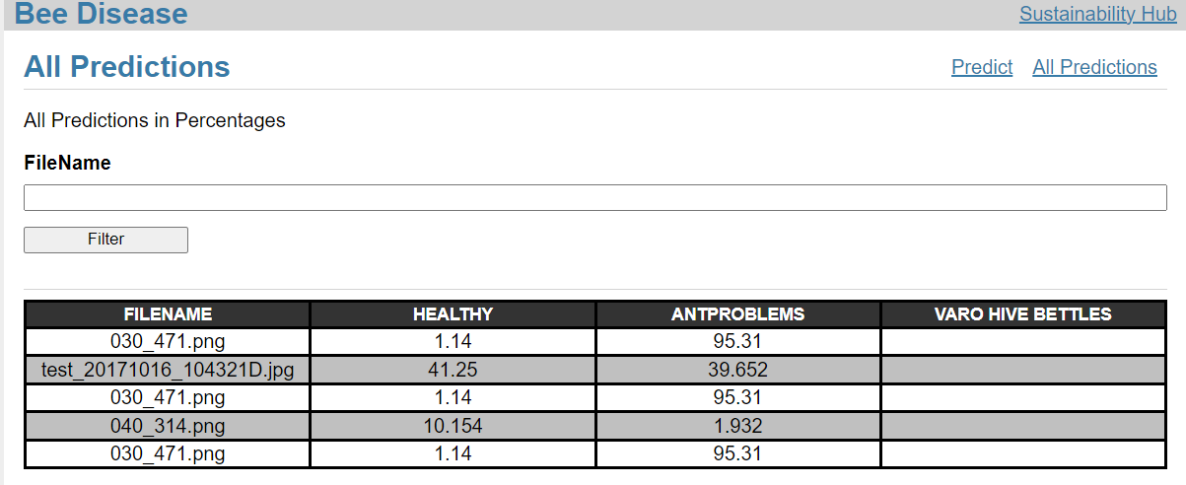

Slide 26
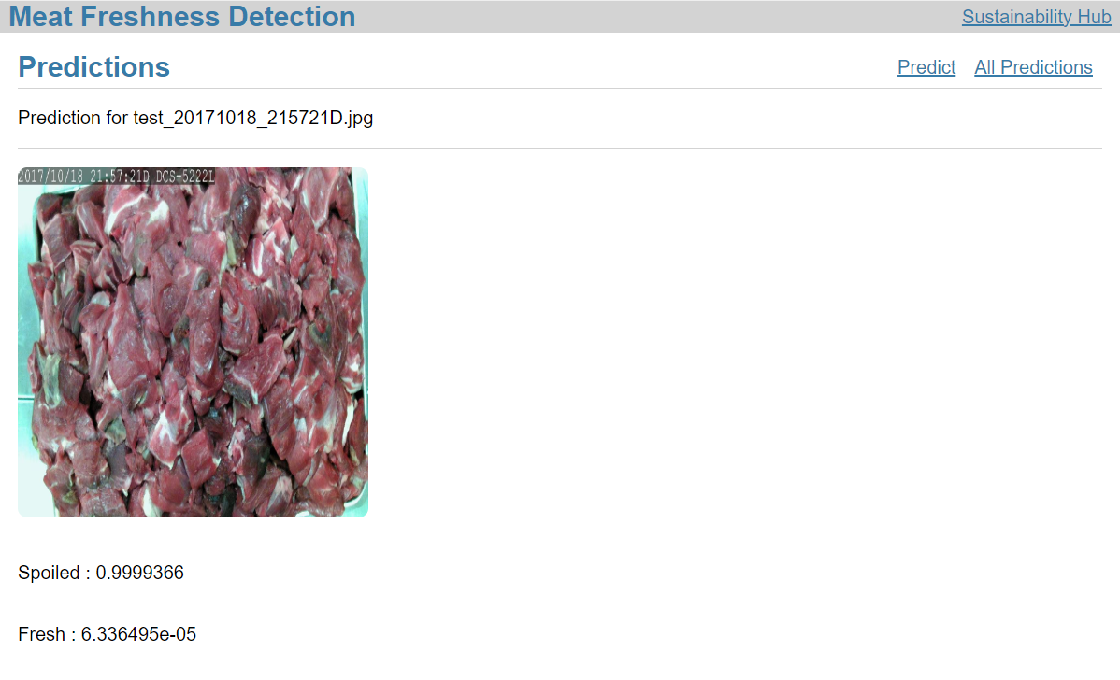

Slide 27
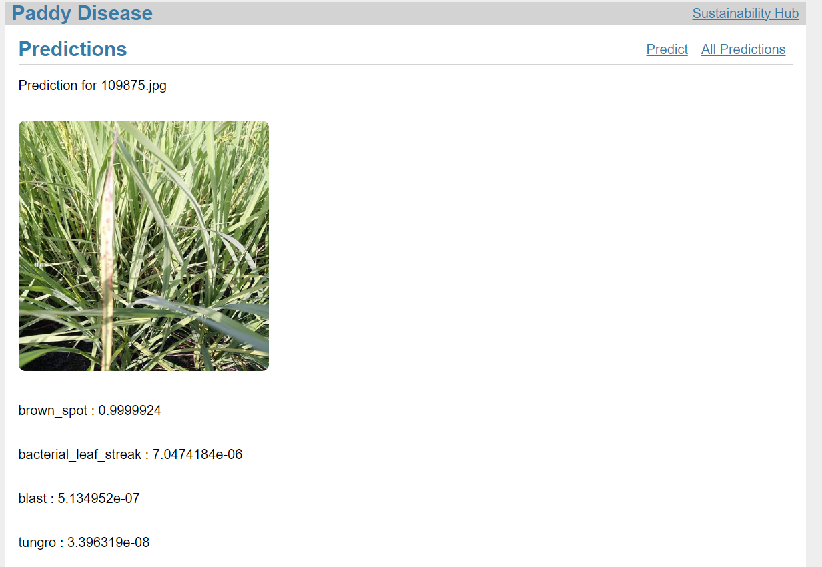

Slide 28
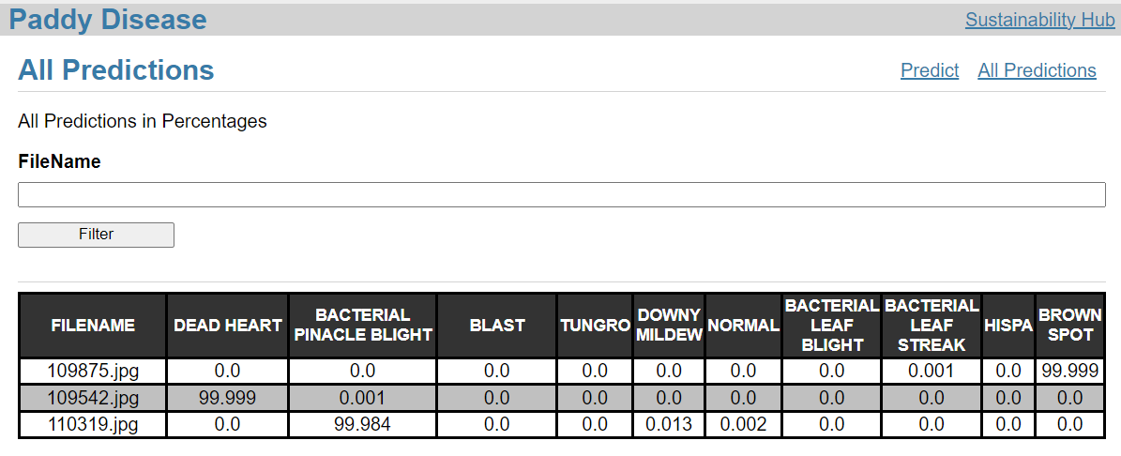

Slide 29
Key Differentiators & Adoption Plan
This application will provide the users to detect diseases and also get prevention and cures for each of the diseases easily
This platform has practiced the BLUE OCEAN Strategy so that there is no product which offers such facilities.

