Slide 1






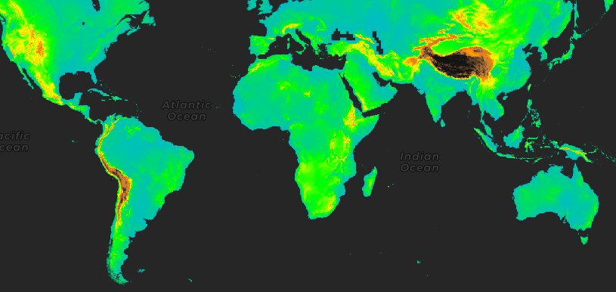




Google Earth Engine with R : : CHEAT SHEET
Basic Estructure fuction
Geometry and Feacture function
Image Esructure function
Examples
Functions no spatial
Geometry types
Image simple
Machine Learning
Type | Code
String | ee$String()
Number | ee$Number()
List | ee$List()
Dictionary | ee$Dictionary()
Date | ee$Date()
Geomtry | Code
Point | ee$Geometry$Point()
Line | ee$Geometry$Line()
Polygon | ee$Geometry$Polygon()
Multipoint | ee$Geometry$Multipoint()
MultiLineString | ee$Geometry$MultiLine()
...
structure type | Code
Image | ee$Image)
constant1 <- ee$Image(1)
constant2 <- ee$Image(2)
image <- ee$Image("USDA/NAIP/DOQQ/m_3712213_sw_10_1_20140613")
Map$setCenter(-122.466123, 37.769833, 17)
Map$addLayer(image, list(bands = c("N", "R", "G")), "NAIP")
ee$String('Hello spatial world!')$getInfo()
> [1] ‘Hello spatial world!’
Basic visualization parameters
point ← ee$Geometry$Point(c(-77,-12))
ee_map(point)
class(point)[1]
Code
Arguments
Type
visualization template structure
ee_map( eeobject = <EESpObj>
,vizparams = <List>
,zoom_start = <Number>
,objname = <String>
,quiet = <Logical>
,maxnimage = <Number>
)
> [1] ‘ee.geometry.Geometry’
Geometry → Feacture
Image collection
Spatial Interpolation
pointFeature ← ee$Feature(point, list('foo' = 42, 'bar' = 'tart'))
class(pointFeature)[1]
structure type | Code
Feacture | ee$Feacture()
> [1] ‘ee.feature.Feature’
collection <- ee$ImageCollection(list(
constant1,
constant2)
)
collectionFromConstructor$getInfo()
library(rgee)
library(cptcity)
image ← ee$Image('CGIAR/SRTM90_V4')
vizParams ← list(min = 0, max = 5000,
palette = cpt(pal = 'grass_elevation'))
ee_map(eeobject = image
,vizparams = vizParams
,zoom_start = 2
,objname = 'SRTM90_V4')
Feacture simple and collection
Geomtry | Code
Feacture | ee$Feacture()
FeactureCollection | ee$FeactureCollection()
> [1] ‘ee.imagecollection.ImageCollection’
polygon ← ee$Feature(
ee$Geometry$Polygon(list(
c(-109.05, 41), c(-109.05, 37),
c(-102.05, 37), c(-102.05, 41))
))
class(polygon)[1]
collection <- ee$ImageCollection("LANDSAT/LC08/C01/T1_TOA")$
filter(ee$Filter$eq("WRS_PATH", 44))$
filter(ee$Filter$eq("WRS_ROW", 34))$
filterDate("2014-03-01", "2014-09-01")
class(collection)
> [1] ‘ee.feature.Feature’
> [1] ‘ee.imagecollection.ImageCollection’
Access to Google Earth Engine is only available to registered users. The current version of rgee has been built considering the earthengine-api 0.1.213 Learn more at webpage or vignette • package version 0.2.0 • Updated: 2020-03

