Slide 1


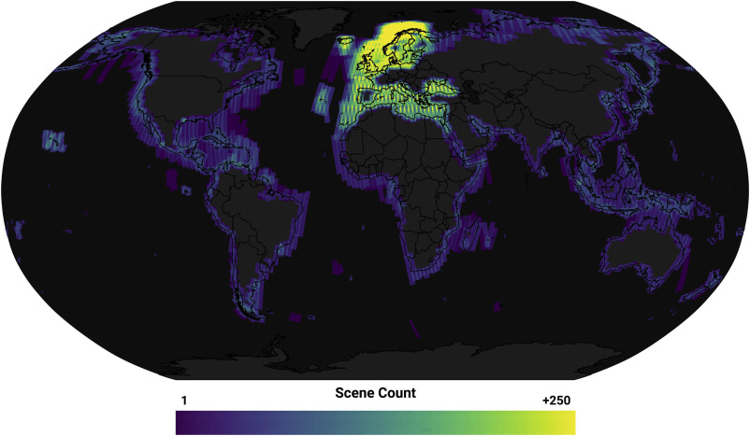






Google Earth Engine with R : : CHEAT SHEET
Basic Estructure fuction
Feacture Estructure Fuction
Image Estructure function
Examples
Functions no spatial
Use headers, colors, and/or backgrounds to separate or group together sections.
CODE
FONTS
Strings
Section 1
Section 2
Section 3
Where possible, use code that works when run.
This template uses several fonts: Helvetica Neue, Menlo, Source Sans pro, which you can acquire for free here, www.fontsquirrel.com/fonts/source-sans-pro, and Font Awesome, which you can acquire here, fortawesome.github.io/Font-Awesome/get-started/
ee$String('Hello world!')
ggplot(mpg, aes(hwy, cty)) +
geom_point(aes(size = fl)) +
geom_smooth(method ="lm")
Numbers
ee$Number(pi)
Create a visual hierarchy. Help users navigate the page with titles, subtitles, and subsubtitles
Word balloons
can help explain
code
Lists
ee$List(list(pi,'Hello world!',TRUE))
Title
To use a font awesome icon, copy and paste one from here fortawesome.github.io/Font-Awesome/cheatsheet/. Then set the text font to font awesome.
Dictionaries
SUBTITLE
ICONS
ee$Dictionary(list(name = 'antony',
age = 15,
sex = 'M'))
These are just font awesome characters
SUBSUBTITLE
☞    
Dates
ee$Date('2020-02-02')
Fit sections to content. Try several different layouts.
Use numbers or arrows to link sections if the order/flow is confusing.
Quickly identify content with a package hexsticker (if available)
Basic visualization parameters
MOCK TABLES
KEYNOTE
ee_map (eeobject = ,
vizparams = ,
zoom_start = ,
objname = ,
quiet = ,
maximage = ,
)
I make my cheatsheets in Apple Keynote, and not latex or R Markdown, because presentation software makes it much easier to tweak the visual appearance of a document
KEYNOTE TIPS
library(rgee)
library(cptcity)
cpt_pal = cpt(pal = 'grass_elevation')
image <- ee$Image('CGIAR/SRTM90_V4')
ee_map(image,
vizparams = list(min = 0,
max = 5000,
palette= cpt_pal),
zoom_start = 2,
objname = 'SRTM90_V4')
MOCK GRAPHS
Select multiple elements by holding down shift and then selecting each. Click on a selected element before letting go of shift to unselect it.
To group elements together. Select them all , then click Arrange > Group
To evenly space multiple objects, select them all then Right Click > Align objects or Right Click > Distribute objects
Click on a table, then visit Format >Table > Row and Column Size to make even width rows/columns.
Copyright
TABLES
sub-option | description
citation_package | The LaTeX package to process citations, natbib, biblatex or none
code_folding | Let readers to toggle the display of R code, "none", "hide", or "show"
colortheme | Beamer color theme to use
RStudio® is a trademark of RStudio, Inc. • CC BY SA Your Name • your@email.com • 844-448-1212 • your.website.com • Learn more at webpage or vignette • package version 0.5.0 • Updated: 2017-01

