Slide 1
Proposal: Gradient Boosting Regression Trees with Variable Learning Rates
Austin Barket

Slide 2
What’s Boosting?
Boosting is a general machine learning technique that combines learning algorithms that barely beat random guessing, known as a weak or base learners, into a single model with significantly improved accuracy or lower error rates over any of its constituent parts. [1] [2]

Slide 3
Brief History of Boosting
1988 - Kearns and Valient asked “Is weak learnability equivalent to strong learnability?” [7][8]
1990 – Yes! Schapire proves boosting works and provides a polynomial time boosting algorithm. [1]
1992 – Lets use it! Drucker, Schapire, and Simard boosted neural networks to perform OCR on handwritten USPS zipcodes. [9]
1995 – We can do better… Freund and Schapire introduced AdaBoost. Hailed for solving many practical limitations of early boosting algorithms. Weights previously misclassified examples so that future base learners focus on getting them right. [11]

Slide 4
Brief History of Boosting
1998 – Why does AdaBoost work so well? Answered by Friedman, Hastie, and Tibshirani from a statistical point of view.
1999 - 2002 – Friedman creates and improves upon his Gradient Boosting Machine. A generalized boosting model applicable to a wide variety of loss functions and base learners and capable of solving most prediction and classification problems.
2003 – Greg Ridgeway implements gradient boosting machine package (gbm) in R. Specifically, this package specializes the algorithm for the case where regression trees are the base learners. (https://cran.r-project.org/src/contrib/Archive/gbm/)
2003 – 2015 – Many other commercial implementations arise, many researchers across diverse fields utilize gradient boosting machines in their work.

Slide 5
Gradient Boosting Machines
A forward stage wise function approximation algorithm that uses a form of steepest descent to minimize a loss function.
Results in a summation of base learners, one trained in each iteration, that together produce a prediction of the response variable.
A bag fraction parameter adds a stochastic element to the algorithm by sampling a portion of the training data to use in each iteration.
A base learner is trained in each iteration to move the function approximation in the direction of steepest gradient descent in the space of the loss function for the selected samples.
This new base learner is then scaled by a constant learning rate and added to the summation of base learners built thus far.
The learning rate helps mitigate overfitting by forcing the algorithm to only take small steps along the direction of the negative gradient.
This ensures it continues to minimize the loss function and doesn’t “overshoot” the minimum.
Source: [3]

Slide 6
Regression Trees
Binary trees that partition a dataset into disjoint subsets by recursively splitting the data on the value of one of the predictor variables.
Predict a constant value for all the instances that fall into a given leaf node.
This value is a function of the response variables of the training data that fell into that leaf node. The function itself is determined by the error measure used.
So regression trees can be thought of as a summation of terms, one for each leaf node.
The value of each term is either the predicted value of that node if the instance falls into that node or zero otherwise.
This means it will be quite natural algebraically to define a learning rate for each leaf note.
Source: [3]

Slide 7
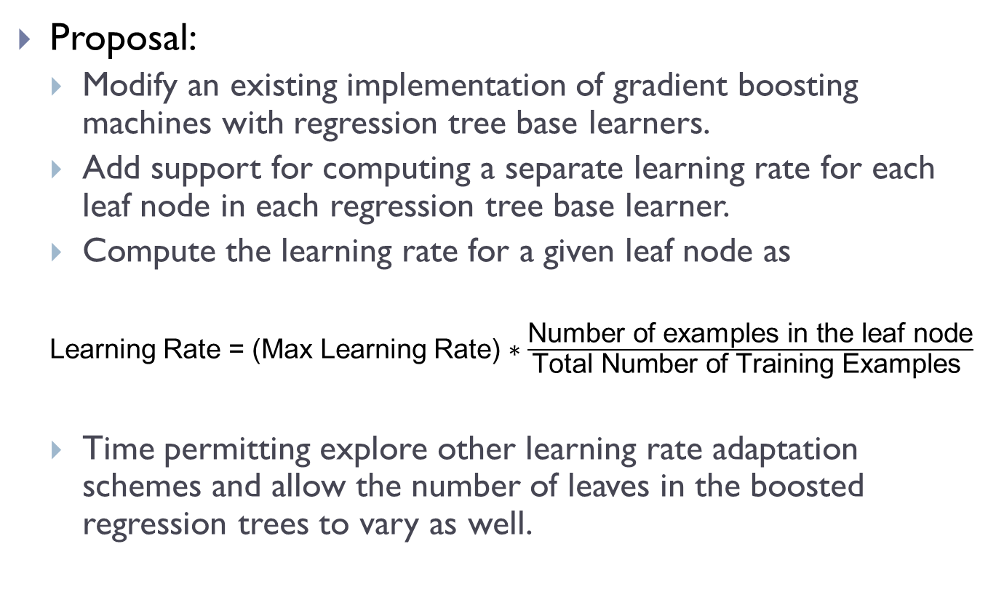
Variable Learning Rate Proposal
Proposal:
Modify an existing implementation of gradient boosting machines with regression tree base learners.
Add support for computing a separate learning rate for each leaf node in each regression tree base learner.
Compute the learning rate for a given leaf node as
Learning Rate = (Max Learning Rate) $∗\frac{\text{Number} \text{of} \text{examples} \text{in} \text{the} \text{leaf} \text{node}}{\text{Total} \text{Number} \text{of} \text{Training} \text{Examples} }$
Time permitting explore other learning rate adaptation schemes and allow the number of leaves in the boosted regression trees to vary as well.

Slide 8
Variable Learning Rate Proposal
Hypothesis:
Varying the learning rate in this way will improve convergence time without compromising the model’s resilience to overfitting.
To analyze the impact of the variable learning rates…
Need a dataset
Perform parameter tuning. Find optimal…
Bag fraction
Maximum learning rate
Number of trees
Number of leaves in each tree
Compare the best model with constant learning rate to the best model with variable learning rate.
Hopefully, the optimal number of trees will be significantly less with the variable learning rate, and the differences in performance on the test data will be negligible.

Slide 9
Case Study: Environments occupied by Anguilla australis
For the purposes of performing parameter tuning and analysis of the effect of my variable learning rate scheme, I will follow a method similar to that found in the following ecological paper.
The following slides detail this paper.

Slide 10
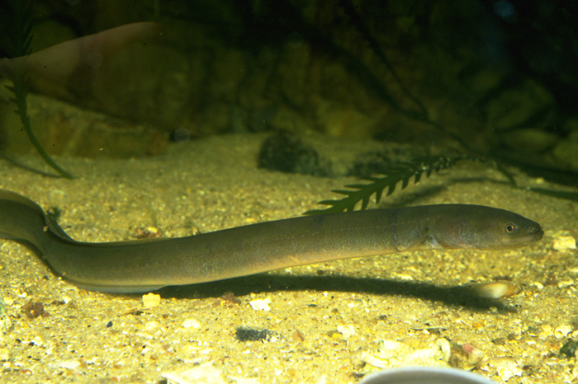
Case Study: Environments occupied by Anguilla australis
Short finned eel species in New Zealand
Produce a logistic regression model that identifies the most important environmental determinants of their distribution and can be used to predict the likelihood of their existence in unsampled rivers.
Source: http://www.fishesofaustralia.net.au/home/species/1423

Slide 11
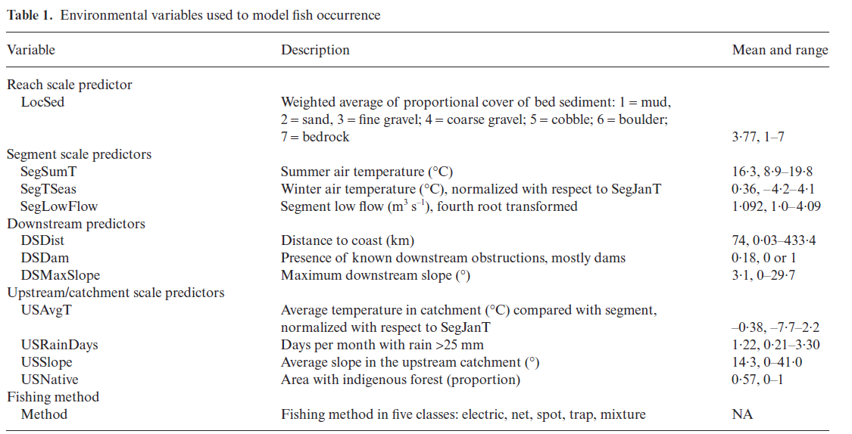
Case Study: Environments occupied by Anguilla australis

Slide 12
Case Study: Environments occupied by Anguilla australis
Use the gbm R package
Dataset of 13, 369 sites, ~20% have recorded the presence of Anguilla australis
Used only 1000 for training, and remaining 12, 369 for testing.
Need to jointly optimize the number of trees, learning rate, and tree complexity (number of leaves).
Decreasing learning rate -> Better fits but more trees required and more computation time
Too high of tree complexity leads to overfitting and thus requires slower learning rate to compensate for it.

Slide 13
Case Study: Environments occupied by Anguilla australis
Bag Fraction: The percentage of training examples selected at random during each iteration to train the new tree.
Helps improve accuracy because each individual tree models a slightly different view of the training data, which generally helps the model as a whole generalize to unseen data.
Also reduces computation time and reduces overfitting.
This study used gbm’s default of 0.5, and noted that fractions in the range of 0.5 to 0.75 tend to have good results.
In my research I’ll likely investigate the bag fraction’s effect on the model a bit more.

Slide 14
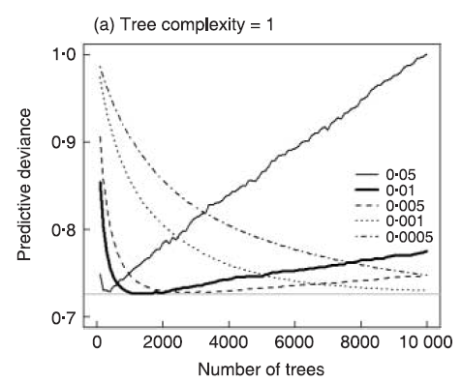
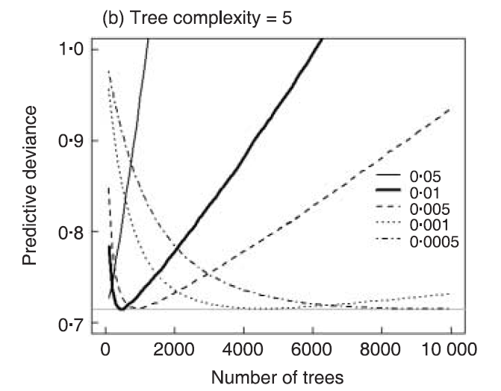
Case Study: Parameter Tuning
Number of Trees vs. Learning Rate
The below graphs show how the deviance varies for different learning rates and number of trees on the test set.
Notice the overfitting that occurs with the higher learning rates, which is dramatically mitigated by decreasing the rate.
Also note that the overfitting is far more dramatic when more complex trees are used. However, increasing tree complexity improves the model fit and decreases the number of trees required to reach the minimum deviance

Slide 15
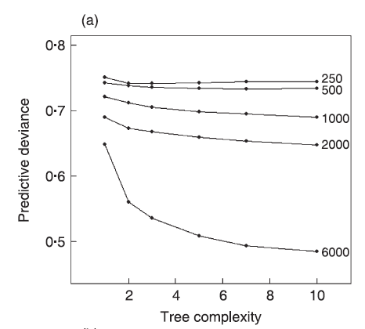
Case Study: Parameter Tuning
Tree Complexity vs Sample size

Slide 16
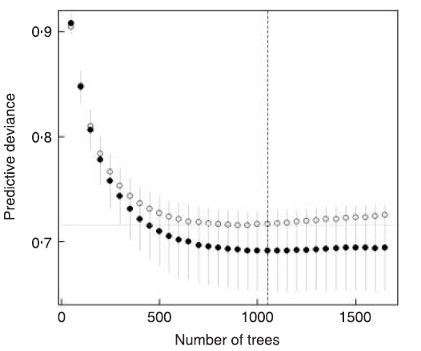
Case Study: Parameter Tuning
Cross validation to find the optimal number of trees for a given configuration.
Used settings
Bag fraction = 0.5
learning rate = 0.005
Tree complexity = 5
Found
Optimal Trees = 1050

Slide 17
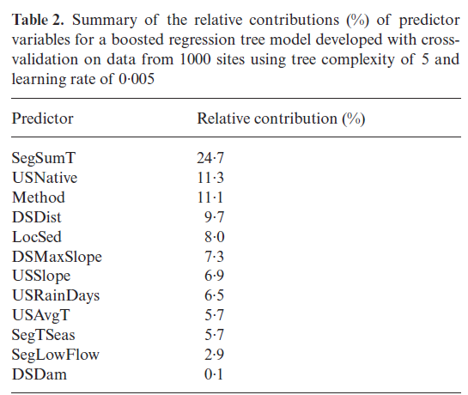
Case Study: Model Analysis
Relative Importance of Predictor Variables:
Based on the number of times a variable is selected for splitting, weighted by the squared improvement to the model as a result of each split, and averaged over all the trees.
The influences of the variables are then scaled to sum to 100

Slide 18
Case Study: Environments occupied by Anguilla australis
Variable Selection, Simplifying the Predictor Set
Regression trees naturally perform variable selection, since they will only create splits on the variables that have the most influence, in other words the variables that explain the most variation in the dataset will be used to split the dataset.
The paper notes however that in some cases, especially with small datasets, having irrelevant predictors can degrade performance. Also it can simplify model analysis to have less predictors.
One way to simplify the predictor set is to create a boosted regression tree model, analyze the relative importance of predictor variables, then drop the least influential predictors.

Slide 19
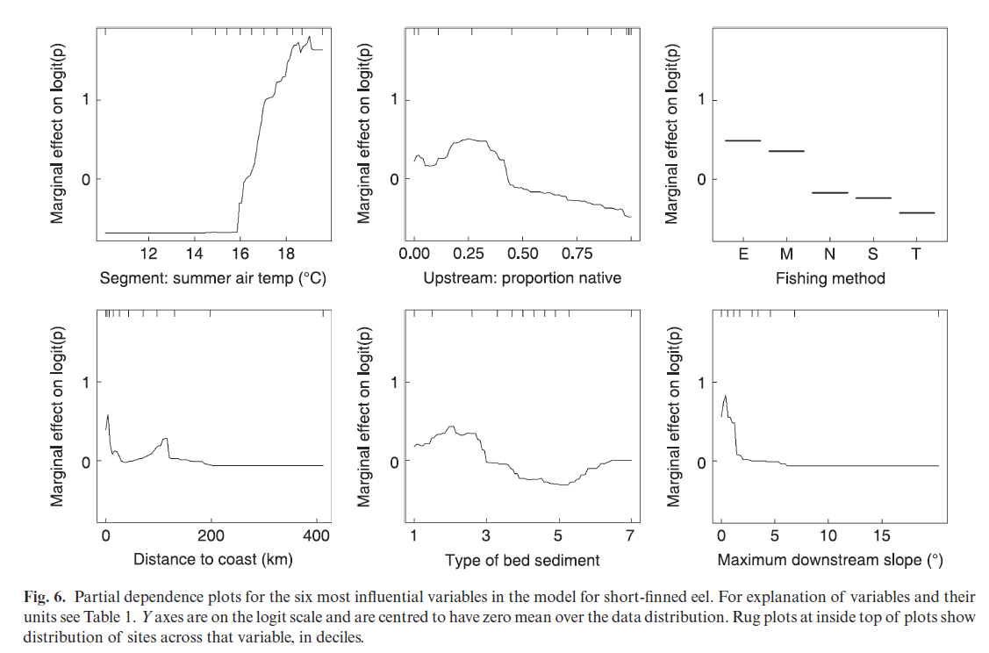
Case Study: Model Analysis
Partial Dependence Plots
Show the effect of a variable on the response after accounting for the average effects of all other variables in the model.
Not perfect if there are strong interactions or correlations between predictors but provides a good basis for interpretation
For example from these graphs we see that this species prefers
Warm temperatures
Little native vegetation upstream
Most easily caught by electric fishing
Prefers to be close to the coast but also ventures inland if conditions are right
Prefers fine sediments
And lowland rivers with gentle downstream slopes.

Slide 20
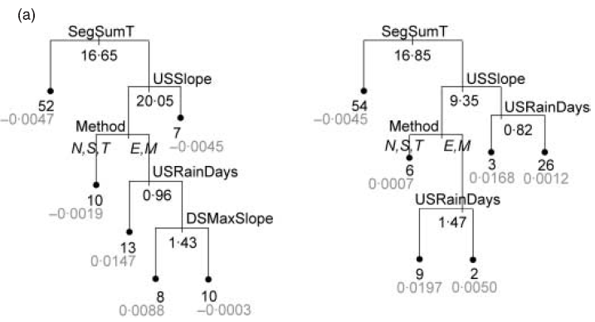
Case Study: Model Analysis
Have the ability to plot and analyze any of the regression trees in the boosted model.
The plots below show the first two regression trees of their final model.

Slide 21
Results
Predictions consistent with known ecology of the species
Analysis of the model interactions highlight the preference of habitats with low flood frequencies and warm temperatures.
Predicts that they live “in warm, lowland rivers in agricultural landscapes, often close to the coast but also penetrating inland, and preferring reaches with fine sediments”
This case study demonstrates the ability of gradient boosted regression trees to
Effectively select the relevant variables
Fit accurate functions
Automatically identify and model the interactions between predictors.
Also, implementations such as gbm provide nice analysis tools such as
Reporting the relative predictor variable performance
Partial dependence plots
The ability to plot and analyze each individual tree in the ensemble.

Slide 22
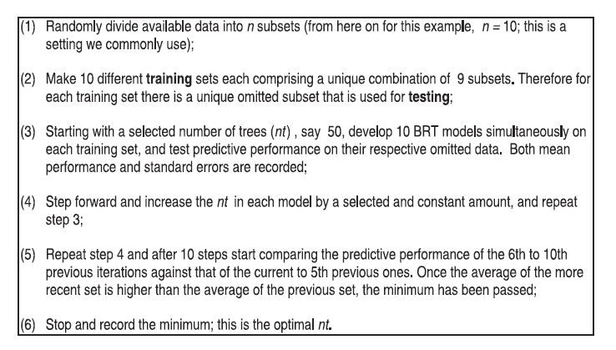

Slide 23
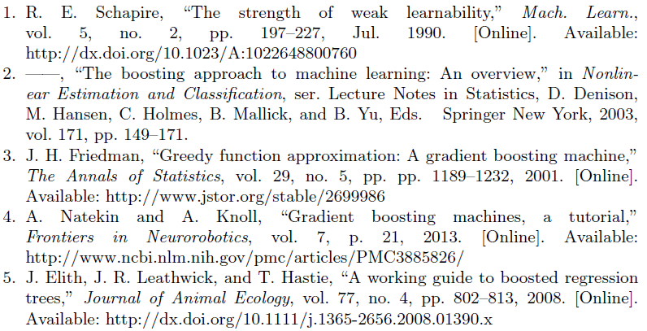
References

Slide 24
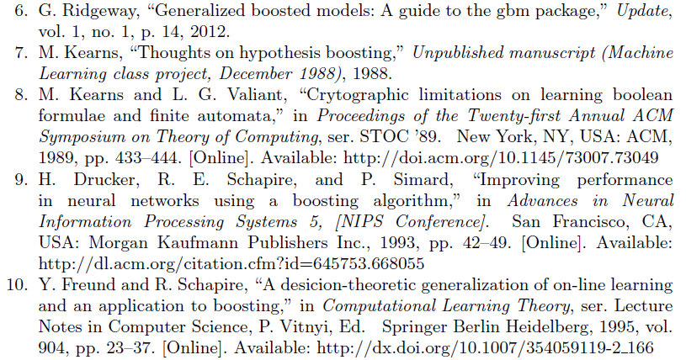
References

Slide 25
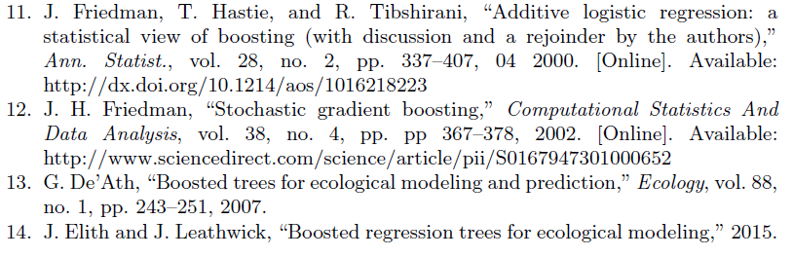
And Some More

Slide 26
Gradient Boosting Machines
A forward stagewise function approximation algorithm
Utilizes steepest descent numerical optimization method to iteratively minimize the loss function.
Simplified Algorithm:
Given:
Dataset (x_{i}, y_{i}) i=1…N
Loss function: Err(y_{i,} F(x_{i})),
Find:
A function that approximates F(x) = y and minimizes Err(y_{i,} F(x_{i}))
Algorithm:
Start with a constant estimate, usually the mean value of y across the dataset.
For m = 1 to M
Select a portion of the training data to use in training the next base learner.
Train a new base learner h_{m}(x) to predict (x_{i}, Err(y_{i,} F_{m-1}(x_{i}))
Update F_{m} = F_{m-1}(x_{i})
At each iteration a new base learner is built to predict the errors made by the current function approximationof the loss function on a randomly selected sample of the training data. The new base learner is then added to the function.
Generates a function with the following form

Slide 27
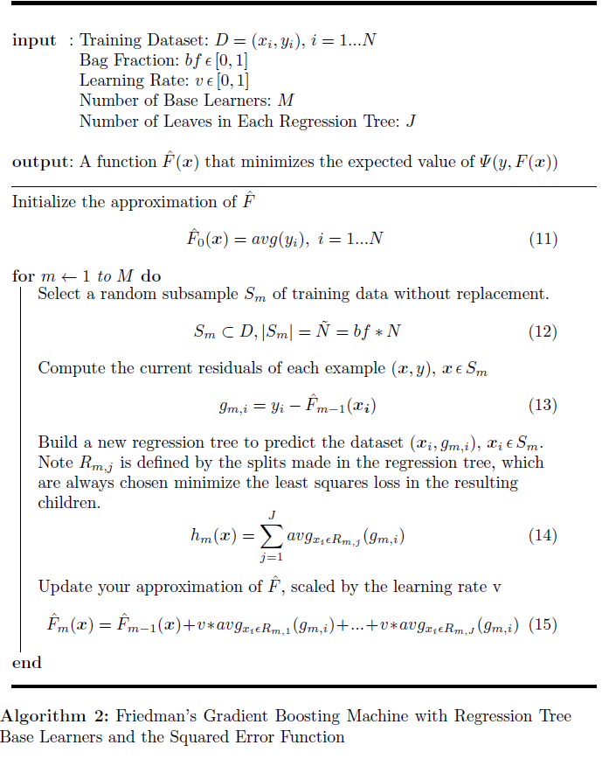

Slide 28
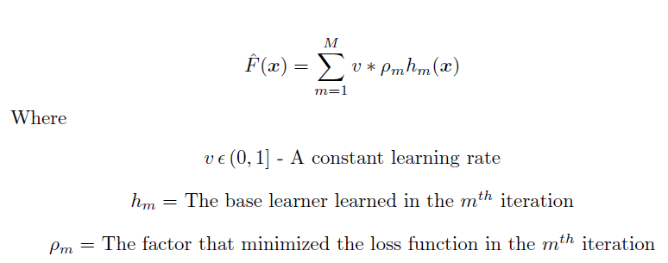
Gradient Boosting Machines
A forward stagewise function approximation algorithm
Utilizes steepest descent numerical optimization method to iteratively minimize the loss function.
Given dataset (x_{i}, y_{i}) i=1…N
Start with an estimate, e.g. the mean value of y across the dataset
At each iteration a new base learner is built to predict the errors made by the current function approximationof the loss function on a randomly selected sample of the training data. The new base learner is then added to the function.
Generates a function with the following form

Slide 29
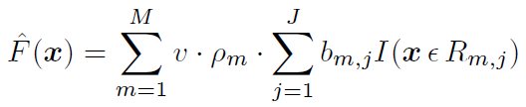
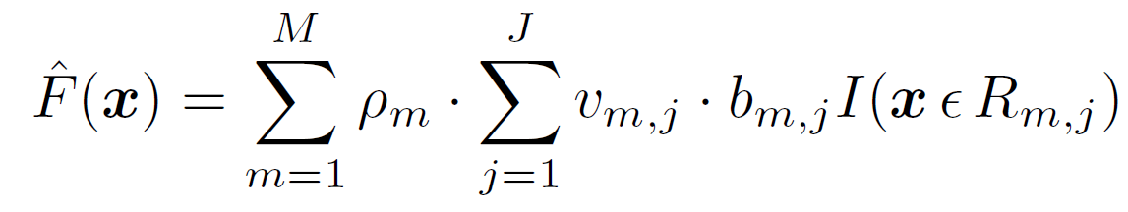
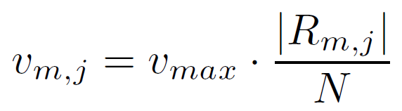
Project Goal
Extend the Gradient Boosting algorithm to compute a learning rate for each leaf in each tree.
Becomes
Where

