Slide 1
An overview of the linux SPI NOR subsystem
Tudor Ambarus, Pratyush Yadav, Michael Walle

Slide 2
Linux SPI NOR team
Tudor Ambarus, co-maintainer
  Embedded linux development: bootloaders, kernel development, board bring-up.
  Living in Bucharest, Romania
  contractor
Pratyush Yadav, co-maintainer
  Living in Dresden, Germany
Michael Walle, reviewer
  Living in Saarbruecken, Germany
  Working at Kontron mostly on upstreaming the ARM boards

Slide 3
What is this talk about?
Overview of the linux kernel SPI NOR subsystem (what happened in the last few years)
SPI NOR parameters initialization
How to update or propose new flash additions
Challenges and future development

Slide 4
An overview of the linux SPI NOR subsystem
Overall architecture

Slide 5
Linux SPI NOR: Overall architecture
SPI NOR introduction
SPI Controller
SPI NOR flash
I/O 0-7
CS
CLK
DS

Slide 6
Linux SPI NOR: Overall architecture
SPI NOR introduction
SPI NOR framework
SPI NAND framework
Hyperbus framework
?
SPI MEM framework
SPI Controller drivers

Slide 7
Linux SPI NOR: Overall architecture
Splitting SPI NOR
spi-nor.c
core.c
sfdp.c
swp.c
manufacturer.c files

Slide 8
Linux SPI NOR: Overall architecture
Adding new functionalities
linux/mtd/spi-nor/
core.c
sfdp.c
swp.c
otp.c
sysfs.c
debugfs.c
manufacturer.c files

Slide 9
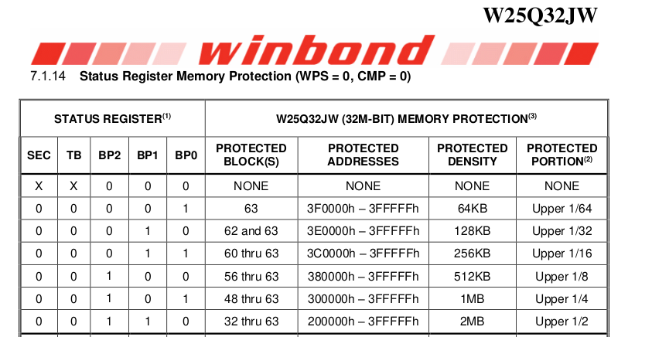
Linux SPI NOR: Overall architecture
About swp.c
SWP - Software Write Protection
Memory array splitted in “protection blocks”
Top/bottom, complement array protection
Will be extended with individual block/sector array protection.

Slide 10
An overview of the linux SPI NOR subsystem
Flash parameters initialization

Slide 11
Linux SPI NOR: Flash parameters initialization
Parameters update sequence
linux/mtd/spi-nor/core.c
spi_nor_init_default_params()
spi_nor_parse_bfpt()
spi_nor_parse_sfdp()
post_bftp() fixup
Parse optional SFPD tables
post_sfdp() fixup
spi_nor_late_init_params()
late_init() fixup

Slide 12
An overview of the linux SPI NOR subsystem
Requirements for flash updates or new flash proposals

Slide 13
Linux SPI NOR: Requirements for flash updates/additions
Flash declaration and flags
Example of a flash update:
{ "gd25q256", INFO(0xc84019, 0, 64 * 1024, 512)
+ PARSE_SFDP
FLAGS(SPI_NOR_HAS_LOCK | SPI_NOR_HAS_TB | SPI_NOR_TB_SR_BIT6)
- NO_SFDP_FLAGS(SECT_4K | SPI_NOR_DUAL_READ | SPI_NOR_QUAD_READ)
FIXUP_FLAGS(SPI_NOR_4B_OPCODES)
.fixups = &gd25q256_fixups },

Slide 14
Linux SPI NOR: Requirements for flash updates/additions
Minimum testing requirement
Dump the sysfs jedec_id, manufacturer, partname and sfdp tables
Check the correctness of erases, writes and reads with mtd_utils

Slide 15
An overview of the linux SPI NOR subsystem
Challenges and future development

Slide 16
Linux SPI NOR: Challenges and future development
Flash ID collisions
Use SFDP tables to differentiate the flashes, where possible
Where run-time differentiation is not possible, use DT to differentiate between them (used as a last resort)

Slide 17
Linux SPI NOR: Challenges and future development
Octal DTR byte swap
Some manufacturers swap the bytes on a 16-bit boundary when flashes are configured in Octal DTR mode.
Bad design decision -> endianness problems. It can affect the boot sequence if the entire boot sequence is not handled in the same mode
Some controllers can swap the bytes back on the fly

Slide 18
Linux SPI NOR: Challenges and future development
FRAMs, MRAMs and SPI NORs
Different kind of memories with their peculiarities
Some FRAMs, MRAMs slip in the SPI NOR driver
Make a generic driver with hooks to handle all

Slide 19
Linux SPI NOR: Challenges and future development
PHY calibration sequence
Needed for high clock speeds in 8D-8D-8D mode
Read predetermined pattern data from the flash and runs a sequence of test reads to find the optimal delays
Nvm cells which point to a fixed partition containing the data to be read. Partitions defined ba command line?

Slide 20
Linux SPI NOR: Challenges and future development
Detecting flash mode at probe
Detecting the flash mode when the flash boots in anything other than 1-1-1 mode (or the flash does not support 1-1-1 mode at all)

Slide 21
Linux SPI NOR: Challenges and future development
SFDP hex dumps and SFDP decoder
License for the vendor SFDP tables
To introduce the SFDP decoder into mtd-utils

Slide 22
Linux SPI NOR: Challenges and future development
Initialize flash solely based on SFDP data
Flash parameters and settings solely discovered by parsing without static parameters declaration.

Slide 23
Questions? Suggestions?
Tudor Ambarus, Pratyush Yadav, Michael Walle

