Slide 1
FACIAL EXPRESSION RECOGNITION
Using Deep Learning
Rahul Ambati

Slide 2
Human facial expressions are complex.
We are well trained in reading different expressions, just a few years old baby can tell the difference between happy and sad.
A question arises can a computer do the same, recognizing facial expressions of a person?
Intention:
If a person can understand facial expression through experience and training so can the computer. The intention is to create a classification model, which can predict a person’s facial expression.
Client:
Any application that needs to classify a person’s facial expression according to a set of predefined labels, before and after an event or activity.
Examples of potential clients, are:
Retail used to evaluate customer interests
Healthcare used to assess patient’s emotional state
Entertainment used to monitor audience’s expressions during an entertaining performance.

Slide 3
Data acquisition and wrangling
The data has been acquired from Kaggle competition.
Facial Expression Recognition Challenge dataset.
The dataset consists of labels, images and test category.
Dataset is clean, no cleaning was necessary.

Slide 4
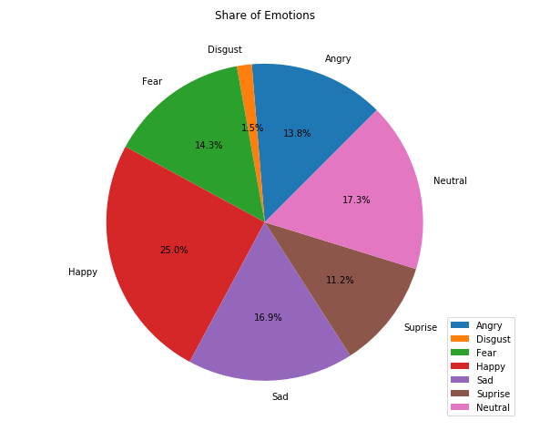
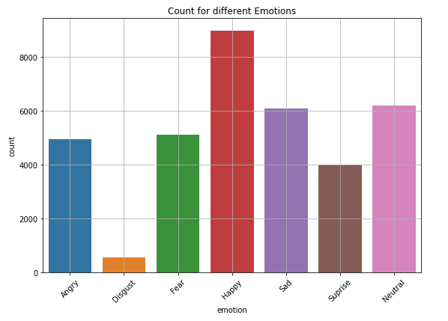
Exploratory Data Analysis
Lot of Happy examples.
Disgust has less examples.

Slide 5
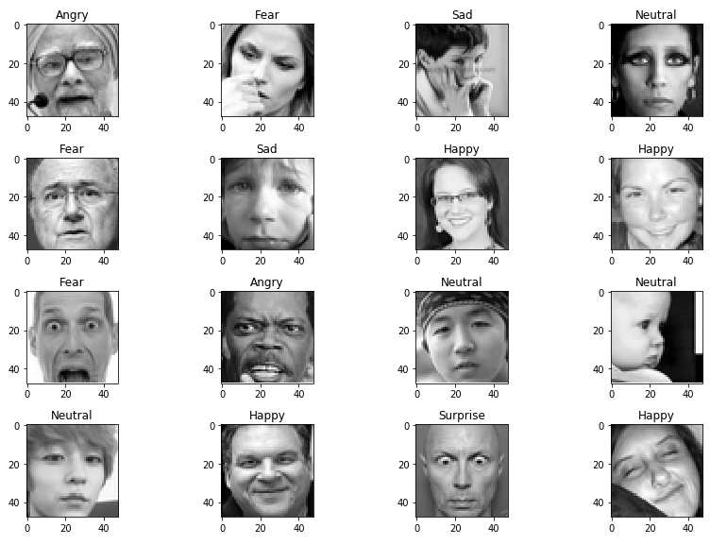
Sample images with labels.
Each image is 48x48 pixels.

Slide 6
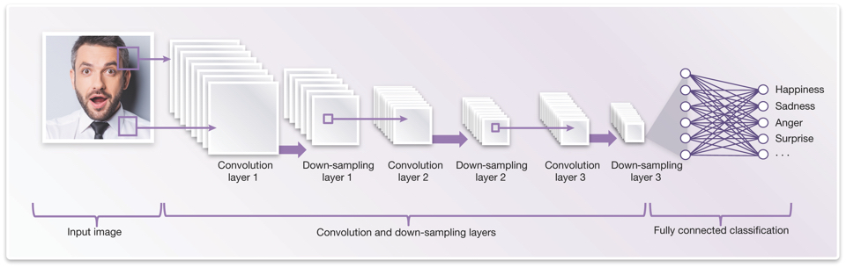
Deep learning for image classification.
Convolutional Neural Network (CNN) is a class of deep, feed-forward artificial neural networks, which is commonly applied to analyzing visual imagery.
CNNs was inspired by biological processes and used to imitate how our brains work in analyzing images.
A typical CNN architecture contains:
Input Convolutional layers Dense layers (fully-connected layers) Output

Slide 7
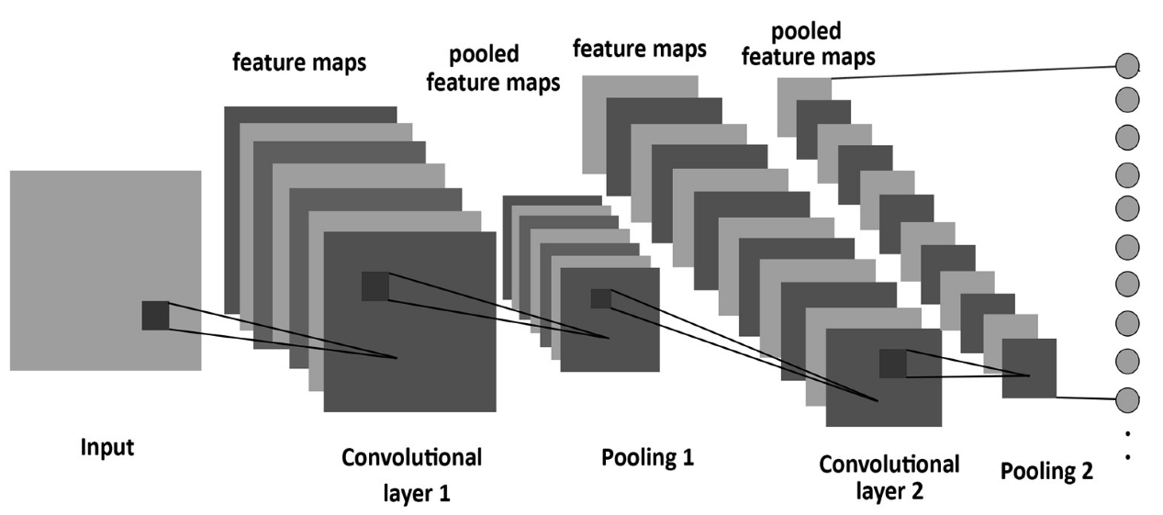
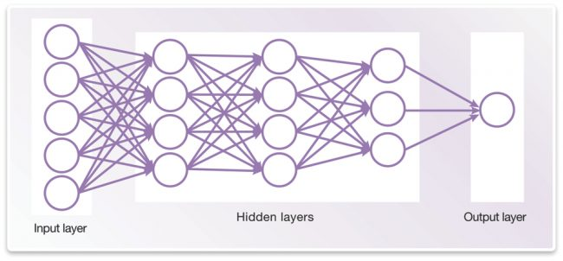
Input is the image
Convolutional layers
(generates features, similar to our eyes)
Dense layers (fully-connected layers)
Output contains labelled classes
Keras is used to create models.
Keras is a high-level neural networks API, written in Python and capable of running on top of TensorFlow, CNTK, or Theano.

Slide 8
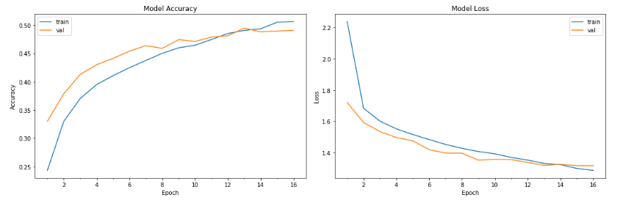
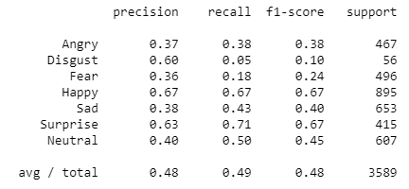
Base Neural Network
Keras.callbacks used for Early Stopping.
“Adam” optimizer is used.
Base Architecture;
Input
2 Convolutions with max-pooling and dropout of 25%
2 Dense layers
Output
Note:
Dropout is used “to prevent over-fitting”, adding penalty to loss function.
An approach to regularization.
Recall’s are pretty low for Disgust, Fear.

Slide 9
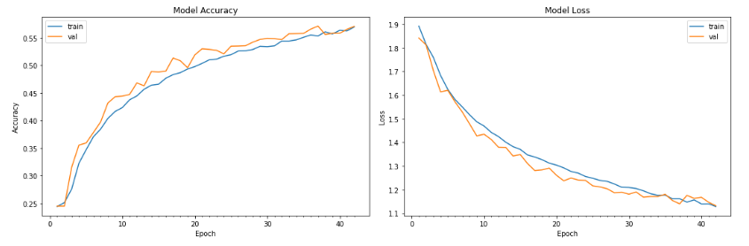
Deep Neural Network
Training stopped around 42 epoch.
Deep Neural Network Architecture;
Input
6 Convolutions with max-pooling and dropout of 25% after 2 convolutions
4 Dense layers with dropout of 25% after 2 layers (256 nodes)
Output

Slide 10
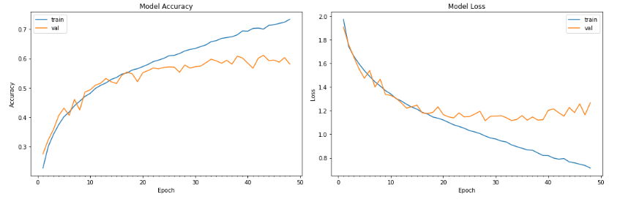
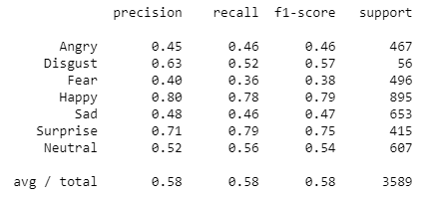
Deep Neural Network with Batch Normalization
Batch Normalization is applied to each layer of the deep neural network.
It’s starts over-fitting.
Training accuracy increasing but not validation score.
Additionally recall has improved significantly.

Slide 11
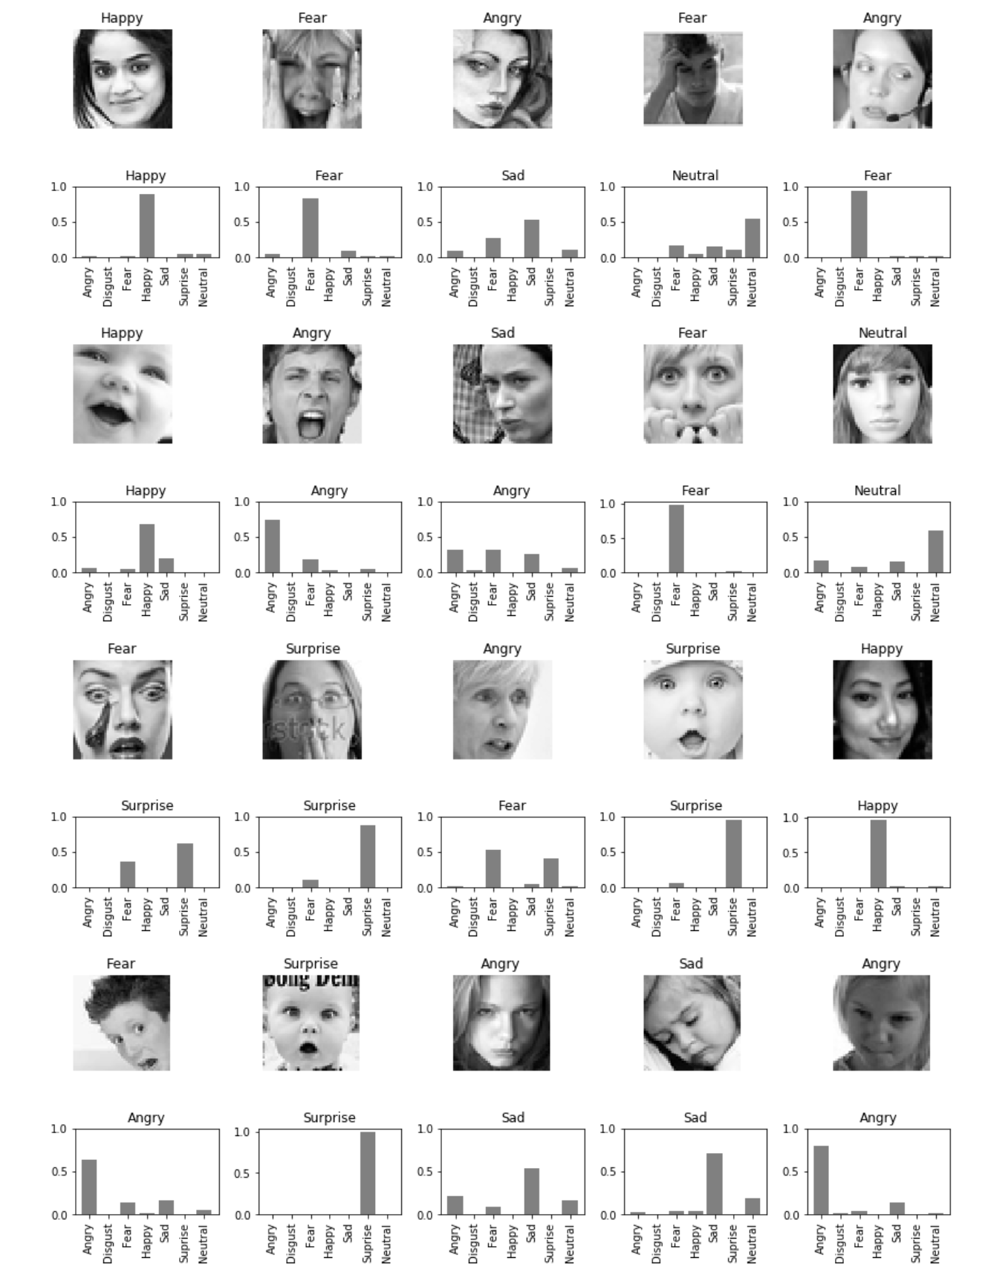
Test images with labels.
Model’s probability for each expression.

Slide 12
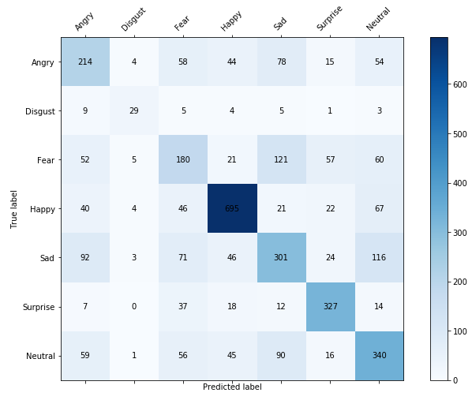
Confusion Matrix, Classification Report

Slide 13
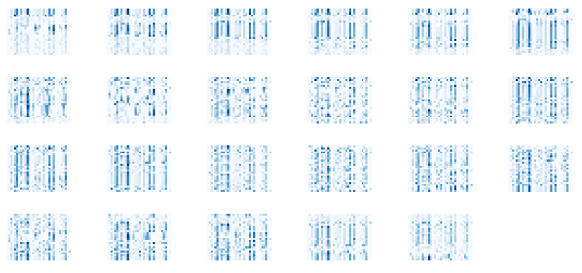
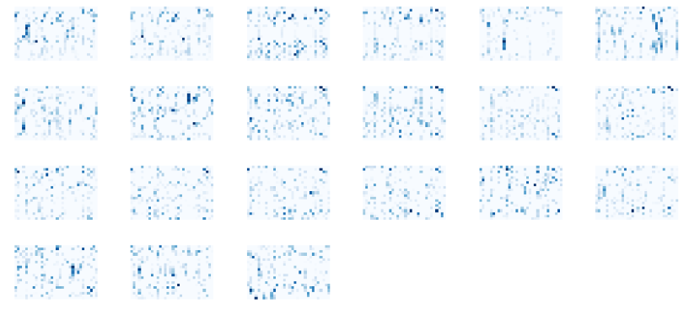
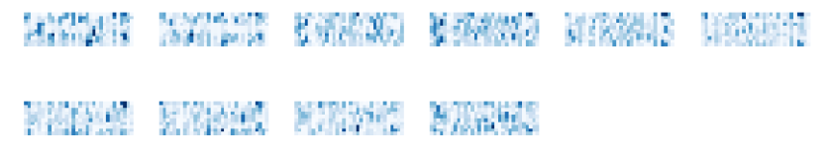
Inner layers visualized.
Low level features picked up after one convolution and batch normalization.
Features after two convolutions with max-pooling and batch normalizations.
Features picked up after four convolutions.

Slide 14
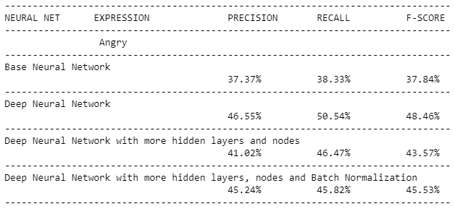
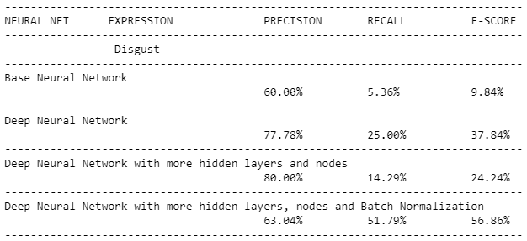
Model Comparisons.
Angry has low metrics in general even with deep neural networks.
Disgust has a low recall but after batch normalization it’s recall improved significantly.
Despite Disgust having few training samples the batch normalization did good in recognizing the expression.

Slide 15
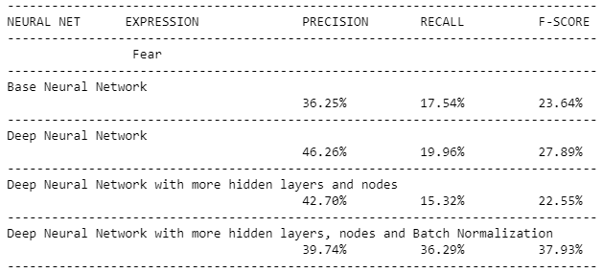
Fear expression has low metrics in general for all neural networks.

Slide 16

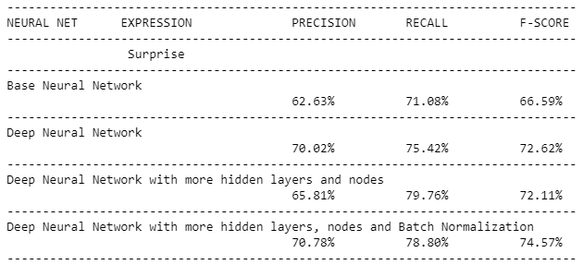
Happy and Surprise have really good metrics for all neural networks.
Also, most of the neural networks built have good metrics in predicting Happy and Surprise expressions, but not for Disgust and Fear.

Slide 17
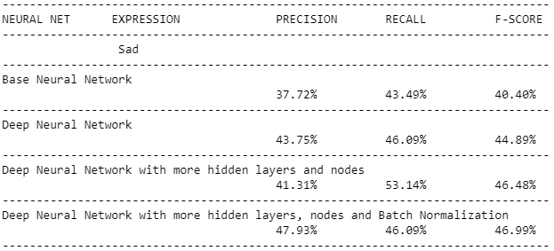
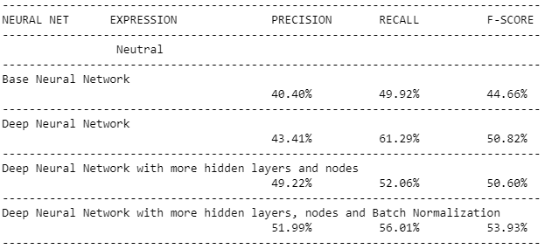
After batch normalization when compared to other neural networks overall metrics improved.
Sad and Neutral expressions, the metrics did not improve significantly.

Slide 18
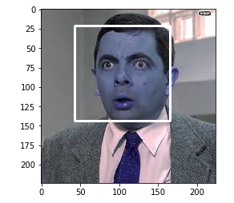
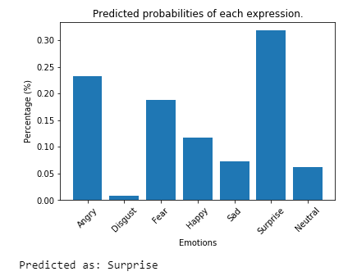
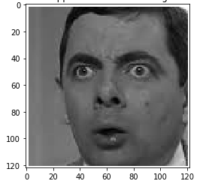
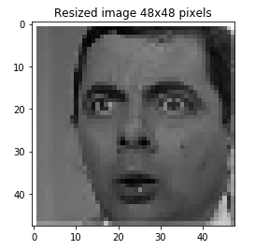
Model’s prediction on real images.
Mr. Bean is Surprised ?
Good Prediction.

Slide 19
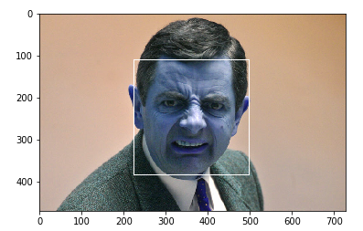
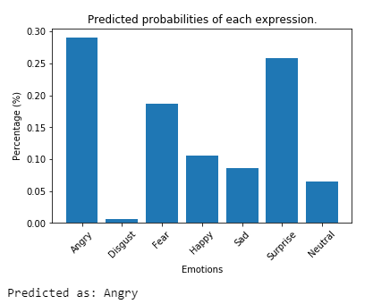
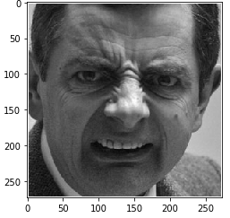
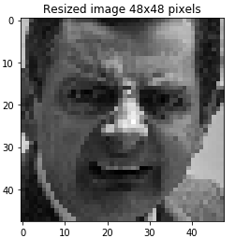
What about this facial expression ?
Disgusted Mr. Bean
OpenCV is used to detect face, crop the image and resize it.
The resized image is feed it to the model to make prediction.
Prediction is wrong.
Mr. Bean has a Disgust look.

Slide 20
Findings
The dataset is imbalanced.
Deep learning is good for image classification, but it needs a lot of examples to be trained on.
A baseline neural network accuracy was less than 50% and it has very low precision and recall scores.
Deep neural networks increased accuracy more than 50% but recall was still low for certain labels.
More layers or nodes does not mean better results (they could be overfitting or byhearting).
After Batch Normalization on each layer, metrics improved significantly especially for labels with low recall.
Deep neural network with Batch Normalization had accuracy of 58.12% which is the best among the implemented architectures.

Slide 21
Ideas for Further Research
Add samples to the minority classes in the dataset.
Image augmentation (blur, crop, flip, rotate, translate, etc.) techniques can be used when there are less number of samples for a class.
Instead of using a single model, an ensemble of multiple models can be used.
Can use pre-trained models for facial expressions by training them on the dataset. Since pre-trained models have certain patterns, features built-in one can replace the classification output layer and tune, or add few layers, according the dataset.

Slide 22
Client Recommendations
The model can be used in real-time facial expression recognition such as on webcams or live pictures. The model can be linked up to any facial recognition software and make it to do predictions.
In sales, clients can use the model to detect the change in facial to drive flash-deals in real time.
Using the model client can build an API (a REST API) to predict facial expressions. Using the API, a micro service can be provided in predicting facial expressions of person – FEAS (Facial Expression as a Service).

Slide 23
Thank you.

