Slide 1
Transcript Intelligence
Turning call transcripts into product, support, and revenue insights
100
6
transcripts analyzed
business themes
Take-home assignment | Product and Engineering Leadership

Slide 2
Executive Summary
The prototype turns raw transcript folders into decision-ready intelligence.
100
50
35
15
transcripts
support calls
external calls
internal calls
Support is the clearest risk surface: technical reliability themes carry the lowest average sentiment.
External calls show renewal and expansion context; trust issues cluster around outage, SLA, pricing, and competitive language.
Internal calls expose whether engineering planning is aligned with customer-facing pain.
Recommended path: operationalize escalation risk, route feature requests to PM review, and build stakeholder-specific views.

Slide 3
What I Built
A repeatable batch pipeline with optional room for LLM-assisted labeling later.
Raw JSON folders
Normalization
Call-type inference
Theme labeling
Sentiment scoring
Insight layer
Stakeholder outputs
Default path runs locally with pandas, scikit-learn, matplotlib, and transparent rules.
LLM use is deliberately optional, so the project works without paid API keys.

Slide 4
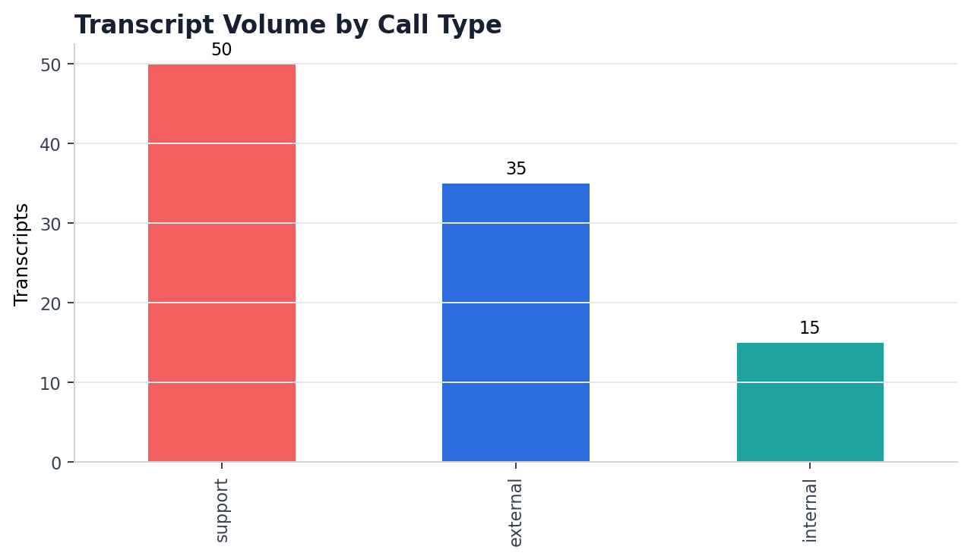
Dataset Overview
The source data includes meeting metadata, transcript turns, topics, summaries, action items, and key moments.
100 transcript folders discovered; each contains six JSON files.
No explicit call_type field was present, so type was inferred from title, content, and email domains.
Customer/account identity is inferred from non-aegiscloud.com email domains where available.
The data quality is strong: structured summaries, topics, action items, speaker names, and sentence-level timestamps are available.

Slide 5
Topic Categorization Approach
Hybrid beats pure rules or pure black-box classification for this assignment.
Discovery: TF-IDF + clustering reveals natural groupings across titles, summaries, and provided topics.
Interpretation: keyword and phrase analysis converts clusters into human-readable business themes.
Grounding: examples and representative keywords are saved for each theme so leaders can inspect the evidence.
Production path: optional LLM labeling can improve nuance, but should be validated against a stakeholder-approved taxonomy.

Slide 6
Themes Identified
The taxonomy prioritizes business actionability over academic topic labels.
Theme | Count | Dominant type | Why it matters
Product bugs and technical reliability | 44 | support | Turns repeated defects into prioritizable engineering work and reduces support
Compliance and audit readiness | 25 | external | Connects product value to regulated buyer urgency and audit deadlines.
Renewal, pricing, and account risk | 16 | support | Highlights revenue risk before the renewal motion becomes reactive.
Internal engineering planning | 8 | internal | Reveals whether engineering execution is aligned with customer-facing pain.
Feature requests and product feedback | 6 | support | Converts customer language into roadmap evidence for PMs.
Onboarding, adoption, and enablement | 1 | external | Shows where customers need enablement before low adoption becomes churn.

Slide 7
Theme Examples
Representative summaries show why the labels matter.
Theme | Example transcript signal
Product bugs and technical reliability | 01KQ2D93184912F0147315E7: Julia Tran from Blackridge Investments called Aegis Cloud Security support in a critical situation where her firm has h
Compliance and audit readiness | 01KQ445B1B5B890316C9E300: Raj facilitated a team standup with Ravi and Sofia covering post-mortem follow-ups from the Detect outage and the Compl
Renewal, pricing, and account risk | 01KQ1DCC80852AE384C898C9: Maria Santos met with Brianna Foster and Leo Marquez to address a serious six-hour outage on March 10-11 that caused a

Slide 8
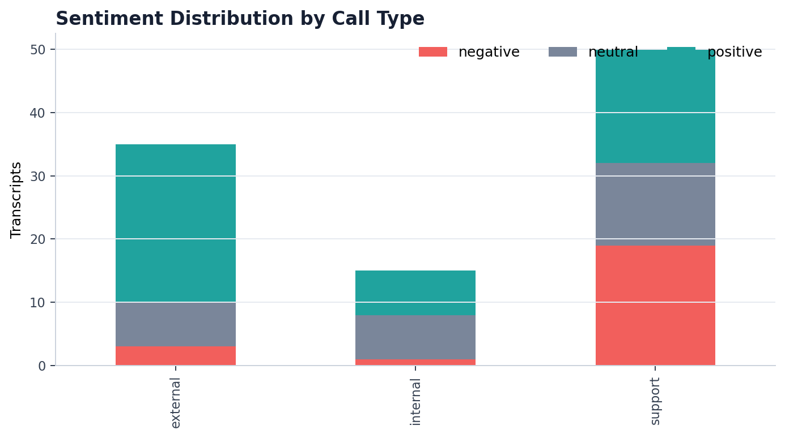
Sentiment Across Call Types
Support calls are the strongest negative signal.
Support has the highest concentration of negative transcripts.
External calls skew positive, but negative moments often carry revenue implications.
Internal calls are mixed: useful for tracking execution pressure and confidence.

Slide 9
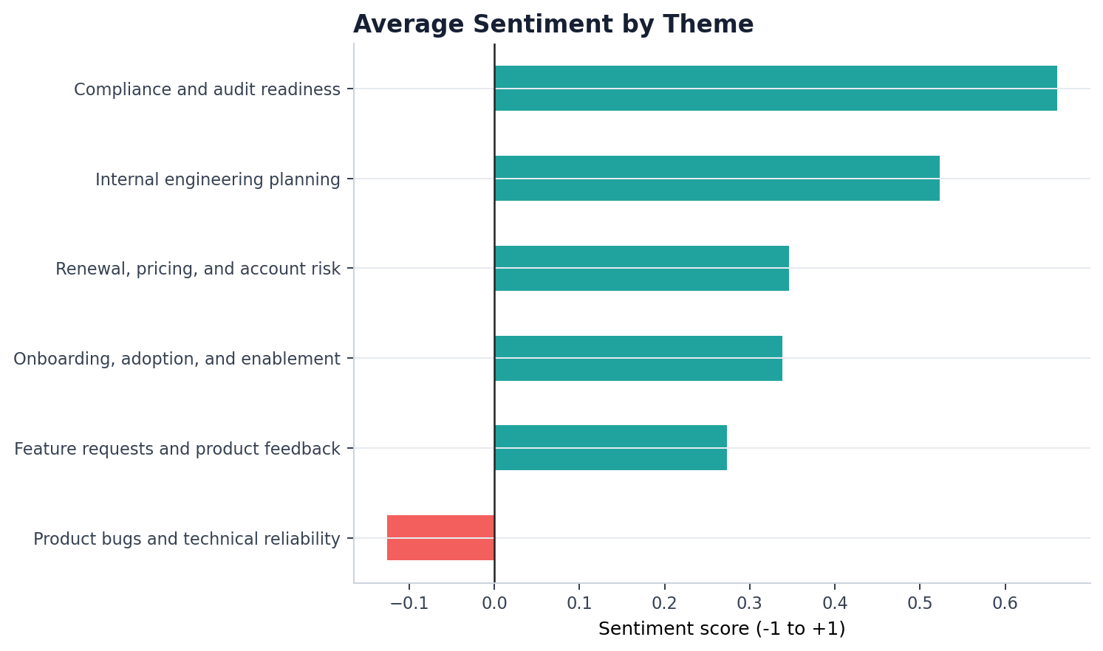
Sentiment by Theme
Technical reliability is the most important pain cluster.
Reliability and outage themes are negative because customers experience them as lost trust, not just technical inconvenience.
Compliance themes are more positive because the product directly supports urgent audit and regulated-buyer needs.

Slide 10
Trend 1: Reliability Is a Product Risk
Support calls concentrate negative sentiment around outage, SLA, and technical issue language.
What it means: technical friction is creating both support burden and account trust risk.
Why it may be happening: customers depend on Detect/backup/security workflows where downtime has high business impact.
Who should care: support leaders, product managers, and engineering leads.
Action: prioritize reliability fixes, publish clearer incident comms, and create an escalation review for top negative reliability transcripts.

Slide 11
Trend 2: External Calls Carry Renewal Context
External conversations reveal both expansion opportunity and risk signals.
What it means: positive external sentiment is encouraging, but risk terms around renewal, pricing, SLA, and competitors need account workflows.
Why it may be happening: buyers see value in compliance and security outcomes, while reliability incidents affect confidence.
Who should care: sales leaders, account managers, and customer success.
Action: connect risk scores to CRM ownership and trigger proactive renewal plays.

Slide 12
Additional Insight: Escalation Risk
Urgent language and SLA/outage markers create an early-warning queue.
Transcript | Type | Risk | Owner | Reason
01KQ2331EFD78BF3B1CAB747 | support | 9 | engineering + support | urgent, escalat, sla, outage, executive, critical
01KQ2D93184912F0147315E7 | support | 9 | engineering + support | escalat, sla, breach, outage, executive, critical
01KQ46A9DE0AECB006D897A0 | support | 9 | engineering + support | escalat, sla, outage, downtime, executive, critica
01KQ38C4101D6774F2F02331 | support | 8 | engineering + support | escalat, sla, breach, outage, critical
01KQ6A5CEAAFFBE3B0099E75 | support | 8 | engineering + support | escalat, outage, downtime, critical, unresolved
Value: helps teams catch customer pain before it becomes churn, SLA exposure, or executive escalation.

Slide 13
Additional Insight: Feature Request Mining
Customer language becomes roadmap evidence.
Requested capability | Frequency | Call types
alerting and escalation | 78 | {"internal": 12, "support": 41, "external": 25}
export and reporting | 77 | {"internal": 11, "external": 33, "support": 33}
dashboarding and analytics | 67 | {"internal": 11, "external": 25, "support": 31}
onboarding and documentation | 59 | {"internal": 8, "support": 24, "external": 27}
integration and API reliability | 52 | {"support": 23, "internal": 7, "external": 22}
granular restore and backup controls | 33 | {"external": 16, "support": 12, "internal": 5}
Product managers can inspect examples rather than rely on anecdotes.
Repeated asks around integrations, API, dashboards, automation, and reporting become roadmap candidates.
Pair frequency with revenue/risk context before prioritizing.

Slide 14
Additional Insight: Churn and Stakeholder Views
Different teams need different slices of the same transcript intelligence.
Stakeholder | Top theme | Neg. | Recommended action
Support leader | Product bugs and technical reliability | 22 | Create a weekly negative-theme and escalation-risk review.
Product manager | Compliance and audit readiness | 0 | Validate top requests with PM taxonomy and attach examples to roadmap candidates.
Sales / account manager | Renewal, pricing, and account risk | 4 | Trigger proactive account plays for high-risk renewal conversations.
Engineering lead | Product bugs and technical reliability | 21 | Tie incident and bug clusters to reliability roadmap ownership.

Slide 15
Product Vision
From analysis prototype to enterprise transcript intelligence layer.
Searchable transcript intelligence across support, external, and internal calls.
Topic and sentiment dashboards for support, product, account, and engineering leaders.
Risk alerts for escalations, renewal threats, and repeated unresolved issues.
Voice-of-customer mining that feeds product roadmap and documentation priorities.
Integrations with CRM, support tools, and project planning systems.

Slide 16
Technical Architecture
Start batch-first; evolve toward near-real-time routing and alerting.
Ingestion
Preprocess
Embeddings / TF-IDF
Classify + sentiment
Insight generation
Dashboard / API
The current implementation is deterministic and inspectable; LLM steps can be added for labeling and summarization when validation is available.
A production system should store transcript metadata, embeddings, predictions, examples, and human feedback separately.

Slide 17
Limitations and Tradeoffs
The design is intentionally practical and transparent.
Sample size is modest; themes should be validated as more transcripts arrive.
Call type is inferred because no explicit field exists.
Sentiment is context-sensitive; constructive outage calls can still indicate serious customer risk.
Rule-based taxonomy is explainable but may miss nuance; LLM labeling would need evaluation and review.
Account names are inferred from email domains when explicit customer fields are unavailable.

Slide 18
Recommendations
Make the prototype useful by connecting insights to ownership.
Prioritize the top negative reliability themes with support and engineering.
Create a weekly escalation-risk workflow with owners and SLA follow-through.
Use feature request mining as an input to roadmap review, not as an automatic prioritization score.
Build stakeholder dashboards around the questions each team actually asks.
Validate taxonomy and thresholds with support, product, sales, and engineering leaders.

Slide 19
Demo Walkthrough
The demo is designed to be short, concrete, and reproducible.
Show the project structure and raw dataset folder.
Run `run_pipeline.py` and confirm outputs are generated.
Open processed transcripts, topic summary, sentiment summary, and additional insights.
Show charts used by the deck.
Close with productization path: search, dashboards, risk alerts, and workflow integrations.

Slide 20
Q&A
How would you use transcripts to change decisions before problems become obvious?

