Slide 1
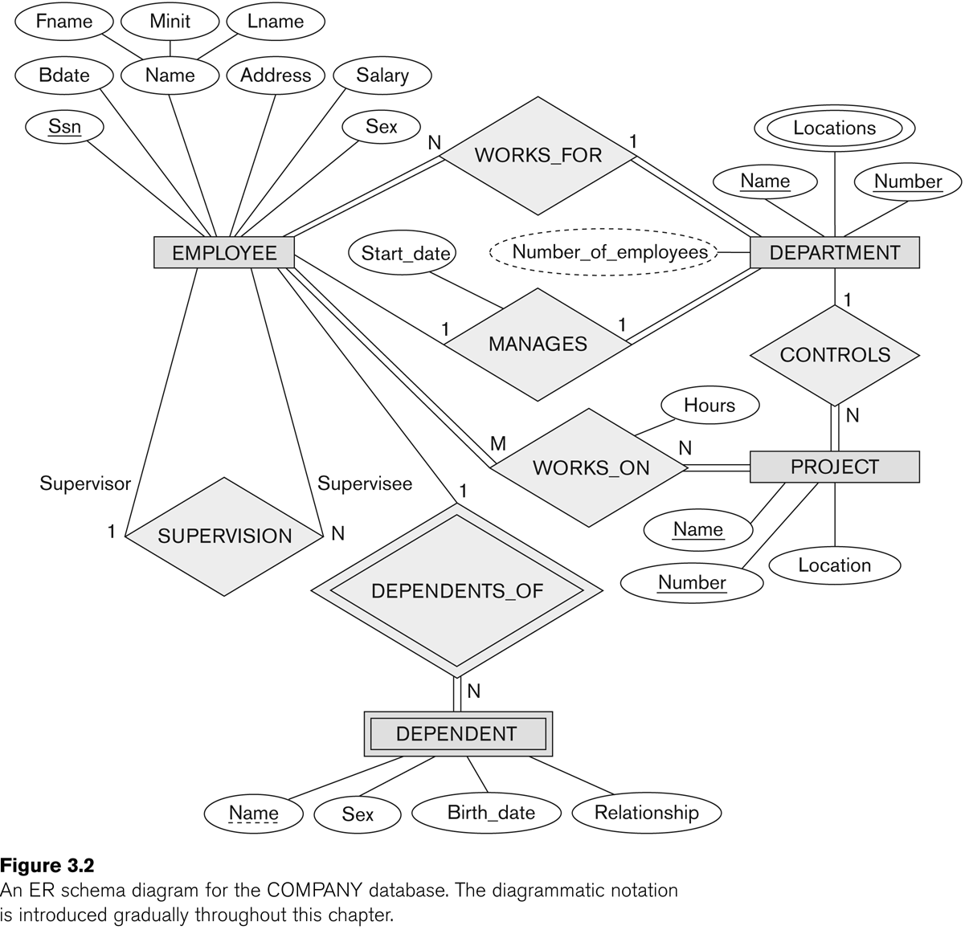
ER (Entity Relationship) Diagram in Chen Notations
References
Modeling Using the Entity–Relationship (ER) Model (chapter 3, Fundamentals of Database Systems by Elmasri)
https://vertabelo.com/blog/chen-erd-notation

Slide 2
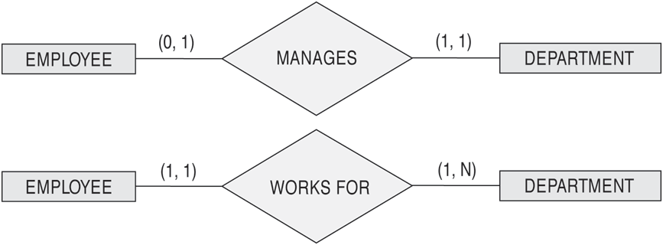
(min,max) notation
Read the min,max numbers next to the entity type and
looking away from the entity type

Slide 3
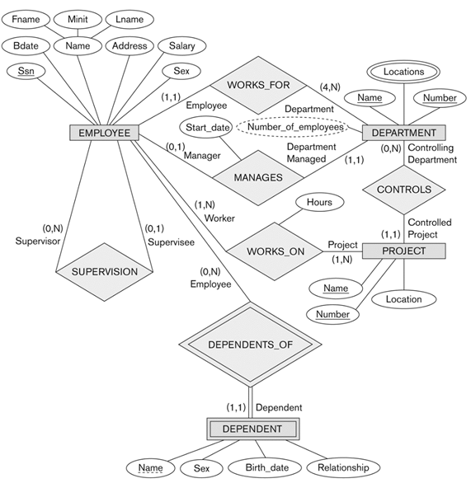
ER Diagram for company using min-max notation and role names

Slide 4
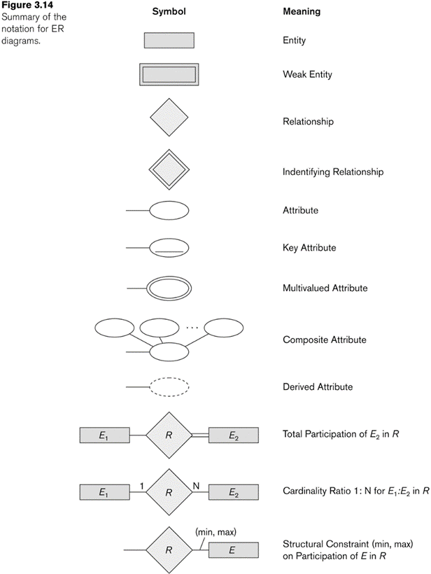
Summary of Chen notation for ERD

Slide 5
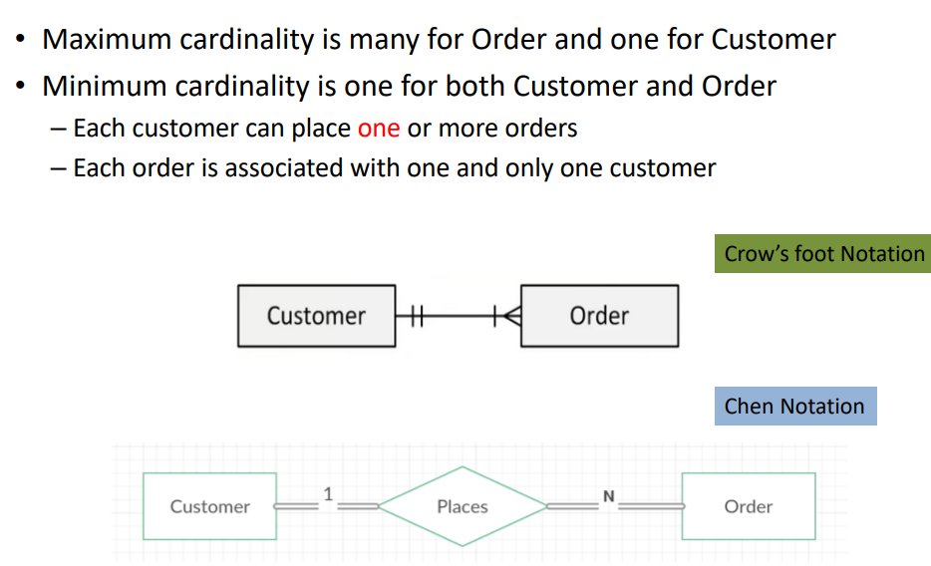
Cardinality Example

Slide 6
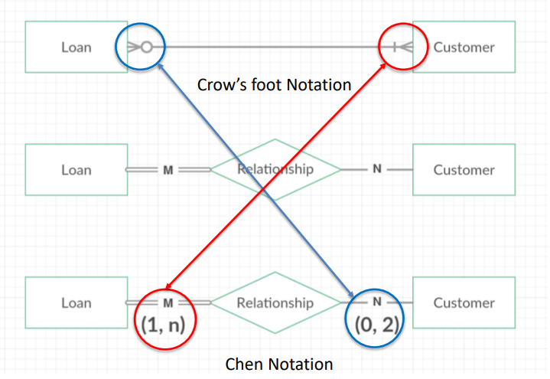
Different Representations

Slide 7
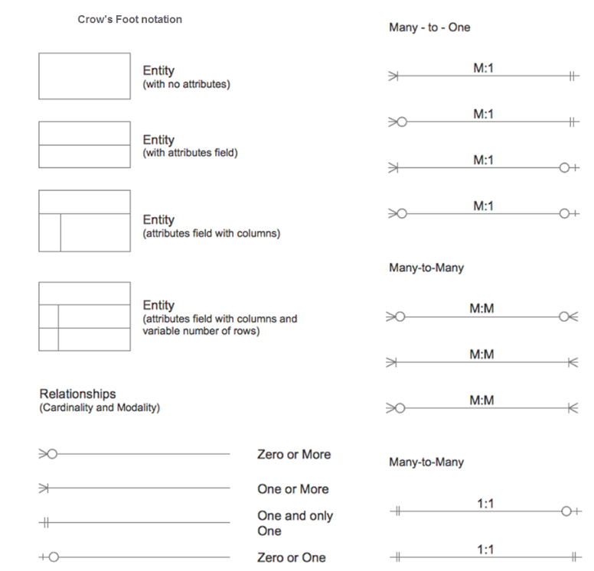
Crow’s Foot notation

Slide 8
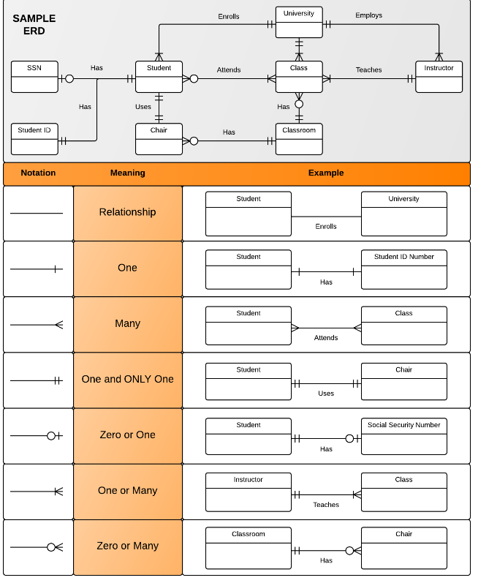
Crow’s Foot Notation Example

Slide 9
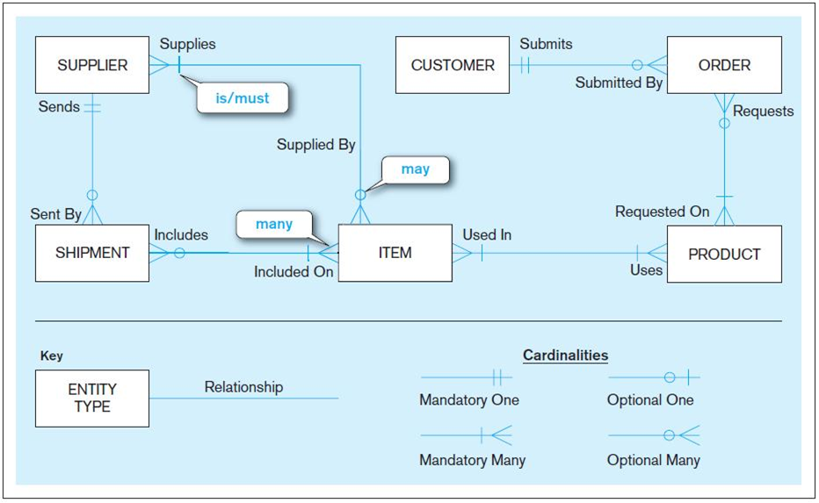
Crow’s Foot Notation Example

Slide 10
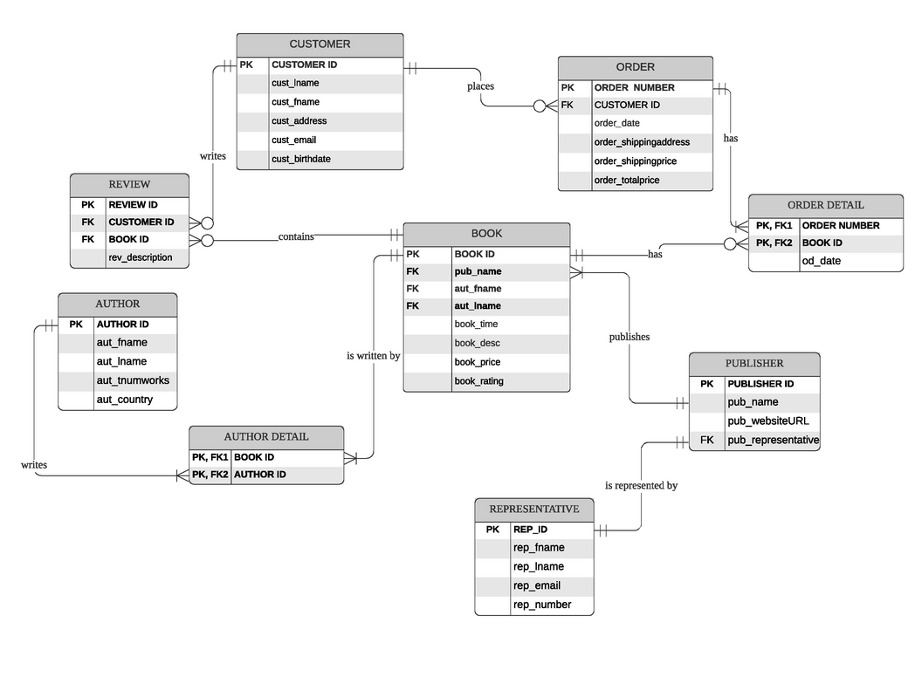
Crow’s Foot Notation Example

Slide 11
Superclass / Subclass Relationship
An entity class can posses groups of such entities that contain some special properties, not immanent to the other ones
e.g.
Person class contains many such groups like: students, employees, children, retired,…
Student class may be divided into full time and part time students, or undergraduate, graduate, master, and doctorate students
To enhance the semantic power of the ER data model, there is a superclass / subclass relationship introduced

Slide 12
Superclass / Subclass Relationship
EmployeeID
Name
Position
Employee
Works_
for
M
1
Position
Department
Superclass
Project
1
Secretary
Programmer
M
Works_
on
TypeSpeed
NoOfLang
Subclass

Slide 13
Superclass / Subclass Relationship
A subclass contains only specific attributes and may participate in relationship types by its own
A subclass is a specialization of its superclass
The superclass is generalization of all its subclasses
Specialization and generalization are inverses of each other
An instance of the subclass is also an instance of the superclass
These two instances represent the same real entity
A subclass instance inherits all the superclass attribute values and all relationship participations from its image in the superclass

Slide 14
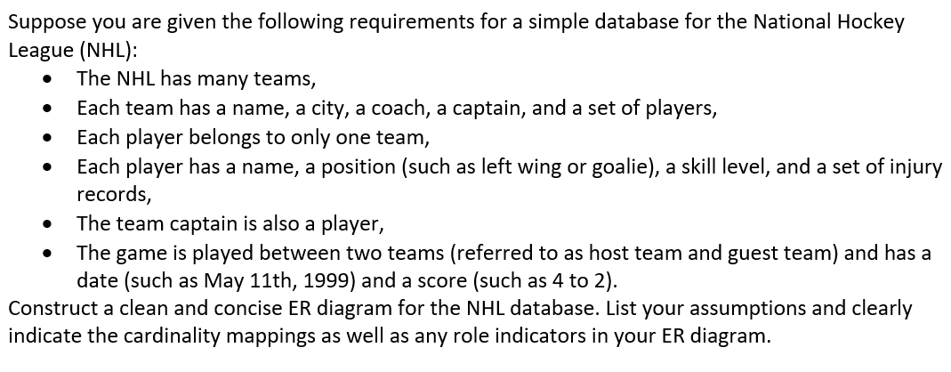
Quiz

