Slide 1
Multi-level Indexes
Because a single-level index is an ordered file, we can create a primary index to the index itself; in this case the original index file is called the first-level index and the index to the index is called the second-level index.
We can repeat the process, creating a third, fourth,… top level until all entries at the top level fit in one disk block.
A multi-level index can be created for any type of first-level index as long as the first-level index consists of more than one disk block.

Slide 2
Multi-level Indexes
Such a multi-level index is a form of a search tree; however, insertion and deletion of new index entries is a severe problem because every level of the index is an ordered file.

Slide 3
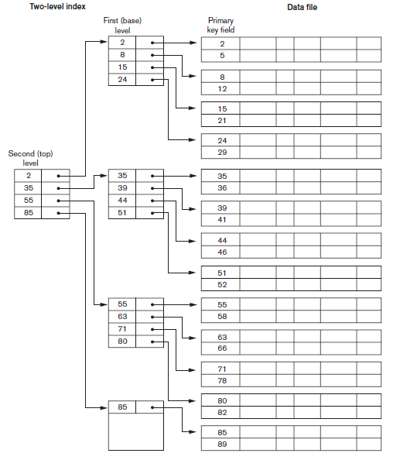
Multilevel Index (Cont.)

Slide 4
Index Update: Deletion
If deleted record was the only record in the file with its particular search-key value, the search-key is deleted from the index also.
Single-level index deletion:
  Dense indices – deletion of search-key is similar to file record deletion.
  Sparse indices – if an entry for the search key exists in the index, it is deleted by replacing the entry in the index with the next search-key value in the file (in search-key order). If the next search-key value already has an index entry, the entry is deleted instead of being replaced.

Slide 5
Index Update: Insertion
Single-level index insertion:
  Dense indices – if the search-key value does not appear in the index, insert it.
  Sparse indices – if index stores an entry for each block of the file, no change needs to be made to the index unless a new block is created. In this case, the first search-key value appearing in the new block is inserted into the index.

Slide 6

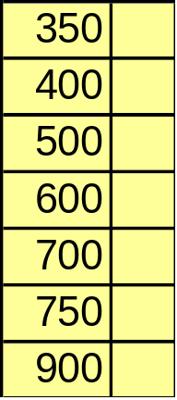
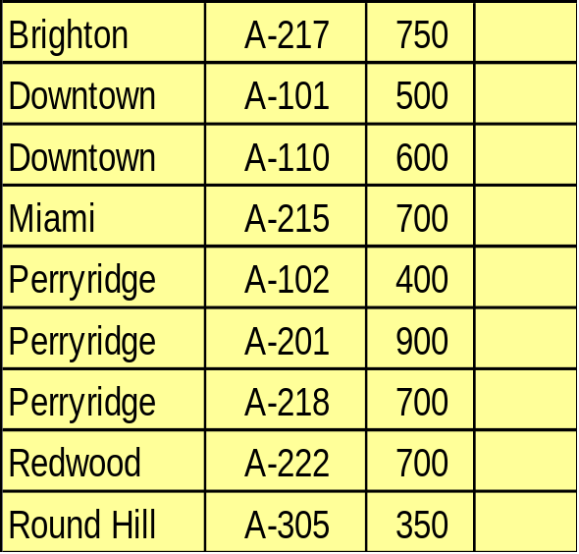

Secondary Index on balance field of account

Slide 7
Bitmap Index
A bitmap index for attribute A of relation R is:
  A collection of bit-vectors
  The number of bit-vectors = the number of distinct values of A in R.
  The length of each bit-vector = the cardinality of R.
  The bit-vector for value v has 1 in position i, if the ith record has v in attribute A, and it has 0 there if not.
Records are allocated permanent numbers
There is a mapping between record numbers and record addresses.

Slide 8
Example
Assume relation R with
  2 attributes A and B.
  Attribute A is of type Integer and B is of type String.
  6 records, numbered 1 through 6 as follows:
    A, B
    30, foo
    30, bar
    40, baz
    50, foo
    40, bar
    30, baz
  A bit map for attribute B is:
value | Vector
foo | 100100
bar | 010010
baz | 001001

Slide 9
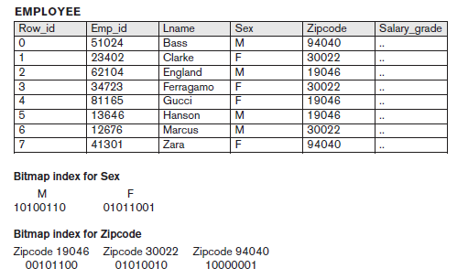
Bitmap Index

Slide 10
Dynamic Multilevel index
To retain the benefits of using multilevel indexing while reducing index insertion and deletion overhead, designers adopt multilevel index that leaves some space in each of its blocks for inserting new entries
This is called dynamic multilevel index and is often implemented by B-trees and B+ trees.

Slide 11
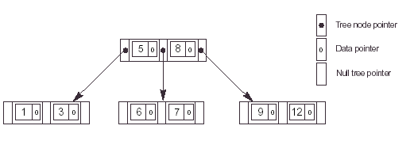
B Tree

Slide 12
B-Trees
A Tree data structure where each node has a predetermined maximum fan-out p
Terminologies: root node, leaf nodes, internal nodes, parent, children

Slide 13
Structure of a Node
K₁
K₂
K_{i-1}
K_{i}
X < K₁
Data
Pointer
K₁ <
X < K₂
Data
Pointer
X > K
Left-most
Subtree
Right-most
Subtree

Slide 14

B Tree insertion

Slide 15

Order of B-Tree

Slide 16
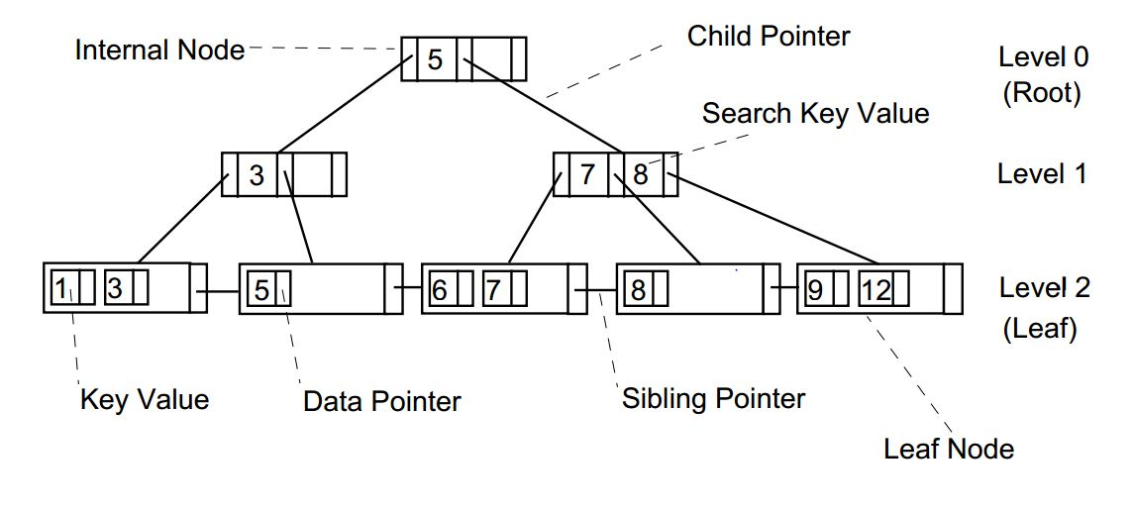
Structure of B+ Tree

Slide 17

Order of B+ tree

