Slide 1

Machine Learning AI3002
Lecture 01

Slide 2
What is Machine learning in simple words?
Machine learning is a branch of artificial intelligence (AI) and computer science that focuses on the use of data and algorithms to imitate the way that humans learn.

Slide 3
What is Machine learning in simple words?
Arthur Samuel (1959). Machine Learning: Field of study that gives computers the ability to learn without being explicitly programmed.

Slide 4
What is Machine learning in simple words?
Tom Mitchell (1998) A computer program is said to learn from experience E with respect to some task T and some performance measure P, if its performance on T, as measured by P, improves with experience E.
Suppose your email program watches which email you do or do not mark as spam, and based on that learns how to better filter spam.
Classifying emails as spam or not spam. (T)
Watching you label emails as spam or not spam. (E)
The number (or fraction) of emails correctly classified as spam/not spam. (P)

Slide 5
Types of Machine Learning Algorithms
Supervised Learning
Unsupervised Learning
Reinforcement Learning

Slide 6
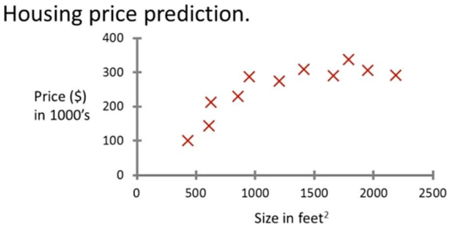
Supervised Learning (Regression)

Slide 7
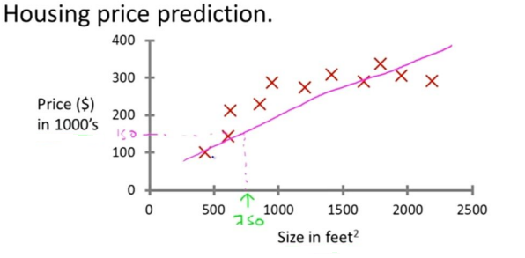
Supervised Learning (Regression)

Slide 8
Supervised Learning (Regression)
Regression: Predict continuous valued output (price)

Slide 9

Supervised Learning (Classification)
An emergency room in a hospital measures 17 variables (e.g., blood pressure, age, etc.) of newly admitted patients. A decision must be taken whether to put the patient in an intensive-care unit. Due to the high cost of ICU, those patients who may survive less than a month are given higher priority. The problem is to predict high-risk patients and discriminate them from low-risk patients.

Slide 10
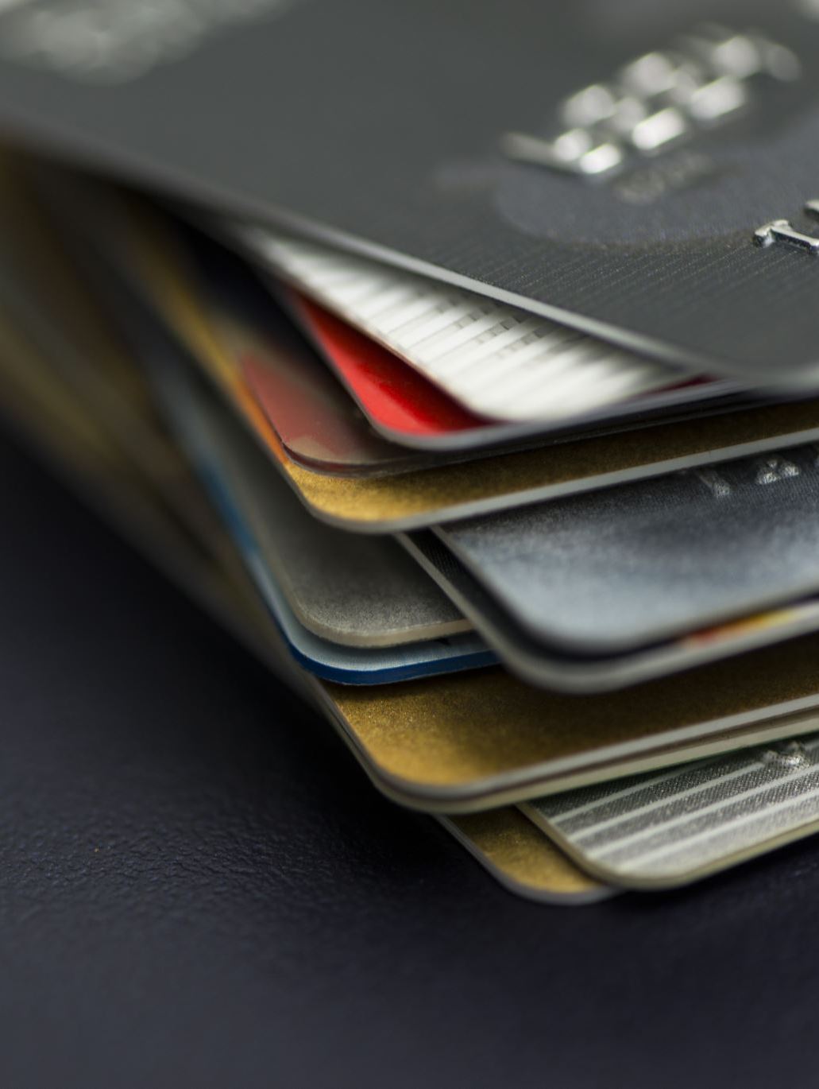
Supervised Learning (Classification)
A credit card company typically receives thousands of applications for new cards. The application contains information regarding several different attributes, such as annual salary, any outstanding debts, age etc. The problem is to categorize applications into those who have good credit, bad credit, or fall into a gray area (thus requiring further human analysis).

Slide 11

Supervised Learning (Classification)
Data: It has k attributes A1 , … Ak . Each tuple (case or example) is described by values of the attributes and a class label.
Goal: To learn rules or to build a model that can be used to predict the classes of new (or future or test) cases.
The data used for building the model is called the training data.

Slide 12
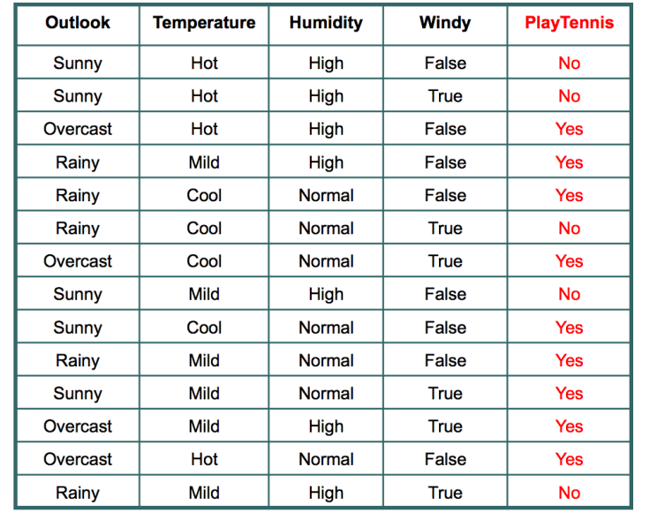
Supervised Learning (Classification)

Slide 13
Classification Two-Step Process
Model construction: describing a set of predetermined classes based on a training set. It is also called learning.
Each tuple/sample is assumed to belong to a predefined class
The model is represented as classification rules, decision trees, or mathematical formulae .
Model usage: for classifying future test data/objects
Estimate accuracy of the model
The known label of test example is compared with the classified result from the model
Accuracy rate is the % of test cases that are correctly classified by the model
If the accuracy is acceptable, use the model to classify data tuples whose class labels are not known.

Slide 14
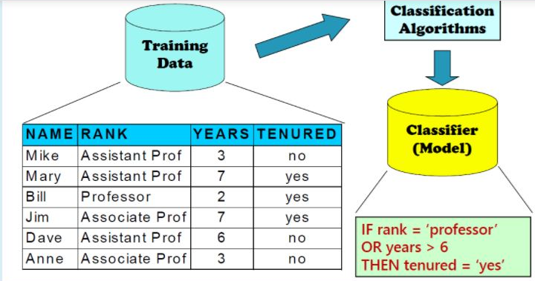
Classification Process (1): Model Construction

Slide 15
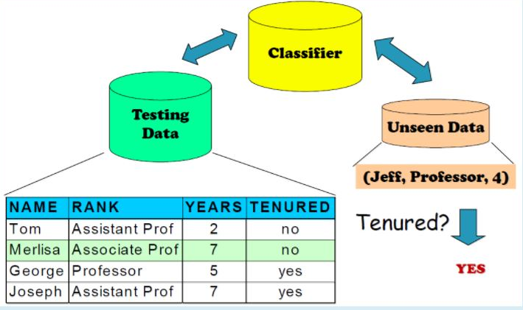
Classification Process (2): Use the Model in Prediction

Slide 16
Supervised vs Unsupervised Learning
Supervised learning: classification is seen as supervised learning from examples.
Supervision: The training data (observations, measurements, etc.) are accompanied by labels indicating the classes of the observations/cases.
New data is classified based on the training set
Unsupervised learning (clustering)
The class labels of training data is unknown
Given a set of measurements, observations, etc. with the aim of establishing the existence of classes or clusters in the data

Slide 17
Clustering
Clustering is a technique for finding similar groups in data, called clusters. i.e.,
It groups data instances that are similar to (near) each other in one cluster and data instances that are very different (far away) from each other into different clusters.
Clustering is often called an unsupervised learning task as no class values denoting an a priori grouping of the data instances are given, which is the case in supervised learning.

Slide 18
What is clustering for?
Let us see some real-life examples
Example 1: groups people of similar sizes together to make “small”, “medium” and “large” T-Shirts.
Tailor-made for each person: too expensive
Example 2: In marketing, segment customers according to their similarities
To do targeted marketing.

Slide 19
What is clustering for?
Example 3: Given a collection of text documents, we want to organize them according to their content similarities,
To produce a topic hierarchy
It has a long history, and used in almost every field, e.g., medicine, psychology, botany, sociology, biology, archeology, marketing, insurance, libraries, etc.
In recent years, due to the rapid increase of online documents, text clustering becomes important.

Slide 20
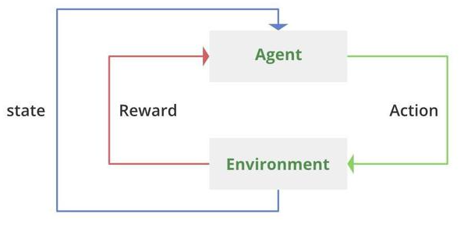
Reinforcement learning
In reinforcement learning, an agent interacts with an environment with an objective to maximize its total reward.
The agent takes an action based on the environment state and the environment returns the reward and the next state. The agent learns from trial and error, initially taking random actions and over time identifying the actions that lead to long-term rewards.

