Slide 1
Classification Decision Tree Algorithm

Slide 2
Building a decision tree: an example training dataset

Slide 3
Output: A Decision Tree for “buys_computer”
age?
<=30
overcast
>40
30..40
student?
yes
credit rating?
no
yes
excellent
fair
no
yes
no
yes

Slide 4
DECISION TREES
Decision Tree Representation
The target function can be Boolean or discrete valued
Each node corresponds to an attribute
Each branch corresponds to an attribute value
Each leaf node assigns a class

Slide 5
DECISION TREES
Basic Decision Tree Learning Algorithm
Most algorithms for growing decision trees are variants of a basic algorithm
An example of this core algorithm is the ID3 algorithm
It employs a top-down, greedy search through the space of possible decision trees

Slide 6
DECISION TREES
Basic Decision Tree Learning Algorithm
First of all we select the best attribute to be tested at the root of the tree
For making this selection each attribute is evaluated using a statistical test to determine how well it alone classifies the training examples

Slide 7
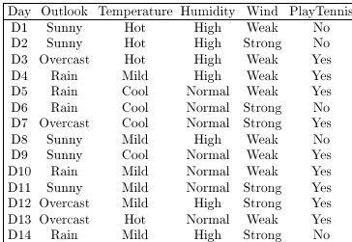
DECISION TREES
Basic Decision Tree Learning Algorithm

Slide 8
DECISION TREES
Basic Decision Tree Learning Algorithm
We have
14 observations
4 attributes
Outlook
Temperature
Humidity
Wind
2 classes (Yes, No)
D12
D11
D1
D2
D5
D10
D4
D6
D3
D14
D8
D9
D7
D13

Slide 9
DECISION TREES
Basic Decision Tree Learning Algorithm
Outlook
Sunny
Rain
Overcast
D10
D6
D1
D8
D3
D14
D4
D11
D12
D9
D2
D7
D5
D13

Slide 10
DECISION TREES
Basic Decision Tree Learning Algorithm
The selection process is then repeated using the training examples associated with each descendant node to select the best attribute to test at that point in the tree

Slide 11
DECISION TREES
Outlook
Sunny
Rain
Overcast
D10
D6
D1
D8
D3
D14
D4
D11
D12
D9
D2
D7
D5
D13
What is the
“best” attribute to test at this point? The possible choices are
Temperature, Wind & Humidity

Slide 12
DECISION TREES
Basic Decision Tree Learning Algorithm
This forms a greedy search for an acceptable decision tree, in which the algorithm never backtracks to reconsider earlier choices

Slide 13
DECISION TREES
Which Attribute is the Best Classifier?
The central choice in the ID3 algorithm is selecting which attribute to test at each node in the tree
We would like to select the attribute which is most useful for classifying examples
For this we need a good quantitative measure
For this purpose a statistical property, called information gain is used

Slide 14
DECISION TREES
Which Attribute is the Best Classifier?: Definition of Entropy
In order to define information gain precisely, we begin by defining entropy
Entropy characterizes the impurity of an arbitrary collection of examples

Slide 15

DECISION TREES
Which Attribute is the Best Classifier?: Definition of Entropy
This formula is called Entropy H
H(X) =
High Entropy means that the examples have more equal probability of occurrence (and therefore not easily predictable)
Low Entropy means easy predictability

Slide 16
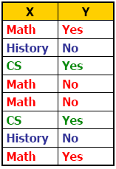
DECISION TREES
Which Attribute is the Best Classifier?: Definition of Entropy
Suppose we are trying to predict output Y (Like Film Gladiator) & we have input X (College Major = v)
Major
Math
CS
History

Slide 17
DECISION TREES
Which Attribute is the Best Classifier?: Definition of Entropy
Conditional Entropy H(Y | X = v)
The Entropy of Y among only those records in which X = v
Major
Math
CS
History

Slide 18
DECISION TREES
Which Attribute is the Best Classifier?: Definition of Entropy
Conditional Entropy of Y
H(Y | X = Math) = 1.0
H(Y | X = History) = 0
H(Y | X = CS) = 0
Major
Math
CS
History

Slide 19

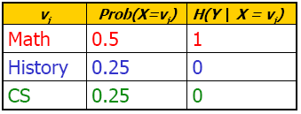
DECISION TREES
Which Attribute is the Best Classifier?: Definition of Entropy
Average Conditional Entropy of Y
H(Y | X) =
Major
Math
CS
History

Slide 20
DECISION TREES
Which Attribute is the Best Classifier?: Information Gain
Information Gain is the expected reduction in entropy caused by partitioning the examples according to an attribute’s value
Info Gain (Y | X) = H(Y) – H(Y | X) = 1.0 – 0.5 = 0.5
In general, we write Gain (S, A)
Where S is the collection of examples & A is an attribute

Slide 21
DECISION TREES
Which Attribute is the Best Classifier?: Information Gain
Let’s investigate the attribute Wind

Slide 22
DECISION TREES
Which Attribute is the Best Classifier?: Information Gain
The collection of examples has 9 positive values and 5 negative ones
Eight (6 positive and 2 negative ones) of these examples have the attribute value Wind = Weak
Six (3 positive and 3 negative ones) of these examples have the attribute value Wind = Strong

Slide 23
DECISION TREES
Which Attribute is the Best Classifier?: Information Gain
The information gain obtained by separating the examples according to the attribute Wind is calculated as:

Slide 24
DECISION TREES
Which Attribute is the Best Classifier?: Information Gain
We calculate the Info Gain for each attribute and select the attribute having the highest Info Gain

Slide 25
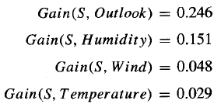
DECISION TREES
Example
Which attribute should be selected as the first test?
“Outlook” provides the most information

Slide 26
DECISION TREES

Slide 27
DECISION TREES
Example
The process of selecting a new attribute is now repeated for each (non-terminal) descendant node, this time using only training examples associated with that node
Attributes that have been incorporated higher in the tree are excluded, so that any given attribute can appear at most once along any path through the tree

Slide 28
DECISION TREES
Example
This process continues for each new leaf node until either:
Every attribute has already been included along this path through the tree
The training examples associated with a leaf node have zero entropy

Slide 29
DECISION TREES
Example

Slide 30
DECISION TREES
From Decision Trees to Rules
Next Step: Make rules from the decision tree
After making the identification tree, we trace each path from the root node to leaf node, recording the test outcomes as antecedents and the leaf node classification as the consequent
For our example we have:
If the Outlook is Sunny and the Humidity is High then No
If the Outlook is Sunny and the Humidity is Normal then Yes
...

Slide 31
DECISION TREES
Decision Tree Representation

