Slide 1
Ensemble Methods

Slide 2
Ensemble Methods
Ensemble methods are techniques that aim at improving the accuracy of results in models by combining multiple models instead of using a single model.

Slide 3
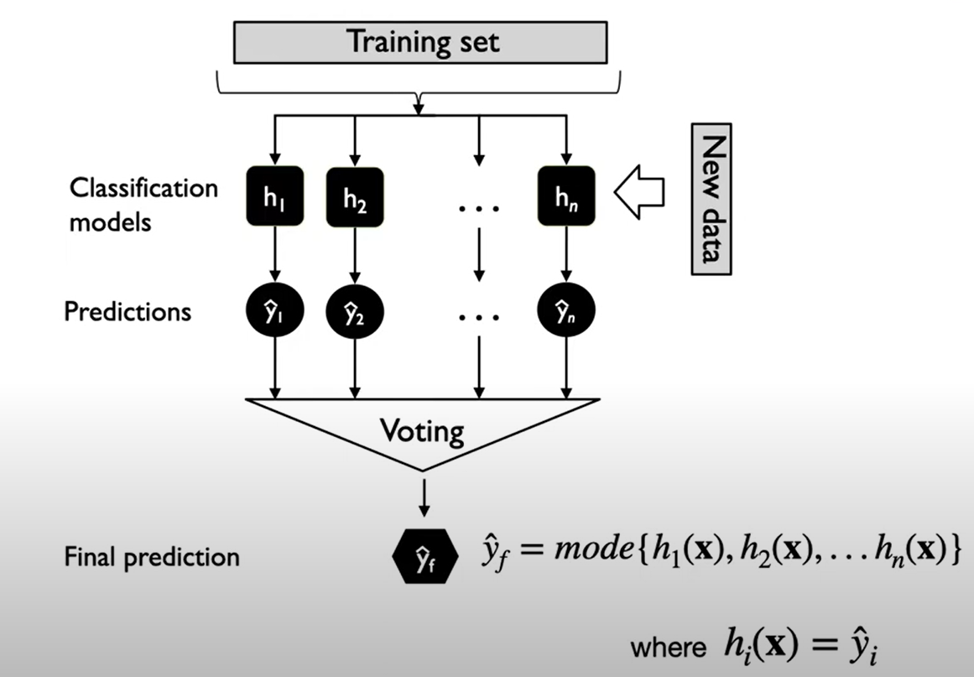
1. Majority Voting Classifier

Slide 4
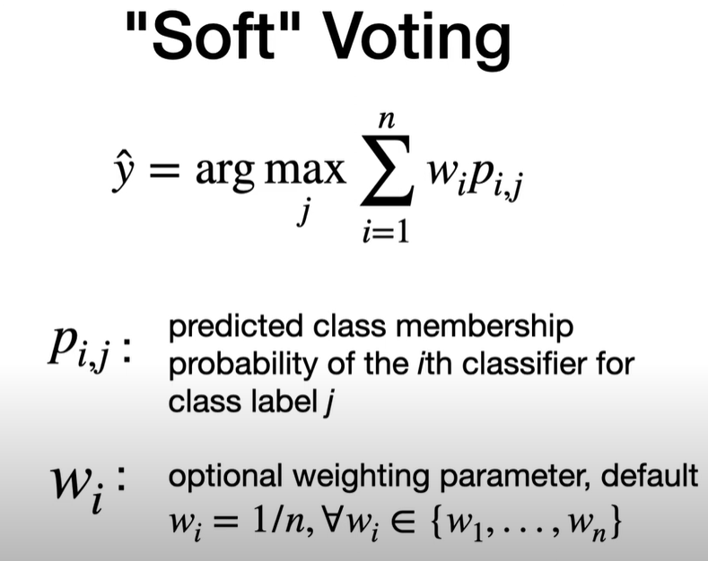
1. Majority Voting Classifier

Slide 5
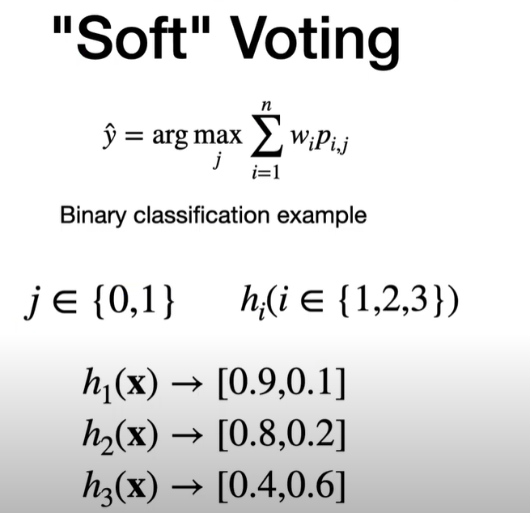
1. Majority Voting Classifier

Slide 6
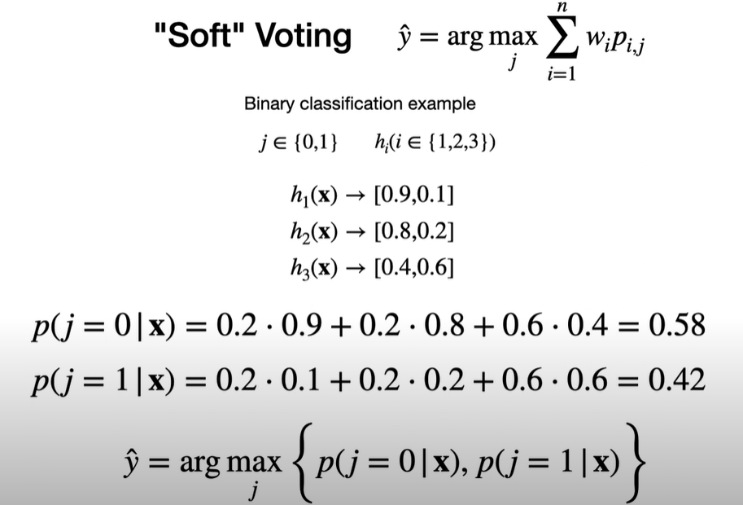
1. Majority Voting Classifier

Slide 7
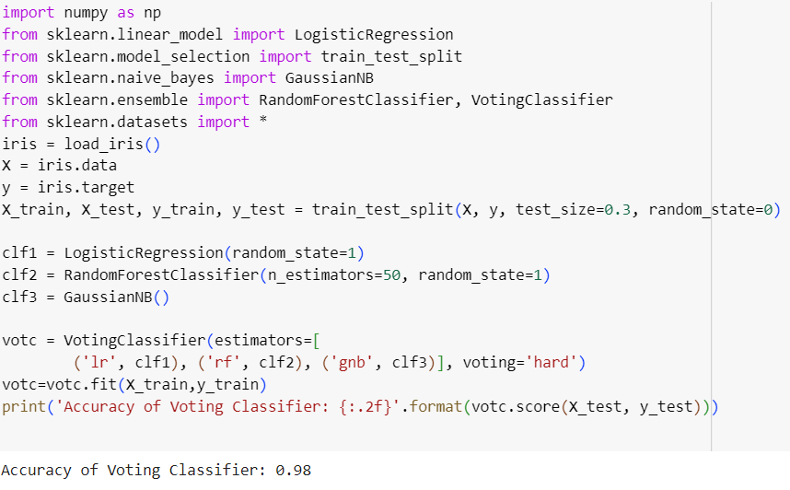
1. Majority Voting Classifier (code)

Slide 8
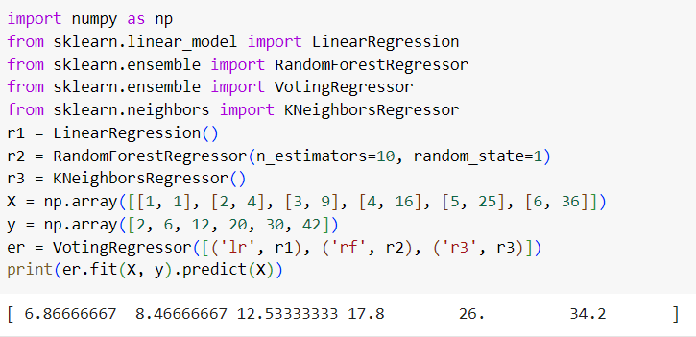
Voting Regressor

Slide 9
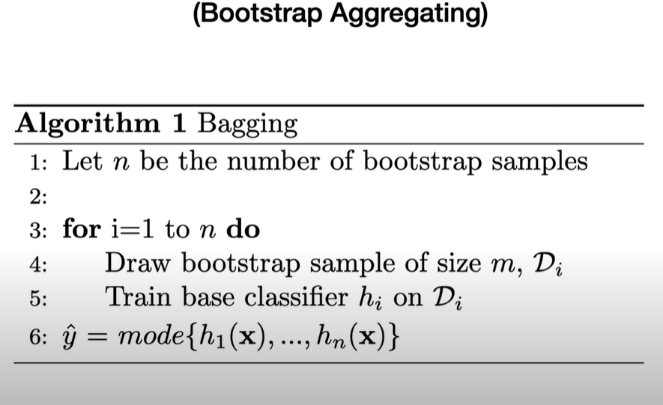
2. Bagging

Slide 10
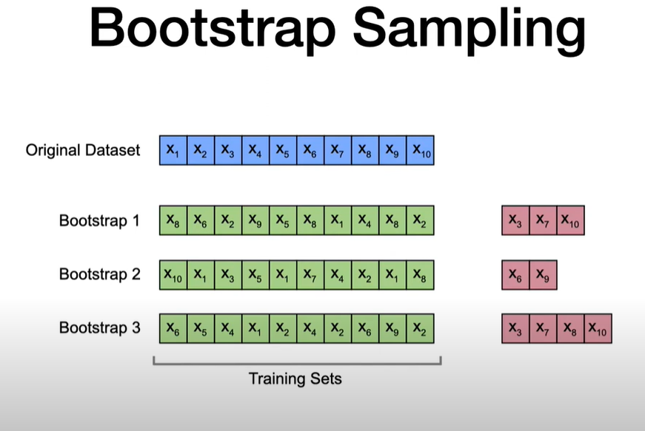
2. Bagging

Slide 11
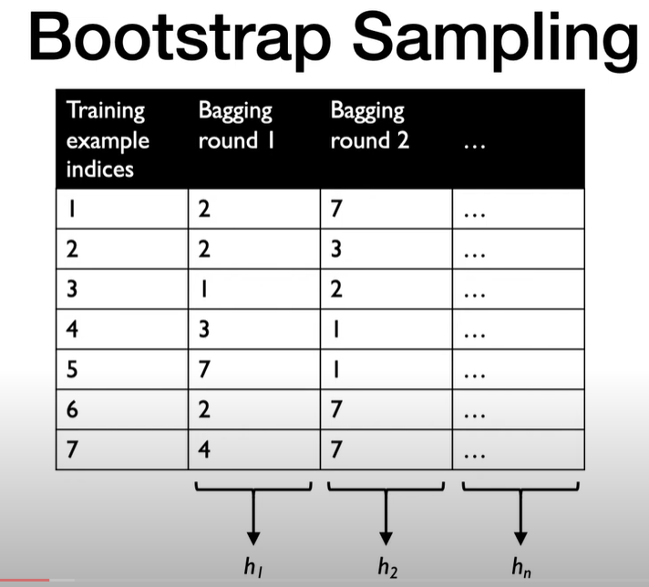
2. Bagging

Slide 12
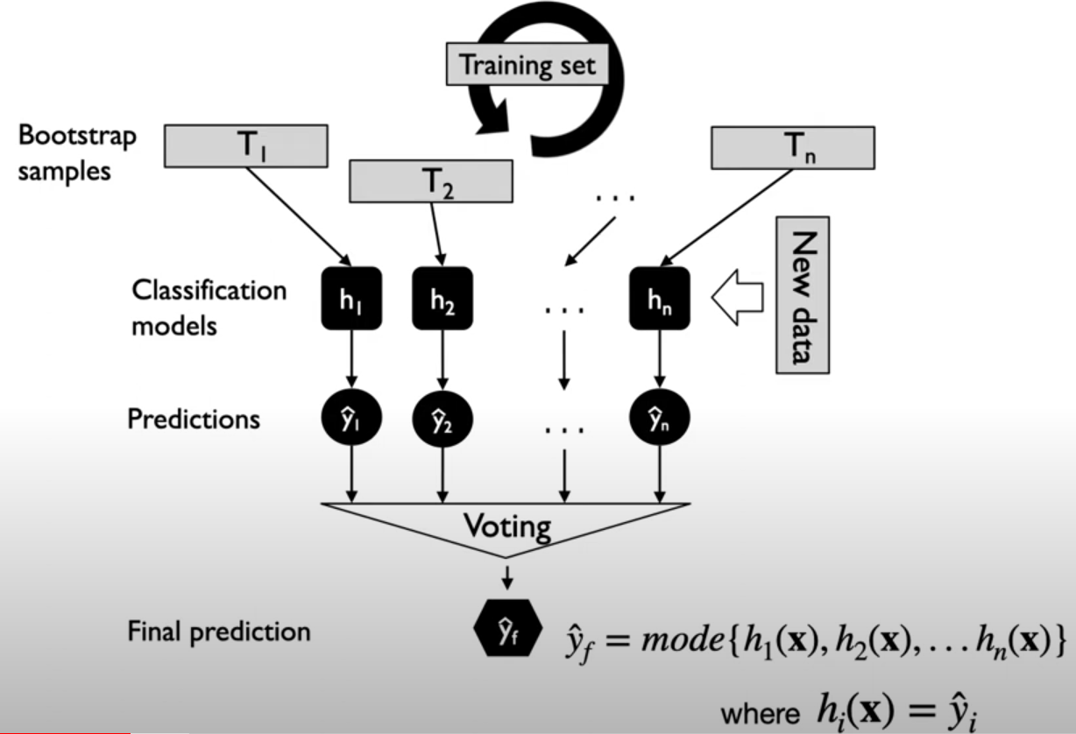
2. Bagging

Slide 13
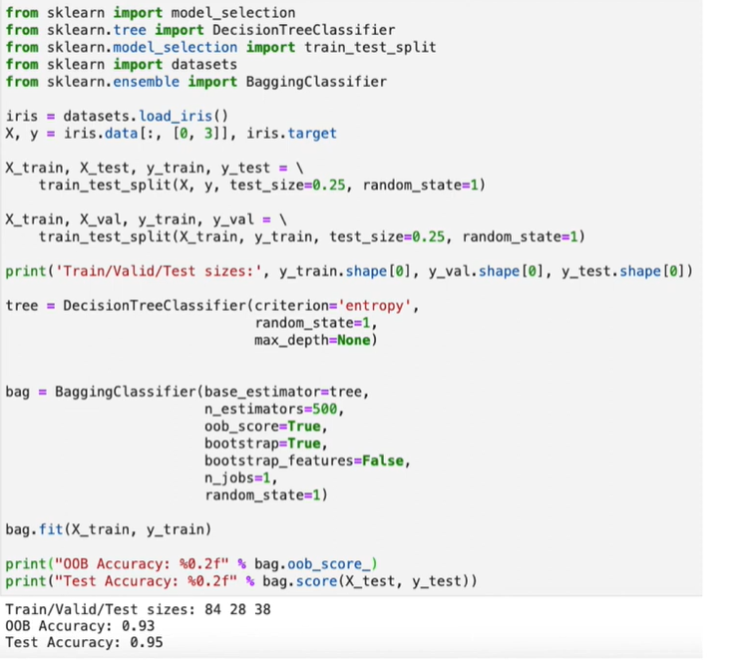
2. Bagging (code)

Slide 14
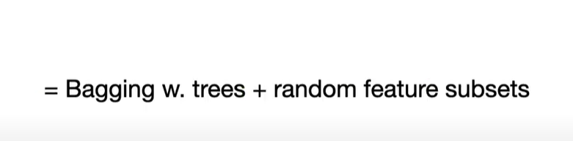
Random forests

Slide 15
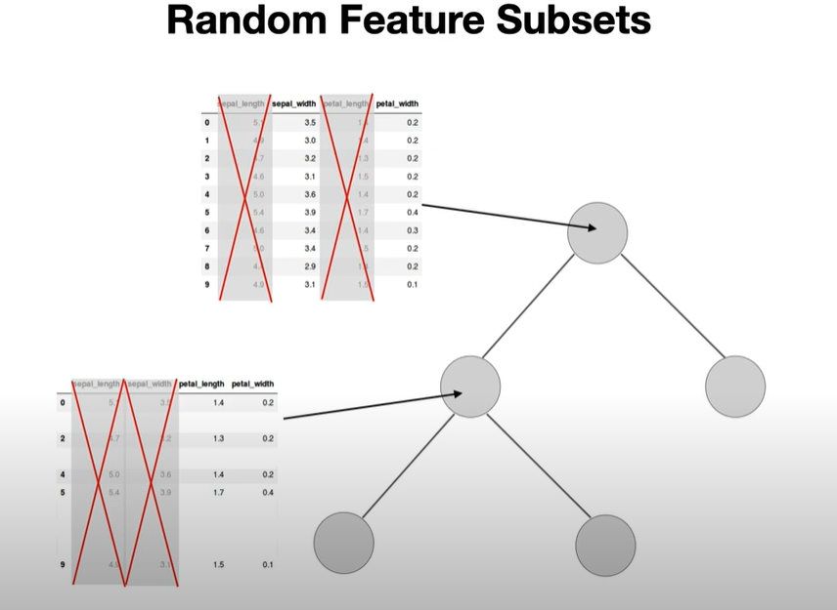
Random forests

Slide 16
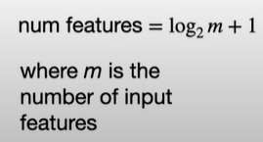
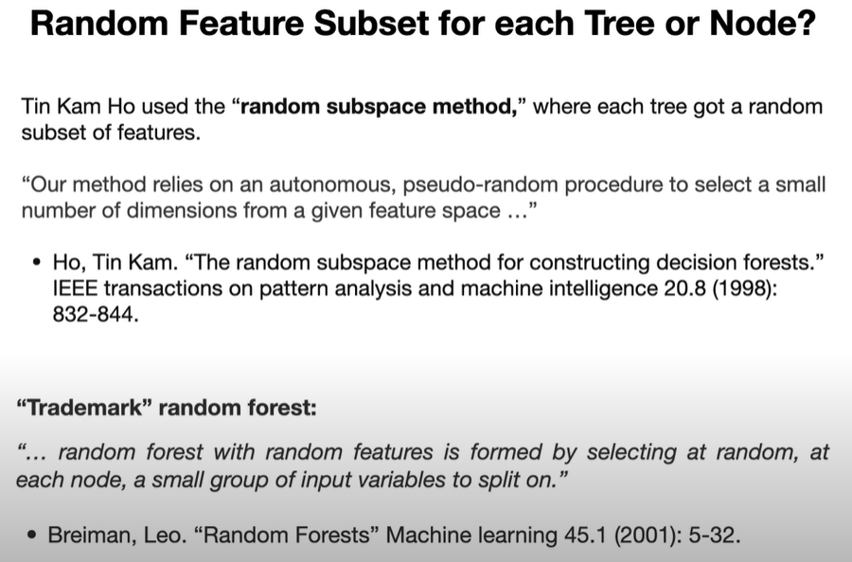
Random forests

Slide 17
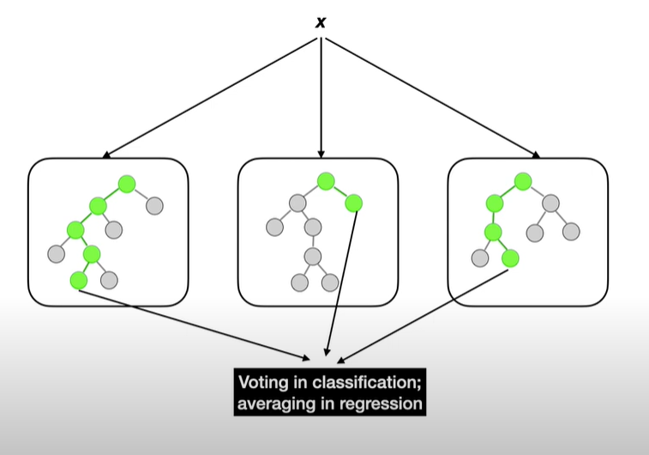
Random forests

Slide 18
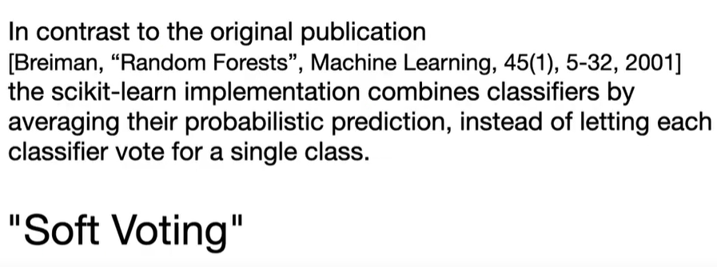
Random forests

Slide 19
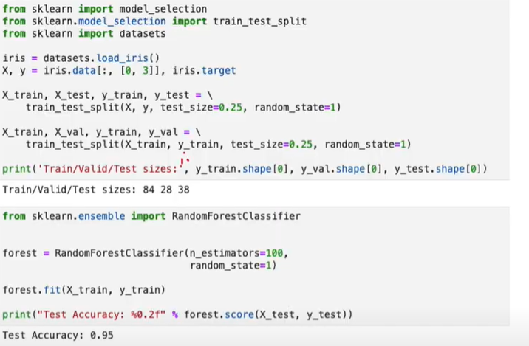
Random forests (code)

