Slide 1
Cross Validation in Machine learning
Cross-validation is a statistical method used to estimate the performance (or accuracy) of machine learning models.
It is used to protect against overfitting in a predictive model.
In cross-validation, you make a fixed number of folds (or partitions) of the data, run the analysis on each fold, and then average the overall error estimate.

Slide 2
Cross Validation in Machine learning
Whenever we fit a machine learning algorithm to a dataset, we typically split the dataset into three parts:
Training Set: Used to train the model.
Validation Set: Used to optimize model parameters.
Test Set: Used to get an unbiased estimate of the final model performance.

Slide 3
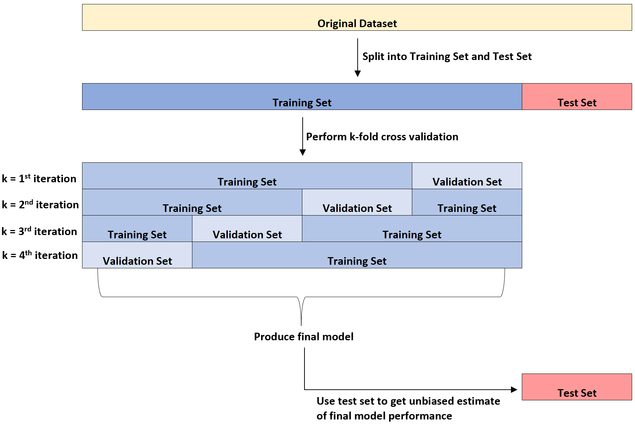
Cross Validation in Machine learning

Slide 4
Types of Cross Validation
K-fold cross-validation
Stratified k-fold cross-validation
Leave-p-out cross-validation
Leave-one-out cross-validation

Slide 5
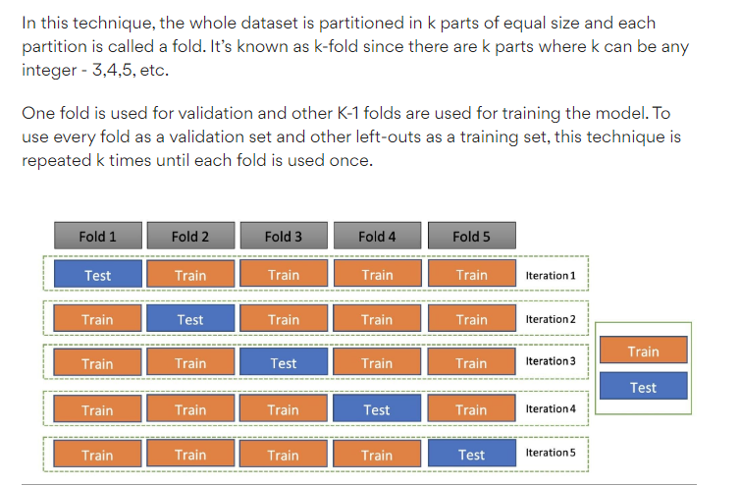
K-fold cross-validation

Slide 6
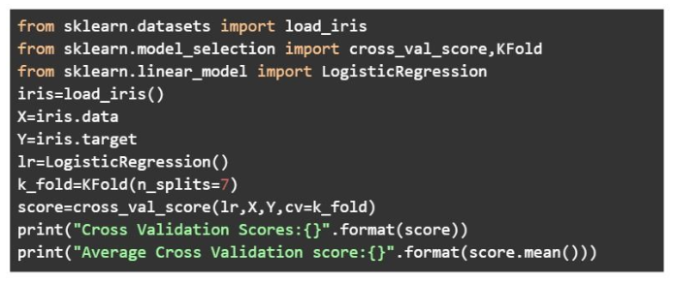
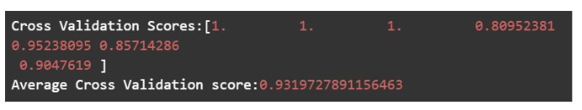
K-fold cross-validation

Slide 7
Stratified k-fold cross-validation
k-fold validation can’t be used for imbalanced datasets because data is split into k-folds with a uniform probability distribution.
Not so with stratified k-fold, which is an enhanced version of the k-fold cross-validation technique.
Although it too splits the dataset into k equal folds, each fold has the same ratio of instances of target variables that are in the complete dataset.
This enables it to work perfectly for imbalanced datasets.

Slide 8
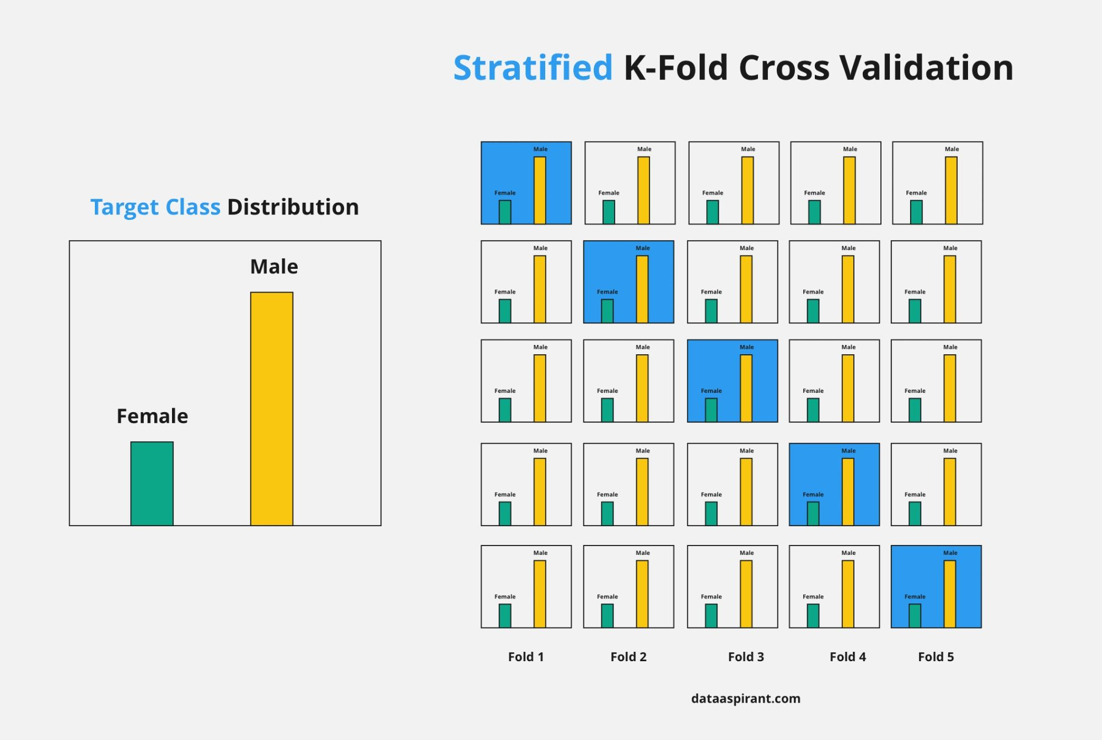
Stratified k-fold cross-validation

Slide 9
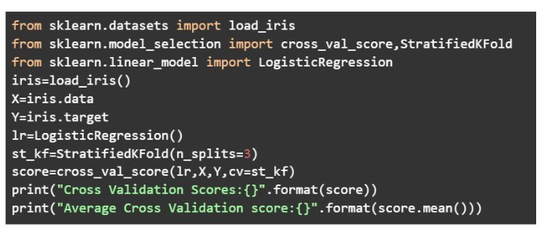

Stratified k-fold cross-validation

Slide 10
Leave-p-out cross-validation
An exhaustive cross-validation technique, p samples are used as the validation set and n-p samples are used as the training set if a dataset has n samples.
The process is repeated until the entire dataset containing n samples gets divided on the validation set of p samples and the training set of n-p samples.
This continues till all samples are used as a validation set.

Slide 11
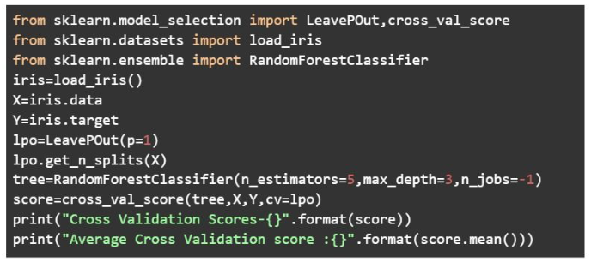
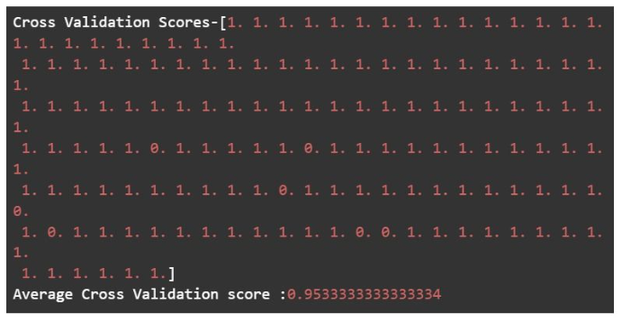
Leave-p-out cross-validation

Slide 12
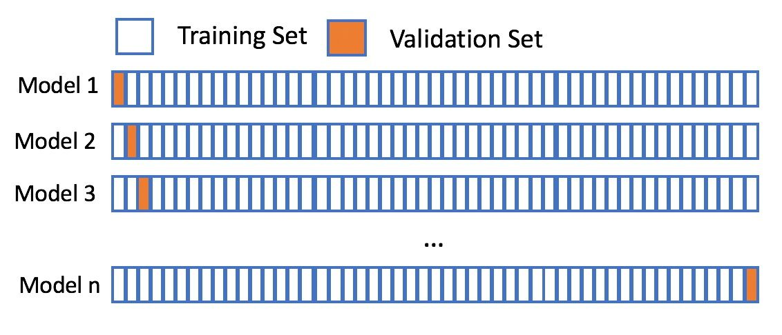
Leave-one-out cross-validation
In this technique, only 1 sample point is used as a validation set and the remaining n-1 samples are used in the training set. Think of it as a more specific case of the leave-p-out cross-validation technique with P=1.

Slide 13
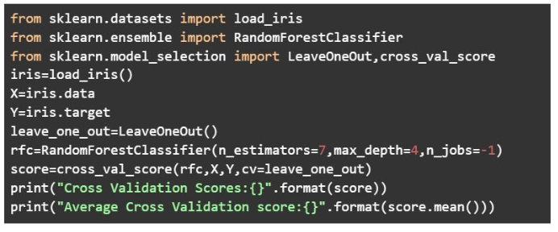
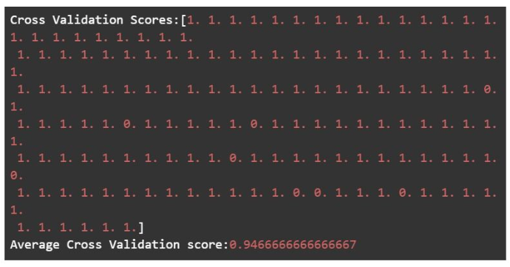
Leave-one-out cross-validation

