Slide 1
Adaboost one of combining models
Explained on white board in class

Slide 2
Boosting
Definition of Boosting:
Boosting refers to a general method of producing a very accurate prediction rule by combining rough and moderately inaccurate rules-of-thumb.
Intuition:
1) No learner is always the best;
2) Construct a set of base-learners which when combined achieves higher accuracy

Slide 3
Boosting(cont’d)
3) Different learners may:
--- Be trained by different algorithms
4) A week learner is “rough and moderately inaccurate” predictor but one that can predict better than chance.

Slide 4
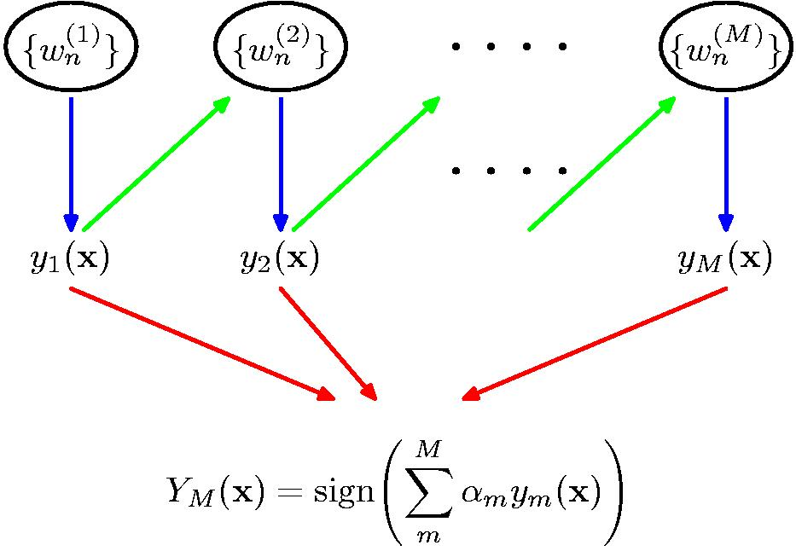
Schematic illustration of the boosting Classifier

Slide 5
A toy example (Adaboost)
Training set: 10 points (represented by plus or minus) Original Status: Equal Weights for all training samples

Slide 6
A toy example(cont’d)
Round 1: Three “plus” points are not correctly classified; They are given higher weights.

Slide 7
A toy example(cont’d)
Round 2: Three “minuse” points are not correctly classified; They are given higher weights.

Slide 8
A toy example(cont’d)
Round 3: One “minuse” and two “plus” points are not correctly classified; They are given higher weights.

Slide 9
A toy example(cont’d)
Final Classifier: integrate the three “weak” classifiers and obtain a final strong classifier.

