Slide 1
Inquest
Date: 4/20/2022
Name: Amber Ramsey
Major: B.S. Computer Science
Project Advisor: Sean Hayes

Slide 2
Project Purpose
Researchers will often have to create their own application to conduct their research which is time consuming and participates will only use it once.
As an example, there have been numerous aptitude tests created from various sources, and these websites are only created for that purpose.
If there was a site that was more customizable for the users and test creators, it would have a more consistent usage.
This customizable application could be used for quizzes, tests, and surveys which would allow researchers and other test creators to simply add their questions to a new evaluation and publish it.

Slide 3
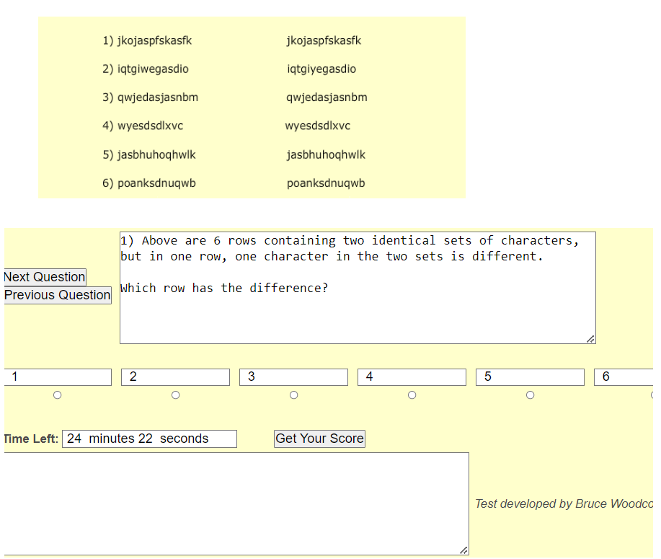
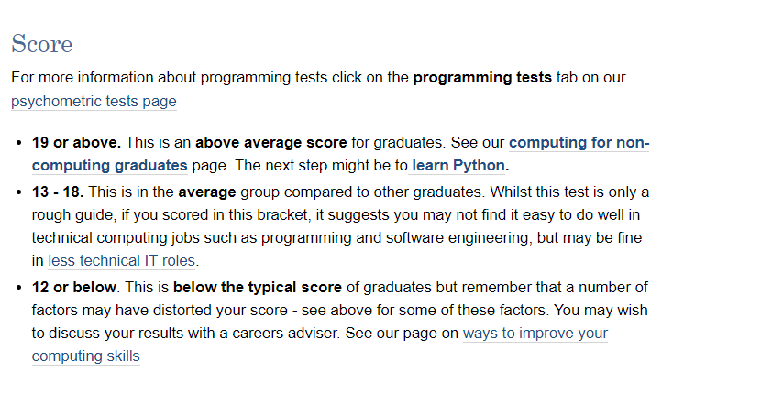
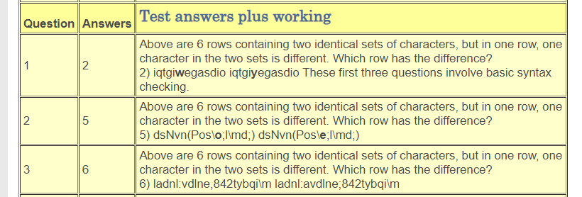
Research & Background
Different Aptitude Tests
https://www.kent.ac.uk/ces/tests/computer-test.html

Slide 4
Languages / Software
Ruby
Rails
Bootstrap
SQLite

Slide 5
Implementation
Features Included
Create New Account / Log In / Log Out
Admin
Create, edit, and delete tests and questions
Promote users to admin
View all user and admin accounts created (Information such as name, email, and id)
Edit their own information
User
Edit their own information
Take Public Tests
Take Private Tests where they know the password

Slide 6
Challenges Overcome
Ruby on Rails
Learn while making the project
Routing
Form Validation
Passing Parameters on button click
Test timer with JavaScript
Amazon Web Services
Learn to use it
Get hacked
Recover Project
Make new local environment
Incorporating Bootstrap

Slide 7
Future Enhancements
Track and store time taken for each test question
Deployed on Heroku
Prevent users from going back to previous questions or leaving the test
More customization with test creation and test results
Sorting and searching for test and user lists
Ability for multiple test creators
Allow admins to be able to take tests
Different admin levels
Root Admin – can edit all tests, demote admin, and deactivate accounts
Admins – can only edit and view test results where they are a creator

Slide 8
Sources
The Ruby on Rails Tutorial by Michael Hartl (https://www.railstutorial.org/)
https://api.rubyonrails.org/
https://guides.rubyonrails.org/v5.1/
https://getbootstrap.com/docs/5.1/getting-started/introduction/
https://medium.com/@anaharris/how-to-add-image-upload-functionality-to-your-rails-app-9f7fc3f3d042
https://medium.com/@nicolaslule/how-to-create-embeddable-javascript-widgets-with-ruby-on-rails-65387b70ee3a

