Slide 1

Corona epidemic in India Context
Amber Trivedi

Slide 2
Abstract
The novel Coronavirus pathogen Covid-19 is a cause of concern across the world as the human-to-human infection caused by it is spreading at a fast pace. The increase in number of deaths in Italy, Iran, USA, and other countries has alarmed both the developed and developing countries. Scientists are working hard to develop a vaccine against the virus, but until now no breakthrough has been achieved. India, the second most populated country in the world, is working hard in all dimensions to stop the spread of community infection. Health care facilities are being updated; medical and paramedical staffs are getting trained, and many agencies are raising awareness on the issues related to this virus and its transmission. The administration is leaving no stone unturned to prepare the country to mitigate the adverse effects. However, as the number of infected patients, and those getting cured is changing differently in different states everyday it is difficult to predict the spread of the virus and its fate in Indian context. Different states have adopted measures to stop the community spread. Considering the vast size of the country, the population size and other socio-economic conditions of the states, a single uniform policy may not work to contain the disease. In this presentation, we discuss a predictive analytical visualisation model that can give us some idea of the fate of the virus, an indicative data and future projections to understand the further course this pandemic can take.

Slide 3
Introduction
In India, for diseases such as Tuberculosis, HIV and Cancer, the related mortality rate is so high that researchers and funding agencies have under-estimated the implications viral diseases can have on public health and socio-economic security. Funding agencies and data scientists have overlooked flu and other human viral pathogens; and in the past years, not much research is funded to work on drug designing or medical research in the field. It is also clear from the recent trends that viral diseases are going to spread at fast pace and many novel viruses will be unearthed in near future. Climate change and deforestation is also causing surge in outbreak of viral epidemics. The changing climate is also responsible for increase in number of vectors that accelerate the spread of pathogens (Khan et al., 2019). In the last few years, WHO (World Health Organization) has been continuously emphasizing that the fast-developing nations such as India should triple their expenditure on health care to meet the SDG goals. The outbreak of the SARS-CoV- 2 has raised the concerns for the Government of India, public policy makers and administration as the pandemic has implication on almost all sectors and strata of the society. It is therefore important to understand how the virus will fare in India and how efficiently the country can handle it without causing severe damage to human population.

Slide 4
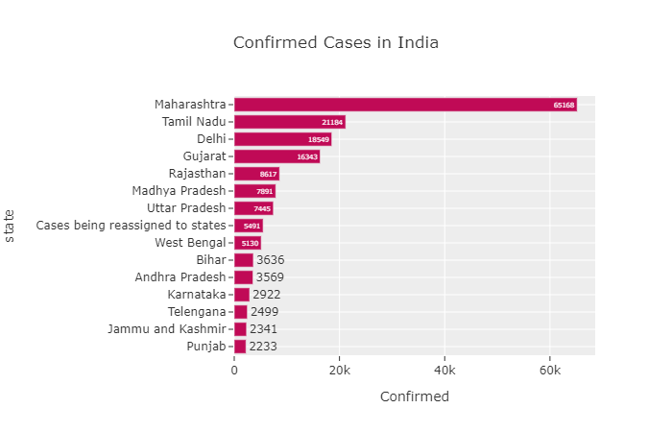
State wise Chart (for top 15 state)

Slide 5
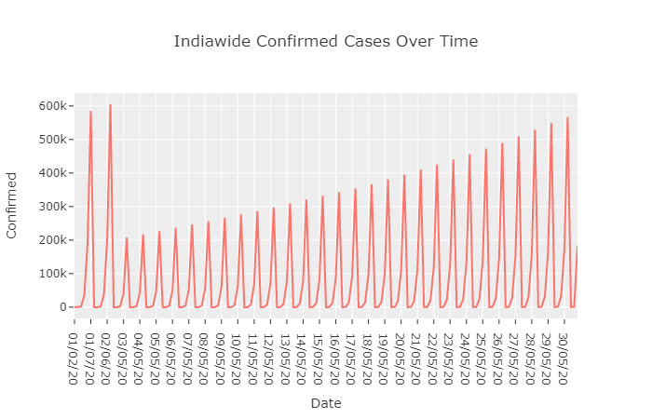
Plot for Cured Cases for Indian National and Foreign Indian National

Slide 6
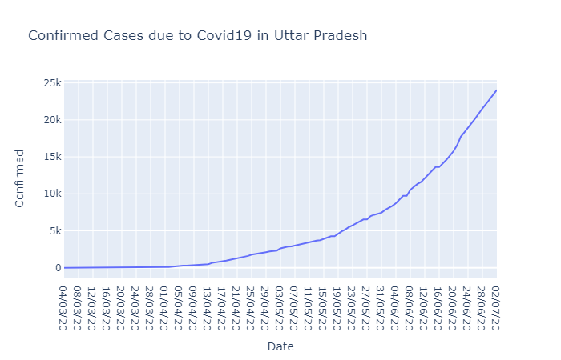
Plot for Confirmed Cases in Uttar Pradesh

Slide 7
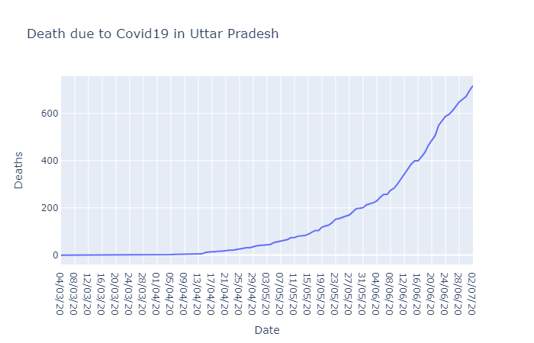
Plot for Death due to corona in Uttar Pradesh

Slide 8
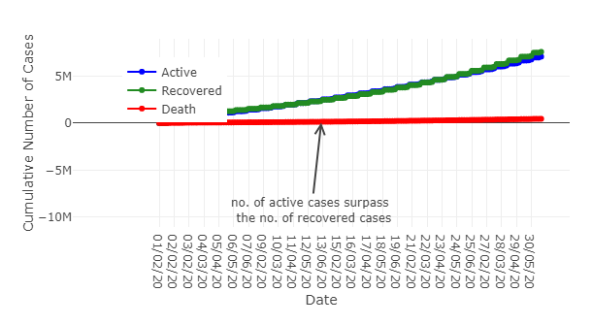
Trending chart

Slide 9
Thank You !

