Slide 1
生存分析
M610109002 陳雅霖
M301109017 郭宇軒
M508108006 王柔涵

Slide 2

Select variables

Slide 3
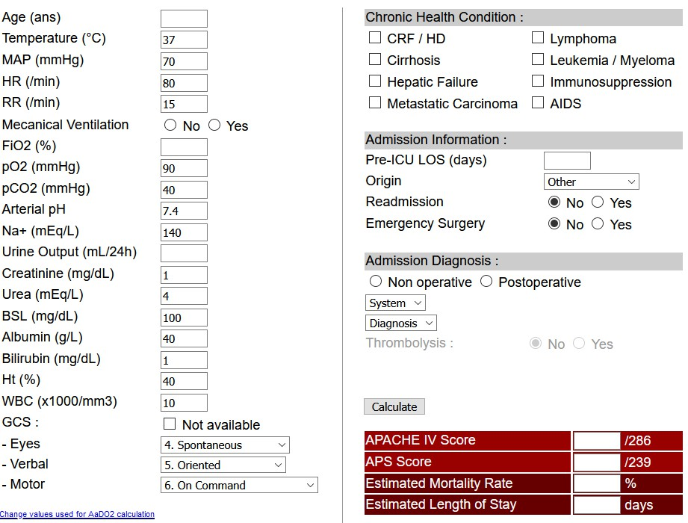
APCHE IV Score: most efficient for predict

Slide 4
Lab data : use APACHE IV score variables
228112 GCSVerbalApacheIIValue (intubated)
220739 GCS - Eye Opening
223900 GCS - Verbal Response
223901 GCS - Motor Response
198 GCS Total
227011 GCSEye_ApacheIV
227012 GCSMotor_ApacheIV
227013 GcsScore_ApacheIV
227014 GCSVerbal_ApacheIV
227015 Glucose_ApacheIV
227016 GlucoseScore_ApacheIV
227017 Hematocrit_ApacheIV
227018 HR_ApacheIV
228388 Glucose (whole blood) (soft)
225664 Glucose finger stick
220621 Glucose (serum)
CHARTEVENT
227037 PH_ApacheIV
227039 PO2_ApacheIV
227516 PO2 (Mixed Venous)
226755 GcsApacheIIScore
226756 GCSEyeApacheIIValue
226757 GCSMotorApacheIIValue
226758 GCSVerbalApacheIIValue
220739 GCS - Eye Opening

Slide 5
Lab data : use APACHE IV score variables
50809 Glucose
50802 Albumin
50883 Bilirubin, Direct
50884 Bilirubin, Indirect
50885 Bilirubin, Total
50810 Hematocrit, Calculated
51300 WBC Count
51301 White Blood Cells
LAB
50824 Sodium, Whole Blood
50983 Sodium
51067 24 hr Creatinine
51080 Creatinine Clearance
51081 Creatinine, Serum
50912 Creatinine
51006 Urea Nitrogen

Slide 6
Diagnosis : reference from YerevaNN-mimic3-benchmarks-847eadc
diagnosis_labels =
['4019', '4280', '41401', '42731', '25000', '5849', '2724', '51881', '53081', '5990', '2720’, '2859', '2449', '486', '2762', '2851', '496', 'V5861', '99592', '311', '0389', '5859', '5070', '40390', '3051', '412', 'V4581', '2761', '41071', '2875', '4240', 'V1582', 'V4582', 'V5867', '4241', '40391', '78552', '5119', '42789', '32723', '49390', '9971', '2767', '2760', '2749',
'4168', '5180', '45829', '4589', '73300', '5845', '78039', '5856', '4271', '4254', '4111',
'V1251', '30000', '3572', '60000', '27800', '41400', '2768', '4439', '27651', 'V4501', '27652',
'99811', '431', '28521', '2930', '7907', 'E8798', '5789', '79902', 'V4986', 'V103', '42832',
'E8788', '00845', '5715', '99591', '07054', '42833', '4275', '49121', 'V1046', '2948', '70703',
'2809', '5712', '27801', '42732', '99812', '4139', '3004', '2639', '42822', '25060', 'V1254',
'42823', '28529', 'E8782', '30500', '78791', '78551', 'E8889', '78820', '34590', '2800', '99859',
'V667', 'E8497', '79092', '5723', '3485', '5601', '25040', '570', '71590', '2869', '2763', '5770',
'V5865', '99662', '28860', '36201', '56210']

Slide 7
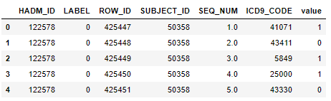
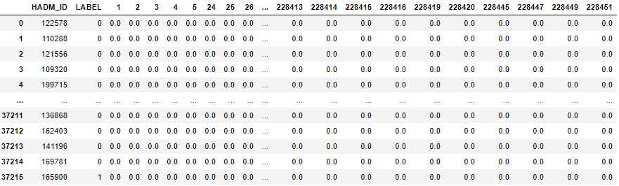
Methodology
pivot

Slide 8
Strategy
Variables selection
Model selection
Outcomes
LABEVENTS data
Logistic regression
or
0/1
CHARTEVENTS data
or
XGBoost
or
DIAGNOSIS data

Slide 9
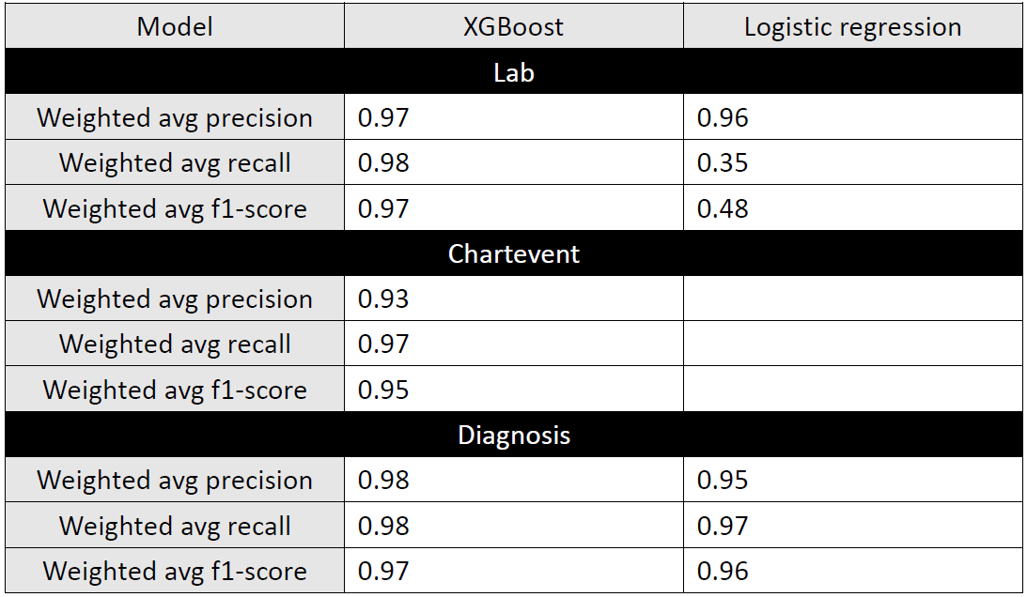
Results

Slide 10
Conclusions
XGBoost > logistic regression
Lab data > chartevent & diagnosis

