Slide 1

Smart Password Strength Checker
A Java application for real-time password analysis and feedback.
Xinyuan Fan (Amber) & Xujing Hui
2025 August

Slide 2



Project Overview
Our Smart Password Strength Checker is a Java desktop application designed to provide instant, actionable feedback on password strength.
Real-time Feedback
Enhanced Security
Solid Architecture
Users receive red (weak), orange (medium), or green (strong) indicators as they type, along with specific suggestions for improvement.
In a world of increasing cyber threats, our tool simplifies understanding password strength, helping users create robust defenses against unauthorized access.
Built with the Model-View-Controller (MVC) pattern and adhering to key OOP principles (encapsulation, inheritance, polymorphism, abstraction). Rigorously tested with 51 passing test cases.

Slide 3
Technical Architecture: MVC Pattern
We chose the Model-View-Controller (MVC) design pattern for its clear separation of concerns, modularity, testability, and maintainability.
Model
View
Controller
Contains business logic: PasswordAnalyzer and validation rules (LengthRule, CharacterVarietyRule, CommonPatternRule). Extensible via interfaces.
Handles UI elements: Java Swing GUI provides real-time, intuitive feedback to users.
Coordinates Model and View: Processes user input, calls Model for analysis, and updates View with results.

Slide 4

Code Walkthrough: Key Implementations
Let's dive into the core components that power our Smart Password Strength Checker, focusing on the foundational interfaces and rule implementations.
PasswordRule Interface
LengthRule Implementation
CharacterVarietyRule
Defines a contract for all validation rules, emphasizing abstraction. Each rule must implement validate() and getFeedback().
An example of a concrete rule, demonstrating encapsulation with a private minimum length field. It validates password length and provides specific feedback.
A more complex rule checking for uppercase, lowercase, digits, and special characters. This showcases polymorphism, as different rules share the same interface methods.
public interface PasswordRule {
boolean validate(String password); String getFeedback(String password);
}
public class LengthRule implements PasswordRule {
private final int minLength; // ... constructor and methods ...}
public class CharacterVarietyRule implements PasswordRule {
@Override public boolean validate(String password) {
// ... logic for character types ... }
// ... getFeedback method ...}

Slide 5
Code Walkthrough: Model (PasswordAnalyzer)
The PasswordAnalyzer is the heart of our Model, applying validation rules to determine password strength. It leverages polymorphism by interacting with rules through the PasswordRule interface,
ensuring flexibility and extensibility for future rule additions.
public class PasswordAnalyzer {
private final List<PasswordRule> rules;
public PasswordAnalyzer() {
rules = new ArrayList<>();
rules.add(new LengthRule(8));
rules.add(new CharacterVarietyRule());
rules.add(new CommonPatternRule());
}
public PasswordStrengthFeedback analyze(String password) {
List<String> feedback = new ArrayList<>();
int passed = 0;
// Apply all validation rules
for (PasswordRule rule : rules) {
if (rule.validate(password)) {
passed++;
} else {
String fb = rule.getFeedback(password);
if (fb != null) feedback.add(fb);
}
}
// Determine strength based on passed rules
String strength;
if (passed == rules.size()) strength = "Strong";
else if (passed >= rules.size() - 1) strength = "Medium";
else strength = "Weak";
return new PasswordStrengthFeedback(strength, feedback);
}
}
Dynamic Rule Application
The analyzer iterates through a list of PasswordRule objects, executing their validation logic without needing to know their specific types.
Extensible Design
Adding new password validation rules is simple: just implement the PasswordRule interface and add the new rule to the analyzer's list.
Strength Scoring
Based on the number of passed rules, the analyzer assigns a strength rating (Weak, Medium, Strong) and compiles specific feedback messages for the user.

Slide 6
Code Walkthrough: Controller
Controller Component
PasswordStrengthController: Coordinates between Model and View
public void onPasswordChanged(String password) {
if (gui != null) {
// Call Model for processing
PasswordStrengthFeedback result = analyzer.analyze(password);
// Update View with results
gui.updateStrength(result.getStrength());
gui.updateFeedback(result.getFeedback());
}
}
Receives user input from View
Calls Model for processing
Updates View with results

Slide 7
Code Walkthrough: View
GUI(Interface)
Interface for GUI components
public interface GUI {
void updateStrength(String strength);
void updateFeedback(List<String> feedback);
}
Enables mock testing
Loose coupling
Testability
The View handles all user interface elements. When the user types, it delegates the action to the Controller. The GUI implements an interface, making it testable without the actual Swing components.

Slide 8
Code Walkthrough: View
CheckerGUI (View)
User interface implementation
// Listen for user typing
passwordField.addKeyListener(new KeyAdapter() {
public void keyReleased(KeyEvent e{
controller.onPasswordChanged(passwordField.getText());
}
});
// Update strength color
public void updateStrength(String strength) {
switch (strength) {
case "Strong": setColor(GREEN); break;
case "Medium": setColor(ORANGE); break;
default: setColor(RED);
}
}
Java Swing GUI
Real-time updates
Color-coded feedback.

Slide 9
Benefits of MVC Architecture
The Model-View-Controller (MVC) pattern provides significant advantages, ensuring our Smart Password Strength Checker is robust, scalable, and easy to manage.
Separation of Concerns
Enhanced Testability
Each component (Model, View, Controller) has a single, well-defined responsibility, simplifying development and debugging. For example, the GUI solely handles display, not analysis logic.
Individual components can be tested in isolation, such as validating the Controller's logic using a mock GUI, which streamlines unit testing and ensures reliability.
Improved Maintainability
Greater Extensibility
Changes or updates in one part of the application, like the user interface, minimally impact other parts, reducing the risk of introducing new bugs and simplifying ongoing support.
Adding new features, such as additional password validation rules, primarily requires updates within the Model, allowing for easy expansion without disrupting the core architecture.

Slide 10
OOP Principles Demonstrated
Encapsulation
Inheritance
Private fields with public getters
Rule classes implement the PasswordRule interface, inheriting contracts for specific implementations.
(e.g., PasswordStrengthFeedback) protect data and provide clean interfaces.
Polymorphism
Abstraction
PasswordAnalyzer works with any PasswordRule implementation, allowing flexible and extensible rule processing.
Interfaces (PasswordRule, GUI) hide complex implementation details, simplifying testing and future development.

Slide 11

Comprehensive Testing Strategy
Our application is backed by a robust testing strategy, ensuring reliability and confidence in our code.
Test Coverage
Results
Unit Tests: Individual component validation.
51 test methods executed.
Integration Tests: Full MVC flow verification.
100% pass rate achieved.
Performance Tests: Scalability and efficiency checks.
Confidence in code correctness and maintainability.
Edge Cases: Robustness against null/empty inputs.
Example Test:
@Test void testStrongPassword() {
PasswordStrengthFeedback feedback = analyzer.analyze("Str0ng!Passw0rd"); assertEquals("Strong", feedback.getStrength()); assertTrue(feedback.getFeedback().isEmpty()); }

Slide 12
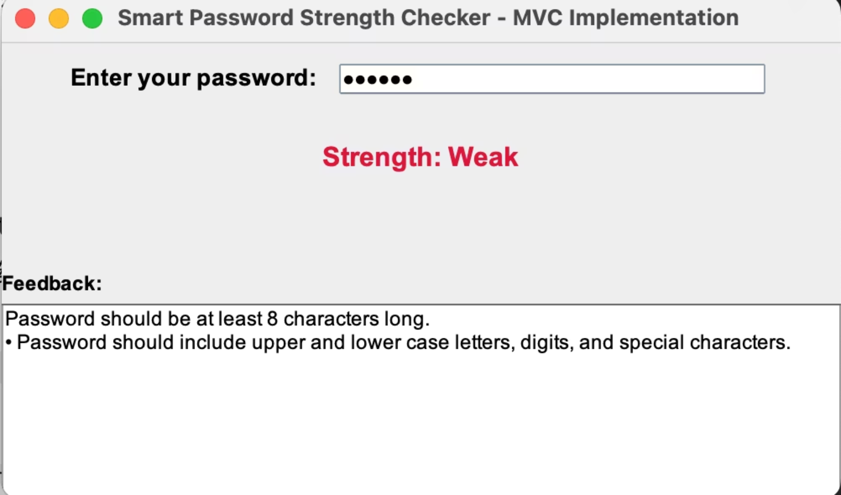
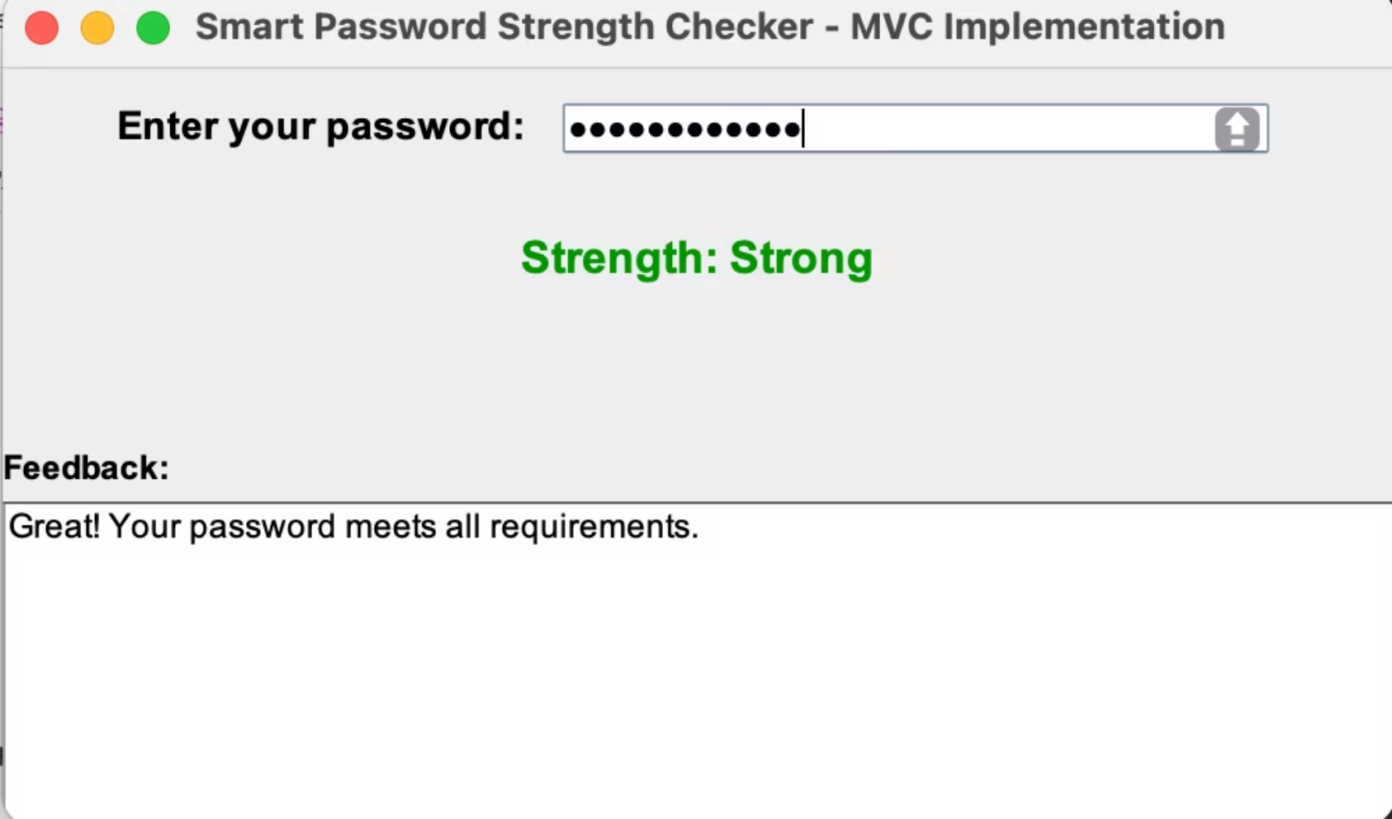
Live Demonstration
Experience the Smart Password Strength Checker in action, showcasing its real-time analysis and intuitive feedback.
Weak Password
Strong Password
Typing "279304726 shows "Weak" in red, with suggestions for length, variety, and common patterns.
Typing "Abc37492749!" results in "Strong" in green, confirming all criteria are met.
Real-time Updates: Feedback and color-coding update instantly as you type, providing immediate guidance.

Slide 13
Challenges and Solutions
MVC Implementation
Challenge: Ensuring proper separation of Model, View, and Controller.
Solution: Clear interfaces and defined communication channels.
GUI Testing
Challenge: Difficulty in testing GUI components directly.
Solution: GUI interface for mock object testing of controller logic.
Rule Extensibility
Challenge: Making it easy to add new validation rules.
Solution: Interface design allows simple implementation and addition of new rules.
Performance
Challenge: Ensuring responsiveness with complex validation.
Solution: Efficient algorithms and data structures for fast analysis.

Slide 14
Future Enhancements
Our project lays a strong foundation for future development, expanding its capabilities and user experience.
Enhanced Security
User Experience
Advanced Features
Scalability
Integrate with compromised password databases.
Password history tracking.
Password generation and strength comparison tools.
Enterprise features: user management, reporting.
Export functionality.
More sophisticated pattern detection.
Multi-language support.
Integration with password managers.

Slide 15
Conclusion
The Smart Password Strength Checker demonstrates professional software engineering practices and provides real value.
Key Achievements
Learning Outcomes
Fully functional, well-tested application with real user value.
Deepened understanding of OOP, design patterns, testing, and GUI development.
Technical Excellence
Real-World Application
Modular, maintainable, extensible code with MVC architecture and comprehensive testing.
Translates theoretical concepts into practical, deployable software.

Slide 16
Q&A
We're happy to answer any questions about our implementation, design decisions, or technical details.

