Slide 1
Changes in U.S Congress between 1917-2020
Amber Naranjo
STA 4102

Slide 2
Introduction
What is the U.S Congress?
House VS. Senate
Motivation

Slide 3
What is the u.s congress?
Congress is a legislature of the federal government of the United States.
It consists of two chambers:
The House of Representatives
The Senate
In total, Congress has 535 voting members:
435 Representatives
100 Senators
Although there are rare instances of a third party or independents, members of congress most often belong to one of two parties:
The Democratic Party
The Republican Party

Slide 4
House vs. senate
HOUSE
Sets policy agenda
Initiates revenue-raising bills
Initiates impeachment cases
SENATE
Propose policy agenda
Approves presidential appointments
Decides impeachment cases

Slide 5
Motivation
My personal motivation for this Shiny App stems from the results of this past election cycle.
As of 2019, there are now 127 women holding seats in Congress- a record high.
I think this is crazy.
I also thought as the only female in this class, including my professor, it would be interesting to look at data involving gender equality.
In particular, gender equality in positions of power.

Slide 6
Motivation
In general, members of Congress are elected to represent hundreds of thousands of people. Therefore, one would hope that the population being represented is reflected equally.
In addition to an expectation of gender equality in Congress, one would also expect there to be balance amongst the two main parties. This led me to the motivation to examine party differences as well.

Slide 7
method
Hypothesis
Analysis

Slide 8
Hypotheses
The data was approached with the following hypotheses:
The number of women members in Congress will increase over time.
The two main parties should exhibit a balanced alternation in majority holding.

Slide 9
Analysis
In the Shiny App, the data is mainly analyzed visually with the use of charts.
There is also the option to view summaries of statistical tests run on particular categories.
In particular, we can test our hypothesis of women in office increasing over time by testing for a linear relationship between the variables “Years” and “Women”.
We can also test our hypothesis regarding a balance in parties over time by testing for a difference in the averages between the variables involving Democrats and Republicans.

Slide 10
Guide
Shiny App

Slide 11
Shiny app
This Shiny App offers simple visualizations of changes which have occurred in the U.S Congress between the years of 1917-2020
In particular, the user may investigate those changes amongst the following categories:
Male Female House Democrats Senate Democrats Total Democrats House Republicans Senate Republicans Total Republicans | House Other (representing non-Democratic and non-Republican parties in the House) Senate Other (representing non-Democratic and non-Republican parties in the Senate) Total Other (representing non-Democratic and non-Republican parties in the Congress)
The user may also compare ratios of the above categories on a given year.

Slide 12
Shiny app
That being said, the primary purpose of this Shiny App is to visualize gender and party ratios over time.

Slide 13
Demo
GitHub

Slide 14
github
A demo of this Shiny App may be found by running the following line of code into R:
runGitHub( ”shinyProject", "ambergnar")

Slide 15
Conclusion
Observed Results

Slide 16
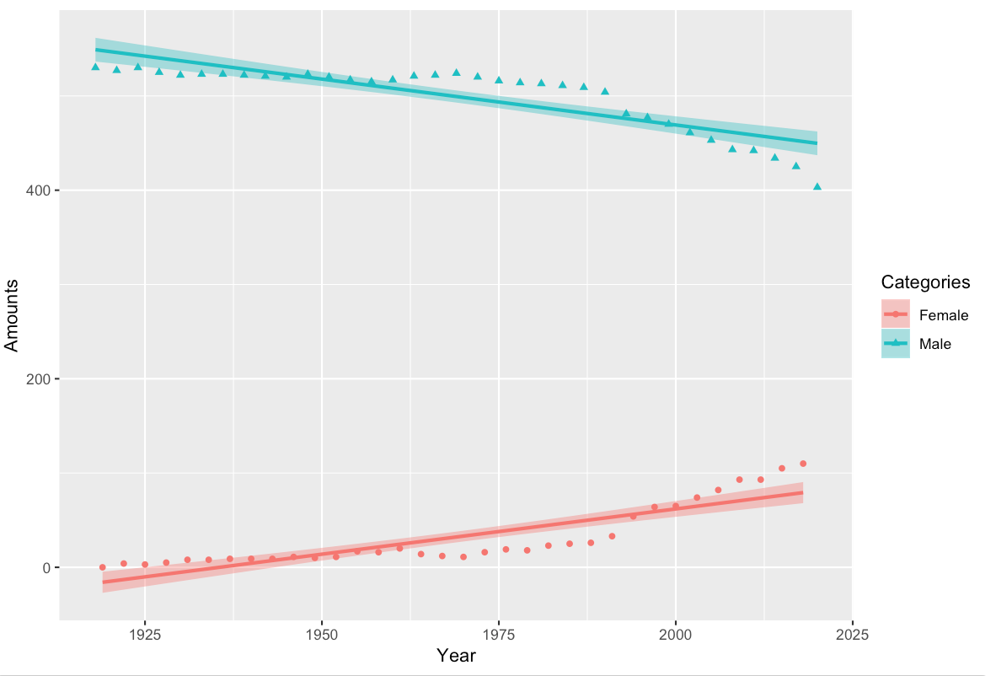
Observed Results
The results found on the Shiny App in regards to the difference in genders appeared to support the given assumption:
Linearly speaking, we can see that as years increase, the amount of Females in office do as well.
Thus, the trend over time appears to suggest that the amount of men will decrease over time as the amount of females increase as they respectively approach a more balanced state.

Slide 17
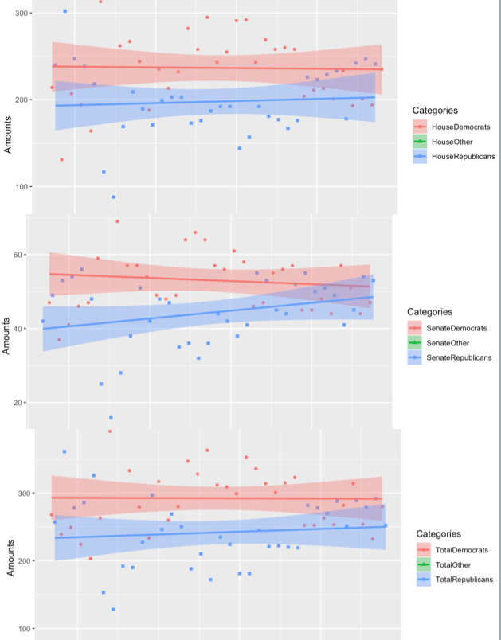
Observed Results
The results found on the Shiny App in regards to the difference in parties appeared to support the given assumption only to a degree:
Although we see there is a clear alternation occurring amongst parties whether in total, by house, or by senate; overall, the Democratic party has appeared to hold majority rule over longer periods of time than the Republican party.

Slide 18
References
Data Sources

Slide 19
Data Sources
https://history.house.gov/Institution/Party-Divisions/Party-Divisions/
https://www.senate.gov/history/partydiv.htm
https://crsreports.congress.gov/product/pdf/R/R45583
https://crsreports.congress.gov/product/pdf/R/R43244
https://www.brookings.edu/wp-content/uploads/2019/03/Chpt-1.pdf
https://www.pewresearch.org/fact-tank/2018/12/18/record-number-women-in-congress/
https://history.house.gov/Exhibitions-and-Publications/WIC/Historical-Data/Women-Representatives-and-Senators-by-Congress/

