Slide 1
Database Systems
Basic SQL

Slide 2
Chapter 6 Outline
SQL Data Definition and Data Types
Specifying Constraints in SQL
Basic Retrieval Queries in SQL
INSERT, DELETE, and UPDATE Statements in SQL
Additional Features of SQL

Slide 3
Basic SQL
SQL language
Considered one of the major reasons for the commercial success of relational databases
Originated with predicate calculus
SQL
Structured Query Language
Statements for data definitions, queries, and updates (both DDL and DML)
Core specification
Plus specialized extensions

Slide 4
SQL Terminology
Terminology:
Table, row, and column used for relational model terms relation, tuple, and attribute
CREATE statement
Main SQL command for data definition
Much of what you’ll see in Data Definition Language is normally done with user-friendly tools like SQL Server Management Studio, etc.
Notes:
You should still know DDL, since you’ll use it to modify scripts

Slide 5
SQL Standards
SQL has gone through many standards: starting with SQL-86 or SQL 1.A. SQL-92 is referred to as SQL-2.
Later standards (from SQL-1999) are divided into core specification and specialized extensions. The extensions are implemented for different applications – such as data mining, data warehousing, multimedia etc.
SQL-2006 added XML features (Ch. 13); In 2008 they added Object-oriented features (Ch. 12).
SQL-3 is the current standard which started with SQL-1999. It is not fully implemented in any RDBMS.

Slide 6
Schema and Catalog Concepts in SQL
SQL schema (In most systems, a Database)
Identified by a schema name
Includes an authorization identifier and descriptors for each element
Schema elements include
Tables, constraints, views, domains, and other constructs
Each statement in SQL ends with a semicolon (not really needed)

Slide 7
Schema and Catalog Concepts in SQL
CREATE SCHEMA statement
CREATE SCHEMA COMPANY AUTHORIZATION ‘Jsmith’;
Catalog
Named collection of schemas in an SQL environment
SQL environment
Installation of an SQL-compliant RDBMS on a computer system

Slide 8
The CREATE TABLE Command in SQL
Specify a new relation
Provide name
Specify attributes and initial constraints
Can optionally specify schema:
CREATE TABLE COMPANY.EMPLOYEE ...
or
CREATE TABLE EMPLOYEE ...

Slide 9
The CREATE TABLE Command in SQL
Base tables (base relations)
Relation and its tuples are actually created and stored as a file by the DBMS
Virtual relations
Created through the CREATE VIEW statement

Slide 10
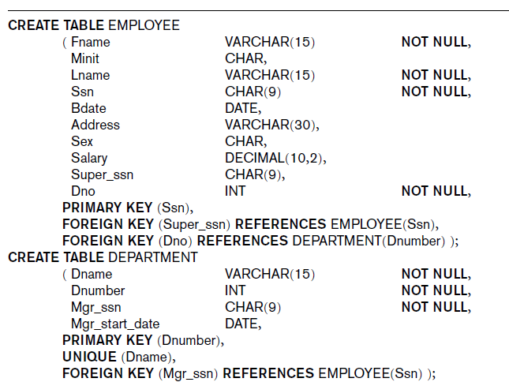
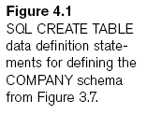

Slide 11
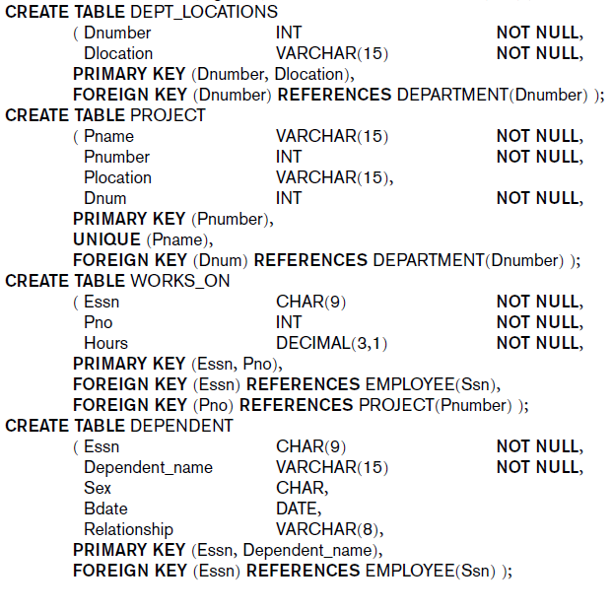

Slide 12
CREATE TABLE Command
Some foreign keys may cause errors
Specified either via:
Circular references
Or because they refer to a table that has not yet been created
Foreign Key: a field that is not a key in the table in which it occurs but which is a primary key in another table in the same database. Used to allow tables to refer to each other.

Slide 13
Attribute Data Types and Domains in SQL
Different dialects of SQL (Microsoft, Oracle, IBM DB2) may have different types)
Basic data types
Numeric data types
Integer numbers: INTEGER, INT, and SMALLINT
Floating-point (real) numbers: FLOAT or REAL, and DOUBLE PRECISION
Character-string data types
Fixed length: CHAR(n), CHARACTER(n)
Varying length: VARCHAR(n), CHAR VARYING(n), CHARACTER VARYING(n)

Slide 14
Attribute Data Types and Domains in SQL
Bit-string data types
Fixed length: BIT(n)
Varying length: BIT VARYING(n)
Boolean data type
Values of TRUE or FALSE or NULL
DATE data type (Use DateTime instead)
Ten positions
Components are YEAR, MONTH, and DAY in the form YYYY-MM-DD

Slide 15
Attribute Data Types and Domains in SQL
Additional data types
Timestamp data type (TIMESTAMP)
Includes the DATE and TIME fields
Plus a minimum of six positions for decimal fractions of seconds
Optional WITH TIME ZONE qualifier
INTERVAL data type
Specifies a relative value that can be used to increment or decrement an absolute value of a date, time, or timestamp
Notes:
Date, time, timestamp, INTERVAL can be converted to string formats for comparison

Slide 16
Attribute Data Types and Domains in SQL
Domain
Name used with the attribute specification
Makes it easier to change the data type for a domain that is used by numerous attributes
Improves schema readability
Example:
CREATE DOMAIN SSN_TYPE AS CHAR(9);
TYPE
User Defined Types (UDTs) are supported for object-oriented applications. (See Ch.12) Uses the command: CREATE TYPE

Slide 17
Specifying Constraints in SQL
Basic constraints:
Relational Model has 3 basic constraint types that are supported in SQL:
Key constraint: A primary key value cannot be duplicated
Entity Integrity Constraint: A primary key value cannot be null
Referential integrity constraints : The “foreign key” must have a value that is already present as a primary key, or may be null.

Slide 18
Specifying Attribute Constraints and Attribute Defaults
NOT NULL
NULL is not permitted for a particular attribute
Default value
DEFAULT <value>
CHECK clause
Dnumber INT NOT NULL CHECK (Dnumber > 0 AND Dnumber < 21);

Slide 19
Adding a Constraint
alter table department
add constraint NUMBER_RANGE
check (dnumber > 0 AND dnumber < 21)

Slide 20
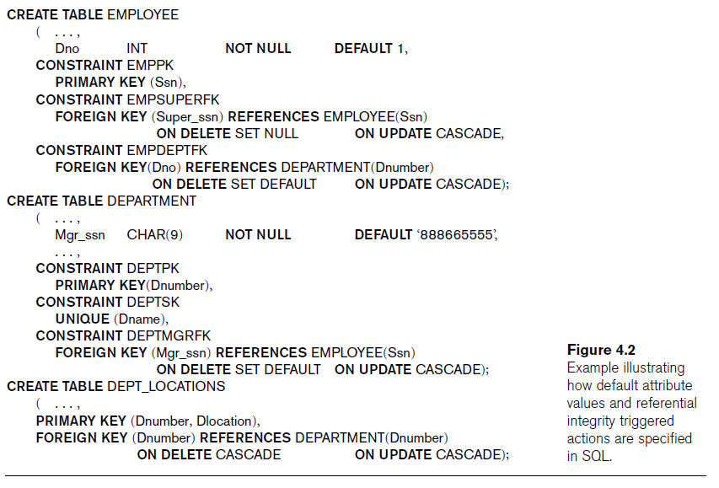

Slide 21
Specifying Key and Referential Integrity Constraints
PRIMARY KEY clause
Specifies one or more attributes that make up the primary key of a relation
Dnumber INT PRIMARY KEY;
UNIQUE clause
Specifies alternate (secondary) keys
Dname VARCHAR(15) UNIQUE;

Slide 22
Specifying Key and Referential Integrity Constraints
FOREIGN KEY clause
Default operation: reject update on violation
Attach referential triggered action clause
Options include SET NULL, CASCADE, and SET DEFAULT
Action taken by the DBMS for SET NULL or SET DEFAULT is the same for both ON DELETE and ON UPDATE
CASCADE option suitable for “relationship” relations

Slide 23
Giving Names to Constraints
Keyword CONSTRAINT
Name a constraint
Useful for later altering

Slide 24
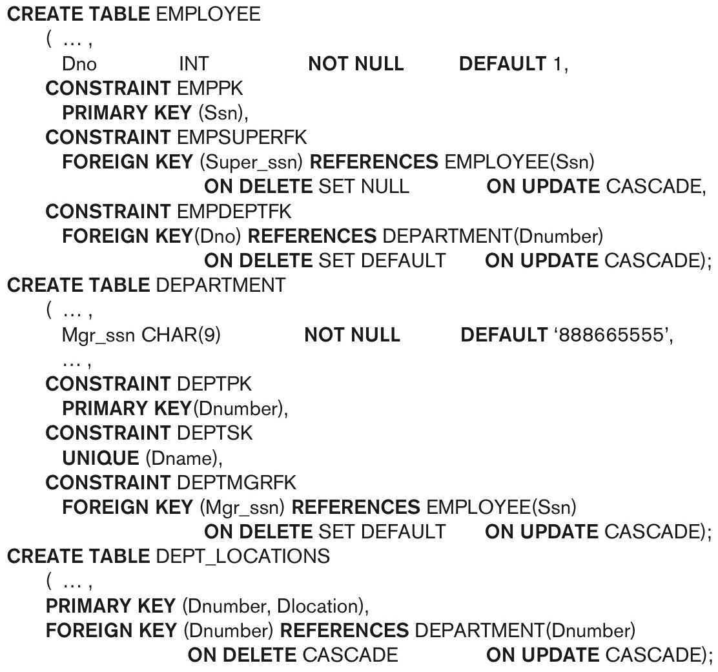
Constraints

Slide 25
Specifying Constraints on Tuples Using CHECK
CHECK clauses at the end of a CREATE TABLE statement
Apply to each tuple individually
CHECK (Dept_create_date <= Mgr_start_date);

Slide 26
Basic Retrieval Queries in SQL
SELECT statement
One basic statement for retrieving information from a database
SQL allows a table to have two or more tuples that are identical in all their attribute values
Unlike relational model
Multiset or bag behavior (sets don’t allow identical members)

Slide 27
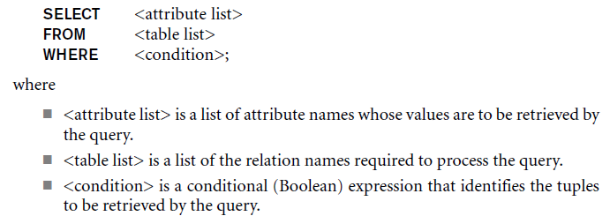
The Structure of Basic SQL Queries
Basic form of the SELECT statement:

Slide 28
The Structure of Basic SQL Queries
Logical comparison operators
=, <, <=, >, >=, and <>
Projection attributes
Attributes whose values are to be retrieved
Selection condition
Boolean condition that must be true for any retrieved tuple

Slide 29
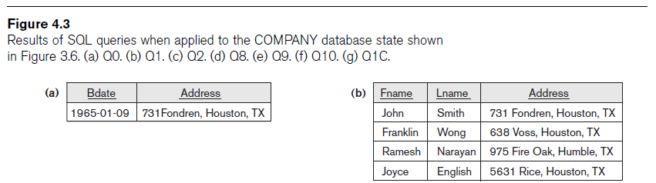
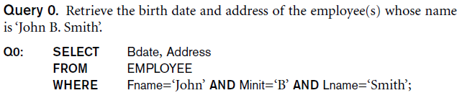
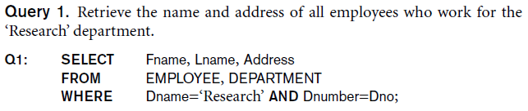
Some Queries

Slide 30

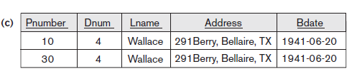
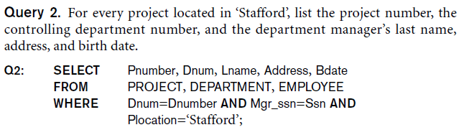
Some Queries

Slide 31

Ambiguous Attribute Names
Same name can be used for two (or more) attributes
As long as the attributes are in different relations
Must qualify the attribute name with the relation name to prevent ambiguity

Slide 32
Aliasing, Renaming, and Tuple Variables
Aliases or tuple variables
Declare alternative relation names E and S
EMPLOYEE AS E(Fn, Mi, Ln, Ssn, Bd, Addr, Sex, Sal, Sssn, Dno)
Query 8. For each employee, retrieve the employee’s first and last name and the first and last name of his or her immediate supervisor.
SELECT E.Fname, E.Lname, S.Fname, S.Lname
FROM EMPLOYEE AS E, EMPLOYEE AS S
WHERE E.Super_ssn=S.Ssn;
Recommended practice to abbreviate names and to prefix same or similar attribute from multiple tables

Slide 33
Aliasing, Renaming, and Tuple Variables
The attribute names can also be renamed
EMPLOYEE AS E(Fn, Mi, Ln, Ssn, Bd, Addr, Sex, Sal, Sssn, Dno)
Note that the relation EMPLOYEE now has a variable name E which corresponds to a tuple variable
The “AS” may be dropped in most SQL implementations

Slide 34
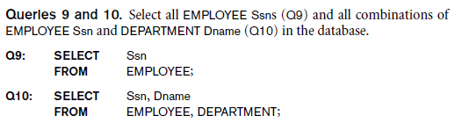
Unspecified WHERE Clause and Use of the Asterisk
Missing WHERE clause
Indicates no condition on tuple selection
CROSS PRODUCT
All possible tuple combinations

Slide 35
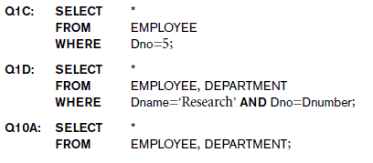
Unspecified WHERE Clause and Use of the Asterisk
Specify an asterisk (*)
Retrieve all the attribute values of the selected tuples

Slide 36
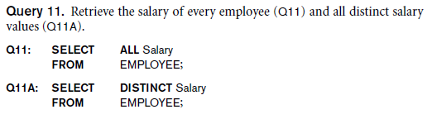
Tables as Sets in SQL
SQL does not automatically eliminate duplicate tuples in query results
Use the keyword DISTINCT in the SELECT clause
Only distinct tuples should remain in the result

Slide 37
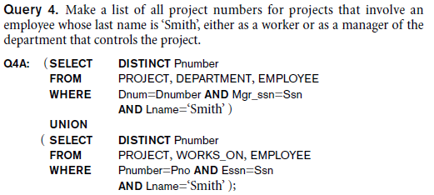
Tables as Sets in SQL
Set operations
UNION, EXCEPT (difference), INTERSECT
Corresponding multiset operations: UNION ALL, EXCEPT ALL, INTERSECT ALL)
Notes:
Who the manager of the department is
Or
The employee that works on it.

Slide 38
Substring Pattern Matching and Arithmetic Operators
LIKE comparison operator
Used for string pattern matching
% replaces an arbitrary number of zero or more characters
underscore (_) replaces a single character
Standard arithmetic operators:
Addition (+), subtraction (–), multiplication (*), and division (/)
BETWEEN comparison operator

Slide 39
Arithmetic Operators
Standard arithmetic operators:
Addition (+), subtraction (–), multiplication (*), and division (/) may be included as a part of SELECT
Query 13. Show the resulting salaries if every employee working on the ‘ProductX’ project is given a 10 percent raise.
SELECT E.Fname, E.Lname, 1.1 * E.Salary AS Increased_sal
FROM EMPLOYEE AS E, WORKS_ON AS W, PROJECT AS P
WHERE E.Ssn=W.Essn AND W.Pno=P.Pnumber AND P.Pname=‘ProductX’;

Slide 40
Ordering of Query Results
SQL results are inherently not ordered. To change this, use ORDER BY clause
Keyword DESC to see result in a descending order of values
Keyword ASC to specify ascending order explicitly
ORDER BY D.Dname DESC, E.Lname ASC, E.Fname ASC

Slide 41
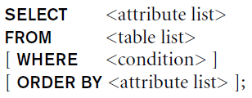
Basic SQL Retrieval Query

Slide 42
Exists vs. In
IN does a direct match between the column specified before the IN keyword and the values returned by the subquery. When using IN there can only be a single column specified in the select clause of the subquery
Exists doesn’t check for a match, it doesn’t care in the slightest what values have been returned from the expression, it just checks for whether a row exists or not. Because of that, if there’s no predicate in the WHERE clause of the subquery that compares rows in the subquery with rows in the outer query, EXISTS will either return true for all the rows in the outer query or it will return false for all the rows in the outer query
Exists is better for when comparisons are needed on two or more columns. This cannot be done easily with an IN

Slide 43
Modifying the Database Data
Three commands used to modify the database:
INSERT, DELETE, and UPDATE
INSERT typically inserts a tuple (row) in a relation (table)
UPDATE may update a number of tuples (rows) in a relation (table) that satisfy the condition
DELETE may also update a number of tuples (rows) in a relation (table) that satisfy the condition

Slide 44

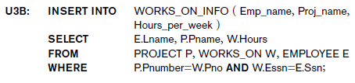
The INSERT Command
Specify the relation name and a list of values for the tuple

Slide 45
INSERT Statement
INSERT INTO Employee (fname, minit, lname, ssn, bdate, dno) values(‘Richard’, ‘S’, ‘Anderson’, ‘999333111’, ‘9/14/1980’, 4)
Attribute values should be listed in the same order as the attributes were specified in the CREATE TABLE command
Constraints on data types are observed automatically
Any integrity constraints as a part of the DDL specification are enforced

Slide 46
Bulk Loading of Tables
Another variation of INSERT is used for bulk-loading of several tuples into tables
A new table TNEW can be created with the same attributes as T and using LIKE and DATA in the syntax, it can be loaded with entire data.
EXAMPLE:
CREATE TABLE D5EMPS LIKE EMPLOYEE
(SELECT E.*
FROM EMPLOYEE AS E
WHERE E.Dno=5)
WITH DATA;

Slide 47
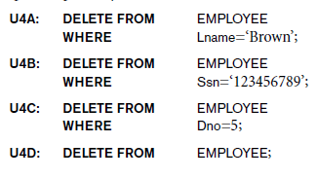
The DELETE Command
Removes tuples from a relation
Includes a WHERE clause to select the tuples to be deleted

Slide 48
The DELETE Command
Removes tuples from a relation
Includes a WHERE-clause to select the tuples to be deleted
Referential integrity should be enforced
Tuples are deleted from only one table at a time (unless CASCADE is specified on a referential integrity constraint)
A missing WHERE-clause specifies that all tuples in the relation are to be deleted; the table then becomes an empty table
The number of tuples deleted depends on the number of tuples in the relation that satisfy the WHERE-clause

Slide 49

The UPDATE Command
Modify attribute values of one or more selected tuples
Additional SET clause in the UPDATE command
Specifies attributes to be modified and new values

Slide 50
The UPDATE Command
Used to modify attribute values of one or more selected tuples
A WHERE-clause selects the tuples to be modified
An additional SET-clause specifies the attributes to be modified and their new values
Each command modifies tuples in the same relation
Referential integrity specified as part of DDL specification is enforced

Slide 51
Additional Features of SQL
Techniques for specifying complex retrieval queries
Writing programs in various programming languages that include SQL statements
Set of commands for specifying physical database design parameters, file structures for relations, and access paths
Transaction control commands

Slide 52
Additional Features of SQL
Specifying the granting and revoking of privileges to users
Constructs for creating triggers
Enhanced relational systems known as object-relational
New technologies such as XML and OLAP

Slide 53
Summary
SQL
Comprehensive language
Data definition, queries, updates, constraint specification, and view definition
Covered in Chapter 6:
Data definition commands for creating tables
Commands for constraint specification
Simple retrieval queries
Database update commands

