Slide 1
Database Design
Relational Calculus

Slide 2
Relational Calculus
Relational Calculus
Tuple Relational Calculus
Domain Relational Calculus

Slide 3
Relational Calculus
A relational calculus expression creates a new relation, which is specified in terms of variables that range over rows of the stored database relations (in tuple calculus) or over columns of the stored relations (in domain calculus).
In a calculus expression, there is no order of operations to specify how to retrieve the query result—a calculus expression specifies only what information the result should contain.
This is the main distinguishing feature between relational algebra and relational calculus.

Slide 4
Relational Calculus
Relational calculus is considered to be a nonprocedural or declarative language.
This differs from relational algebra, where we must write a sequence of operations to specify a retrieval request; hence relational algebra can be considered as a procedural way of stating a query.

Slide 5
Tuple Relational Calculus
The tuple relational calculus is based on specifying a number of tuple variables.
Each tuple variable usually ranges over a particular database relation, meaning that the variable may take as its value any individual tuple from that relation.
A simple tuple relational calculus query is of the form
{t | COND(t)}
where t is a tuple variable and COND (t) is a conditional expression involving t.
The result of such a query is the set of all tuples t that satisfy COND (t).

Slide 6
Tuple Relational Calculus
Example: To find the first and last names of all employees whose salary is above $50,000, we can write the following tuple calculus expression:
{t.FNAME, t.LNAME | EMPLOYEE(t) AND t.SALARY>50000}
The condition EMPLOYEE(t) specifies that the range relation of tuple variable t is EMPLOYEE.
The first and last name (PROJECTION π_{FNAME, LNAME}) of each EMPLOYEE tuple t that satisfies the condition t.SALARY>50000 (SELECTION σ _{SALARY >50000}) will be retrieved.

Slide 7
The Existential and Universal Quantifiers
Two special symbols called quantifiers can appear in formulas; these are the universal quantifier (∀) and the existential quantifier (∃).
Informally, a tuple variable t is bound if it is quantified, meaning that it appears in an (∀ t) or (∃ t) clause; otherwise, it is free.
If F is a formula, then so are (∃ t)(F) and (∀ t)(F), where t is a tuple variable.
The formula (∃ t)(F) is true if the formula F evaluates to true for some (at least one) tuple assigned to free occurrences of t in F; otherwise (∃ t)(F) is false.
The formula (∀ t)(F) is true if the formula F evaluates to true for every tuple (in the universe) assigned to free occurrences of t in F; otherwise (∀ t)(F) is false.

Slide 8
The Existential and Universal Quantifiers
∀ is called the universal or “for all” quantifier because every tuple in “the universe of” tuples must make F true to make the quantified formula true.
∃ is called the existential or “there exists” quantifier because any tuple that exists in “the universe of” tuples may make F true to make the quantified formula true.

Slide 9
Example Query Using Existential Quantifier
Retrieve the name and address of all employees who work for the ‘Research’ department. The query can be expressed as :
{t.FNAME, t.LNAME, t.ADDRESS | EMPLOYEE(t) and (∃ d) (DEPARTMENT(d) and d.DNAME=‘Research’ and d.DNUMBER=t.DNO) }
The only free tuple variables in a relational calculus expression should be those that appear to the left of the bar ( | ).
In above query, t is the only free variable; it is then bound successively to each tuple.
If a tuple satisfies the conditions specified in the query, the attributes FNAME, LNAME, and ADDRESS are retrieved for each such tuple.
The conditions EMPLOYEE (t) and DEPARTMENT(d) specify the range relations for t and d.
The condition d.DNAME = ‘Research’ is a selection condition and corresponds to a SELECT operation in the relational algebra, whereas the condition d.DNUMBER = t.DNO is a JOIN condition.

Slide 10
Example Query Using Existential Quantifier
Find the names of employees who work on all the projects controlled by department number 5. The query can be:
{e.LNAME, e.FNAME | EMPLOYEE(e) and ( (∀ x)(not(PROJECT(x)) or not(x.DNUM=5)
OR ( (∃ w)(WORKS_ON(w) and w.ESSN=e.SSN and x.PNUMBER=w.PNO))))}
Exclude from the universal quantification all tuples that we are not interested in by making the condition true for all such tuples.
The first tuples to exclude (by making them evaluate automatically to true) are those that are not in the relation R of interest.
In query above, using the expression not(PROJECT(x)) inside the universally quantified formula evaluates to true all tuples x that are not in the PROJECT relation.
Then we exclude the tuples we are not interested in from R itself. The expression not(x.DNUM=5) evaluates to true all tuples x that are in the project relation but are not controlled by department 5.
Finally, we specify a condition that must hold on all the remaining tuples in R.
( (∃ w)(WORKS_ON(w) and w.ESSN=e.SSN and x.PNUMBER=w.PNO)

Slide 11
Safe Expressions
Expressions using negation, the universal quantifier, and the existential quantifier must make sense
An safe expression is one guaranteed to yield a finite number of tuples
For example {t|NOT(employee(t))} is not safe

Slide 12
Languages Based on Tuple Relational Calculus
The language SQL is based on tuple calculus. It uses the basic block structure to express the queries in tuple calculus:
SELECT <list of attributes>
FROM <list of relations>
WHERE <conditions>
SELECT clause mentions the attributes being projected, the FROM clause mentions the relations needed in the query, and the WHERE clause mentions the selection as well as the join conditions.
SQL syntax is expanded further to accommodate other operations.

Slide 13
Languages Based on Tuple Relational Calculus
Another language which is based on tuple calculus is QUEL which actually uses the range variables as in tuple calculus. Its syntax includes:
RANGE OF <variable name> IS <relation name>
Then it uses
RETRIEVE <list of attributes from range variables>
WHERE <conditions>
This language was proposed in the relational DBMS INGRES. (System is currently still supported by Computer Associates – but the QUEL language is no longer there).

Slide 14
The Domain Relational Calculus
Another variation of relational calculus called the domain relational calculus, or simply, domain calculus is equivalent to tuple calculus and to relational algebra.
The language called QBE (Query-By-Example) that is related to domain calculus was developed almost concurrently to SQL at IBM Research, Yorktown Heights, New York.
Domain calculus was thought of as a way to explain what QBE does.
Domain calculus differs from tuple calculus in the type of variables used in formulas:
Rather than having variables range over tuples, the variables range over single values from domains of attributes.
To form a relation of degree n for a query result, we must have n of these domain variables— one for each attribute.

Slide 15
The Domain Relational Calculus
An expression of the domain calculus is of the form
{ x₁, x₂, . . ., x_{n} |
COND(x₁, x₂, . . ., x_{n}, x_{n+1}, x_{n+2}, . . ., x_{n+m})}
Where x₁, x₂, . . ., x_{n}, x_{n+1}, x_{n+2}, . . ., x_{n+m} are domain variables that range over domains (of attributes)
And COND is a condition or formula of the domain relational calculus.

Slide 16
Example Query Using Domain Calculus
Retrieve the birthdate and address of the employee whose name is ‘John B. Smith’.
Query :
{uv | (∃ q) (∃ r) (∃ s) (∃ t) (∃ w) (∃ x) (∃ y) (∃ z)
(EMPLOYEE(qrstuvwxyz) and q=’John’ and r=’B’ and s=’Smith’)}
Abbreviated notation EMPLOYEE(qrstuvwxyz) uses the
variables without the separating commas: EMPLOYEE(q,r,s,t,u,v,w,x,y,z)
Ten variables for the employee relation are needed, one to range over the domain of each attribute in order.
Of the ten variables q, r, s, . . ., z, only u and v are free.
Specify the requested attributes, BDATE and ADDRESS, by the free domain variables u for BDATE and v for ADDRESS.
Specify the condition for selecting a tuple following the bar ( | )—
namely, that the sequence of values assigned to the variables qrstuvwxyz be a tuple of the employee relation and that the values for q (FNAME), r (MINIT), and s (LNAME) be ‘John’, ‘B’, and ‘Smith’, respectively.

Slide 17
QBE: A Query Language Based on Domain Calculus
This language is based on the idea of giving an example of a query using “example elements” which are nothing but domain variables.
Notation: An example element stands for a domain variable and is specified as an example value preceded by the underscore character.
P. (called P dot) operator (for “print”) is placed in those columns which are requested for the result of the query.
A user may initially start giving actual values as examples, but later can get used to providing a minimum number of variables as example elements.
Notes:
Query by Example; Appendix C

Slide 18
QBE: A Query Language Based on Domain Calculus
The language is very user-friendly because it uses minimal syntax.
QBE was fully developed further with facilities for grouping, aggregation, updating etc. and is shown to be equivalent to SQL.
The language is available under QMF (Query Management Facility) of DB2 of IBM and has been used in various ways by other products like Microsoft Access, and PARADOX.
For details, see Appendix C in the text.

Slide 19
QBE Examples
QBE initially presents a relational schema as a “blank schema” in which the user fills in the query as an example:

Slide 20
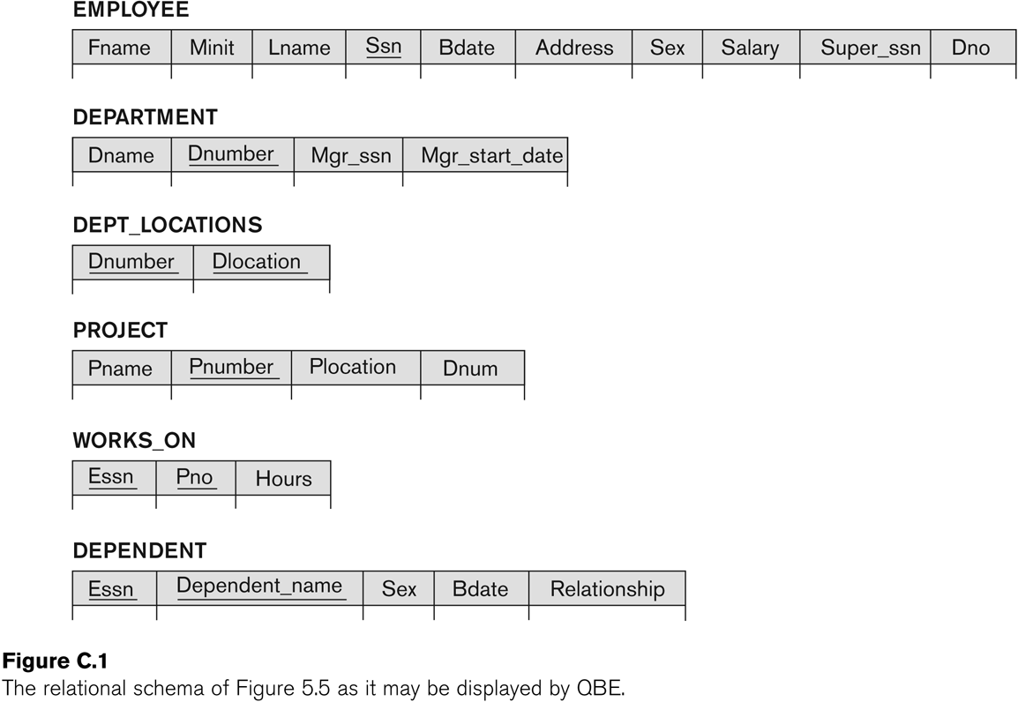
Example Schema as a QBE Query Interface

Slide 21
QBE Examples
The following domain calculus query can be successively minimized by the user as shown:
Query :
{uv | (∃ q) (∃ r) (∃ s) (∃ t) (∃ w) (∃ x) (∃ y) (∃ z)
(EMPLOYEE(qrstuvwxyz) and q=‘John’ and r=‘B’ and s=‘Smith’)}

Slide 22
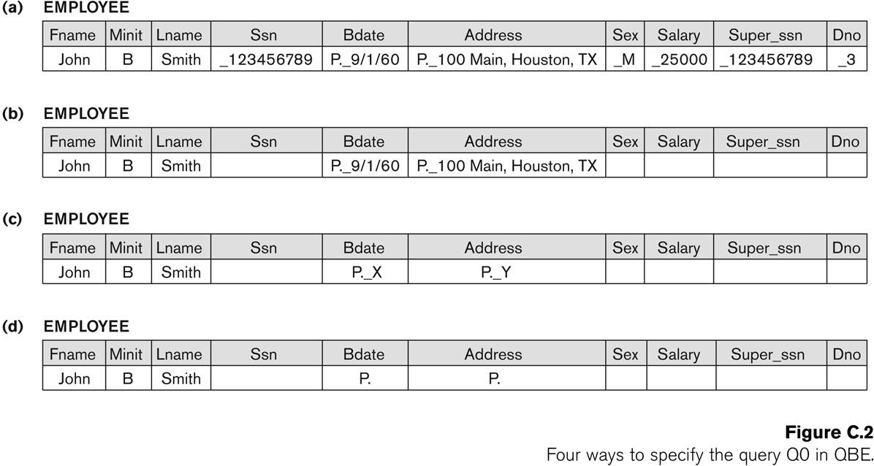
Four Successive Ways to Specify a QBE Query

Slide 23
QBE Examples
Specifying complex conditions in QBE:
A technique called the “condition box” is used in QBE to state more involved Boolean expressions as conditions.
The C.4(a) gives employees who work on either project 1 or 2, whereas the query in C.4(b) gives those who work on both the projects.

Slide 24
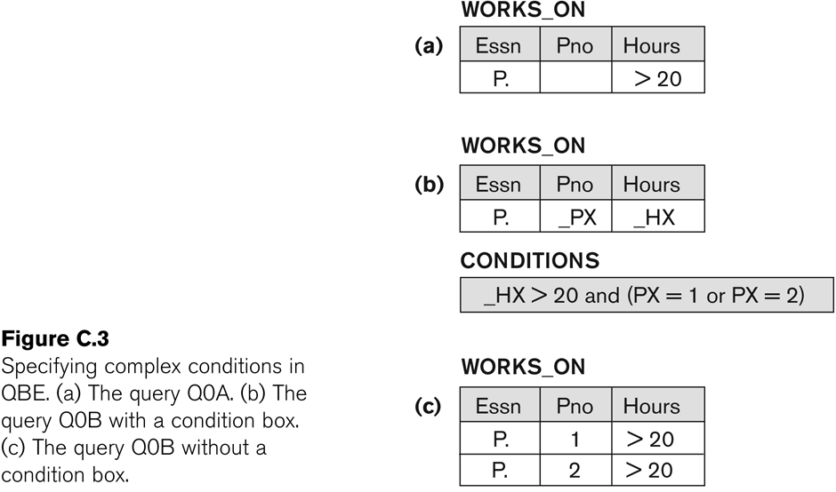
Complex Conditions with and without a condition box as a part of QBE Query

Slide 25
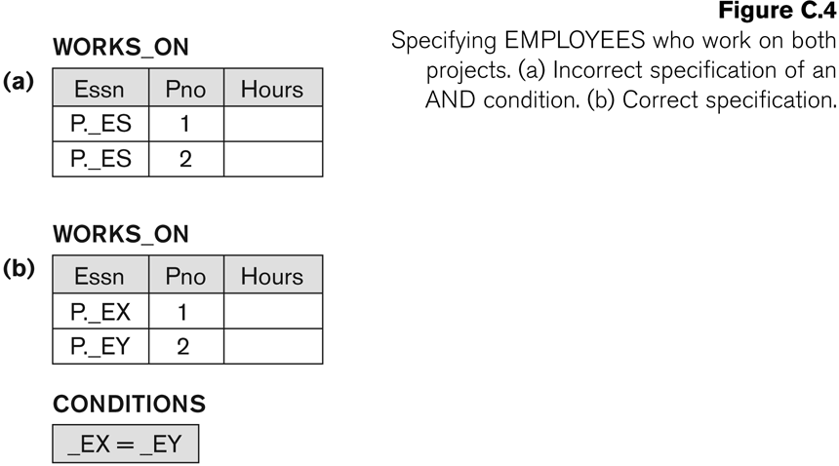
Handling AND conditions in a QBE Query

Slide 26
JOIN in QBE : Examples
The join is simply accomplished by using the same example element (variable with underscore) in the columns being joined from different (or same as in C.5 (b)) relation.
Note that the Result is set us as an independent table to show variables from multiple relations placed in the result.

Slide 27
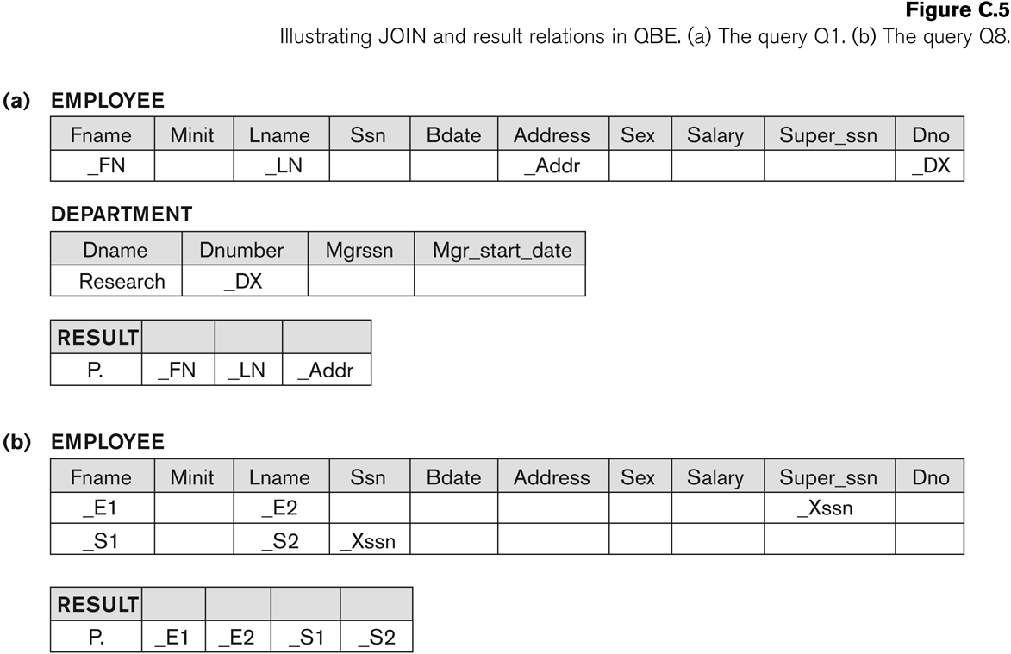
Performing Join with common example elements and use of a RESULT relation

Slide 28
AGGREGATION in QBE
Aggregation is accomplished by using .CNT for count,.MAX, .MIN, .AVG for the corresponding aggregation functions
Grouping is accomplished by .G operator.
Condition Box may use conditions on groups (similar to HAVING clause in SQL – see Section 8.5.8)

Slide 29
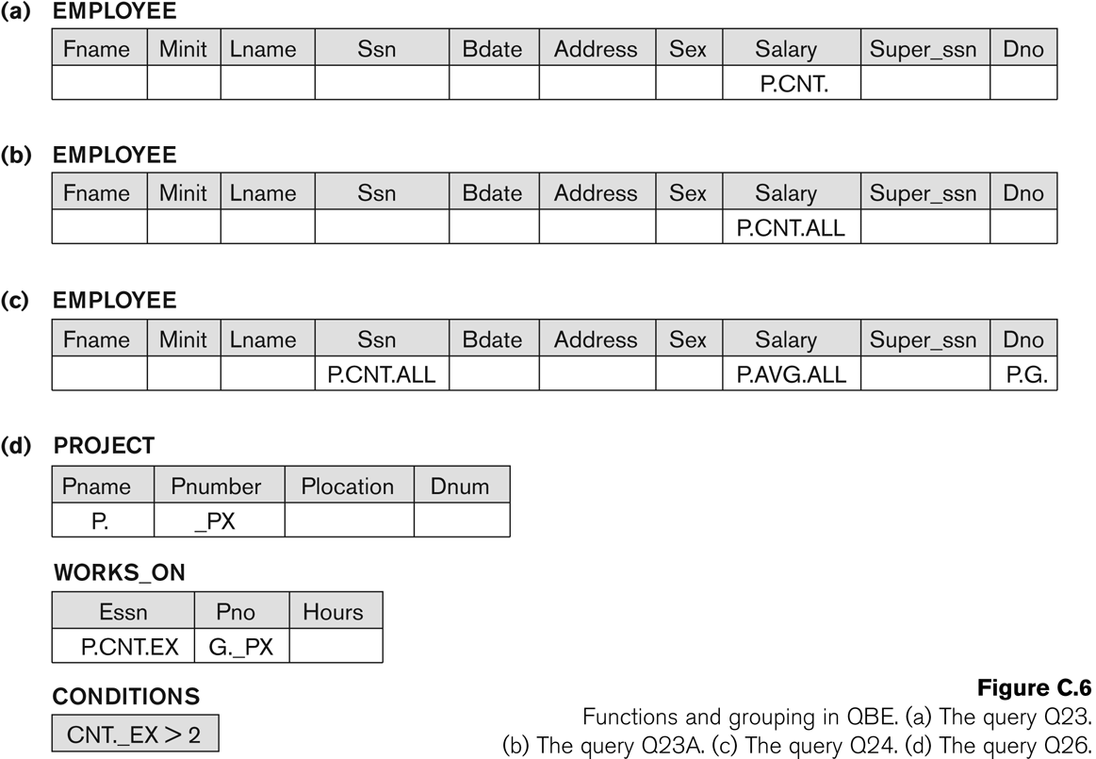
AGGREGATION in QBE : Examples

Slide 30
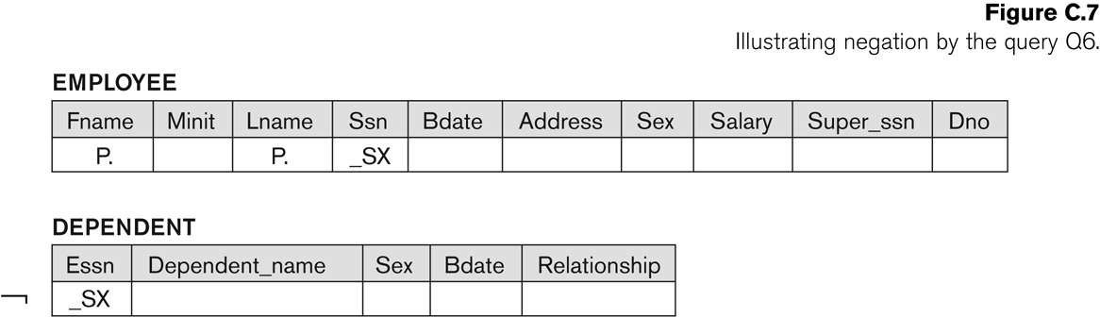
NEGATION in QBE : Example

Slide 31
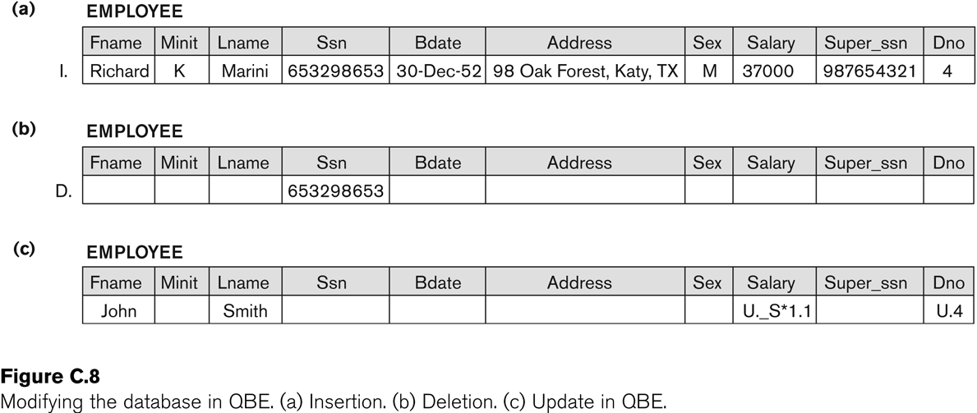
UPDATING in QBE : Examples

