Slide 1
Code of Conduct for Data Science
Should It Be Mandatory?

Slide 2
Outline
Types of Regulations
Why They Are Needed
What Regulations Already Exist for Data
What’s Needed
Conclusions
Questions and Witty Banter

Slide 3
What Kinds of Regulations and Codes Are There?
Regulated Industries
Professional Associations
Chartered
Non-chartered

Slide 4
Why Are They Needed?
Health and Safety
Privacy
Human Rights

Slide 5
Regulated Industries
Charities, Education, Finance, Housing, Social Care, Transport
Law - SRA Code of Conduct
Health - GMC, RCVS, MHRA

Slide 6



Recognisable Regulatory Bodies

Slide 7
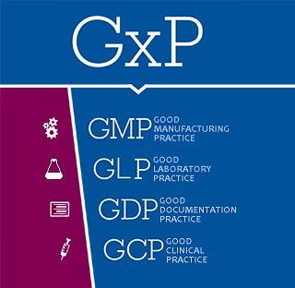
GxP
https://www.pharmaguideline.com/2017/01/concept-of-gxp-in-pharmaceuticals.html

Slide 8
Professional Associations
Chartered (formal credentials)
Institute and Faculty of Actuaries
Royal Statistical Society
British Computer Society - Chartered IT Professionals (CITP)
Non-Chartered
Institution of Analysts and Programmers

Slide 9

What Already Exists?
Data Science Association (USA)
https://www.datascienceassn.org/code-of-conduct.html

Slide 10
Data Science Association Code of Professional Conduct
9 rules under 3 headings
Terminology
Data Scientist - Client Relationship
Maintaining the Integrity of the Data Science Profession

Slide 11
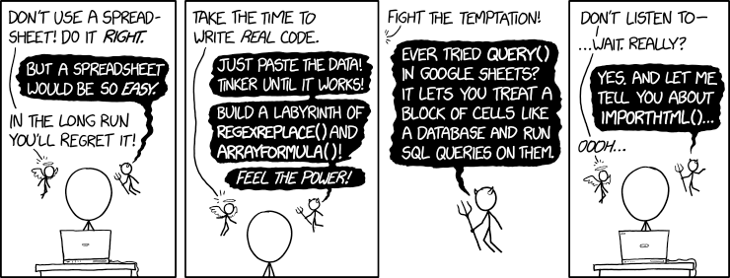
Why an Association Is Needed

Slide 12
Data Code of Conduct Modeled on Examples
Traceability
Compliance
Standardised Protocols
Training and Professional Development

Slide 13
Other Considerations
International Society?
Sensitive information
Global information
International work
Professional Membership/License?
Accredited courses, universal requirement, standardised training

Slide 14
Conclusions
Regulatory Bodies and Professional Associations provide standards, laws, and codes of ethics
They are needed for reasons such as health and safety, privacy, and human rights
Data Scientists and Analysts work across many fields
Will already be held accountable to the particular regulations of the employer
Must understand the importance of ethics, the sensitive nature of the work, and the potential impact of not following regulations

Slide 15
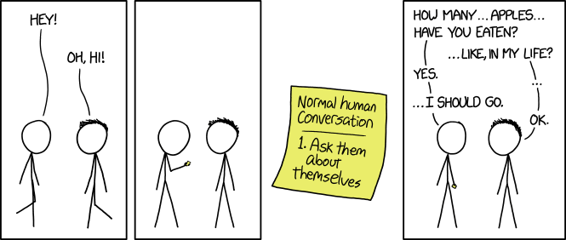
Questions?

Slide 16
Image Sources
https://www.datascienceassn.org/code-of-conduct.html
https://www.gov.uk/government/news/impersonation-of-mhra-staff--2
https://www.policymed.com/2019/01/fda-releases-two-draft-guidances-on-rems-programs.html
https://kioskindustry.org/standards/ul-standards/
https://imgs.xkcd.com/comics/spreadsheets.png
https://imgs.xkcd.com/comics/friendly_questions.png

