Slide 1
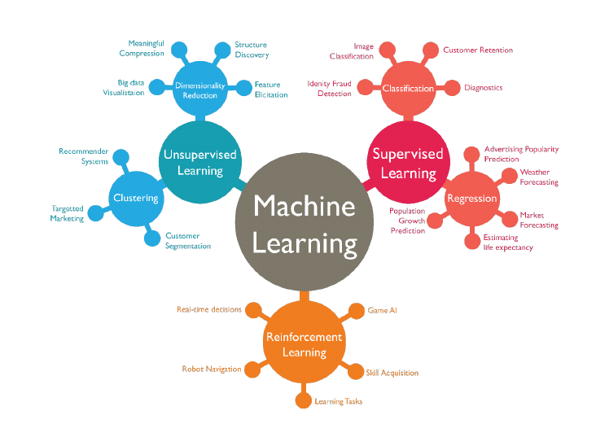
Wage Crime and Education
Project4: Machine Learning Integrations
Presented By:
Amber Lee, Sai Obijiofor, Alain,
Steve Kitay and Anil Kumar

Slide 2

Wage Crime and Education
Compare Living Wags with other factors
to determine the impact of a community/
(sate/County) crime rate.

Slide 3
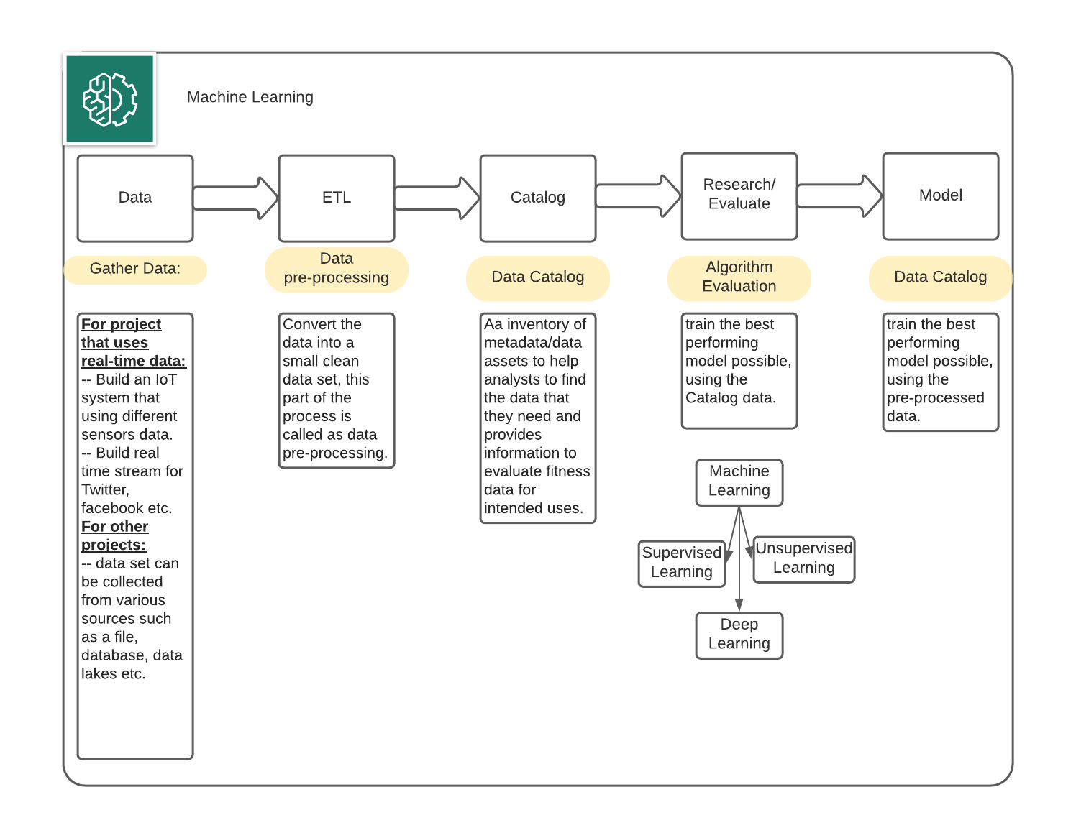
Machine Learning

Slide 4


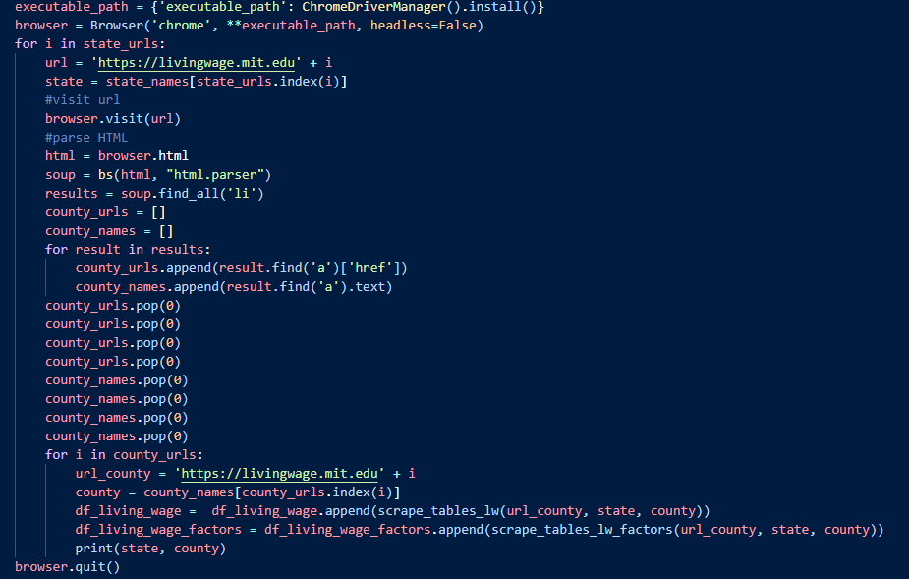

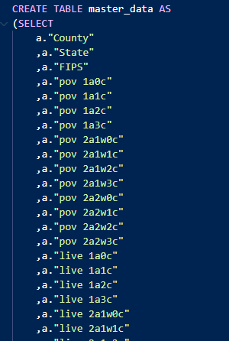
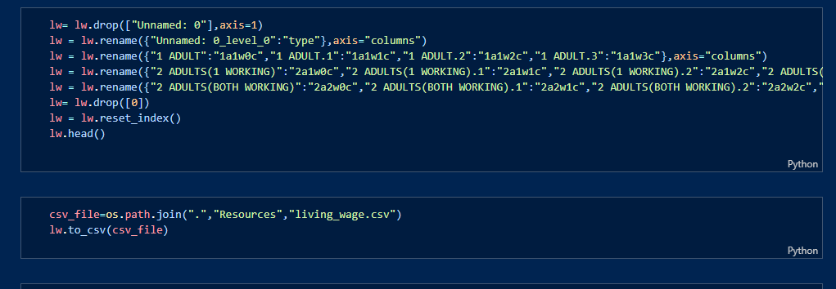
ETL
Extract
Load
Transform

Slide 5
Modeling Selection Process
Linear
Linear was our goal model to predict crime with changes in the LW factors
Collinearity and scope of data held accuracy back
Neural Net
Iterated through several variation, with a mixture of linear activation functions
Vanishing Gradient Descents led to zeroed accuracy scores quickly
Random Forest
Highest accuracy score out of all regressions we ran against test data
Tuned hyperparameters by iterating to get the highest test score

Slide 6
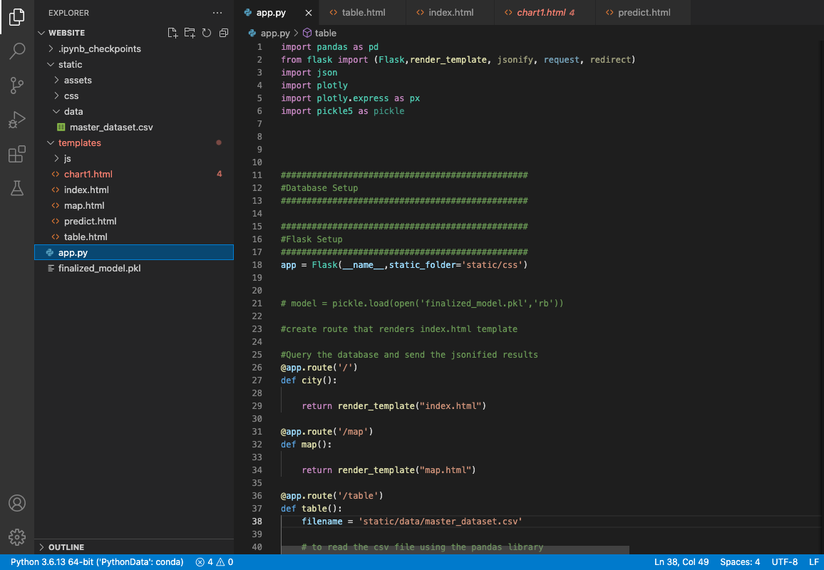
Flask- (Web Component)
Flask: Python-based microframework for web development, light weight and ease of use.
Gunicorn: Python
WSGI HTTP Server, efficient for its pre-fork worker model.
Bootstrap: templates for base
layouts

Slide 7
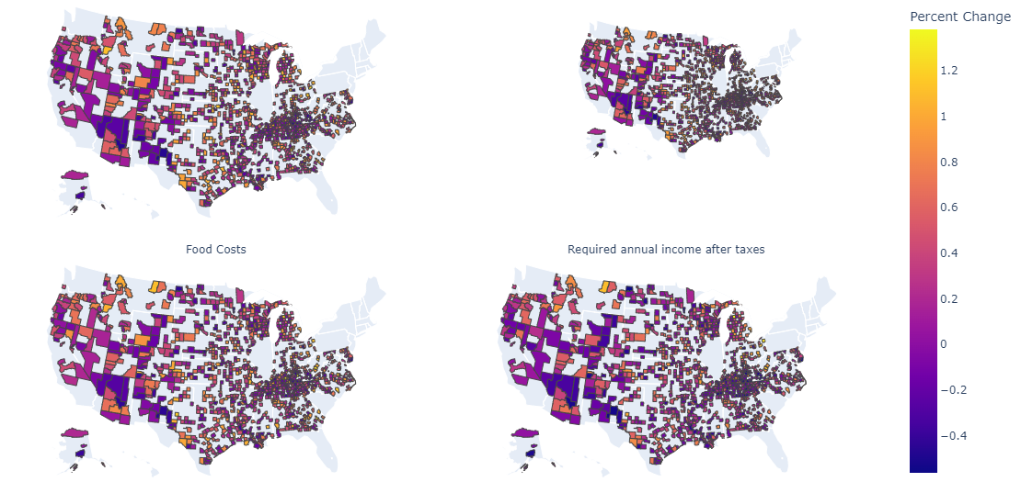
Visualizations Tech Stack
Plotly: To visualize a variety
of types of data stored in a
Pandas DataFrame.

Slide 8
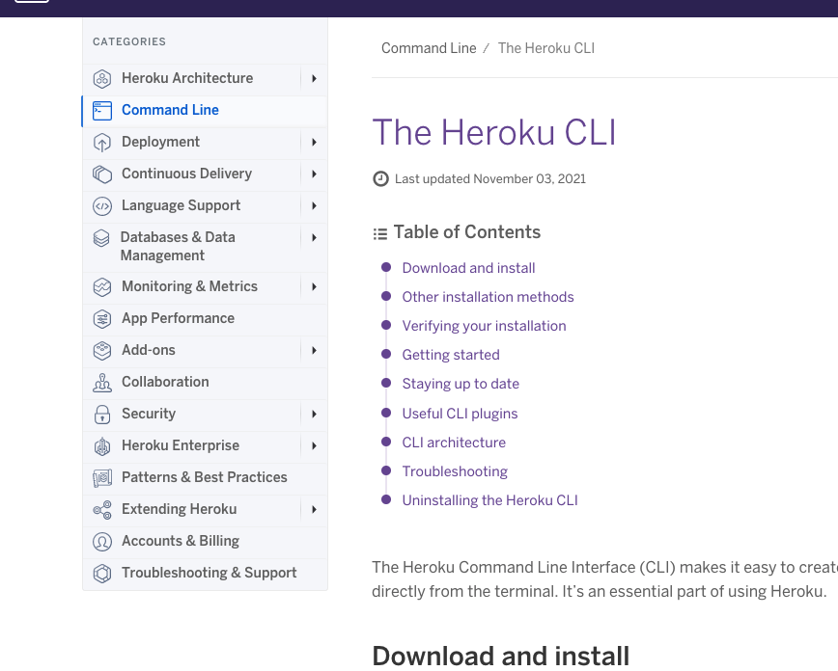
Deployment: Heroku
Heroku: Container-based cloud
Platform as a Service (PaaS),
to deploy, manage, and
scale web apps.

