Slide 1
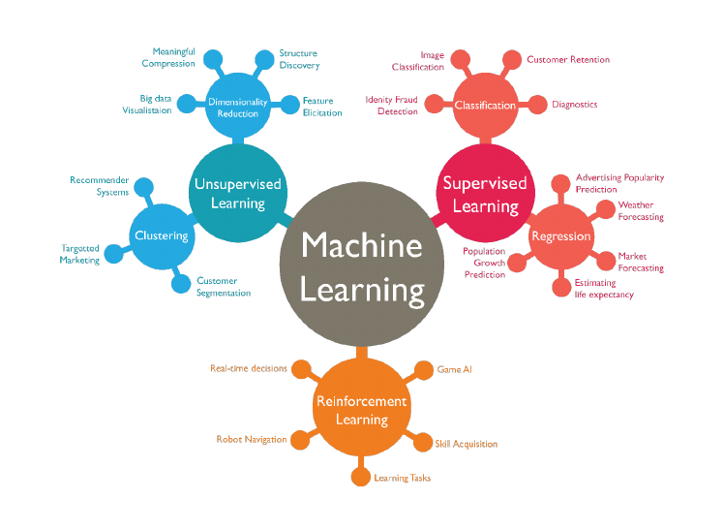
Wage Crime and Education
Project4: Machine Learning Integrations
Presented By:
Amber Lee, Sai Obijiofor, Alain,
Steve Kitay and Anil Kumar

Slide 2

Wage Crime and Education
Compare Living Wags with other factors
to determine the impact of a community/
(sate/County) crime rate.

Slide 3
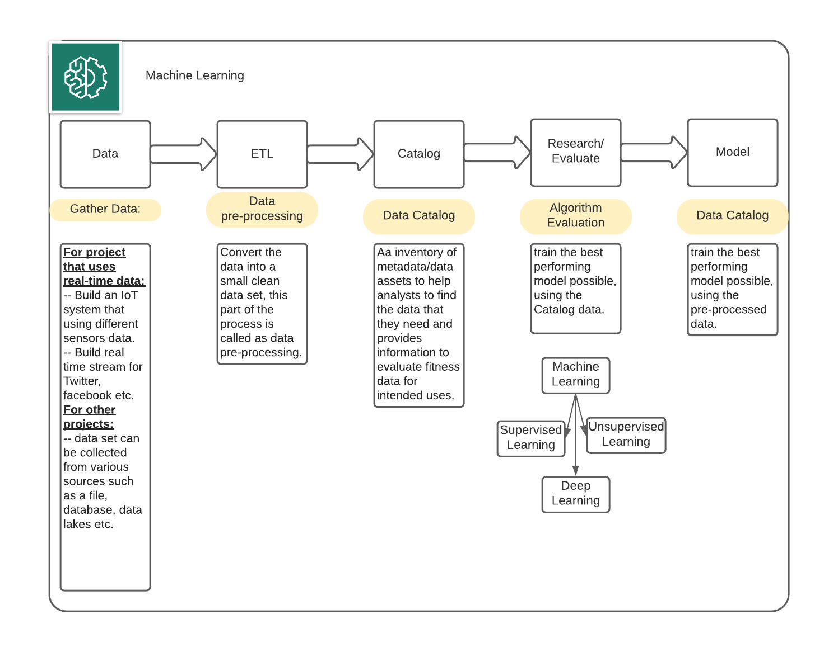
Machine Learning

Slide 4
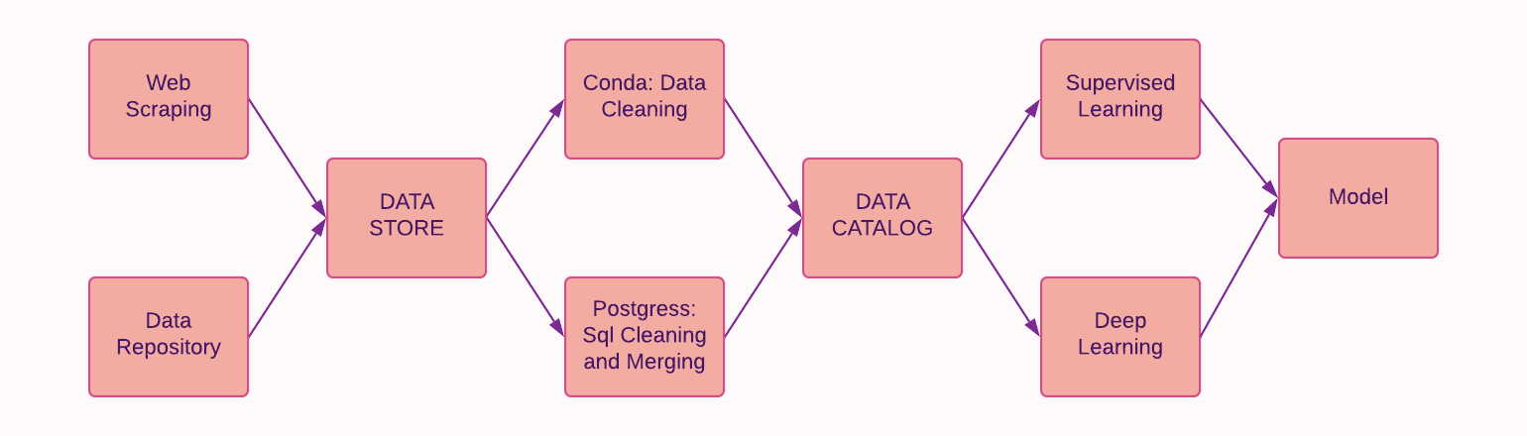
How did we do it?

