Slide 1
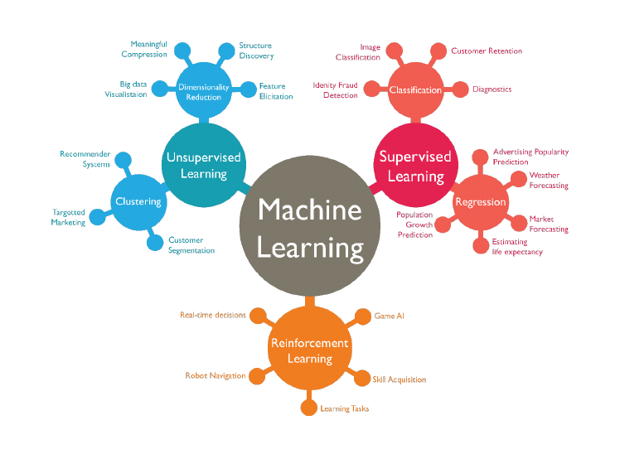
Wage Crime and Education
Project4: Machine Learning Integrations
Presented By:
Amber Lee, Sai Obijiofor, Alain,
Steve Kitay and Anil Kumar

Slide 2

Wage Crime and Education
Compare Living Wags with other factors
to determine the impact of a community/
(sate/County) crime rate.

Slide 3
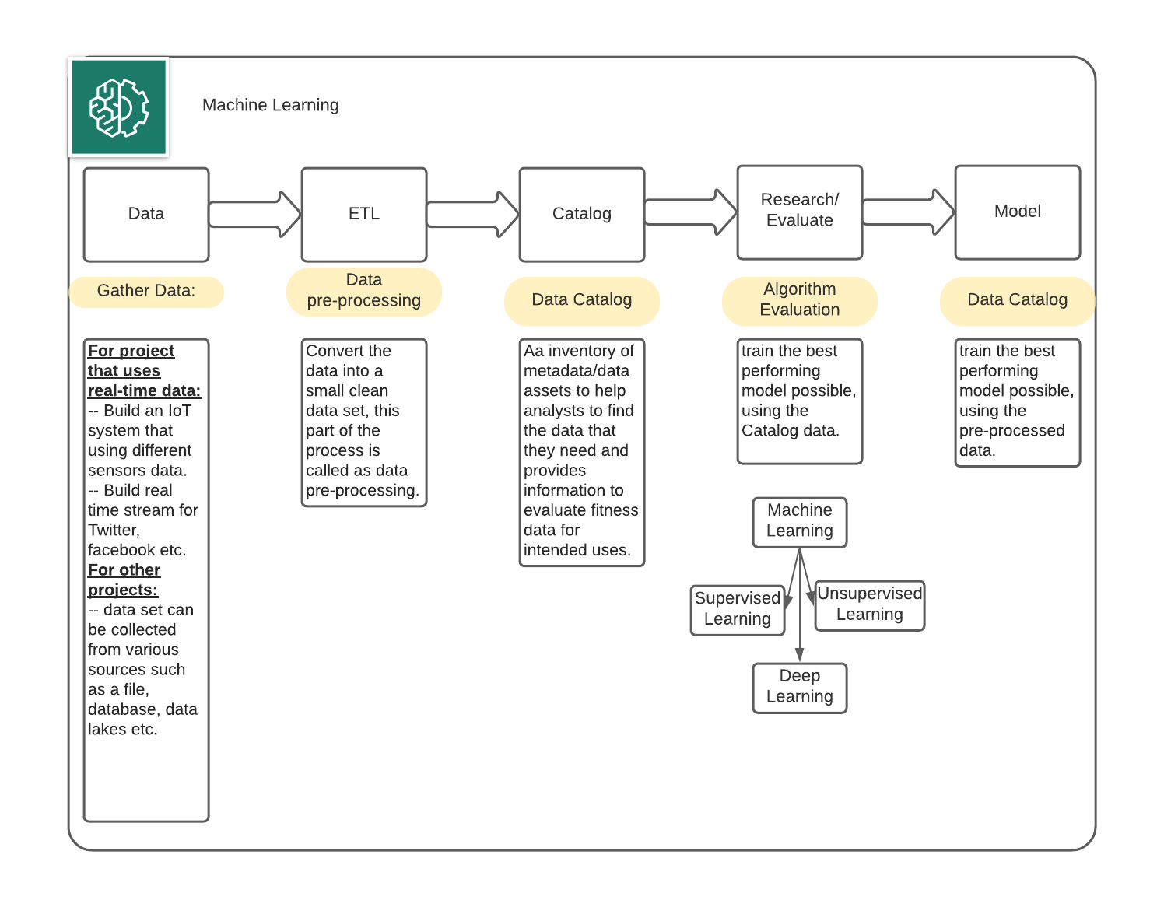
Machine Learning

Slide 4
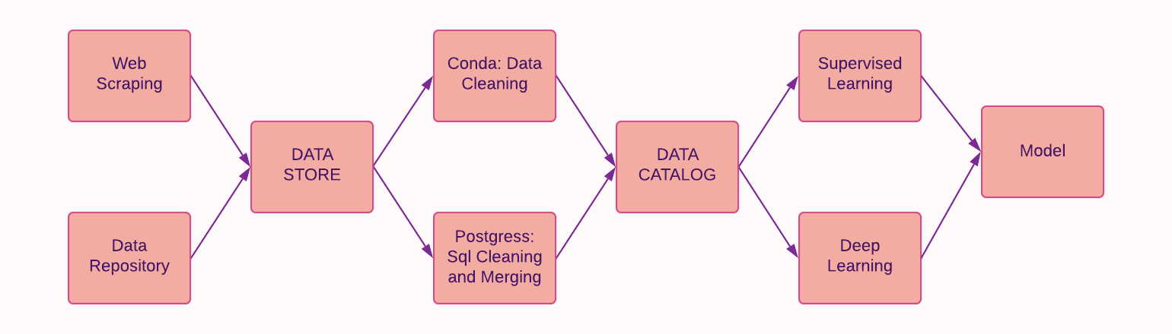
How did we do it?

Slide 5
Modeling Process
Linear
Neural Net
Random Forest

Slide 6
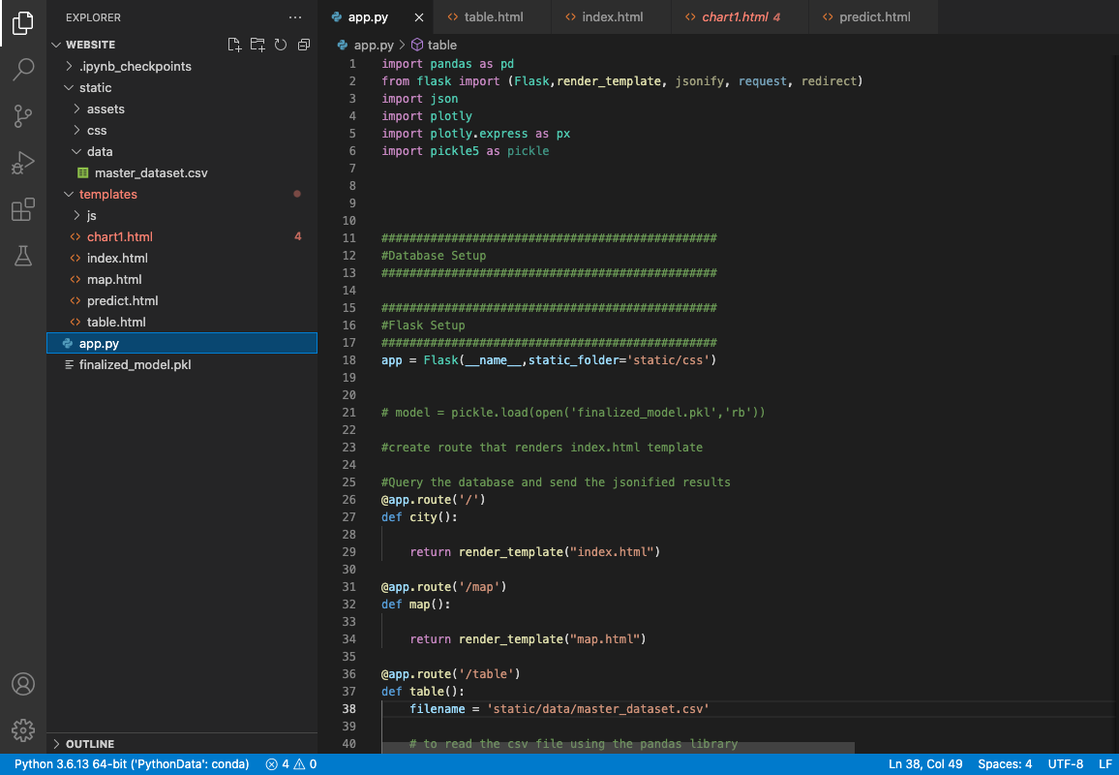
Flask- (Web Component)
Flask: Python-based microframework for web development, light weight and ease of use.
Gunicorn: Python
WSGI HTTP Server, efficient for its pre-fork worker model.
Bootstrap: templates for base
layouts

Slide 7
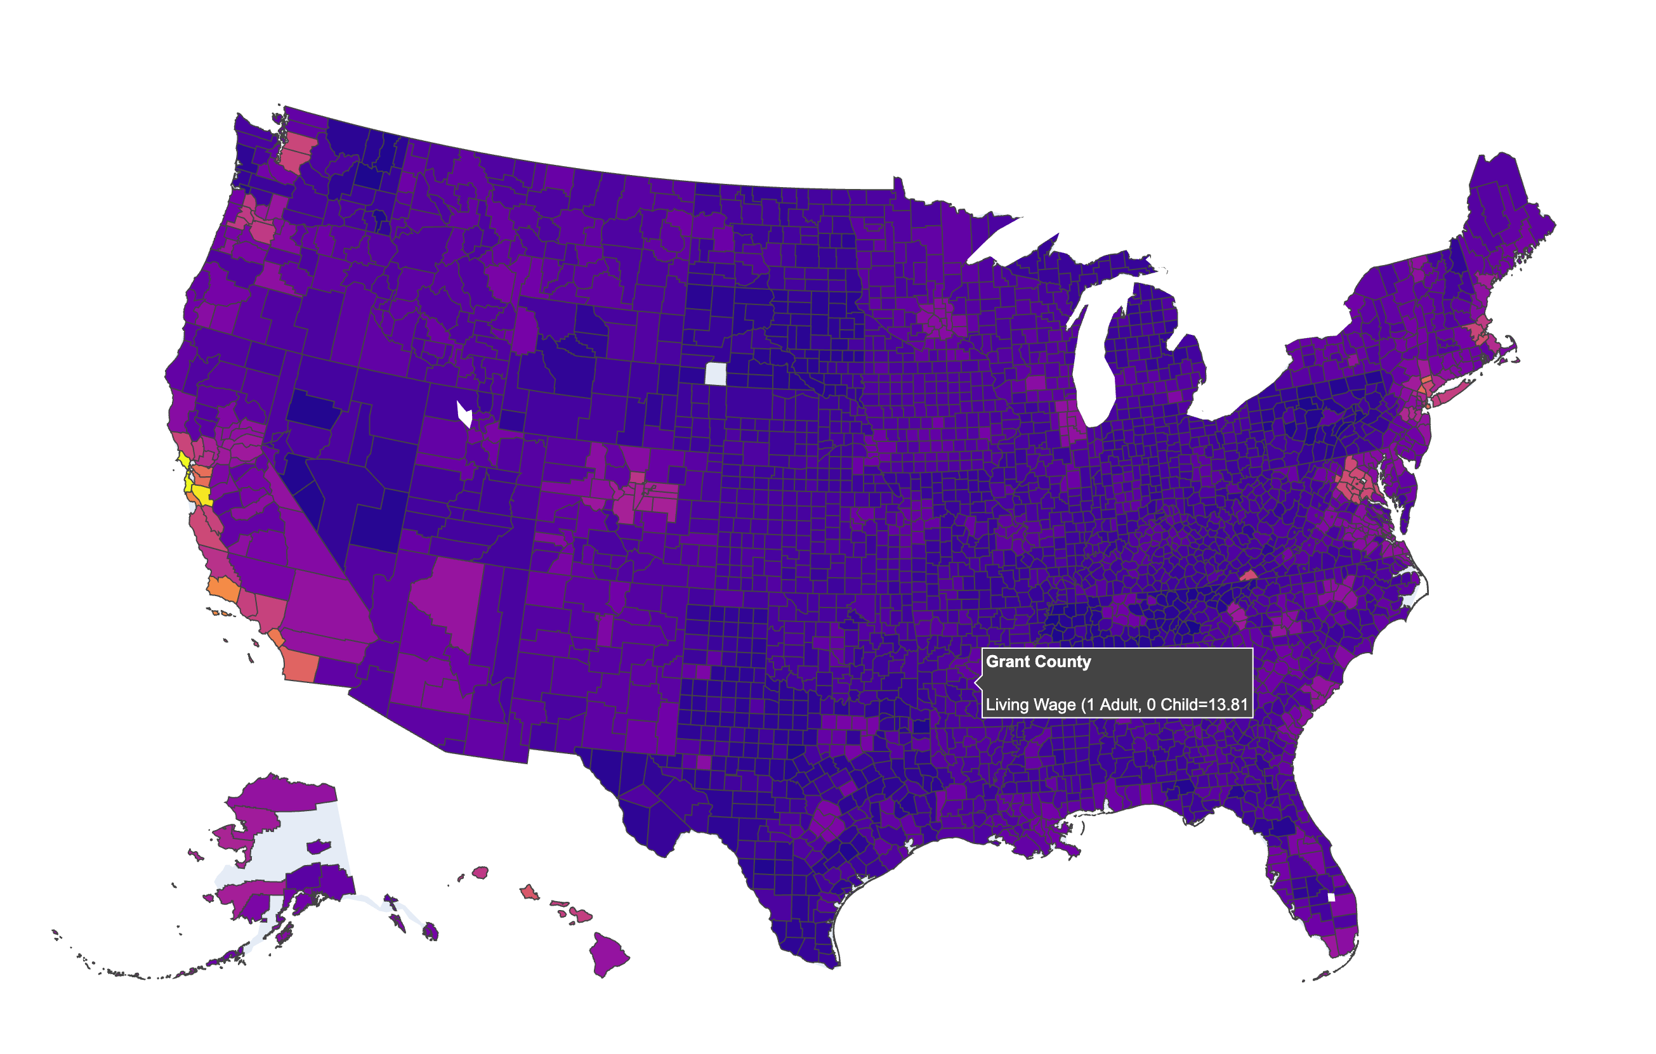
Visualizations Tech Stack
Plotly: To visualize a variety
of types of data stored in a
Pandas DataFrame.

Slide 8
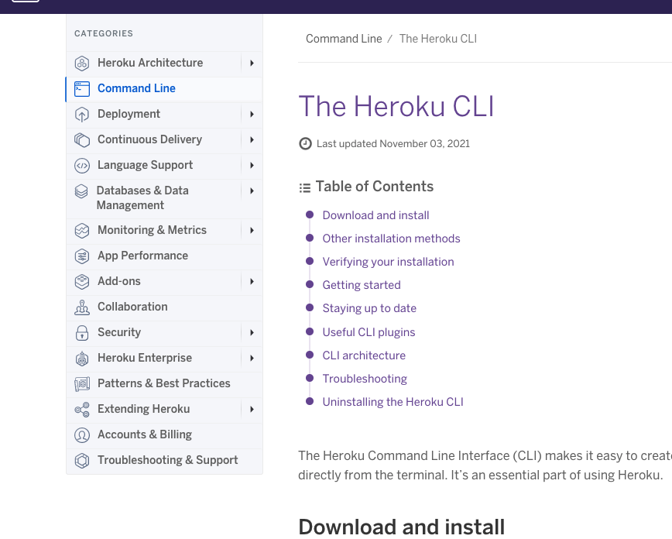
Deployment: Heroku
Heroku: Container-based cloud
Platform as a Service (PaaS),
to deploy, manage, and
scale web apps.

