Slide 1
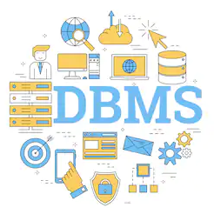

DATABASE MANAGEMENT SYSTEM
Database Management Systems
Presented by : Amber,Siva

Slide 2
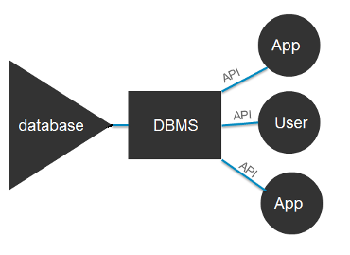
What is it ?
A database management system (DBMS) is system software for creating and managing databases. The DBMS provides users and programmers with a systematic way to create, retrieve, update and manage data.

Slide 3

Facts about Database
Oracle -1980. This was the first most popular relational DBMS which gradually edged out earlier mainframe products such as IMS.
DBMS - personal computers. In fact, now you can find DBMS on almost every custom business application.
Databases help programmers focus on algorithms and features by completing all the data storage and search work. Had there been no databases, the time taken to develop applications would be at least 10 times greater.
The total amount of data in the world was 4.4 zettabytes in 2013. That is set to rise steeply to 44 zettabytes by 2020.

Slide 4

Why we need Database?
The various reasons for which we require databases are:
To manage large chunks of data: if your size of data increases into thousands of records, it will simply create a problem of speed.
Accuracy: When doing data entry files in a spreadsheet, it becomes difficult to manage the accuracy as there are no validations present in it.
Ease of updating data: With the database, you can flexibly update the data according to your convenience. Moreover, multiple people can also edit data at same time.

Slide 5
Why we need Database?
Security of data: There is no denying the fact that your data is less secure in spreadsheets. Anyone can easily get access to file and can make changes to it. With databases you have security groups and privileges you set to restrict access.
Data integrity: Data integrity also becomes a question when storing data in spreadsheets. In databases, you can be assured of accuracy and consistency of data due to the built in integrity checks and access controls.

Slide 6
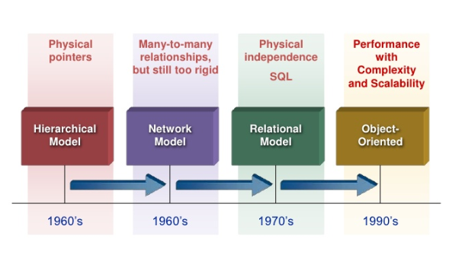
History of Databases

Slide 7
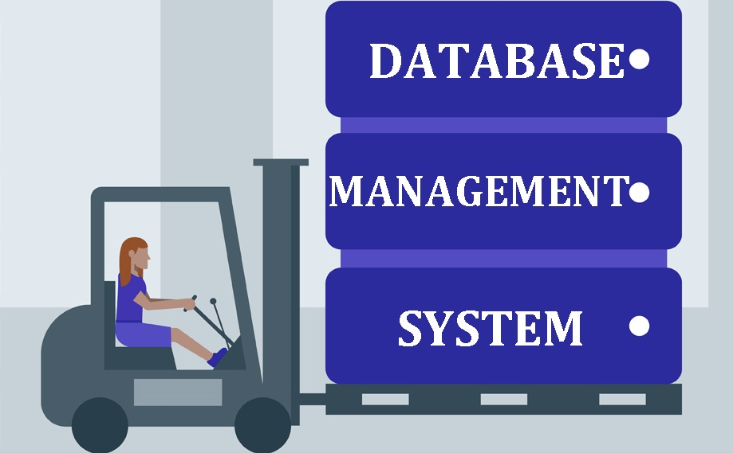
Database Models
Popular database models and their management systems include:
Relational database management system (RDBMS) - RDBMS can be quite expensive.
NO SQL - well-suited for loosely defined data structures that may evolve over time.
In-memory database management system (IMDBMS) –
provides faster response times and better performance.
Columnar database management system (CDBMS) –
well-suited for warehouse that have a large number
of similar data items.
Cloud-based data management system –
the cloud service provider is responsible for providing
and maintaining the DBMS.

