Slide 1
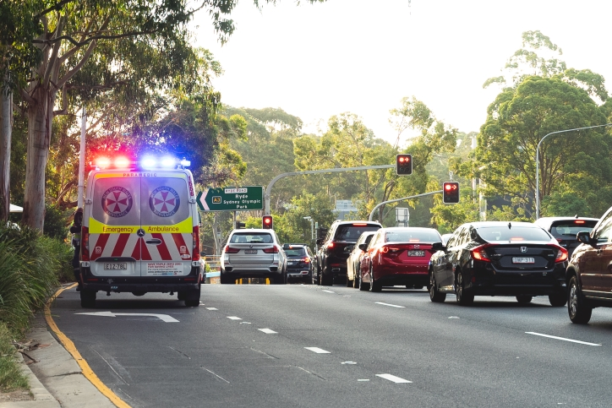
NSW Road Crash Data Analysis
(2017 - 2021)
Group M13A-G01
z5310499 Abigail Joesan Johan
z5313435 Andrew Li
z5488713 Edward Yu
z5432399 Wei-Chen Tsai
z5419818 Nicole Lou

Slide 2
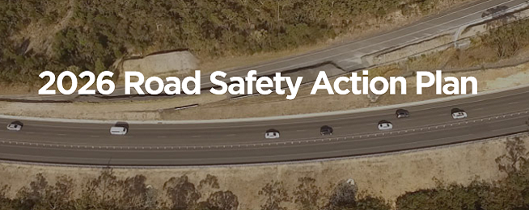
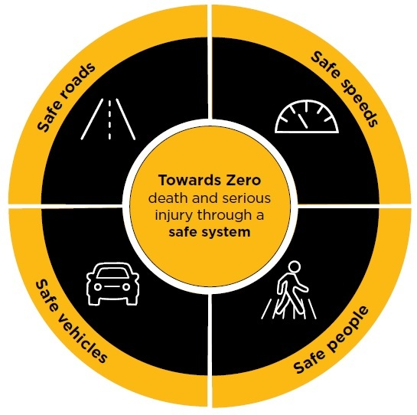
Project Background & Research Question
Project background
In every state, Australia’s roads have become more deadly in every state and territory
In the year to Match 31 2023, there were 1204 (5.9% rise) in deaths on Australian roads
Reduction target March 2023: 1011 deaths
Failure in meeting set reduction targets has led to 193 more deaths than expected nationally
Conducted to identify and raise awareness of major crash factors
Visualizations will inform Transport for NSW of key trends
2026 Road Safety Action Plan Goal: Reduce fatalities on NSW roads to 164 by 2030.
If no action is taken now to improve road safety in NSW, it is highly likely this target will not be met.
Why is this project being conducted?
To identify key trends in the data in determining leading factors causing crashes on NSW roads
This will be conducted through data visualisation and predictive modelling
Key Stakeholders involved: Government, taxpayers and community
Goal: Provide evidence based recommendations to assist in reducing fatalities and crashes on NSW roads and meet the 2030 target to effectively allocate road safety campaign budgeting

Slide 3
Preprocessing
5. Data type conversion
To ensure all columns have the correct data type, we convert data by using these functions: .to_datetime / .to_string / .to_numeric
Using the correct data types ensures that the data stored in each columns is in the expected format, preventing data corruption or inconsistencies
Dealing with missing values
The function .dropna() retains the records that have no missing values.
Use the mean value to replace the missing values by using function .fillna(df.mean() in case the data distribution is symmetric.
Use the most probable value to replace missing values as example: most_probable_value = 0, df.fillna(0).
For the decision tree classification, SimpleImputer was used to fill missing values in both the Numerical and Categorical columns using the Mean and the Most Frequent strategy respectively.
Pre-processing is critical to ensure our models are accurate, prevents overfitting and boosts interpretability of the models to extract meaningful trends and analysis
Cleaning of the dataset
Dropping columns or rows that were irrelevant to the specific question
We firstly defined a list containing the names of all columns/rows to drop then use the drop() function
Remove duplicates
Used the function drop_duplicates() to remove duplicates
Set the header as the first (0-indexed) row
The function header=1 sets the header as the first row in the dataset, ensuring the column then are with names
This makes it much easier to understand the data as we can refer to columns by meaningful names rather than numerical indices and it also helps generate informative labels for charts and graphs
Rename columns
Using function rename()
Dealing with invalid values
If invalid values are few and do not significantly impact the analysis, we can use function .drop() to remove invalid values.
Transform the invalid values to make them valuable by using function .log().

Slide 4
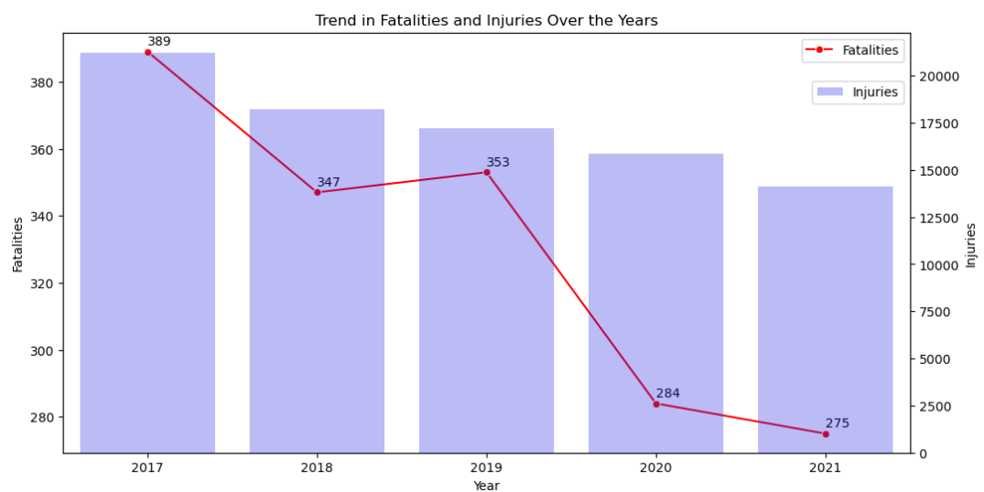
Initial Data Insights
What is occurring?
Quick understanding of dataset before predictive modelling process
Who, What, Where, When & Why
Decrease in both Fatalities + Injuries
30% decrease in fatalities
33% decrease in injuries
However, consider 2020-2021:
COVID restrictions meant less travel

Slide 5
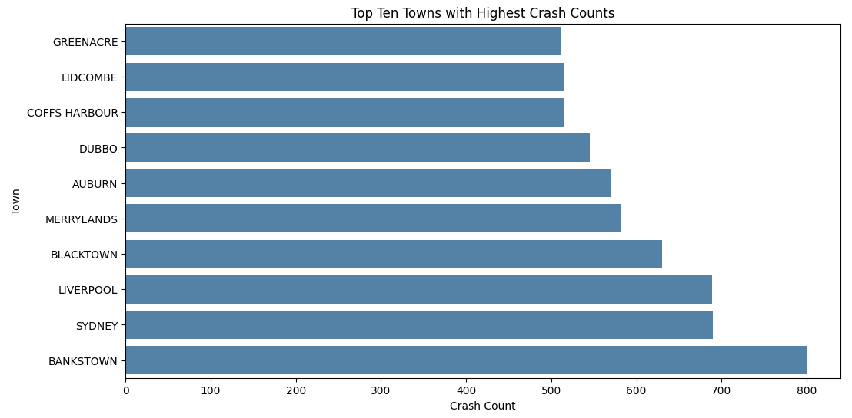
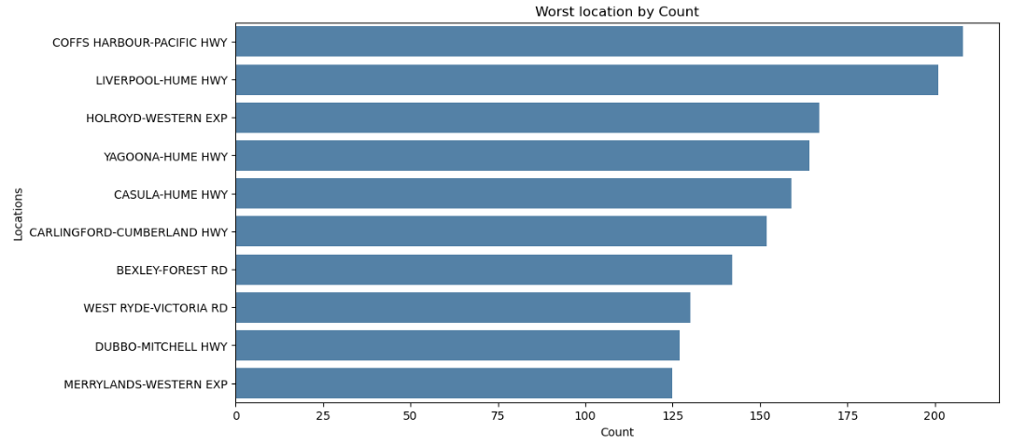
Initial Data Insights
Where are accidents occurring?
Suburbs : Mainly Western
Bankstown, Liverpool, Blacktown, etc.
Roads : Highways & Expressways
Hume Highway
Western Expressway

Slide 6
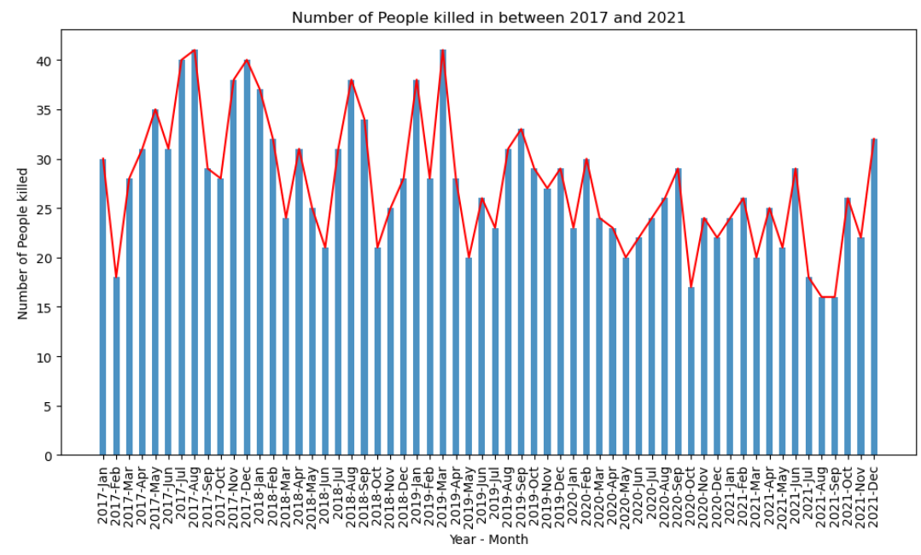
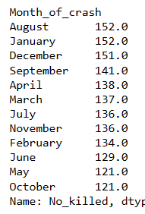
Initial Data Insights
When are fatal accidents occurring?
Fluctuates every month, but can see similar peaks & troughs
Months where most fatalities occurred:
August, January, December
Peak holiday periods

Slide 7
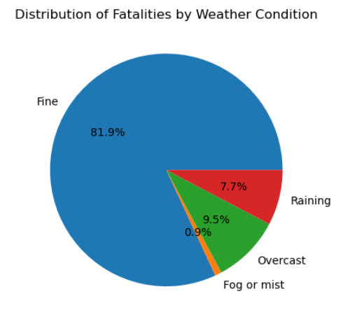
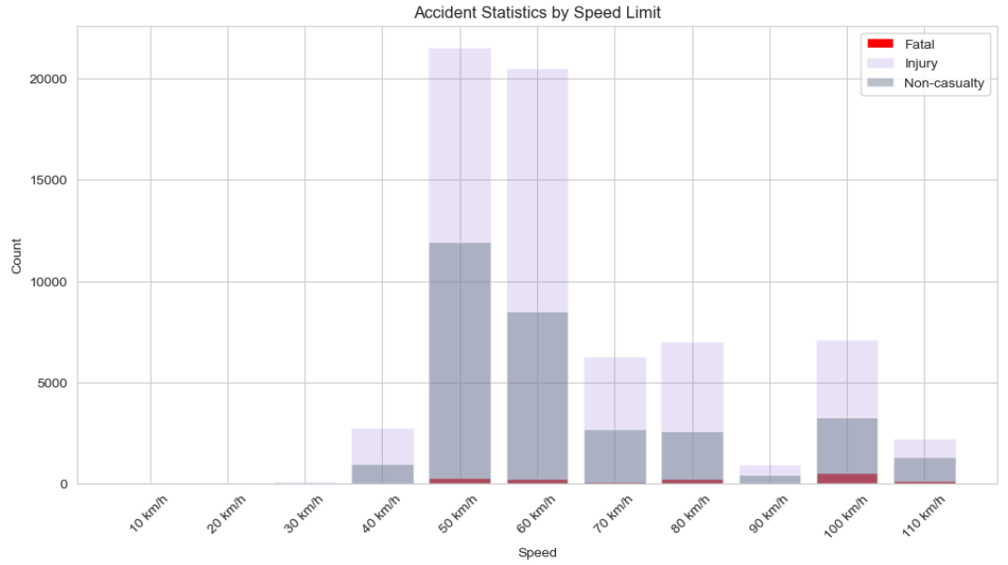
Initial Data Insights
Why are accidents occurring?
Possibly Weather and Speed Limit factors.
Weather : Majority fatalities during Fine weather
Fine weather conditions encourages travel
Speed Limit: Most accidents in 50-60km/hr
Most common speed limit
Higher speeds increases fatalities

Slide 8
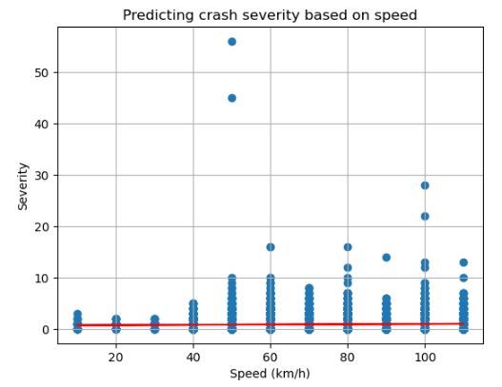
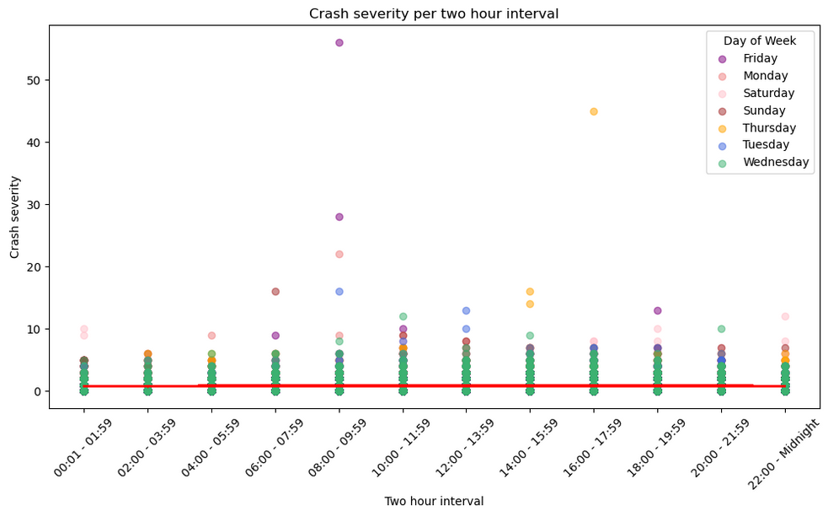
Data Modelling & Analysis
Linear Regression (Speed & Time)
R2 = 0.004
Move onto Predictive Modelling & Analysis
Which factors most influence crash severity & what are the most appropriate models?
Crash Severity = sum of all fatalities, severely & moderately injured
Very low predictive capabilities (R2 values)
Fails to explain majority of the observed variability in crash severity.
However, definitely has relationship in both.
R2 = 0.005
Notes:
So now that we have a bit of initial insights , we can now move onto predictive modelling & analysis, and try to understand which factors most influence crash severity and what the most appropriate models to determine these are.
So we first use linear regression on the speed limit and time period, and calculated severity by summing all the fatalities and the severely and moderately injured figure. We can see from the extremely low R squared values of .004 and .005 respectively that these models have very low predictive capabilities and fail to explain the majority of the observed variability in the crash severity.
We can see that linear regression is not a suitable model for these variables, however we can definitely see that there is a relationship in both graphs.

Slide 9
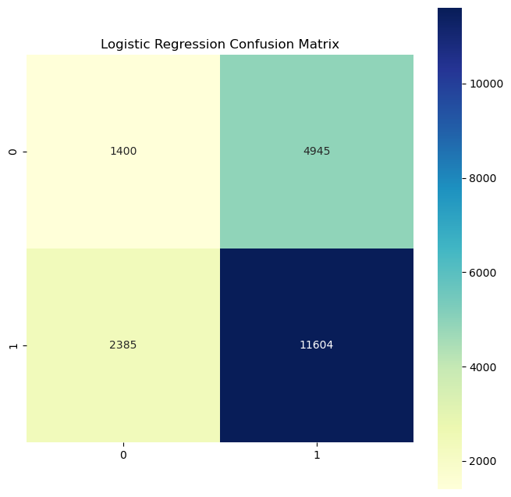
Data Modelling & Analysis - Logistic Regression
Benefits: Sigmoid function returns the probability for each output value from the regression line, which makes it easier to classify the output.
 | Weather | Alignment | Classification
Accuracy | 0.64 | 0.40 | 0.50
Precision | 0.70 | 0.70 | 0.70
Recall | 0.83 | 0.22 | 0.47
F1 score | 0.76 | 0.34 | 0.56
True negative
False positive
False negative
True positive
Key Findings:
Weather recall value close to 1 Model’s ability to identify severe crashes is strong.
Weather F1 score close to 1 Good variable to predict whether the crash is severe.
Weather and Severity

Slide 10
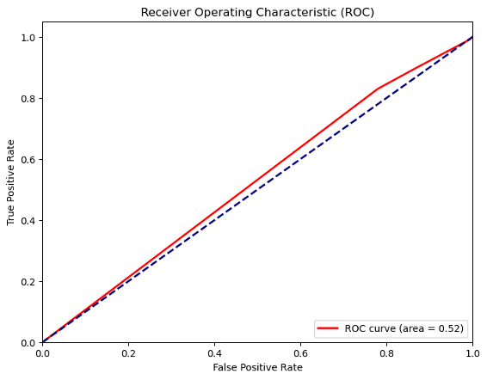
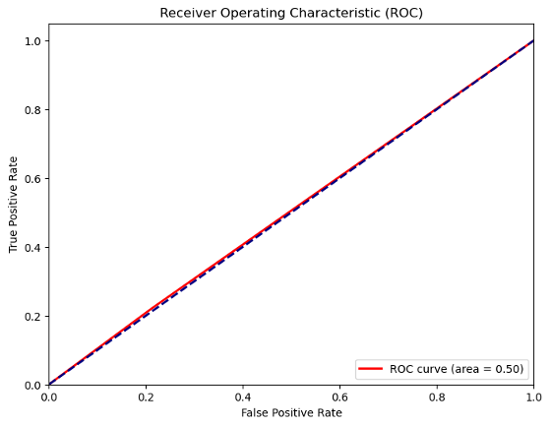
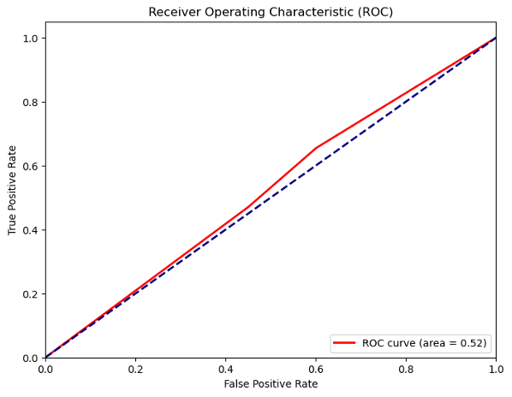
Data Modelling & Analysis - Logistic Regression
Weather & Severity
Alignment & Severity
Classification & Severity
Area = 0.52
Area = 0.50
Area = 0.52
Key Findings:
Slightly larger than 0.5 Performance is only slightly better than random guessing
Equals to 0.5 Model has no discrimination and is making random predictions

Slide 11
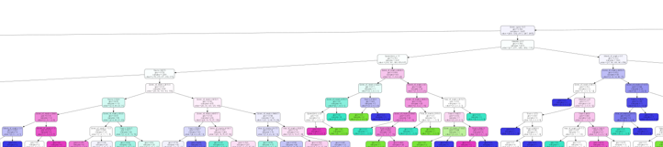
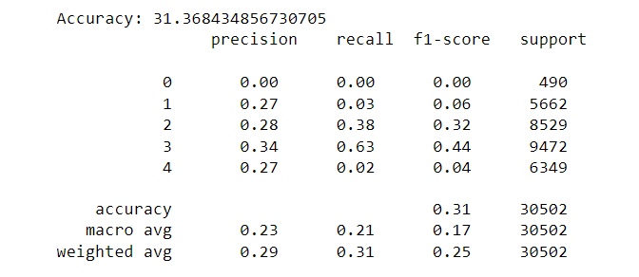
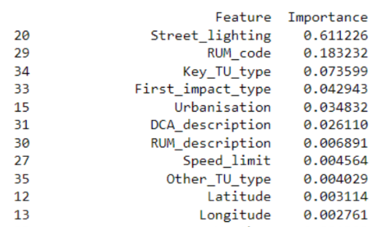
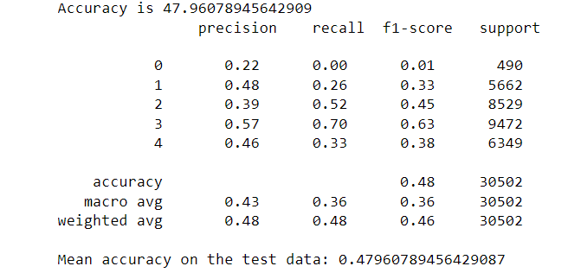
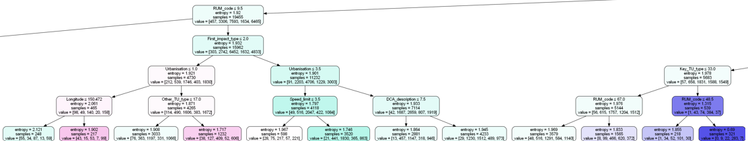
Data Modelling & Analysis- Decision Tree Classification
Variables stated in Q1: Town, Street_of_crash, Street_Type, Weather, Speed_limit, Year_of_crash, Month_of_crash
New variables: 'Street_lighting', 'RUM_code', 'Key_TU_type','First_impact_type' , 'Urbanisation', 'DCA_description', ‘RUM_description’, ‘Speed_limit’, 'Other_TU_type', 'Latitude', 'Longitude'
Figure 1
Figure 2

Slide 12
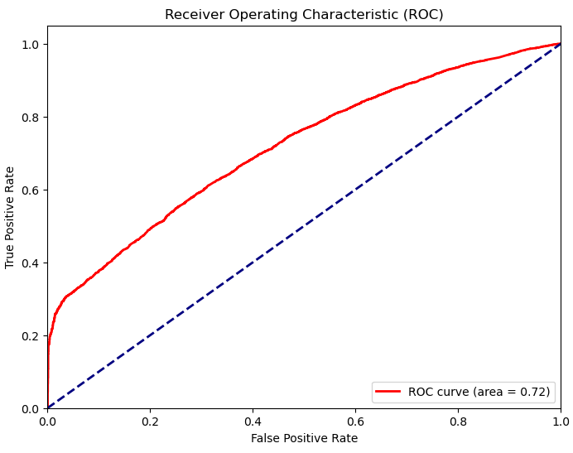
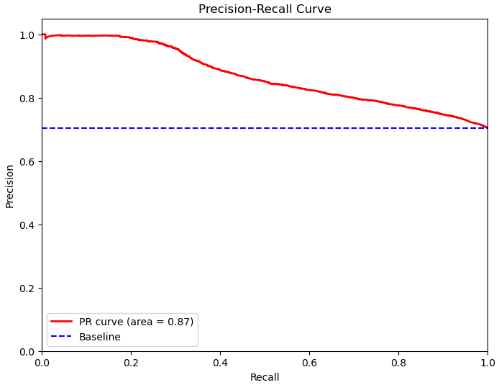
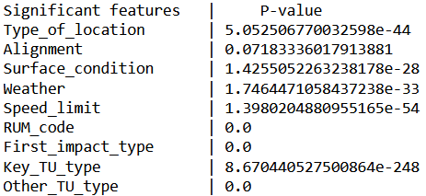
Data Modelling & Analysis
Conducted new logistic analysis with updated features
Variables used: Type_of_location, Alignment, Surface_condition, Weather, Speed_limit, RUM_code, First_impact_type, Key_TU_type, Other_TU_type
Used chi-square test to determine the optimal features to use in predicting crash severity
ROC score - 0.72, Precision-recall score - 0.87
Results from Chi-square test

Slide 13





Overall Findings
Western Sydney suburbs (eg Bankstown, Liverpool) had highest crash count
Location with highest crash rate are on highways
Consistent trend of increased fatalities during holiday seasons
Other factors contributed to crash severity, such as:
street lighting
surface condition
road alignment

Slide 14




Budget Recommendations & Conclusion
Increase police presence
Such as RBT and highway patrols especially during holiday periods as there is more traffic to deter dangerous driving behaviours, reducing likelihood of accidents occuring and improves overall road safety.
Educational programs & campaigns
Implement education programs in LGAs with high crash counts to increase awareness of safe driving practices
Road Maintenance
Ensure roads are in optimal condition to eliminate hazards especially on highways
Street Lighting
Improved street lighting to ensure roads are well lit, allows drivers to detect hazards early and respond promptly

Slide 15
References
The Sydney Morning Herald 2023, Sydney Morning Herald website, accessed 24 October 2023, <https://www.smh.com.au/politics/federal/road-deaths-rise-as-every-state-except-nsw-misses-reduction-target-20230512-p5d828.html/>.

