Slide 1
Automatic Paper Summary
Sprint 1
Github: https://github.com/jyueling/601Project
Trello: https://trello.com/b/3dmbWQol/automatic-paper-summary
Yueling Jiang
Yuying Wang
Yuxuan Liu

Slide 2
Product Statement
We expect to provide a website that users can browse the latest(the most popular) paper based on their interests, or upload documents and then feed it with articles and documents on the same topic.

Slide 3
Target Users
School of Engineering students and faculties
People who are interested in the latest technology field
People who want to browse papers or researches based on their research direction or paper

Slide 4
User Stories
I’m a ECE student of BU, I want to know the recent trend of my field.(e.g browse the latest and the most popular paper)
I’m a researcher of AI,I want to upload my paper and find other paper which has related content with my paper.
I’m a product manager of a tech company , I receive a product introduction, however I don’t understand some concept of it. So I want to know the core idea of my product and find some keywords which are convenient for me to search more.

Slide 5
Research Background
Natural Language Processing
-------Multi-label Classification (deep learning)
Website Development and GUI Design

Slide 6
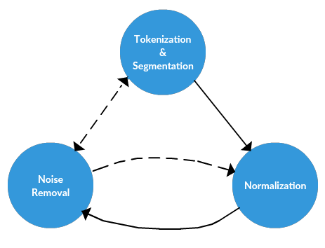
Multi-lable Classification(NLP)
Creating Dataset--BigQuery Public Datasets
Data pre-processing
1、tokenization & segmentation
----splits longer strings of text into smaller pieces
2、normalization
----puts all words on equal footing, and allows processing to proceed uniformly
3、noise removal
Notes:
在利用CNN进行文本分类的时候，首先要将原始文本进行预处理，主要还是分词、去除停用词等，然后对预处理后的文本进行向量化利用word2vec，我利用的shiword2vec中的skip-gram模型，将搜狗数据集表示为了200维的词向量形式;转化为词向量后就可以将每一句话转化为一个矩阵的形式，这样就跟利用CNN处理图像分类很相似;

Slide 7
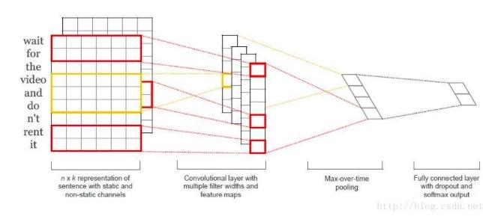
Multi-lable Classification(NLP）
CNN(convolution nerual network)
Word2Vec(word-=>vector)
CBOW(Continuous Bag-of-Words Model)
Skip-gram(Continuous Skip-gram Model)
Embedding
Convolution
Training、Deploying
Prediction
Notes:
https://towardsdatascience.com/how-to-do-text-classification-using-tensorflow-word-embeddings-and-cnn-edae13b3e575

Slide 8
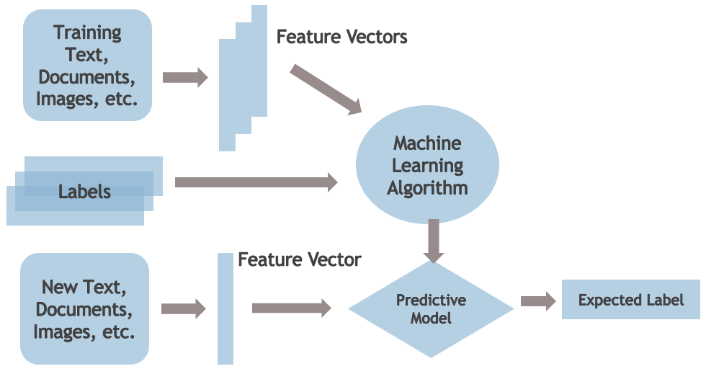
Data Processing Diagram

Slide 9
Tools to use
HTML ----- Build website
------ https://www.w3schools.com/html/
TensorFlow ----- Deep Learning，Build neural network
------ https://www.tensorflow.org/tutorials/
Programming：Python --- CNN，GUI

Slide 10
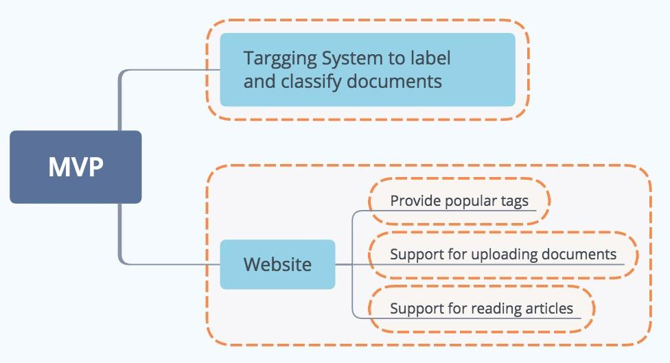
Minimum Viable Product(MVP)

Slide 11
Team Responsibility
Yueling: Researching about Deep Learning based multi-label system
Yuxuan: Researching about NLP,especially implementing CNN.
Yuying: Website Development and GUI Design
All: Contributed to the PPT

Slide 12
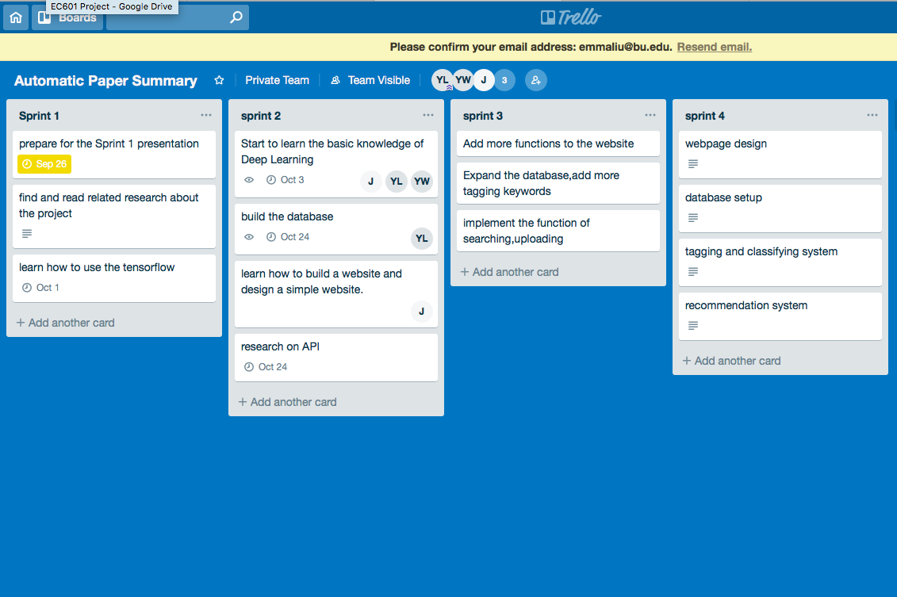
Trello

Slide 13
Question?

Slide 14
Thank you!

