Slide 1
Automatic Paper Summary
Sprint 2
Github: https://github.com/jyueling/601Project
Trello: https://trello.com/b/3dmbWQol/automatic-paper-summary
Yueling Jiang
Yuying Wang
Yuxuan Liu
Tianyi Sun

Slide 2
Content
System Architecture
Technology Selection
Functional Demonstration of your major user story

Slide 3
System Architecture
Text
Training Text, Documents
Feature Vectors
Word2vec
Machine Learning Algorithm
Vectors
Labels
TextRank
Feature Vector
New Text, Documents
Predictive Model
Expected Label

Slide 4
Technology Selection
Word2vec + TextRank
Auto Paper
Summary
Extractive
Word2vec + TextTeaser
Abstractive
LSTM RNN + Attention Mechanism
Notes:
总结起来使用word2vec+textrank方法的基本流程是：
（1）将article分句，装成一个链表。
（2）再将上述的链表中的每一句（sentence）分词，这里推荐jieba分词，当然最好去掉标点符号，以及一些停用词。得到一个二维的list。
（3）然后将每一个句子中的单词，分别于其它句子进行两两相似性计算。
（4）然后计算每一句的相对于另一句的分数，具体方式在上述的pagerank的算法中。
（5）迭代计算每一句的分数，重复迭代，直到分数的差值在0.0001下。
（6）排序上述得到的句子，取分数最高的topN。便是想要得到的句子
Pre-process the text: remove stop words and stem the remaining words.
Create a graph where vertices are sentences.
Connect every sentence to every other sentence by an edge. The weight of the edge is how similar the two sentences are.
Run the PageRank algorithm on the graph.
Pick the vertices(sentences) with the highest PageRank score
http://www.sohu.com/a/197255751_609569

Slide 5
Accomplishment
TextRank
Tokenize the text into sentences
Tokenize each sentence into a collection of words
Score the sentences via PageRank
Convert the sentences into graphs

Slide 6
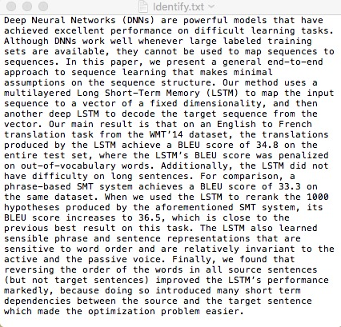
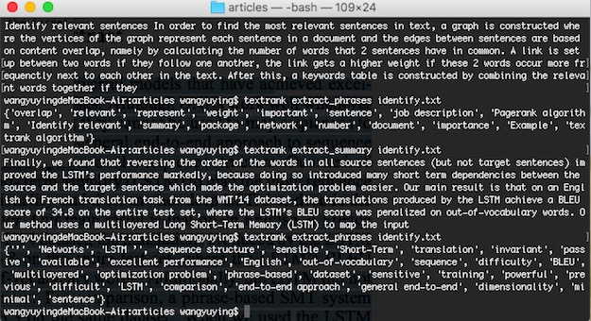
Demo

Slide 7
User Stories
I’m a ECE student of BU, I want to upload my paper to find the abstract of the paper and the keywords of each paragraph
I’m a product manager of a tech company , I receive a product introduction, however I don’t understand some concept of it. So I want to know the core idea of my product and find some keywords which are convenient for me to search more.

Slide 8
Functional Demonstration

Slide 9
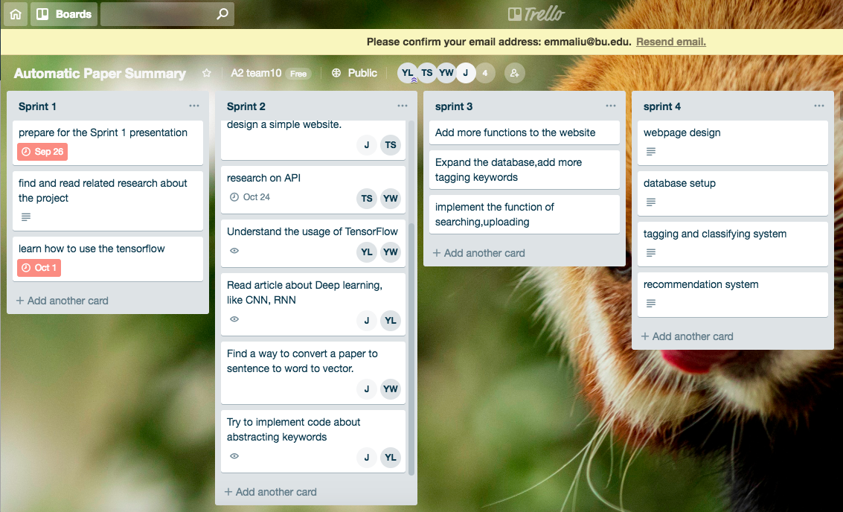
Trello

Slide 10
Question?

Slide 11
Thank you!

