Slide 1
NAME : NILESH AMBESTHA
PROJECT NAME : CALCULATOR
ORGANISATION : Nexthikes IT Solutions

Slide 2
INTRODUCTION :
  I have created a simple calculator using Tkinter library.
  I tried to make my calculator as colorful as I can.
  I have also added some Scientific features in the calculator.
FEATURES :
  The calculator has basic features or Addition, Subtraction, Division, Multiply & Percentage.
  It also includes some Trigonometric functions like, SIN, COS & TAN etc.
  I have also added, Square Root and Nature Log functions to make it a bit advanced.
  There is Exponential function also.

Slide 3
PURPOSE :-
  I first created a simple calculator
  I kept it simple as I am still trying to learn the code.
  I added some more features and colors and size as I became more comfortable with code.
  I am still learning and practicing the code and flows.
LIBRARY USED :
  I used the “TKINTER” library
  I also tried “KIVY” and “PySimpleGUI”
  I found “TKINTER” more interactive. Will keep trying with other libraries also
  I started to build the project quite late so was not able to play around more with other libraries also.
  I created this calculator with “KIVY” also. But could not make much changes. The screenshot is attached.

Slide 4
CHALLENGES :
  I came across a lot of challenges as was completely new to Python
  The first and foremost was to start the project. To overcome this, I took reference from the link provided : https://dev.to/spiff/calculator-with-gui-using-python-tkinter-jpn
  I also faced some issues while designing the UI. I wanted to make it colorful. I took reference from some YouTube videos and links. Below are some reference links:
    https://www.youtube.com/watch?v=do0hUPjayQ4
    https://stackoverflow.com/questions/67859701/colours-are-not-being-displayed-on-buttons-in-calculator-why
  I encountered a lot of errors in the for loop. For this I took help from below link :
    https://www.youtube.com/watch?v=xbDkJ7Ih9d4
  I am still learning the code and will overcome all this as I practice the code

Slide 5
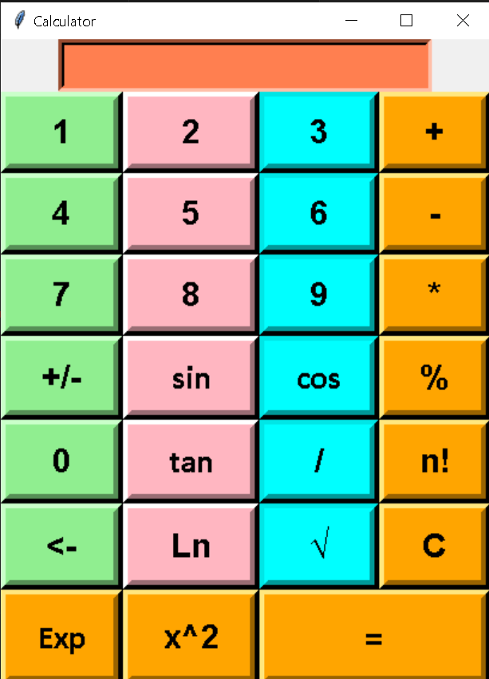
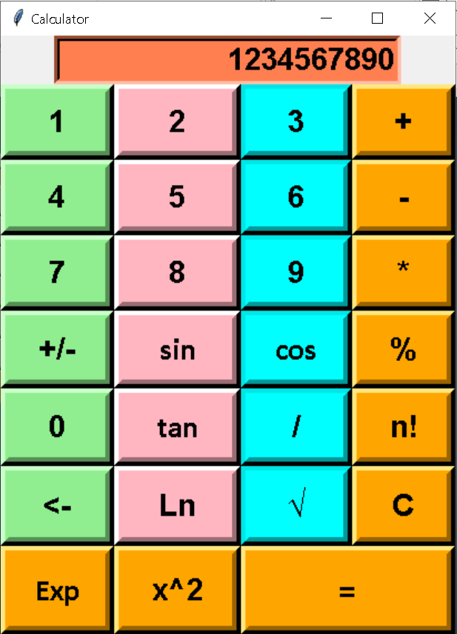
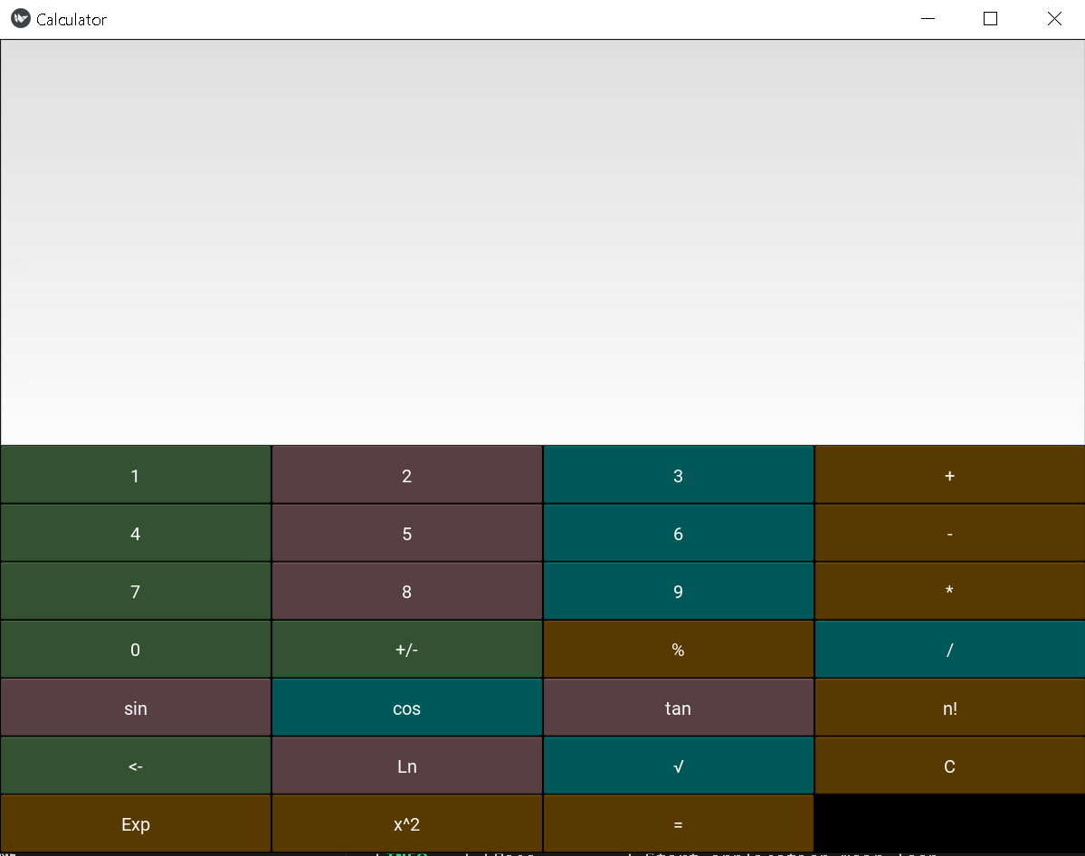
SCREEN SHOTS : Below are screenshots for my working calculator.
SCREEN SHOTS : Below is the screenshot for the calculator that I tried created with “KIVY” library

Slide 6
THANK YOU
Below are some learnings :
I learnt a lot about Python
How to create a new project
Creating a layout
About different libraries
Most importantly, learnt a lot about Loops

