Slide 1

Hybrid Intelligence Defense System (HIDS)
Combating AI Misuse Through Advanced Detection and Human-AI Collaboration. Presented by the AI Research Team.

Slide 2
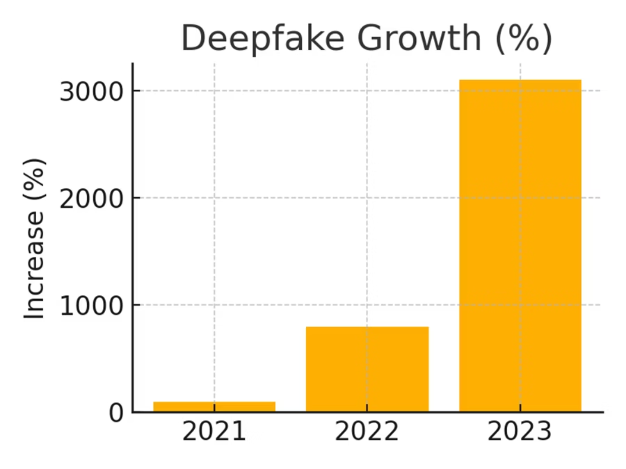
The Growing Threat of AI Misuse
As AI capabilities advance, so does the potential for its malicious exploitation. This new era introduces sophisticated threats that traditional cybersecurity measures struggle to counter.
Automated Cyber Attacks: AI-powered malware and phishing campaigns are becoming more evasive and difficult to detect.
Deepfakes & Disinformation: Generative AI enables the creation of highly convincing fake content, eroding trust and spreading misinformation.
Autonomous Weapons: The development of AI-driven autonomous systems poses ethical and security dilemmas on a global scale.
Bypassing Defenses: AI's ability to learn and adapt makes it a formidable tool for circumventing existing security protocols.
Cisco SecureX logs 1.5 trillion security events daily - AI threats are evolving faster than detection

Slide 3




The Growing Threat of AI Misuse
The rapid advancement of generative AI has created unprecedented threats to digital security and information integrity. Organizations face sophisticated threats, including deepfake fraud and AI-generated malware.
Deepfake Attacks
AI Cyberattacks
Deepfake fraud attempts increased by 3,000% in 2023, causing significant financial losses in single incidents. Current detection accuracy drops to 65% against real-world deepfakes.
Anticipated to rise by 50% in 2024, these include AI-generated malware and sophisticated social engineering attacks that bypass traditional cybersecurity measures.
Data Poisoning
Erosion of Trust
AI systems are vulnerable to data poisoning, where as little as 1-3% of corrupted training data can compromise system integrity and lead to misinformation.
The proliferation of AI-generated malicious content erodes trust in digital media and communications, impacting public perception and organizational credibility.

Slide 4
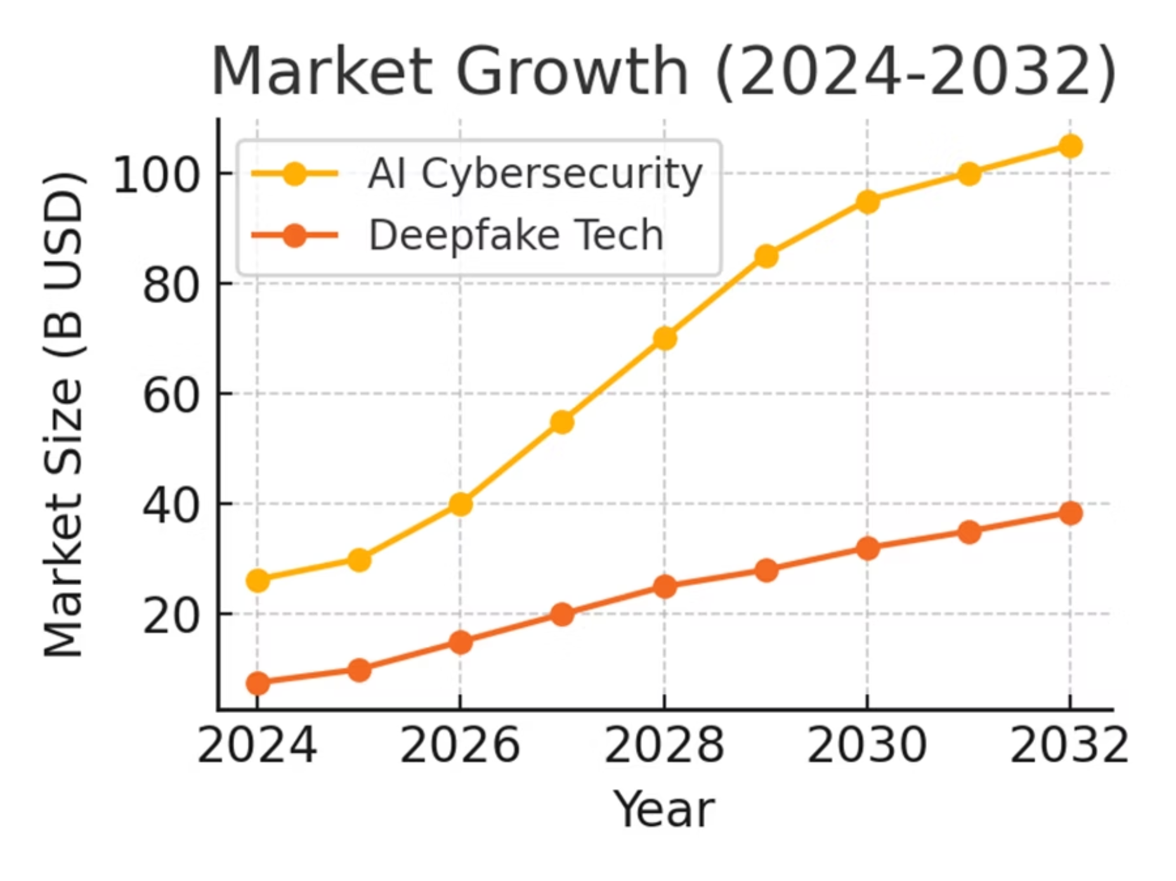

Slide 5
Why HIDS is Crucial Now
The urgency for advanced AI defense systems is underscored by rapid market growth, increasing AI adoption, and mounting security incidents.
47.6%
73%
$3.81M
Deepfake Detection Market CAGR
Enterprises with AI Incidents
Average Savings Per Breach
Nearly three-quarters of enterprises experienced AI-related security incidents in the past 12 months, highlighting prevalent vulnerabilities.
AI-enhanced security can significantly reduce financial losses, saving organizations an average of $3.81M per breach.
The deepfake detection market is projected to reach $5.6B by 2034, reflecting the critical need for effective countermeasures.
Implementing HIDS also ensures compliance with emerging AI governance frameworks, aligns with ESG goals for responsible AI, and protects innovation by safeguarding legitimate AI applications.

Slide 6
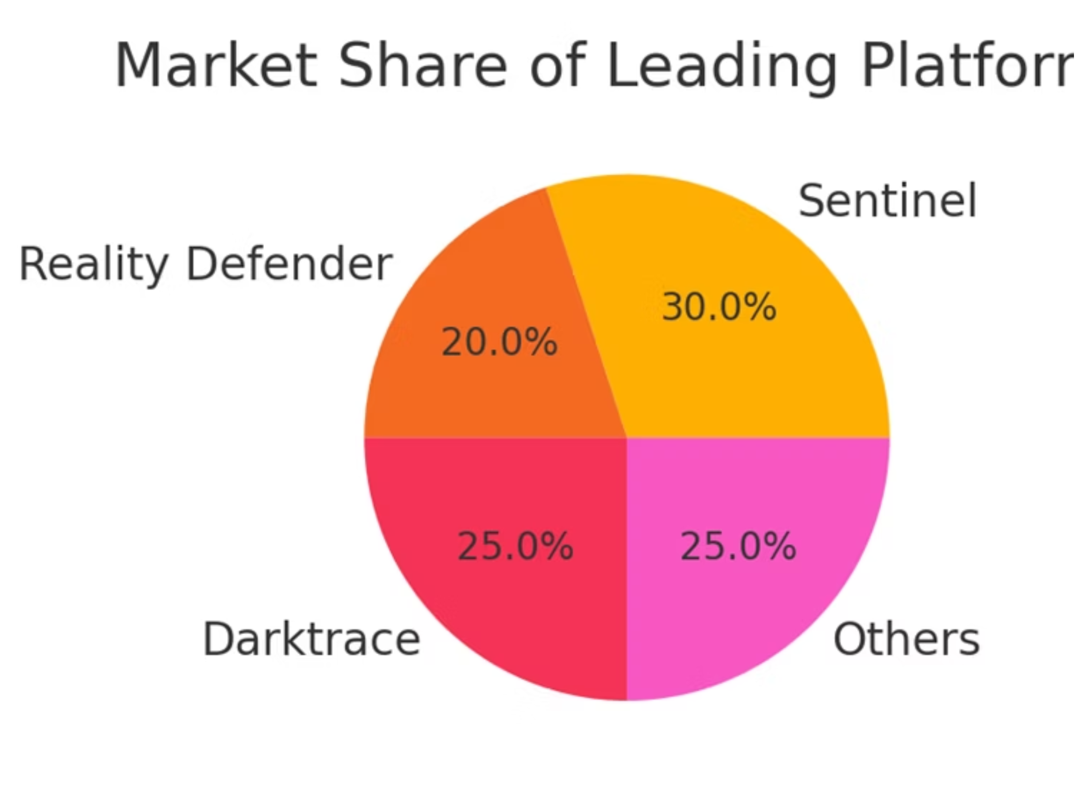

Slide 7








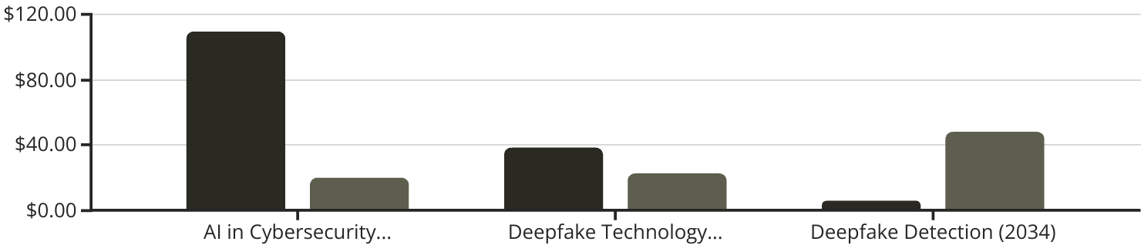
Current AI Cybersecurity Landscape
Cisco Advantage: $13.1B security revenue, 100,000+ customer networks, 60,000+ channel partners
The market for AI in cybersecurity is expanding rapidly, yet significant gaps remain in integrated defense capabilities and real-time processing. HIDS addresses these critical areas.
Integrated Multi-Modal Detection
Real-Time Processing
Current solutions often lack a unified approach to detecting diverse threats across multiple data types.
Insufficient processing speed hinders the ability to respond effectively to rapidly evolving AI-powered attacks.
Cross-Industry Threat Intelligence
Human-AI Collaboration
Absence of shared insights across industries leaves organizations vulnerable to common emerging threats.
Limited synergy between human intelligence and AI systems reduces overall defense efficacy.
Projected Market Size (Bill...
CAGR (%)
The chart above highlights the rapid growth across AI cybersecurity markets, with AI in Cybersecurity projected to reach $109.33B by 2032 and the Deepfake Detection market showing a high 47.6% CAGR. Despite these significant market expansions, key gaps remain.
Existing Solutions & Gaps
Additional Market Trends
Commercial platforms: e.g., Sentinel, Reality Defender, Intel FakeCatcher (up to 96% accuracy).
AI-powered malware detection is 70% more effective than traditional methods.
Academic tools: Limited real-world performance, with accuracy drops of 50% on current deepfakes.
Data sent to generative AI applications increased 30-fold in the past year.
Key gaps: Lack of integrated multi-modal detection, insufficient real-time processing, limited human-AI collaboration, and absence of cross-industry threat intelligence sharing.
Nearly three-quarters of enterprises experienced AI-related security incidents in the past 12 months.

Slide 8




Research Insights & Foundation
Our solution is built upon key findings from leading research in AI security, emphasising multi-modal approaches and collaborative intelligence.
2022: AI-Driven Threat Detection
2024: Deepfake-Eval-2024
Demonstrated superiority of ML/DL over traditional methods.
Revealed 50% accuracy drop in current detection models.
2023: Protecting Society from AI Misuse
2024: Global Policies for AI Misuse
Introduced "Misuse Chain" framework for intervention strategies.
Emphasised awareness, technology, ethics, and enforcement in policy.
These insights confirm that multi-modal strategies, federated learning, and human-AI collaboration are crucial for robust, real-time threat mitigation.

Slide 9
Introducing the Hybrid Intelligence Defense System (HIDS)
HIDS is a comprehensive framework integrating advanced technologies to provide a robust, adaptive defense against AI misuse.
Multi-Modal Content Authentication Layer
Federated Learning Security Network
Blockchain-based provenance tracking with ensemble detection.
Privacy-preserving collaborative threat intelligence.
Human-AI Collaboration Framework
Adaptive Learning System
Tiered autonomy with expert augmentation for complex cases.
Continuous model evolution and predictive threat modelling.
HIDS targets 98% detection accuracy across all media types, <300ms response time, 70% reduction in threat detection time, and 80% improvement in incident response.

Slide 10
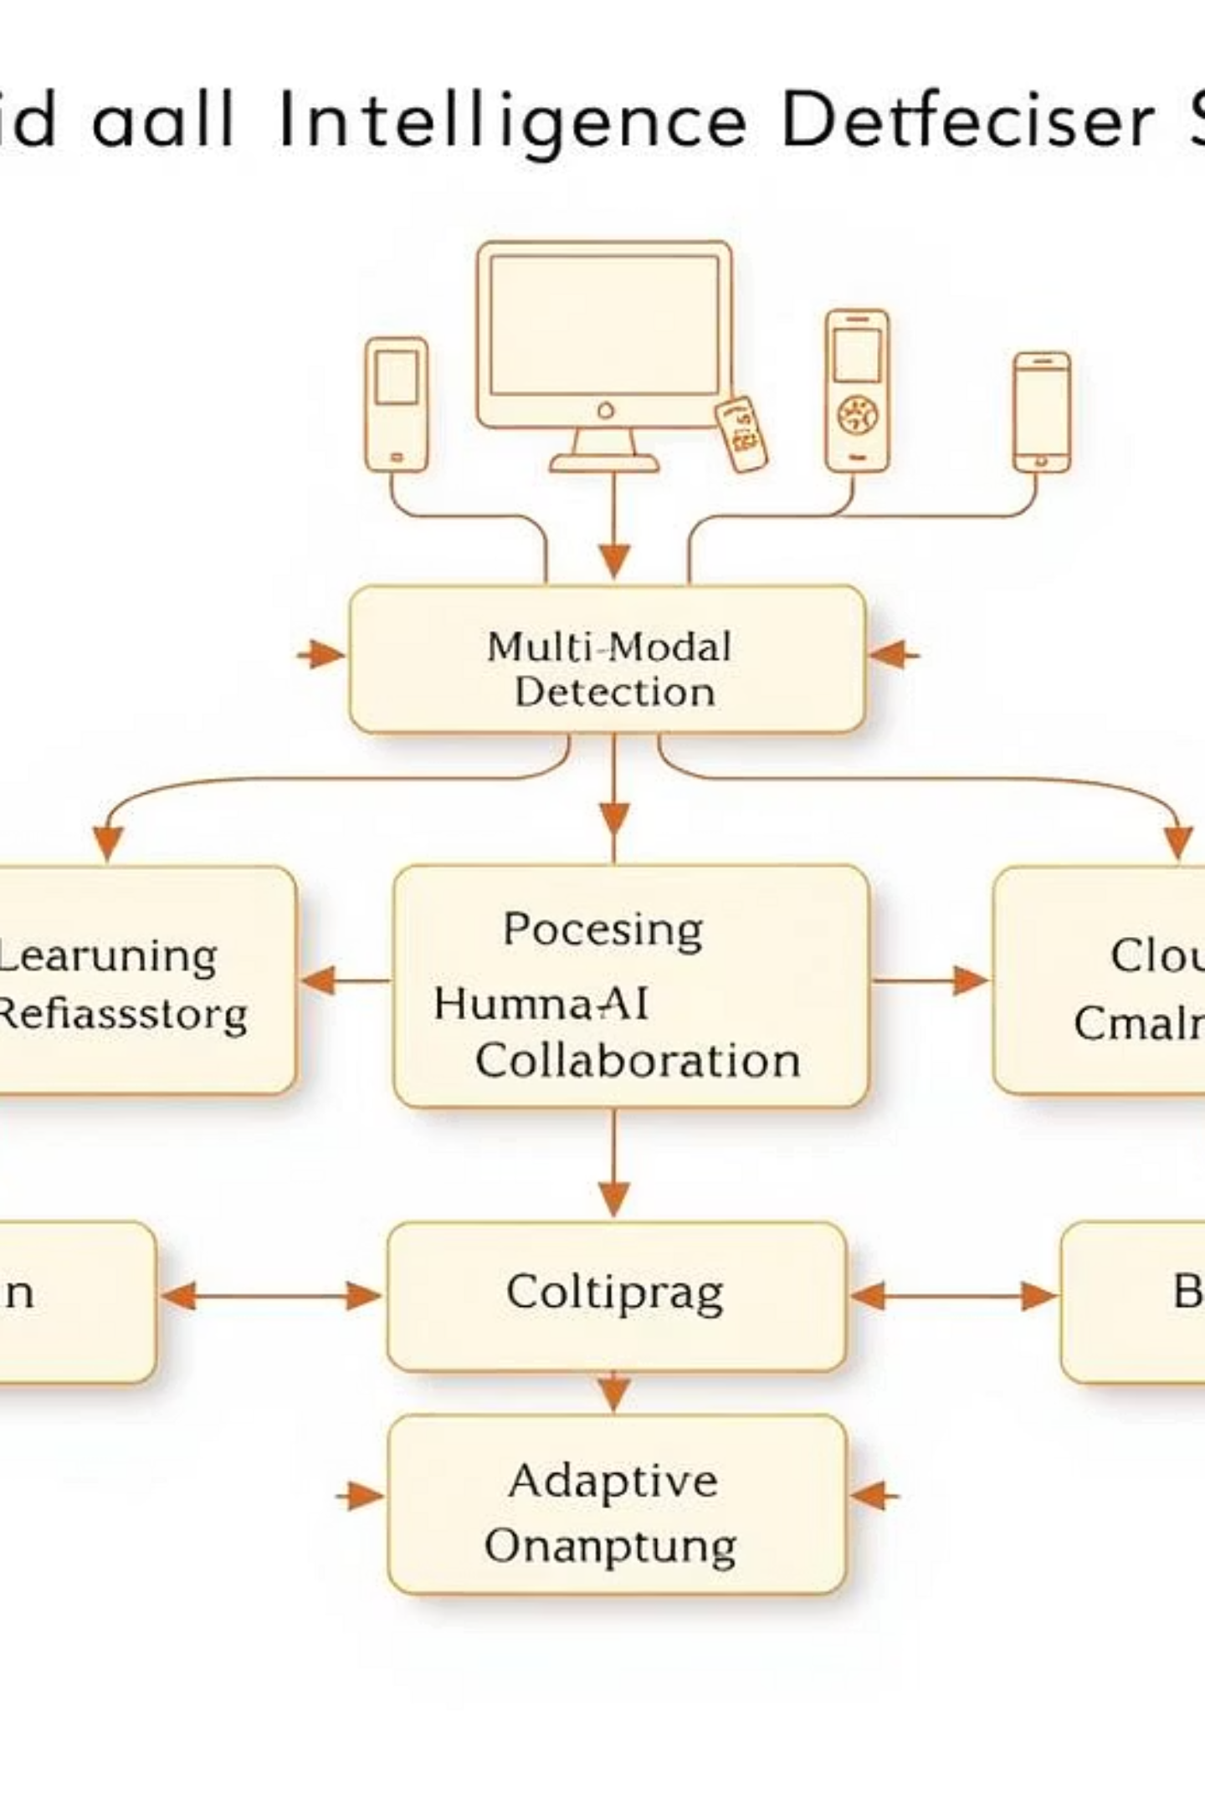
HIDS System Architecture
The HIDS architecture is designed for real-time, comprehensive threat detection and mitigation.
User Interface Layer: Security analyst dashboard, content verification portal, API gateway.
Processing Layer: Four integrated components for comprehensive threat detection.
Infrastructure Layer: Blockchain network, edge computing, cloud analytics.

Slide 11

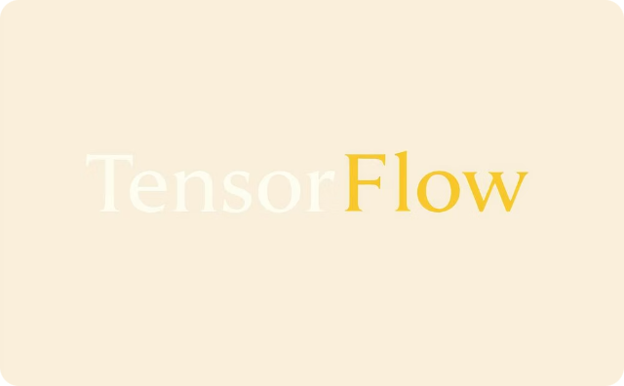



Robust Technology Stack
Our choice of technologies ensures high performance, scalability, and security, addressing the complex demands of AI threat mitigation.
Immutable
Proven
Latency
Scalable
Secure
These selections meet sub-300ms processing requirements, support global deployment, and ensure compatibility with existing systems.

Slide 12



Implementation Roadmap
Cisco Partnership Integration: Leverage existing customer relationships and channel network
Our phased approach ensures iterative development, rapid feedback, and validated effectiveness before full-scale deployment.
Phase 1: Foundation Infrastructure (0-6 months)
Phase 3: Scale & Optimization (13-18 months)
MVP with basic blockchain, 95% accuracy detection models, and a pilot program with 5-10 partners.
Global network expansion (100+ organisations), cross-industry threat sharing, and continuous model updates for full deployment.
Phase 2: Enhanced Detection & Integration (7-12 months)
Advanced multi-modal detection, real-time processing (<300ms), and human-AI interface integration.
This modular architecture allows for component-wise optimisation and reduces development risk through proven technology and incremental deployment.

Slide 13
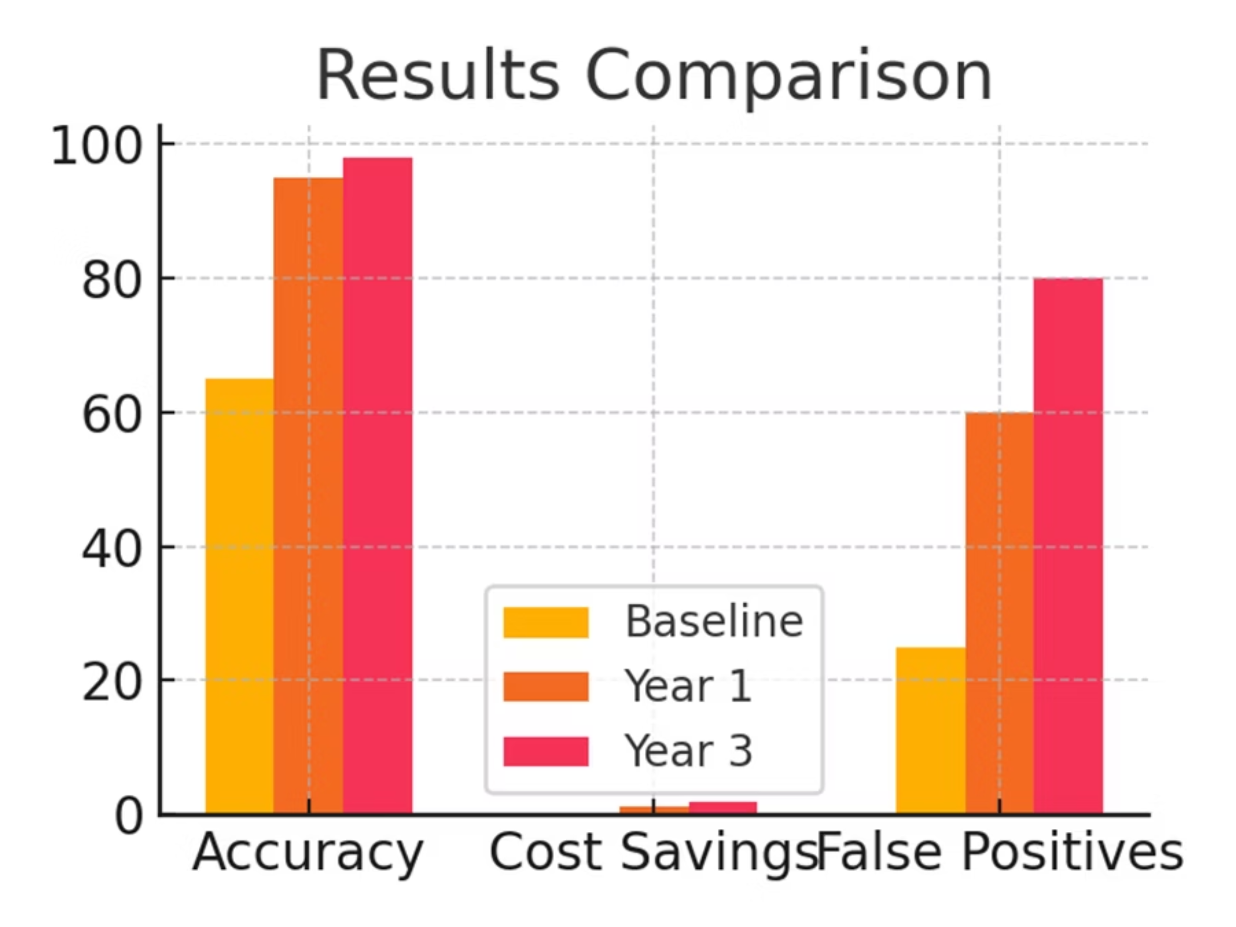

Slide 14
HIDS Impact & Future Outlook
HIDS offers substantial benefits to organisations, governments, and citizens, addressing critical gaps in cybersecurity and fostering digital trust.
Metric
Current State
Target (Year 1)
Target (Year 3)
Detection Accuracy
65%
95%
98%
Response Time Reduction
Baseline
50%
70%
Cost Savings per Org
$0
$1.2M
$1.88M
False Positive Reduction
20-30%
60%
80%
With AI threats evolving rapidly, proactive defense systems like HIDS are essential for protecting our digital future.

Slide 15




Limitations & Future Work
Addressing the challenges and exploring future enhancements to HIDS.
Evolving Adversarial Techniques
High Compute & Data Needs
The constant evolution of AI threats requires HIDS to continuously adapt its detection models against new and sophisticated adversarial techniques.
HIDS requires significant computational power and vast datasets for training and real-time processing, posing resource management challenges.
Privacy vs. Detection Trade-offs
Future Outlook
Balancing effective threat detection with user privacy concerns necessitates careful design and robust privacy-preserving mechanisms within HIDS.
Future work includes integrating quantum-resistant security measures, expanding to XR (Extended Reality) environments, and enhancing explainable AI for transparency.

Slide 16



Conclusion & Call to Action
Cisco Partnership Opportunities:
Pilot Program: Partner with 5 Cisco enterprise customers
Innovation Lab: Establish joint R&D facility
Market Launch: Co-launch at Cisco Live 2024
Global Expansion: Leverage Cisco's international presence
HIDS: Adaptive Defense
Strategic Collaboration
Secure Our Future
Offers real-time, adaptive defense against AI misuse, safeguarding digital integrity.
Seeking 5-10 pilot partners for technology and policy collaboration.
Join us in our mission to protect and secure our shared digital future.

